Slide 1
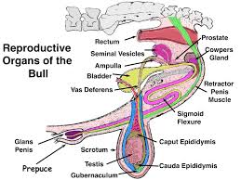
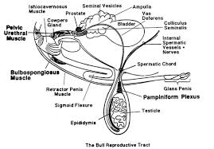
VETERINARY ANATOMY-UNIT-6 TOPIC- URINARAY SYSTEM-URETER & URINARY BLADDER- OF DIFFERENT ANIMALS
Instructor- DR. SANJAY KUMAR BHARTI
HOD, VETERINARY ANATOMY
Bihar Veterinary College Patna

Slide 2
URINARAY SYSTEM
The urinary organs are the kidneys, ureters, bladder and urethra
The kidneys are organs having two supra renal glands play major role for filtration and secrete the urine.
The ureters are tubes, which convey the urine to the urinary bladder
The urinary bladder is a reservoir for the urine & located on UB
The urine accumulates in the bladder and is then expelled through the urethra

Slide 3
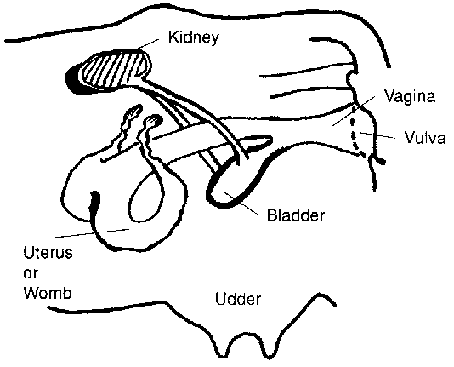
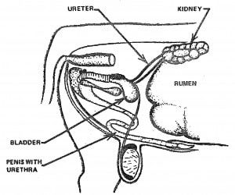
DIGRAMATIC Structures of UROGENITAL SYSTEM-OX-COW

Slide 4
DIGRAMATIC Structures of UROGENITAL SYSTEM-OX

Slide 5
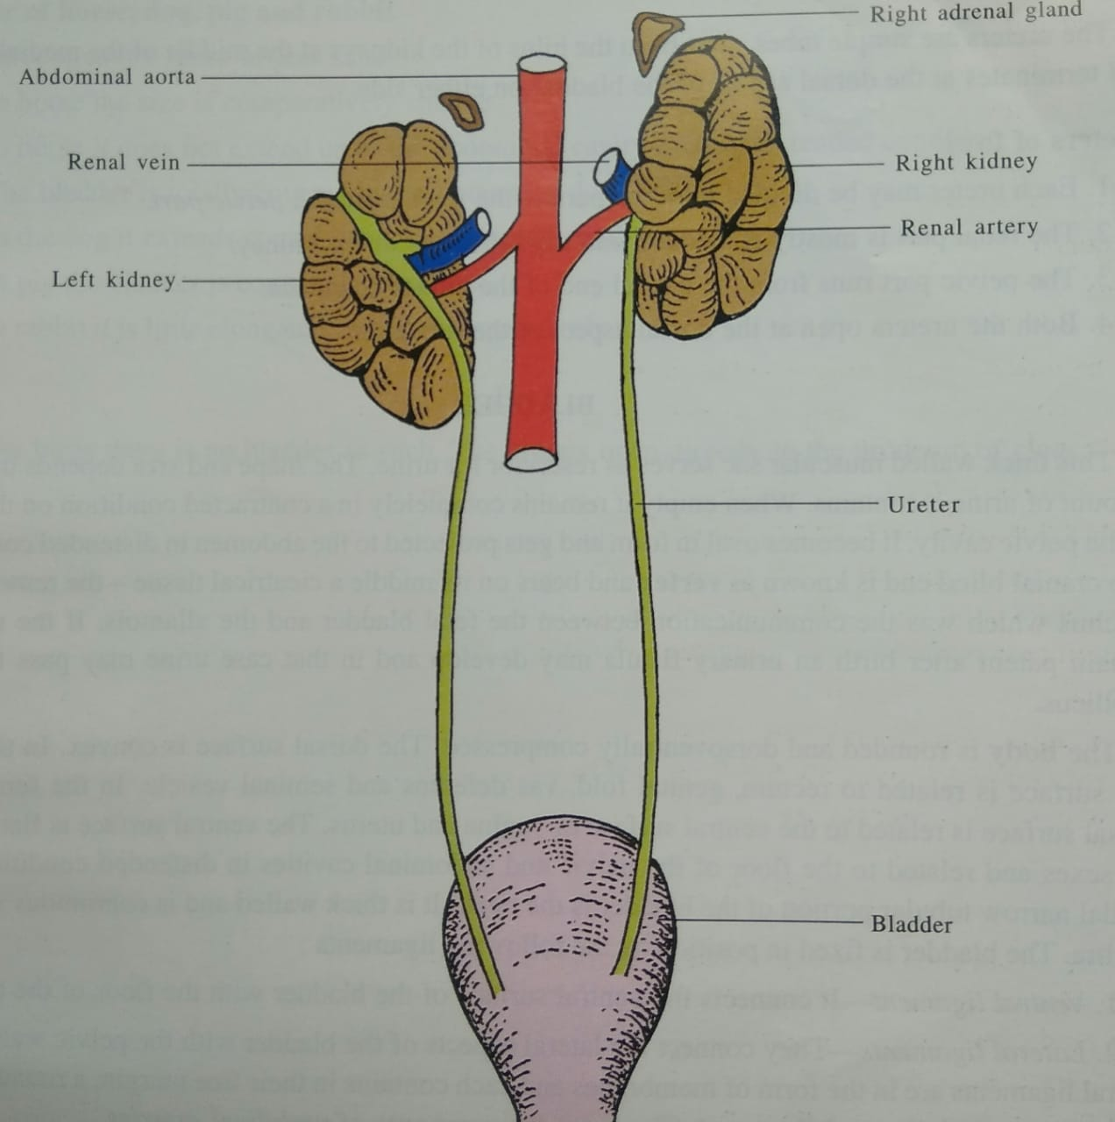
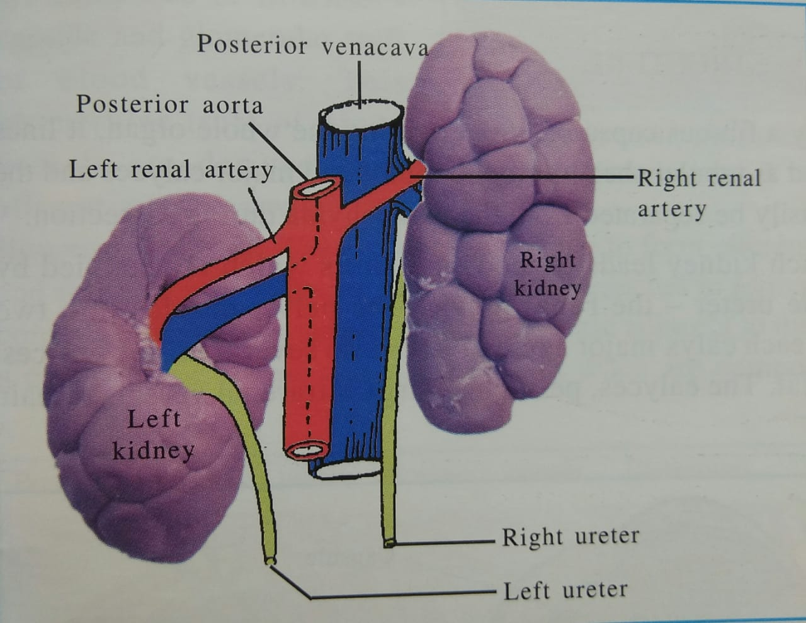
DIGRAMATIC Structures of kidney of URINARY SYSTEM OX

Slide 6
URETER -OX
The ureters are the excretory ducts of the kidneys and each begins at the junction of the calyces majores and terminates at the bladder
It is about 6 to 8 mm in diameter. The right ureter emerges out of the hilus of the right kidney from its ventral face, runs inwards, gains the middle of the medial border of the kidney and runs along it
The left ureter emerges out of the hilus on the antero-lateral aspect of the dorsal face, crosses over this face medially and gains the medial border and runs backwards.
Each ureter consists of abdominal and pelvic parts

Slide 7
URETER –OX-cow

Slide 8
URETER-OX-Contin..
The abdominal part runs backwards and inwards, the right being related to the lateral face of the caudal vena cava and the left to the aorta
Then it passes back in the sub-peritoneal tissue on the ventral face of the psoas muscle crosses the external iliac artery and enters the pelvic cavity
The pelvic part passes backwards and downwards on the lateral wall of pelvic cavity, turns inward and pierces the superior wall of the bladder near the neck
In the male, the pelvic part enters the genital fold and crosses vas deferens whereas in the female it is situated in the dorsal part of the broad ligament of the uterus

Slide 9
Species difference-URETER
Sheep and goat- It resembles that of ox
Horse-The ureter arises from the renal pelvis and real pelvis more dilated
- Tube is narrow but longer than the ox.
Dog- It resembles that of the horse except origin point.
Pig- The Cranial part is wide and gradually diminishes in calibre Slightly flexuous
Fowl
The ureter is white in colour. It may be divided into a renal part and a pelvic part.
The renal part embedded in the ventral surface of the kidney and the pelvic part runs backward in relation to the vas deferens or oviduct
It opens into the urodeum of the cloaca, internal to the opening of the vas deferens or oviduct

Slide 10
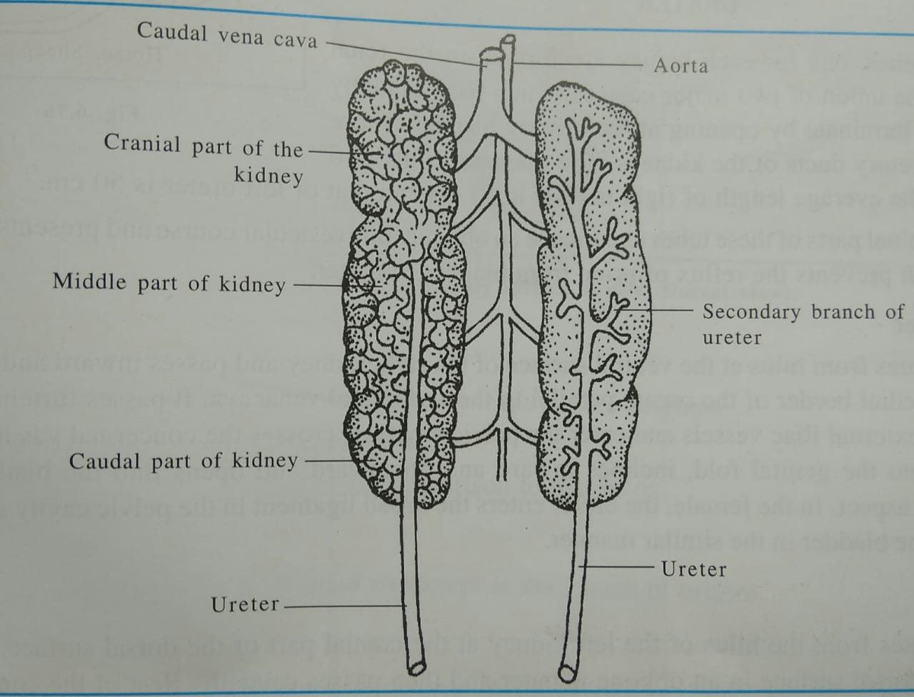
URETER- FOWL

Slide 11
URINARY BLADDER-OX
The urinary bladder is a musculo-membranous sac, differs in form, size and position according to the amount of its contents
When contracted, it is a dense pyriform mass about the size of a fist and lies on the ventral wall of the pelvic cavity at a variable distance behind the pelvic inlet
When moderately full, it is oval in shape and extends into the abdominal floor.
Its capacity is about 3 to 4 litres.
The bladder has 3 parts-a vertex, a body and neck
The cranial part or the vertex is a blind end and presents in its middle a rounded cul-de-sac called as cicatrix - the vestige of the urachus, which forms a connection between the bladder and the allantois in the fetus
The middle part or body is rounded and somewhat flattened from above downwards
It presents two surfaces- superior and inferior which are convex when full
The caudal narrow extremity is the neck and it joins the urethra

Slide 12
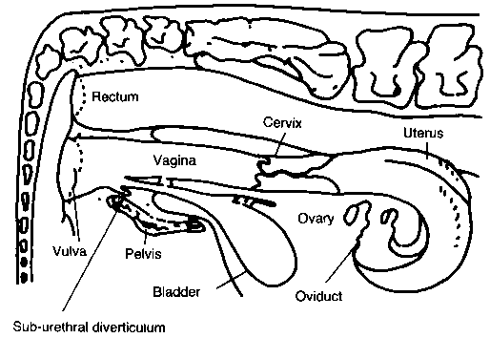
URETER AND URINAY BLADDER OF OX-COW

Slide 13
Relations- URINARY BLADDER
They vary according to the amount of the contents and sex
The ventral surface is related to the floor of the pelvis and extends into the abdomen as it distends
The dorsal surface in the male is related to the rectum, the genital fold, and the terminal parts of the vas deferens, the seminal vesicle and the prostate
In the female, it is related to the body of uterus and vagina. When the bladder is full, the vertex reaches the rumen and small intestine

Slide 14
Ligaments- URINARY BLADDER
The bladder is fixed in position by three peritoneal folds -the ligaments of the bladder
The ventral or middle ligament is a median triangular fold extends from the ventral face of the bladder to the floor of the pelvis and abdomen
In the newborn animal, it is extensive and reaches to the umbilicus
The lateral ligaments are two and extend on either side of the lateral aspects of the bladder to the lateral wall of the pelvis. Each contains in its free edge a round cord the round ligament, which is the remnant of the fetal umbilical artery
The caudal part of the bladder has no peritoneal covering and is attached to the surrounding parts by fat and connective tissue.
The mucous membrane is pale, thin and is loosely attached to the submucous tissue

Slide 15
Ligaments- URINARY BLADDER
It forms numerous folds when bladder is empty and contracted
It is modified over a triangular area on its dorsal wall close to neck called the trigonum vesicae where the mucous membrane is firmly attached without any folds
The two cranial angles of the trigonum vesicae present the openings of the two ureters and the caudal angle shows the opening of the bladder into the urethra -internal urethral orifice
The two urethral orifices are placed near each other on either side of the median line. From each urethral orifice, a fold of mucous membrane passes backward and inward, uniting with its fellow to form a median urethral crest in the first part of urethra.
The terminal part of ureter after piercing the muscular coat of the bladder and passes for a distance of about 2.5 cm between the muscular and mucous coats before piercing the latter
This arrangement constitutes a valve, which prevents the return of urine from the bladder into ureter
The internal urethral orifice lies at the apex of the trigonum

Slide 16
Species difference-UB
Sheep and Goat- Resembles the ox
Horse
Shorter but wider
It does not extend into the abdomen as forward as in the ox
Caudal part of the bladder is retro peritoneal
Pig
It is relatively very large
When full, it is abdominal in position
Dog
When empty, it is pelvic in position and when full it is entirely abdominal in position
Fowl
The ureters open into the urodeum of the cloaca. So there is no bladder as such

Slide 17
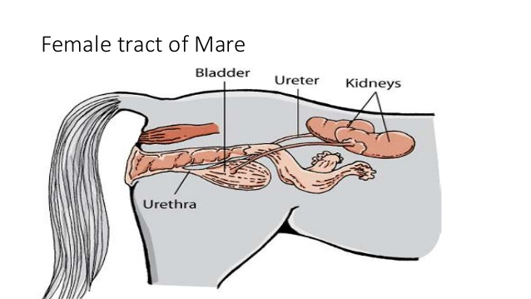
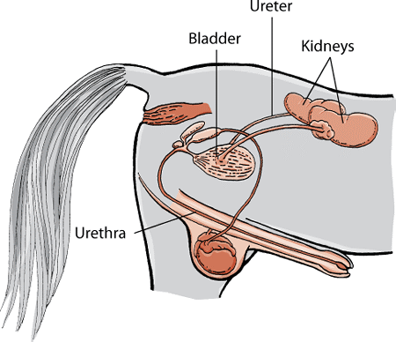
Urinary Tract- H0RSE & MARE

Slide 18
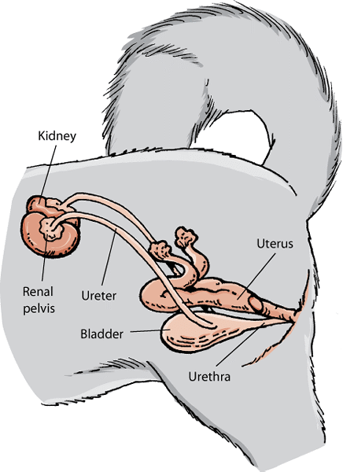
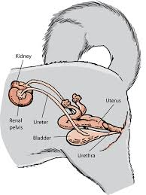
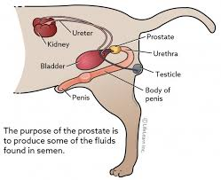
URINARY TRACT OF BITCH & DOG

Slide 19
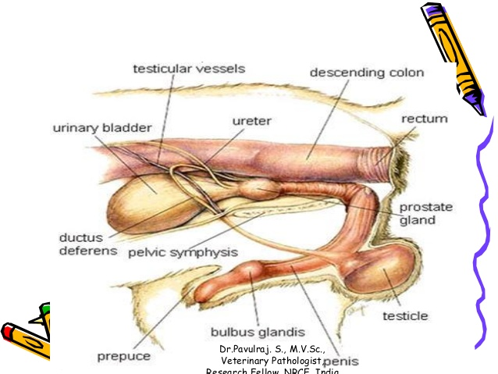
URINARY TRACT OF BITCH & DOG

Slide 20
DIGRAMATIC Structures of kidney-Ureter of FOWL.

