Slide 1
FACILITIES AVAILABLE AT
CENTRAL INSTRUMENTAL FACILITY
At
Bihar Animal Sciences University
Patna

Slide 2
S. No. | Name of equipment | S. No. | Name of equipment
 | Bench Top Flowcytometer | 9. | Electroporator
2. | Real Time PCR | 10. | Semi dry blot apparatus
3. | Inverted Microscope with Fluorescence Photograph attachment | 11. | Analytical Weighing Balance
4. | Nano spectrophotometer | 12. | Precision balance
5. | High speed refrigerated micro centrifuge | 13. | Digital Vortex mixture
6. | Refrigerated and heating bath circulator | 14. | Portable pH meter
7. | -80˚C Upright ultra low deep freezer | 15. | Microcentrifuge
8. | -20˚C Upright Freezer | 16. | Binocular Microscope

Slide 3
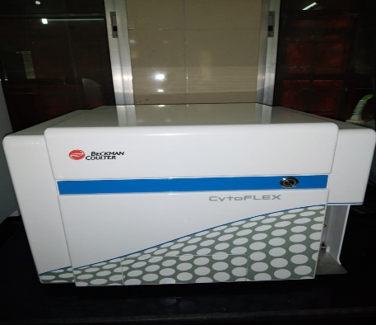
Bench Top Flowcytometer

Slide 4
APPLICATION
Blue and red filter
FITC,PE,APC,GFP, ALEXA
Immunophenotyping-Florescence tag antibody/Kit
Apoptosis- Kit- Beckman Coulter/ B.D Biosciences
Necrosis study- Propidium Iodide (PI)- Sigma
Cell cycle and DNA ploidy- Propidium Iodide (PI)- Sigma
Transfection study- GFP
Stem cell enumeration- Florescence tag antibody
Mitochondrial study- JC-1- Sigma
ROS study- DCFDA- Sigma

Slide 5
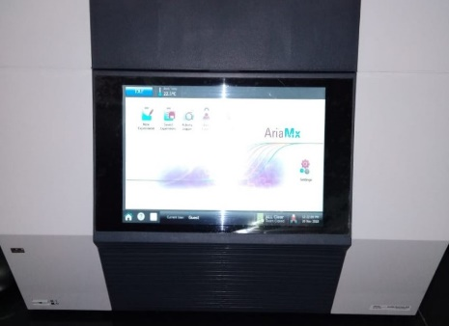
Real time PCR

Slide 6
APPLICATION
Gene Expression analysis
SYBR Green/EVA green- Fermatas/ Agilent/Invitrogen
Florescence tag Probe- Xceleris
Diagnosis of Infectious Diseases
Florescence tag Probe- Xceleris

Slide 7
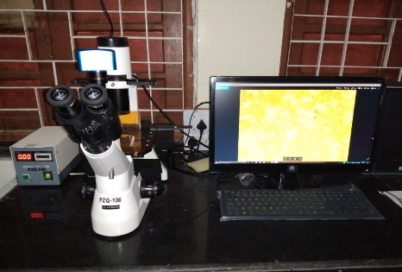
Inverted Microscope

Slide 8
APPLICATION
Transfection study-Florescence tag antibody
Immunohistochemistry-Florescence tag antibody
Cell culture Study

Slide 9
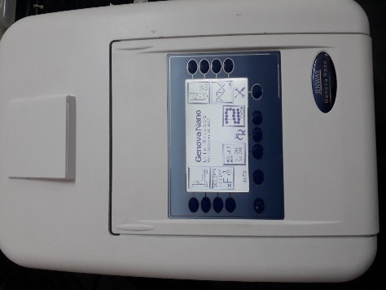
Nano Spectrophotometer

Slide 10
APPLICATION
Concertation of DNA/RNA
Purity of DNA/RNA

Slide 11
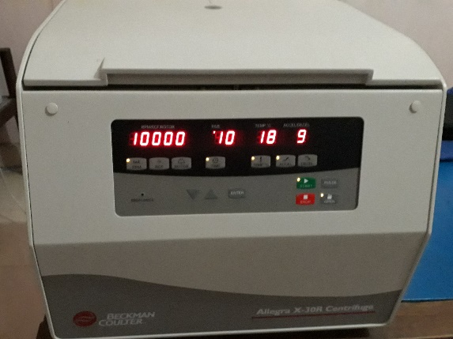
Refrigerated Centrifuge

Slide 12
APPLICATION
1.5 ml rotor
15 ml rotor
50 ml rotor
Speed 17000rpm
DNAI solation- Kit- Fermatas/ Invitrogen
RNA Isolation- Trizol- Sigma
Kit- Fermatas/ Invitrogen

Slide 13
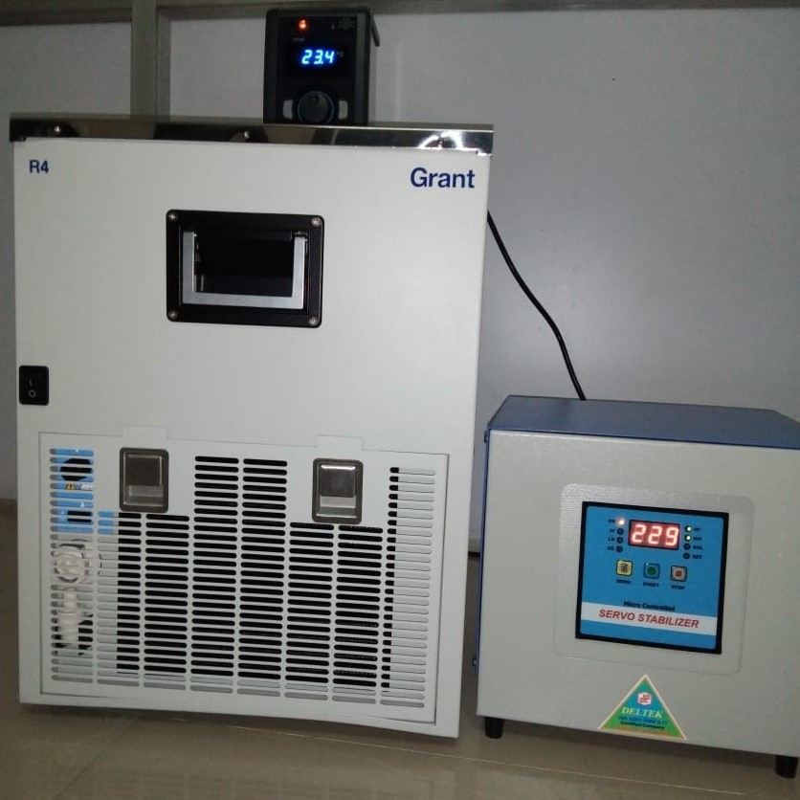
Refrigerated and heating water bath

Slide 14
APPLICATION
Used between 4 to 100 degree C
Transformation
Ligation reaction- Ligase- Fermatas/ NEB
Restriction digestion- Restriction enzyme- Fermatas/ NEB

Slide 15
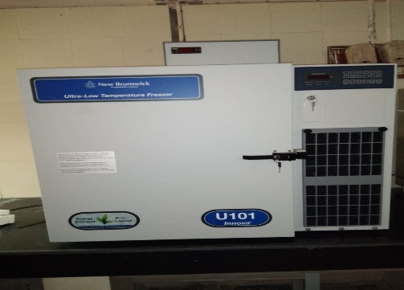
-80˚C Upright ultra low deep freezer

Slide 16
APPLICATION
Long term Storage of sample

Slide 17
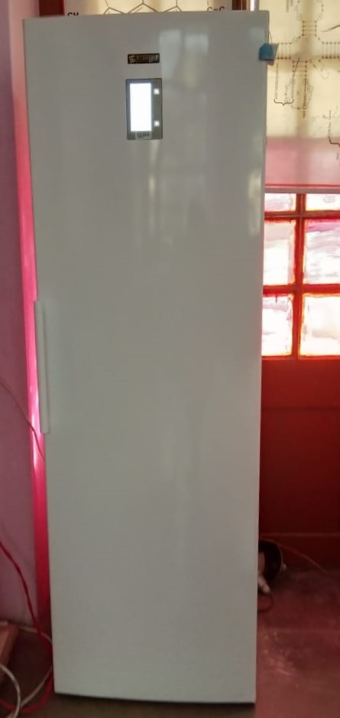
-20˚C Upright Freezer

Slide 18
APPLICATION
Storage of sample
Storage of Reagent /Kit

Slide 19
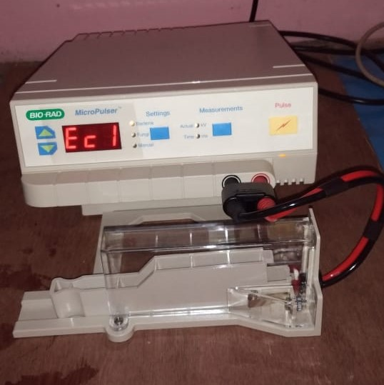
Electroporator

Slide 20
APPLICATION
High efficacy Transformation
Bacterial genome editing
Cuvette- Bio-Rad

Slide 21
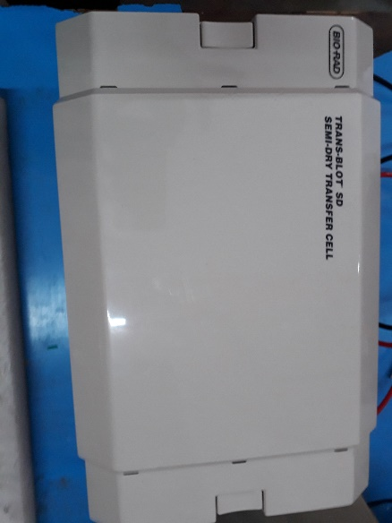
Semi dry blot apparatus

Slide 22
APPLICATION
Western Blotting

Slide 23
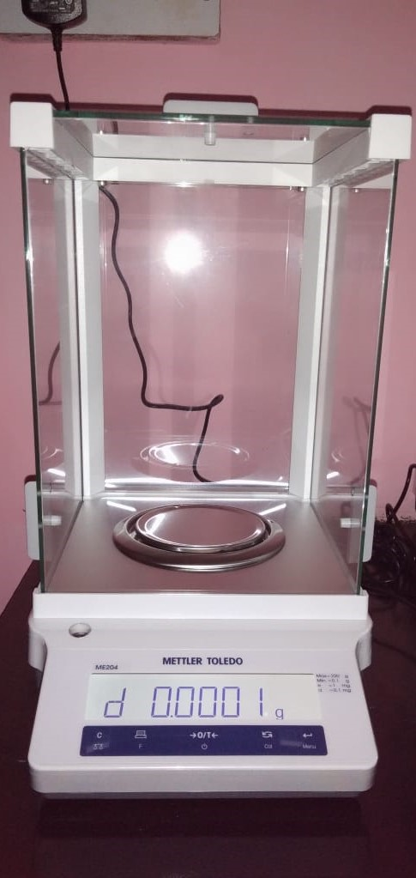
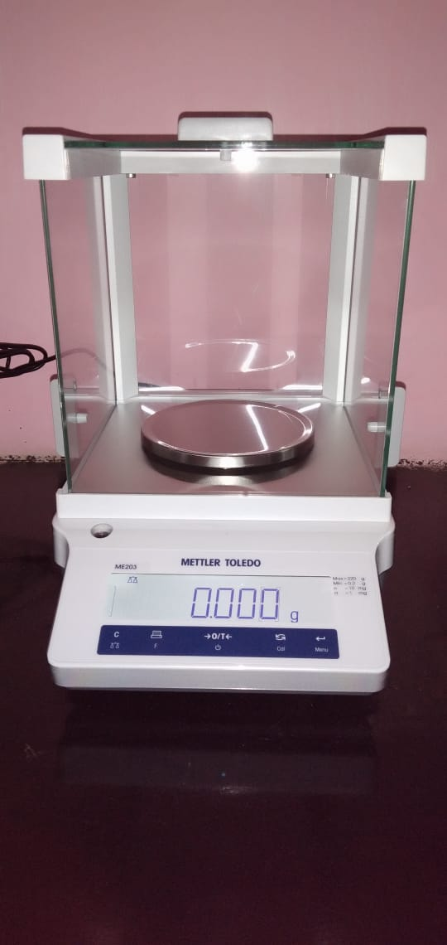
Analytical Balance
Precision balance

Slide 24
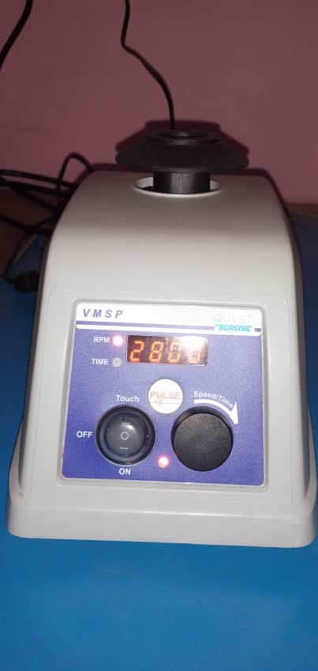
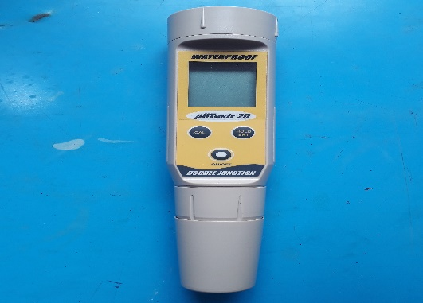
Vortex
Portable pH meter

Slide 25
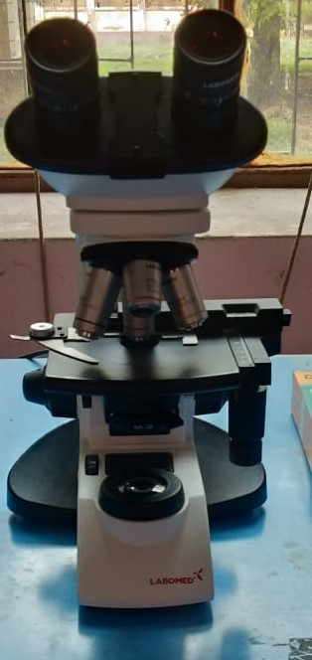
Binocular Microscope

Slide 26
Serum Repository
Department of Biochemistry mentioning the serum repository obtained from VCC
Planning of research

Slide 27
Practical Utility of Equipment
DNA/ RNA Isolation
Cloning
Expression of protein
SDS PAGE
Western Blotting
FACS Analysis
Expression analysis by real time PCR
Immunohistochemistry
Bacterial genome editing
Storage of samples

