Slide 1
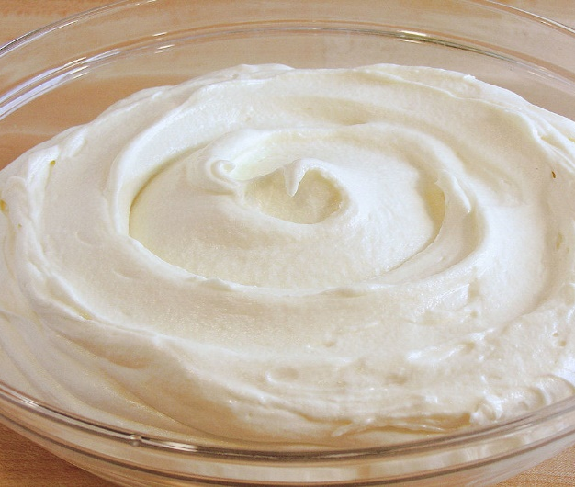
Class Lecture
Cream
(Definition & Legal standards)
Dr. Sanjeev Kumar
Associate Professor
Department of Dairy Technology
SGIDT, Patna-14

Slide 2
DEFINATION OF CREAM
According to FSSAI (2011)
“Cream” means the fluid product comparatively
rich in fat,
in the form of an emulsion of fat-in-skimmed milk,
obtained by physical separation from cow milk, buffalo milk or milk of any other species as defined under this regulation or a mixture thereof.
be free from starch and other ingredients foreign to milk

Slide 3
CLASSIFICATION OF CREAM
Cream may be broadly classified as:
Market cream : used for direct consumption
Manufacturing cream : used for manufacture of dairy products
According to FSSAI (2011)
1. Low fat cream: containing milk fat not less than 25.0 % by weight
2. Medium fat cream: containing milk fat not less than 40.0 % by weight
3. High fat cream: containing milk fat not less than 60.0 % by weight
Note:- Cream sold without any indication about milk fat content shall be treated as high fat cream.

Slide 4
Based on the end use, cream is classified as
TYPE OF CREAM | FAT PER CENT IN CREAM
TABLE CREAM | 20-25%
LIGHT CREM | 20-25%
COFFEE CREAM | 20-25%
WHIPPED CREAM | 30-40%
HEAVY CREAM | 30-40%
PLASTIC CREAM | 65-85%

Slide 5
COMPOSITION OF CREAM
Cream generally contains all the constituents of milk but non-fat constituents are inversely proportional to the fat content as show in table :
CONSTITUENTS | Cream with 25% fat | Cream with 50% fat
WATER | 68.20% | 45.45%
FAT | 25.00% | 50.00%
PROTEIN | 2.54% | 1.69%
LACTOSE | 3.71% | 2.47%
ASH | 0.56% | 0.37%
TOTAL SOLIDS | 31.80% | 54.55%
SOLIDS NOT FAT | 6.80% | 4.55%

Slide 6
COMPOSITION OF CREAM
SNF of cream can be calculated by taking the ratio of water to SNF of milk.
If ratio of water to SNF of milk is 10:1, then the approximate SNF in cream = (100 - F/11)
where F is fat content of cream
SNF in cream can be estimated as :
%SNF in cream= (100-%fat in cream)* %SNF in milk
(100-%fat in milk)

Slide 7
NUTRITIVE VALUE
CREAM is rich in fat and fat soluble vitamins
Vitamin A
Vitamin D
Vitamin E
Vitamin K

