Slide 1
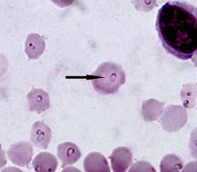
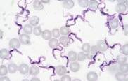
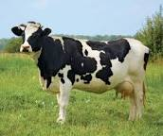
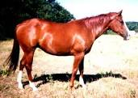
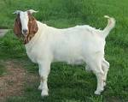
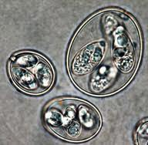
GENERAL CHARACTERS OF
PROTOZOA
Dr. AJIT KUMAR
HoD
Department of Parasitology
Bihar Veterinary College
Bihar Animal Sciences University
Patna-800014
Image source: Google image

Slide 2
PROTOZOA
Protozoology is the study of protozoa.
The word protozoa is derived from the Greek words – “Proto” means first and “Zoa” means animals.
The first animal life which appeared on this earth belonged to this category.
Protozoa was discovered by Antoni Van Leeuwenhoek (Dutch scientist) and also known as Father of Protozoology.
Protozoa are an unicellular, microscopic and eukaryotic organism having a distinct nucleus enclosed in a membrane.

Slide 3
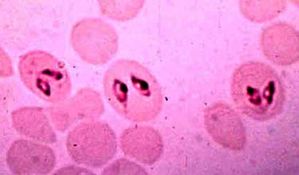
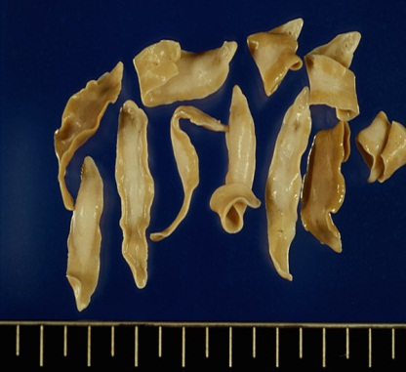
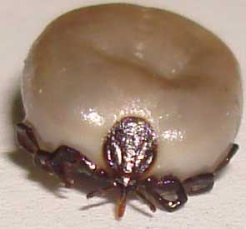
PROTOZOA
Protozoa | Metazoa
Unicellular | Multicellular
A single cell perform all the functions like reproduction, digestion, respiration etc. | Each cell performs a particular function
It contains organelles like mitochondria, Golgi apparatus etc. | It contains organs like alimentary canal, respiratory organs, reproductive organs etc.
Examples: Trypanosoma spp., Babesia spp. | Examples: Helminthes and arthropods
Image source: Google image

Slide 4
PROTOZOA
Protozoa | Bacteria
Eukaryotic organisms | Prokaryotic organisms
Presence of distinct nucleus | Distinct nucleus is absent but DNA is present in the form of closed circle.
Capsule is absent outside the cell-wall | Capsule is present outside the cell-wall
Usually larger than bacteria | Smaller than protozoa
Examples: Theileria annulata | Pasturella multocida

Slide 5
PROTOZOA
Protozoa | Protophyta
Unicellular micro-organisms | Unicellular plant cells
Nucleus is well defined | Nuclear materials are scattered throughout the cytoplasm as granules
Protozoan are bounded by duplicate, non-rigid membrane called periplast | Plant cells are bounded by rigid wall made of cellulose.
Nutrition is holozoic type and take readymade organic materials for food | Holophytic type of nutrition and prepare their food by process of photosynthesis in chloroplast
Examples: Amoeba etc. | Examples: Algae , Euglena etc.

Slide 6
PROTOZOA
Protozoa | Rickettsia
Eukaryotic | Prokaryotic
Intra or extra-cellular organisms | Intracellular organisms
Cytoplasm present | Cytoplasm absent
Examples: Hepatozoon canis | Examples: Anaplasma spp.

Slide 7
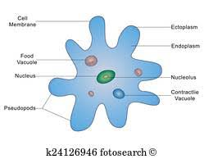
PROTOZOA
Body of protozoa is consisted of two parts-
Cytoplasm
Nucleus
Cytoplasm -
it is an extranuclear part which is divided into two parts-
Ectoplasm- external hyaline portion of the cytoplasm which helps in locomotion and sensation.
Endoplasm- inner granular part of cytoplasm. it contains food vacuoles, membranes organelles ( mitochondria, Golgi apparatus and endoplasmic reticulum).
Image source: Google image

Slide 8
PROTOZOA
Organelle is a tiny cellular structure that have specific function ( mitochondria, golgi apparatus, nucleus and endoplasmic reticulum etc).
Organ is the collection of tissues performing similar function. e.g.- Heart, kidney etc.
Organelles function to keep a cell alive while organs perform functions to keep an organism alive.

Slide 9
NUCLEUS OF PROTOZOA
Nucleus :-
it is found in endoplasm. Usually one nucleus is found but some protozoa have two nucleus ( Balantidium coli, Giardia spp. etc.).
Nucleus is composed of nuclear membrane, nucleoplasm, chromatin granules and karyosome (endosome) or nucleolus.
Endosome is devoid of DNA whereas nucleolus contains DNA.
Two types of nucleus found-
Vesicular nucleus – most of the protozoa are having vesicular type nucleus except ciliates.
Compact nucleus- it contains large amount of chromatin materials and small amount of nucleoplasm. Example- macronucleus of Balantidium coli.

Slide 10
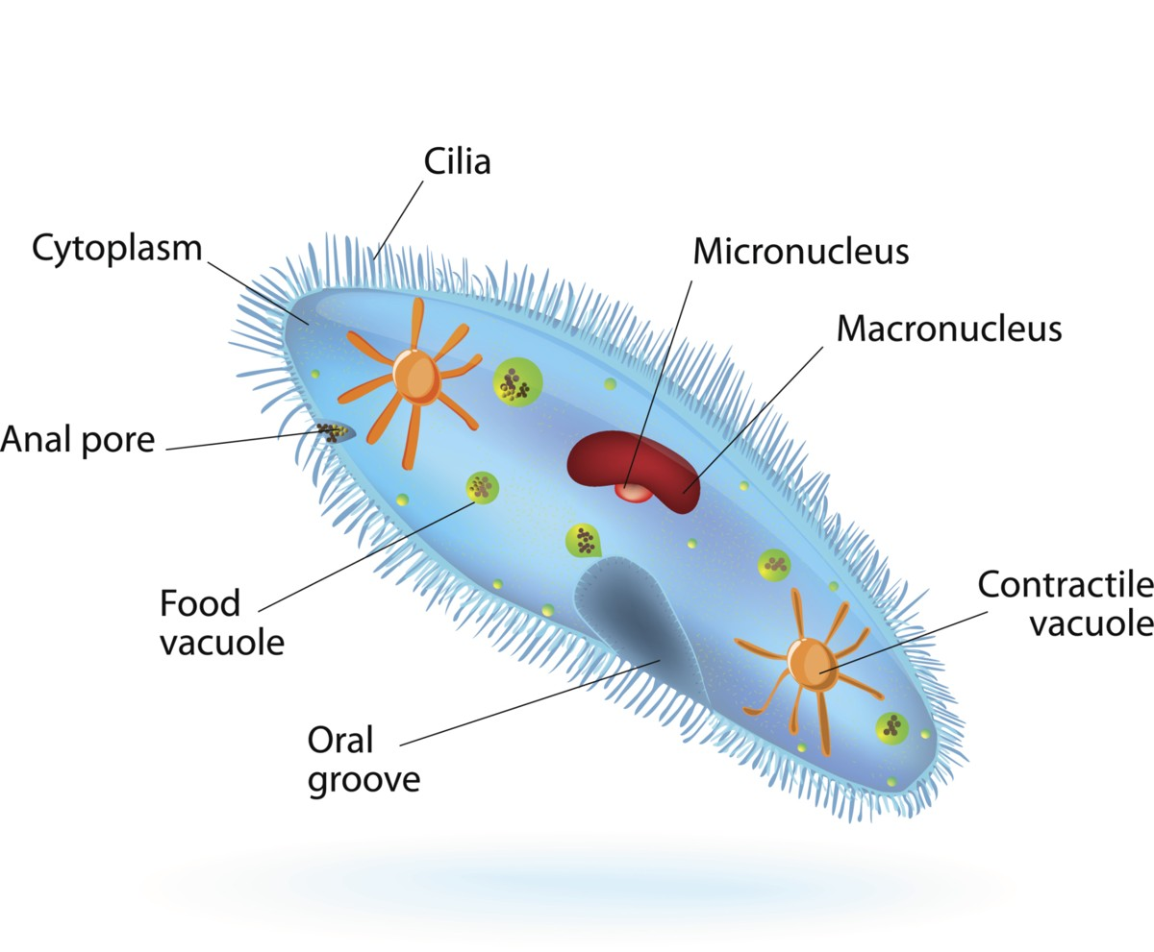
PROTOZOA
Some protozoa may have two similar nuclei (Giardia and Hexamita species) or two dissimilar nuclei (Balantidium coli).
In dissimilar nuclei species, larger nucleus (macronucleus) governs cytoplasmic functions whereas smaller vesicular nucleus (micronucleus) helps reproductive functions of the protozoa.
Image source: Google image

Slide 11
NUTRITION OF PROTOZOA
Nutrition: – 3 –types
Holophytic nutrition – plant like nutrition where organisms can synthesize the carbohydrates by the chlorophyll present in the chromatophores. Examples- free living protozoa like Euglena, Volvox etc.
Holozoic nutrition – food materials are ingested by means of pinocytosis or phagocytosis or through a cytostome and taken into the phagosome or food vacuoles for digestion. Examples- Entamoeba spp. and Balantidum coli.
Saprozoic nutrition- food materials are absorbed by means of osmosis through their surface membrane . Example – Eimeria, Babesia , Theileria, Trypanosoma spp.

Slide 12
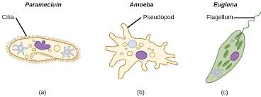
LOCOMOTION OF PROTOZOA
Locomotion: – takes place by means of different locomotary organelles like flagella, cilia and pseudopodia in different protozoa.
Pseudopodia (false foot)– it is temporary locomotary organelle formed from the projection of ectoplasm. It is also help in engulfing the food materials. Example- Entamoeba spp.
Flagella – flagellum is a whiplike filamentous structure originated from the blepharoplast. The part of the flagellum which remains inside the body is known as axoneme and the outside portion is called as free flagellum. Examples- Tritrichomonas foetus, Giardia spp. etc.
Image source: Google image

Slide 13
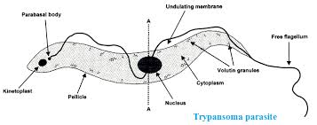
PROTOZOA
In some protozoa, the flagellum attached to the body of the protozoa and form an undulating membrane which helps in movement . Examples- Trypanosoma , Giardia spp. etc.
Image source: Google image

Slide 14
PROTOZOA
Cilia- Elongated hair-like structure and shorter than flagella and usually present throughout the body margin. It also help in ingestion of food and serve as sensory organs. Example – Balantidium coli.
Gliding- Due to absent of locomotary organelle, some protozoa may move by gliding (members of Phylum Apicomplexa and class sporozoea i.e. Toxoplasma, Sarcocystis, Eimeria, Isospora, Cryptosporidium, Hepatozoon,Theileria, Babesia, Besnoitia, Hammondia, Plasmodium, Haemoproteus and Leucocytozoon spp.).

Slide 15
Difference between Cilia and Flagella
Eukaryotic motile cilia and flagella are cell organelles that are structurally similar. Each is a bundle of 9 fused pairs of microtubule doublets surrounding two central single microtubules ( 9 + 2 arrangement).
Characters | Cilia | Flagella
Sahpe | Short, hair like appendages | Long, thread like appendages
Length | short | Longer than cilia
Motion | Rotational, very y fast movement | Often wave-like and undulating
Density | Many per cell | Fewer per cell
Present | Eukaryotic cells | Eukaryotic and prokaryotic cells

Slide 16
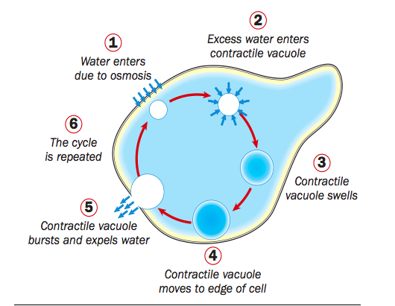
EXCERETION IN PROTOZOA
Metabolic waste product excreted out either through the body surface membrane by osmosis or by means of contractile vacuole which plays an osmoregulatory function.
Image source: Google image

Slide 17
REPRODUCTION IN PROTOZOA
Reproduction in protozoa may be either asexual or by both asexual and sexual.
Asexual reproduction :-
Binary fission is commonest mode of asexual reproduction, Nucleus divides first, and then cytoplasmic division occurs.
Schizogony (Multiple fission): First nucleus divides several times, then cytoplasm. The dividing forms with a multinucleated mass and surrounded by a distinct wall known as Schizont and daughter forms called merozoites.

Slide 18
REPRODUCTION IN PROTOZOA
Budding: Two or more daughter forms are produced from the parent cell and grow to full size.
Edodyogeny ( Internal budding): Two daughter cells are formed within the parent cells.
Endopolygeny- Many daughter cells are formed within the parent cells. e.g. Toxoplasma and Sarcocystis spp.

Slide 19
REPRODUCTION IN PROTOZOA
Sexual Reproduction:
Conjugation - Exchange of nuclear materials from the micronucleus takes place in conjugation e.g. Ciliates.
Syngamy - Two gamete fuse to form a zygote called syngamy.
Two similar size gametes i.e. isogametes and process of their fusion called isogamy.
Two dissimilar size gametes i.e. anisogametes and it fusion called anisogamy.

Slide 20
REPRODUCTION IN PROTOZOA
In anisogamy, the smaller gamete is a male gamete known as microgamete and the larger one is a female gamete known as macrogamete which are produced from microgametocyte and macrogametocyte, respectively.
Sporogony is an asexual process of multiple fission and sporogony normally follows syngamy.
In sporogony, zygote forms a number of sporozoites within the walls of a cyst.

Slide 21
REPRODUCTION IN PROTOZOA
Sporozoites are infective stage of some protozoa which are released by the lysis of sporocyst / ookinete.
Sporozoites enter into cell membrane of the hosts and form trophozoites .
Trophozite stage of protozoa in the host which feeds and grows until division commences.
Nucleus of trophozoite divides several times by schizogony and form multinucleated mass which is surrounded by distinct wall called schizont.
Schizont is filled with a large numbers of elongated organisms called merozoites.

Slide 22
THANK YOU

