Slide 1
SWINE FEVER (Hog Cholera)
Synonym:- Hog cholera ,Swine plague, Classical swine fever, European swine fever.
The disease causes multimillion dollar losses before eradication programme has been taken.
USA, UK, Australia, New Zealand, Ireland eradicated these disease.
But again the disease came in some of the countries, like Belgium, Netherland, Germany etc in 1990.

Slide 2
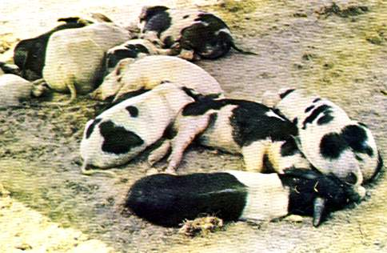
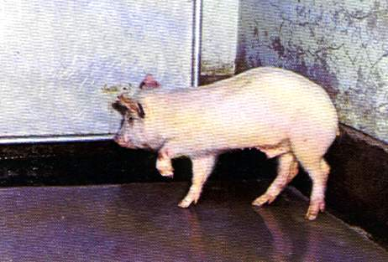
SWINE FEVER (Hog Cholera)
Swine fever is an acute contagious viral disease of pigs caused by pestivirus and characterized by gluing of eyes, button ulcers in intestine, congestion and haemorrhage in visceral organs.

Slide 3
Etiology
Pestivirus of Togaviridae family
RNA virus
The virus of Hog cholera and Mucosal disease are antigenically similar.

Slide 4
Incubation period
1 to 4 days by artificial infection and
7 days in natural infection

Slide 5
Incidence
First recognized in 1885 in the United States, its viral aetiology was established in 1903
The disease is seen worldwide including India
Susceptibility
The pig is the only domestic animal which is naturally infected by the virus

Slide 6
Transmission
The infection is usually acquired by ingestion, but inhalation is also a possible route
Routes of infection
Digestive tract
Respiratory tract
Conjunctiva
Nasal mucosa

Slide 7
Pathogenesis
The first virus enters into blood after multiplication in tonsillar tissue
After that the virus will infect the lymphoid organs
and also infect liver, spleen and other internal organs.
There is leukopaenia, thrombocytosis.

Slide 8
Sing & Symptoms
The virus has special affinity for the endothelial cells of blood vessels & reticulo -endothelial system.
The vascular endothelial cells swell, proliferate and occlude the lumen.
The wall of blood vessels undergo hyaline degeneration with infiltration by lymphocytes, macrophages and plasma cells.
These changes of blood vessels are the cause of hemorrhages, necrosis and infarection found in various organs.

Slide 9
Spleen – severally infarcts are wedge shaped, found on the edges of the orgen & are browinesh in color.
Lungs – croupous pneumonia.
In the Intestine – especially in the cecum and colon, are found the characteristic “Button shaped ulcer”.
Kidney – found petechiae on the cortex extending deeply into the parenchyma. These gives a characteristic “Turkey egg appearance”.

Slide 10
Skin – shows erythematous patches which become cyanotic. Later vesicles may form on the lips, vulva & edges of ears.
Brain – non – purulent meningo – encephalomyelitis.
“Perivascular cuffing” - i.e – accumulation of lymphocytes, monocyes, plasma cells & local histocytes in the perivascular space – ( Robin Virchow).

Slide 11
Sing & Symptoms
In mixed infections – Salmonella cholerae suis often complicates the picture.
The original name of the disease “Hog Cholera” was derived from the discovery.

Slide 12
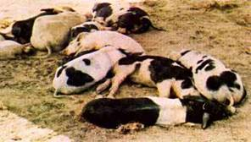
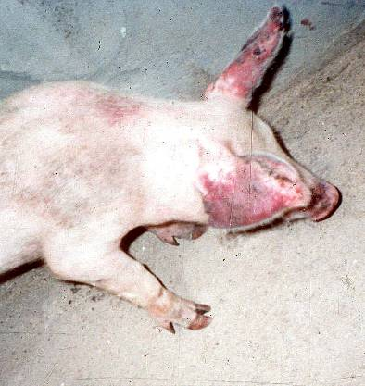
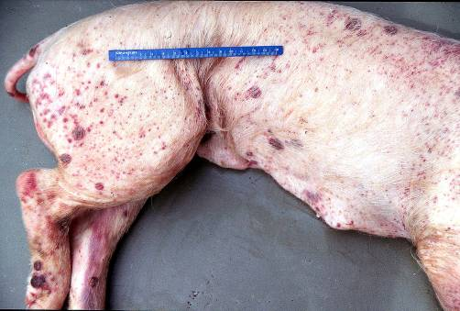
Clinical Signs
Acute disease
Huddling, dullness
High fever (105ºF)
Anorexia
Erythema, cyanosis
Petechiae
Staggering, weakness
Convulsions
Poor reproductive performance
Abortions, stillbirths
Deformities

Slide 13
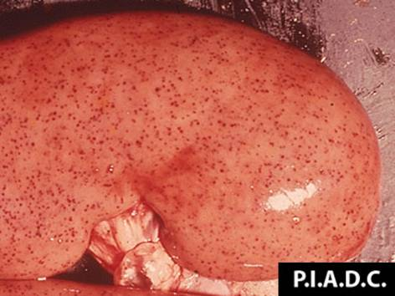
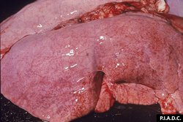
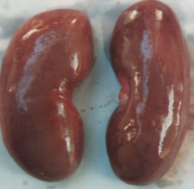
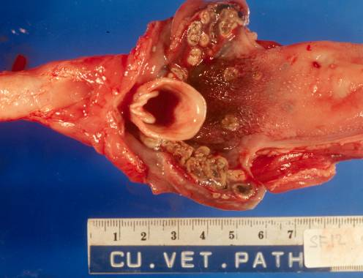
Post Mortem Lesions
Highly variable
Acute infection
Hemorrhage
Necrotic foci in tonsils
Petechiae
Kidney, larynx, trachea, intestines, spleen, lungs

Slide 14
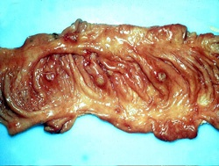
Post-Mortem Lesions
Chronic infection
Necrotic foci
Intestinal mucosa (‘button’ ulcers)
Epiglottis
Larynx
Congenital infection
Cerebellar hypoplasia, thymic atrophy, deformities of head and legs
Photo courtesy of Dr. R. Panciera, Oklahoma State University

Slide 15
Differential Diagnosis
Diagnosis is impossible without lab testing
Porcine reproductive and respiratory syndrome (PRRS)
Porcine circovirus associated disease
Salmonellosis
Erysipelas
Leptospirosis
Aujeszky’s disease (pseudorabies)
African swine fever
Tonsil samples should be sent with every submission to your state diagnostic lab

Slide 16
Sampling
If Classical Swine Fever is suspected:
The proper animal health authorities should be contacted, before collecting or sending any samples,
Samples should only be sent under secure conditions, to authorized laboratories to prevent spread of the disease

Slide 17
Diagnosis
Laboratory Tests
Detect virus, antigens, nucleic acids
Tissue samples (tonsils, spleen, kidneys, distal ileum)
Whole blood
ELISA or direct immunofluorescence
Serology
ELISA or virus neutralization
Comparative neutralization test
Definitive test

Slide 18
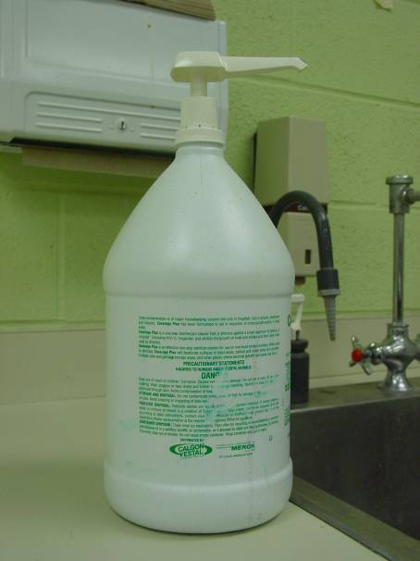
Disease Control
Disinfectants
Sodium hypochlorite
Phenolic compounds
Virus sensitive to
Drying
Ultraviolet light
pH of less than 3 or greater than 11
Killed at high temperatures
150ºF for 30 minutes; 160ºF 1 minute

