Slide 1
VETERINAY ANATOMY,
UNIT- 5,
PELVIC LIMB BONES
Instructor- DR. SANJAY KUMAR BHARTI
HOD, VETERINARY ANATOMY

Slide 2
PELVIC LIMB BONES
The general designations for the different parts of the pelvic limb and bones present given below.
Pelvic girdle and hip region : Ilium, ischium, and pubis
Thigh : Femur
Leg : Tibia & fibula
Pes : Consisting of
  Tarsus: A number of small bones called tarsals arranged in the domestic mammals in three rows.
  Metatarsus: Typically consisting of five bones designated only by numbers 1 to 5, but showing considerable modifications in different animals.
  Digits: These form the terminal parts of the limbs and usually correspond to the number of the fully developed Each digit is composed of a number of bones arranged serially called the phalanges.
  The number of phalanges may vary (from 1 to 5) within the species and also in different digits of the same species.

Slide 3
OS COXAE -PELVIC GIRDILE
(Ox)
The os coxae or hip bone consists of three flat bones, ilium, ischium and pubis, which fuse together to form the acetabulum.
Acetabulum- Which is for accommodation of head of femur and forms a joint, i.e- Known as Hip Joint
The ilium extends from acetabulum upwards forming the lateral wall of the pelvic cavity.

Slide 4
OS COXAE -PELVIC GIRDILE
…….Continued
The pubis and ischium extend medially and backward respectively and their medial borders fuse with those of the opposite side to form the pelvic / ischio-pubic symphysis.
The pubis and ischium form the anterior and posterior parts respectively of the floor of the bony pelvis and enclose between them on each side, a large obturator foramen.

Slide 5
Ilium
  The ilium is the largest of the three parts.
  It is irregularly triangular being wide above narrow and prismatic at the middle and slightly expanded below.
  It presents two surfaces, three borders and three angles
  SURFACES-.
  A-The lateral or gluteal surface is directed dorso-laterally and backward. The inferior third of this surface presents rough lines for the origin of the gluteus profundus. This surface is traversed by the gluteal line running nearly parallel to the cotyloid edge from a little below the tuber coxae to become continuous with the ischiatic spine. This surface serves for the origin of the gluteus medius.

Slide 6
Ilium- cont……..
  B-The medial or pelvic surface presents a rough triangular medial part-the sacral surface and a smooth quadrilateral part -the iliac surface. The former presents an irregular facet, the articular surface for the sacrum.
  C-The iliac surface – This is directed forward and is covered by iliacus. The ilio-pectineal line, which separates these two surfaces, begins below the articular surface and joins the anterior border of the pubis and forms the lateral boundary of the pelvic inlet. It bears about the middle the psoas tubercle for the psoas minor.

Slide 7
Ilium- cont……..
  BORDERS-For description ilium having 3 borders
  A- The cotyloid border leads to the acetabulum, little above and infront of which are two depressions (the lateral one is faint) for the origin of the rectus femoris.
  B-The ischiatic border is concave and forms the greater isciatic notch. The notch forms the greater ischiatic foramen which is covered by the sacro-sciatic ligament in life and serves for the passage of gluteal nerves and anterior gluteal vessels. In its lower part, it is convex, rough and is continuous with the ischiatic spine, which gives attachment to the sacro-sciatic ligament at its free edge and to the gluteus profundus on its lateral aspect.
  C-The dorsal border or the crest of the ilium is concave thick and rough for the attachment of the muscles of the loin.
  .

Slide 8
Ilium- cont……..
  ANGLES- For description ilium contains 3 angles’
  A- The medial angle or tuber sacrale is separated from its fellow and forms with it and the sacrale spines, the point of the croup.
  B- The lateral angle or tuber coxae is large and prominent, wide in the middle and smaller at either end and serves for the attachment of the iliacus, obliquus abdominis internus, tensor fasciae latae, gluteus medius etc.
  C-The inferior or acetabular angle is thick and meets the other two parts at the acetabulum.

Slide 9
Ishium
Ishium
  The ischium is smaller than ilium.
  It is irregularly quadrilateral and placed behind the ilium and the pubis.
  It has two surfaces, four borders and four angles.

Slide 10
Ishium- Continued…..
  SURFACES- For description it contains 2 surfaces
  A-The Dorsal pelvic surface
  The dorsal pelvis surface is slightly concave transversely and forms the posterior part of the pelvic floor.
B-The Ventral surface
The ventral surface presents about its middle a rough ridge for the biceps femoris.
It is roughened for the origin of the adductor muscles of the thigh

Slide 11
Ishium- Continued…..
  BORDERS- For description it contains 4 borders
  A-The anterior border is concave and forms the posterior boundary of the obturator foramen.
  B-The posterior border slopes forward and downward and meets the same borders of its fellow to form the ischial arch, which constitutes the inferior boundary of the pelvic outlet.
  C-The medial border with its fellow form the ischiatic symphysis, presents ventrally a ridge which gives attachment to the suspensory ligament of the penis in the male and that of the udder in the female.
  D-The lateral border is concave and forms the lesser isciatic notch and is continuous with the ischiatic spine. The notch forms the lower boundary of the lesser sciatic foramen bordered above by the sacro-sciatic ligament (in life), which is for the passage of the posterior gluteal vessels.

Slide 12
Ishium- Continued…..
  ANGLES- For description it contains 4 angels
  A-The antero-lateral angle joins the ilium and the pubis at the acetabulum.
  B-The postero lateral angle-tuber ischii is a trifid process and serves for the origin of the biceps femoris, semitendinosus and semimembranosus.
  C-The antero-internal angle- This angle forms the postero-medial border of obturator foramen with the help of posterior part pelvic symphysis.
  C-The postero-internal angle- This angle forms the postero-external border of obturator foramen.

Slide 13
PUBIS
Pubis
  The pubis is the smallest of the three parts.
  It is irregularly triangular bones forms floor of the pelvic cavity and is for accommodation of Urinary Bladder.
  For description it contains and two surfaces, three borders and three angles

Slide 14
Pubis- Continued…..
  The dorsal or pelvic surface forms the anterior part of the pelvic floor and the urinary bladder rests on it in life.
  The ventral surface is rough for muscular attachment.
  The anterior border is thick. Laterally it bears the ilio-pectineal eminence and curves for the attachment of the prepubic tendon.
  The posterior border forms the anterior margin of the obturator foramen.
  The medial border meets the same border of its fellow at the pubic symphysis. The acetabular angle joins the ilium and the ischium at the acetabulum.
  The medial borders of the pubis and the ischium meet the corresponding borders of their fellows to form the pelvic symphysis / Ischio-pubic symphysis and the pelvic floor is basin like.

Slide 15
Acetabulum
Acetabulum
  Acetabulum is a cotyloid cavity formed on the ventro-lateral aspect of the os coxae by the meeting of its three components.
  It consists of an articular and a non-articular part.
  The former is nearly circular and articulates with the head of the femur. The rim of the cavity presents on its postero-medial spect the acetabular notch, which transmits the round ligament of the hip joint.
  The non-articular part, the acetabular fossa is situated in the depth of the acetabulum.
  Another small notch may be seen antero-medially, though sometimes it is replaced by a foramen or is absent.

Slide 16
OBTURATOR FORAMEN & PELVIC CAVITY
Obturator foramen
  The obturator foramen is a largest foramen of body, elliptical opening on the floor of the pelvis and is circumscribed by the ischium and the pubis.
It is covered in life by the obturator muscles.
Pelvic cavity
  The pelvic cavity is the smallest and the most posterior of the three visceral cavities of the body.
  The bony pelvis composed of the os coxae laterally and ventrally. The sacrum and the first three coccygeal vertebrae dorsally. The lateral vacuities are closed up by the sciatic ligaments in life.
  The pelvic inlet is bounded by the terminal line or brim which is composed of the base of the sacrum dorsally, ilio-pectineal lines laterally and the anterior borders of pubis ventrally.
  The pelvic outlet is much smaller and is very incomplete in the skeleton. The third coccygeal vertebra bound it dorsally and ventrally by the ischial arch and the sacro-sciatic ligament and semimembranosus muscle completes it laterally.

Slide 17
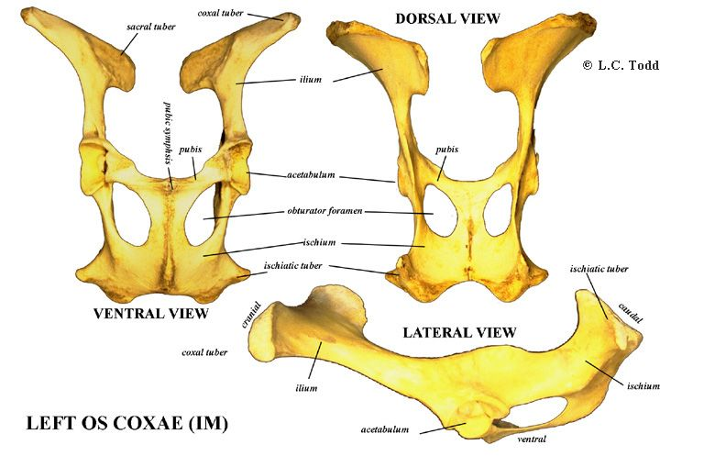
Pelvic Girdle - Ox

Slide 18
SEXUAL DIFFERENCES
Sexual differences
  The ischial arch is wider and the outlet is larger in the female than in the male.
  The conjugate (vertical) and transverse diameters are greater in the female so that the cavity is roomier.
  The pubis and the ischium of the opposite sides meet at a more open angle in the female than in the male.

Slide 19
GOAT & SHEEP
1.The long axis of the ilium is almost in straight line with that of ischium.
2. Greater ischiatic spine is low and everted.
3. Ischial symphysis is not ossified even in old animals.
4. Acetabulum is large and deep.
5. The pelvic brim is elliptical in outline.

Slide 20
HORSE- Pelvic Girdle
1. The gluteal line is very faint.
2. The tuber coxae is large and compounded four tuberosities arranged in pairs.
3.The pelvic surface of the ischium is less concave and meets its fellow at a more open angle.
4. The ischial arch is wide and shallow.
5. The ridge on the inferior face of the ischium is absent.
6. The symphyseal ridge is also absent.
7. The tuber ischii is not trifid and its lower border forms the ventral ischiatic spine.
8. The ventral face of the pubis crossed near the anterior border by the pubic groove which leads to the acetabular notch which transmits the pubo-femoral or the accessory and round ligaments of the hip to femur.
9. The acetabular notch is on the medial part of the rim.

Slide 21
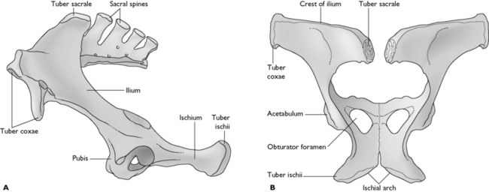
Horse – Pelvic Girdle Cont….

Slide 22
PIG-PELVIC GIRDLE
1. Os coxae is long and narrow.
2. The ilium and ischium are almost in line with each other.
3. The gluteal surface is divided into two fossa by a ridge which is continuous with the greater ischiatic spine behind.
4. The iliac crest forms the highest point of the bone.
5. There is a crest or tubercle on the ventral surface of the ischium.
6.The ilio-pectineal line is prominent and the psoas tubercle is well marked.
7. Pelvic inlet is elliptical in outline.

Slide 23
DOG- Pelvic Girdle
1. The ilium is nearly in a vertical plane.
2. The gluteal surface is concave.
3. The crest of the ilium is strongly convex.
4. The ischium has a twisted appearance.
5. The lesser ischiatic notch is absent.
6. The acetabulum is deep.
7. The symphyseal part of pubis is thick and fuses late with the opposite bone.

Slide 24
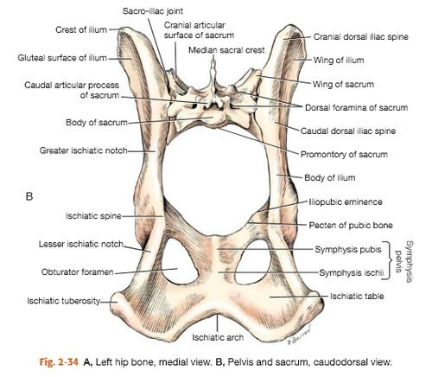
Dog- Pelvic Girdle, Conti…..

Slide 25
FOWL-PELVIC GIRDLE
1. The ilium is elongated and extends over the entire length of the hipbone. It is firmly fused to the transverse processes of the lumbo-sacral mass. The pelvic face is concave for the lodgment of kidney. The lateral border is free in its anterior half but is fused with the ischium behind.
The ischium is smaller and lies below and lateral to the posterior part of the ilium is triangular. The sciatic foramen is formed by the adjacent borders of the ischium and ilium behind the acetabulum. The ventral border forms the obturator foramen with the pubis.
The pubis is a long and slender rod running along the ventral border of the ischium. The anterior end has a muscular process.
The acetabulum is large and perforated and presents at its supero-posterior part process - anti-trochanter for articulation with the great trochanter of the femur.

Slide 26
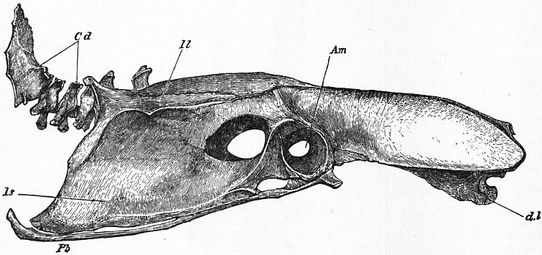
FOWL-PELVIC GIRDLE

Slide 27
BONY PELVIS / BONE OF HIP (PELVIC) REGION
Bony pelvis consist of sacrum, 1st three coccygeal vertebrae and two Os-coxae. Each formed by the ilium, ischium and pubis.
Sacrum
S. No. Mare Cow
1. It consist of 5 sacral segments, 1. It consist of 5 sacral segments.
base and apex.
2. It is shorter than the cow 2.It is longer than the mare.
3. Triangular in shape. 3. Roughly triangular in shape.
4. Dorsal surface presents 5 sacral spines 4. Dorsal surface presents spines fuse
which have tuberous summits and to form median sacral crest
4 pairs of dorsal sacral foramina. Articular processes fuse to form
lateral sacral crest and 4 pairs
of dorsal sacral foramina.
5
Ventral surface lodges 4 transverse lines.
Ventral surface presents 4 transverse groove and 4 pairs of foramina.
6
Pelvic surface presents transverse lines.
pelvic surface is concave in both directions and presents groove for middle sacral artery.
7
Smooth notches are present on either side of the body of 1st sacral segment.
No notches on either side of the body of 1st sacral segment.
8
Articular surface directed dorso-laterally which is slightly concave in its length. It is rough, irregular and articulates with ilium. Portion lateral to the foramina is formed by the fusion of the transverse processes.
Articular surfaces are concave and semicylindrical in curvature medially and process are large and widely separated.
9
Alae are the lateral part of the base (wing). Ventral margin of the base projects & form sacral promontory.

Slide 28
BONY PELVIS / BONE OF HIP (PELVIC) REGION,CONTIN…..
SACRUM
S.N. MARE COW
5. Ventral surface lodges 4 5. Ventral surface presents 4
transverse lines. transverse groove and 4
pairs of foramina
6. Pelvic surface presents transverse line 6. Concave in both direction
having groove for medial sacral artery
7. Smooth notch are present 7. Absent
8. Articular surface directed 8. Articular surfaces are concave
dorso-laterally
9. It is rough, irregular and articulate 9. emicylindrical in curvature medially
with ilium.

Slide 29
Diameters of Pelvic inlet
Sacro-pubic (Conjugate) diameter :- It is measured from sacral promontory to the anterior margin of pubis symphysis.
Transverse (Bis-iliac) diameter :- Measured at its greatest width just above psoas tubercle.
  Superior bis-iliac diameter :- It is measured at upper 3rd of pelvic inlet and receives greatest width of the fetus at shoulder in anterior presentation and hip in the posterior presentation.
  Inferior bis-iliac :- It is measured at the lower 4th of pelvic inlet at elbow of fetus in anterior presentation and stifle in posterior presentation.
Vertical diameter of inlet :- It is measured between anterior end of symphysis pubis and articulation of sacral 3rd and 4th vertebra.
Oblique / sacro-iliac / ilio-sacral diameter of inlet :- It is measured from sacro-iliac joint of one side through the center of pelvic cavity to the psoas tubercle of opposite side. It is intermediate between sacro-pubic and superior bis-iliac diameter

Slide 30
Diameter of Pelvic outlet
Superio-inferior (Vertical) diameter :- It is measured between the summit of ischial arch and articular of coccygeal 1st and 2nd vertebrae.
Transverse diameter :- It is measured between two ischiatic spines.

Slide 31
Coccygeal vertebrae :
Each vertebra consist of body, spinous and transverse processes.
S.No. Cow Mare
1. 18-20 in numbers 1. 15-21 in number
2. 1st Vertebrae, well developed 2 . Having groove medially
3. Ventrally groove for median 3. For coccygeal artery
saccral artery.
4. First 5-6 vertebare having 4. Less Developed
complete arches and spinous
process.

Slide 32
FEMUR - Thigh Bone-Longest Bone
(Ox)
1. The femur, the most massive and longest bones.
2. Extends obliquely downward and forward in direction.
3. Proximally it head articulates with acetabulum and forms joint that is known as hip joint.
4. Distally it articulates with proximal ends of tibia, fibula and dorsal surface of patella and forms joint that is known as stifle joints
For description, It consists of a shaft and two extremities.

Slide 33
FEMUR - Thigh Bone-Cont……
Shaft:
The shaft posses four surfaces.
The anterior, medial and lateral surfaces are continuous, convex from side to side and are covered in life by the quadriceps femoris.
The posterior face is narrow in the middle where it is rough for the adductor. Below this is an oblique vascular impression running downward and outward marking the course of the femoral vessels.

Slide 34
FEMUR - Thigh Bone-Cont……
The medial border of posterior surface presents in its upper third the trochanter minor, which is for quadratus femoris and ilio-psoas. Extending from this trochanter obliquely and joining the trochanter major is trochanteric ridge, which forms the postero-lateral boundary of the trochanteric fossa, ridge is for the gluteus medius and fossa for gemellus, obturator externus and obturator internus.
The distal third of this border carries above the medial condyle the medial supra condyloid crest for the medial head of the gastrocnemius. The rest of this border below the trochanter minor is for the pectineus.
The lateral border presents in its distal third the supracondyloid fossa, which is bounded laterally by the lateral supra-condyloid crest. The fossa for the superficial flexor of the digit and the crest for the lateral head of the gastrocnemius.

Slide 35
Femur- Proximal extremity
It composed of the head, neck and the trochanter major.
The head is medial and articulates with the acetabulum. The small non-articular sulcus, fovea capitis, on the middle of the head is for the round ligament of the hip joint.
The trochanter major or greater trochanter is massive and is for the gluteus medius. The lateral face is convex. Below its base are two rough tubercles -the upper one for the middle gluteus and the lower one for the deep gluteus.

Slide 36
Femur- Distal extremity
The distal extremity is large and comprises of trochlea in front and two condyles behind.
The trochlea articulates with patella. The medial ridge of the trochlea is more prominent.
The condyles are separated by the intercondyloid fossa and articulate with the condyles of the tibia through the medium of the interarticular cartilages or menisci.
The medial condyle presents an eminence on its medial aspect for the medial ligament.
The lateral condyle presents two depressions on its lateral aspect, the upper one for the lateral ligament of the stifle and the lower one for the popliteus.
Between the lateral condyle and the lateral ridge of the trochlea is, the extensor fossa for the complex muscle.
The inter-condyloid fossa lodges the spine of the tibia. Its anterior part is for the posterior crucial ligament. At its posterior part close to the medial condyle is a depression for the coronary ligament of the lateral meniscus and close to the lateral condyle is another depression for the anterior cruciate ligament.

Slide 37
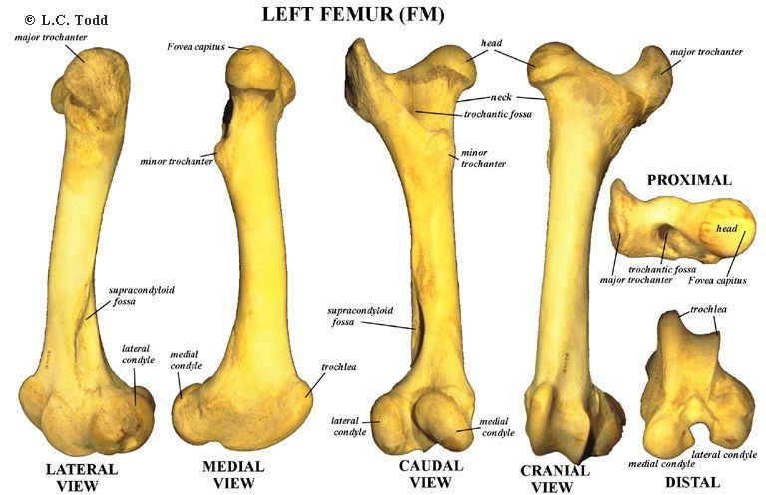
FEMUR - OX

Slide 38
Goat and Sheep- Fumer
A distinct line separates the lateral and posterior surfaces.
The trochanter major is little higher than the head.
Trochlear ridges are slightly oblique.

Slide 39
Horse-FEMUR
It is more massive and longest bone of body.
The posterior face bears in its proximal third a rough eminence for the biceps femoris. Fovea Capatis is deeper and notched.
The trochanter minor is in the form of a rough ridge.
The lateral border bears the trochanter tertius that is also known as Third Trochanter in its proximal third for the superficial gluteus.
The supracondyloid fossa and the lateral supra condyloid crest is better developed.
The trochanteric ridge is vertical and extends from the proximal third to the great trochanter.
The great trochanter is made up of a convexity a summit and a crest.
The crest is below and lateral to the convexity

Slide 40
PIG-FEMUR
The shaft is wide and relatively massive.
A ridge extends from the trochanter major to the lateral supracondyloid crest and there is no supracondyloid fossa.
The third trochanter is absent.

Slide 41
DOG-FEMUR
The shaft is proportionately large and strongly curved with the convexity forward.
The supra condyloid fossa is absent.
The trochanteric fossa is rounded and deep.
The ridges of the trochlea are sagittal and equal.
The inter condyloid fossa is wide.
On the posterior aspect of the distal extremity immediately above each condyle is a small facet for a sesamoid-the fabella.
The fabellae are two small rounded sesamoid bones, located one each on the condyles of the femur on the posterior aspect.
They are developed in the tendons of origin of the gastrocnemius muscle.

Slide 42
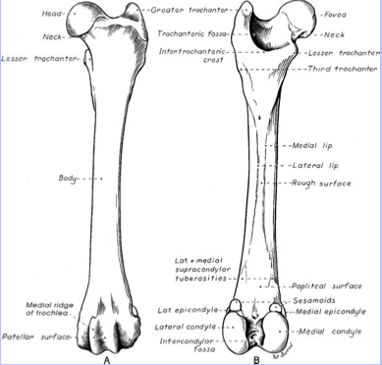
FEMUR- DOG

Slide 43
FOWL-FEMUR
The head is prominent but smaller than the acetabulum and the articular surface extends on the trochanter and articulates with the acetabulum and the facet on its rim.
The lateral condyle presents on its lateral aspect a groove for the head of fibula.

Slide 44
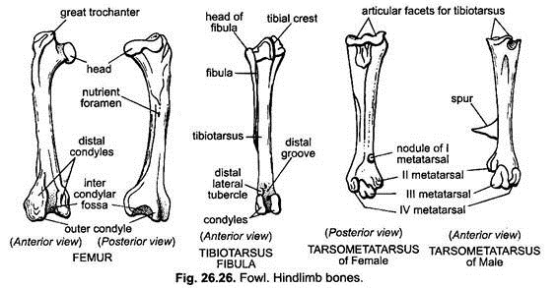
HIND LIMB - FOWL

Slide 45
PATELLA- KNEECAP
Ox
It is a large sesamoid bone placed on and articulating with the trochlea of the femur.Look like seasame seed.
It looks triangular in shape on their dorsal/anterior view.
It gives increased leverage to the extensors of leg. It is irregularly triangular and presents two surfaces, two borders, a base and an apex.
The anterior surface is convex and rough.
The posterior or articular surface is divided by a vertical ridge into two concave areas of which the medial is larger.
The two borders converge to the apex below.
The lateral border is convex.
The medial border is concave, forms an angle at the base and gives attachment to the fibro-cartilage of the patella.
The base faces upward and is irregular and narrow.

Slide 46
PATELLA – KNEECAP, CONTI…
Sheep and Goat
It is relatively longer and narrower than that of ox.
Horse-The base is wide and large.
It looks quadrlateral in shape on their dorsal/anterior view.
Pig-It is very much compressed transversely and presents 3 surfaces.
Dog- It is long and narrow.
Fowl- It is wide and thin.

Slide 47
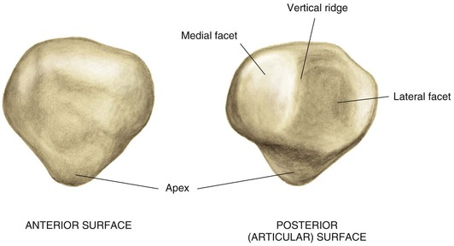
PATELLA – KNEECAP, CONTI..(OX)

Slide 48
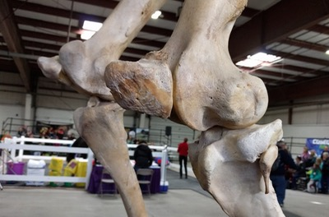
PATELLA – KNEECAP, CONTI..(HORSE)

Slide 49
TIBIA-SHINBONE-SHANKBONE-Ox
The tibia is a long bone placed obliquely downward and backward between the stifle and the hock joints. It consists of a shaft and two extremities.
Shaft
The shaft is three sided above and becomes smaller and flattened below.
It has three surfaces and three borders.
The lateral surface is wide above and inclines gradually to the front of the bone distally. It is covered by the tibialis anterior.
The medial face is subcutaneous, broad above and is slightly convex and rough for the medial ligament of the stifle, sartorius, gracilis and semimembranosus.
The posterior face is flat. The upper fourth of this surface has a triangular area marked by the popliteal line for the popliteus. The rest of this surface is marked by rough lines for the deep flexor.

Slide 50
TIBIA-SHINBONE-SHANKBONE-Ox
BORDERS-3
The anterior border is prominent in its upper third forming the tibial crest. It presents on its medial aspect a rough prominence for the semitendinosus. The rest of its extent is rounded and indistinct.
The lateral border is concave and has the fibrous part of fibula applied against it in life.
The medial border is thick and rounded in its upper fourth for the popliteus.

Slide 51
TIBIA-SHANKBONE-Ox, CONTI..
EXTERMITIES- 2, Proximal and Distal
The proximal extremity is large and is made up of two condyles, a tuberosity and a spine.
The tuberosity is anterior; it is continuous distally with the tibial crest and is for the straight ligaments of the patella. Between the tuberosity and the lateral condyle is the sulcus muscularis for the passage of the tendon of origin of the complex muscle.
The condyles are medial and lateral. Each presents a saddle shaped articular surface above for the corresponding condyle of the femur and the meniscus. The condyles are separated behind the popliteal notch on the medial aspect of which is a tubercle for the posterior cruciate ligament. The lateral condyle has the rudimentary fibula fused with it on its lateral aspect and serves for the attachment of the lateral ligament of the stifle.
The tibial spine is placed between the condyles whose articular surfaces are continued on the spine. It is bifid at the summit. Before and behind the spine are the depressions for ligaments

Slide 52
TIBIA-SHANKBONE-Ox, CONTI..
Distal extremity
The distal extremity is smaller than the proximal.
The articular surface presents two deep sagittal grooves.
The malleoli are bony prominences on the outer marigins of the sagittal grooves. The medial is smaller and fused with the distal extremity of the tibia. The medial groove is bounded on the medial aspect by the medial malleolus (which is fused to the tibia). The latter is rough medially for ligamentous attachments and articulates laterally. Its anterior part is prolonged downward to end in a blunt point. The lateral groove is separated by a sharp ridge from an outer area, which is for the lateral malleolus. The latter completes the lateral groove.

Slide 53
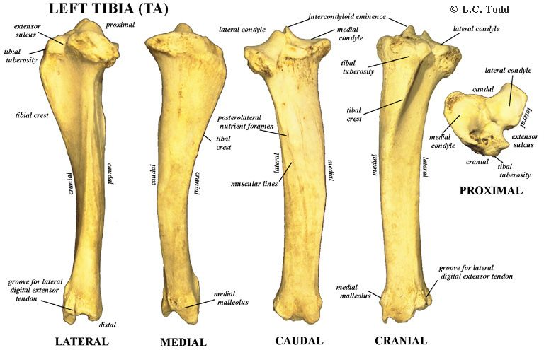
TIBIA-SHANKBONE-Ox, CONTI..

Slide 54
TIBIA-SHINBONE-SHANKBONE-
Horse
The medial border presents at its upper part a small tubercle for the popliteus.
The popliteal line is prominent.
The anterior tuberosity is grooved vertically.
Below the lateral margin of the lateral condyle is a facet for the fibula.
The grooves on the distal extremity are oblique.
The lateral malleolus is fused to the tibia.

Slide 55
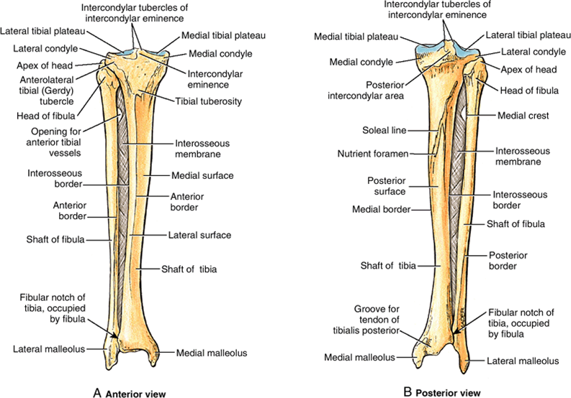
TIBIA-SHINBONE-SHANKBONE-Horse

Slide 56
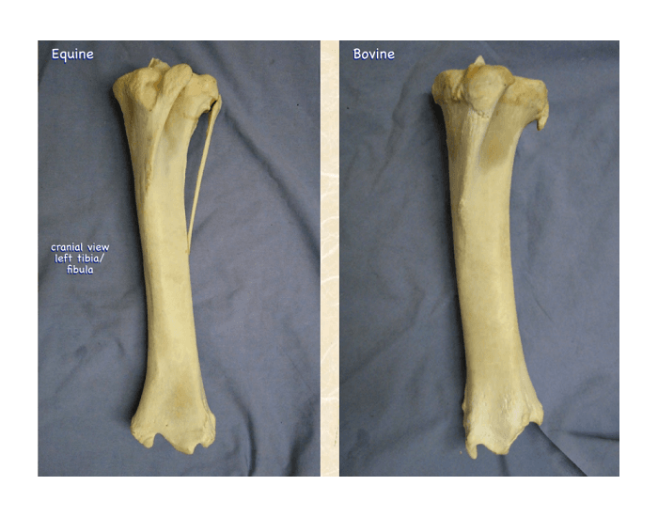
TIBIA-SHINBONE-SHANKBONE-HORSE & BOVINE

Slide 57
TIBIA-SHINBONE-SHANKBONE-pig
Pig
The shaft is slightly curve.
Tibial tuberosity is grooved in front and a narrow sulcus separates it from the lateral condyle.
Proximal part of the tibial crest is very prominent.

Slide 58
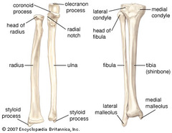
TIBIA-SHINBONE-SHANKBONE-pig along with radius ulna

Slide 59
TIBIA-SHINBONE-SHANKBONE-dog
The shaft forms a double curve, the proximal part is convex medially and the distal part convex laterally.
The tibial crest is prominent.
The facet for the fibula is on the postero-lateral aspect of the lateral condyle.
The distal extremity presents laterally a facet for fibula.

Slide 60
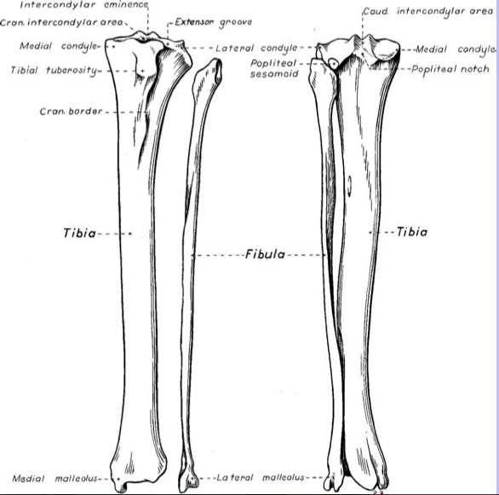
TIBIA-SHINBONE-SHANKBONE-dog

Slide 61
TIBIA-SHINBONE-SHANKBONE-fowl
The tibia fuses below with the upper row of tarsal bones and hence called tibio-tarsus.
The tibio tarsus is the longest bone in the body.
The proximal extremity is large and irregular.
The distal extremity comprises of a trochlea behind and two condyles in front, representing the fused bones of the upper row of the tarsus.

Slide 62
TIBIA-SHINBONE-SHANKBONE-fowl

Slide 63
FIBULA-CALF BONE-OX
- The fibula in Ox is rudimentary.
The head is fused to the tibia and is continued below by a small shaft.
The distal extremity or lateral-malleolus is connected to the shaft in life by a fibrous cord. It is quadrilateral in outline and compressed from side.
The proximal articular face is concave in front and convex behind. It articulates with the lateral facet of the distal extremity of tibia.
The distal face has a concave facet for the fibular tarsal.
The medial face presents a curved groove, which responds to the lateral ridge of the tibial tarsal. The lateral face is rough and irregular.
Sheep and Goat
The fibula has no shaft and its proximal end is represented by a small prominence below the lateral condyle of the tibia.
The distal end forms the lateral malleolus as in the ox.

Slide 64
FIBULA-CALF BONE-HORSE
Horse
It is better developed and placed along the lateral border of the tibia.
The shaft is a slender rod, extends down to about the middle of the tibia with which it forms the tibio-fibular arch.
The proximal extremity is large and flattened from side to side.
The medial face has a facet for the lateral condyle of the tibia.
The lateral face is slightly convex and rough.
The anterior and posterior edges are blunt and rounded, the posterior being the thicker.
The distal extremity -the lateral malleolus is fused to the tibia.
Pig
It extends the entire length of the tibia.

Slide 65
FIBULA-CALF BONE-HORSE

Slide 66
FIBULA-CALF BONE-PIG
ALONG WITH RADIUS AND ULNA

Slide 67
FIBULA-CALF BONE-DOG
It is nearly as long as tibia.
It is slender, somewhat twisted and enlarged at either end.
The proximal extremity presents a facet on the medial aspect for the tibia.
The distal extremity articulates with the tibia and the tibial tarsal medially and bears two tubercles laterally, the proximal being anterior

Slide 68
FIBULA-CALF BONE-DOG

Slide 69
FIBULA-CALF BONE-FOWL
Fowl
It is thin rod shaped bone.
It is thick above and tapers to a point below reaching the lower third of tibia.
The head is massive and articulates with the lateral condyle of the tibia and a presents a facet on its medial aspect for the lateral condyle of the femur.

Slide 70
TARSAL BONE- OX
The tarsus is composed of five short bones arranged in below:
Lateral Medial
Proximal row Tibial tarsal Fibular tarsal
Central row Fused Central and 4th tarsal
Distal row First tarsal Fused second & third tarsal

Slide 71
Tibial tarsal (astragalus)
It has six surfaces.
The proximal and the dorsal face continuous and form a trochlea with vertical ridges for the tibia and the lateral malleolus.
Distal face articulates with the fused central and 4th tarsal.
The plantar face responds to fibular tarsal. A narrow elongated area on the medial aspect of the lower part of this face for the planter prolongation of the fused central and 4th tarsal.
The lateral face is more depressed and shows two facets for the fibular tarsal.

Slide 72
Fibular tarsal (os calcis)
It is the largest tarsal, is placed behind and lateral to tibial tarsal.
It has body and medial process -the sustentaculum tali.
The lateral face of the body is flat and rough while the medial face presents two facets for the tibial tarsal.
The process the sustentaculum tali-projects medially and presents a facet dorsally for tibial tarsal. The body is prolonged above to form the tuber calcis.

Slide 73
Fused central and fourth tarsal (scapho-cuboid)
The proximal face presents two concave areas for the tibial tarsal, a projection postero-medially for the narrow medial facet on the distal face of the tibial tarsal and a narrow facet on its lateral aspect for fibular tarsal.
The distal face is uneven. The medial half is higher in level and presents a large facet in front for second and third tarsal and a small facet behind for the first tarsal. The lateral half presents two facets separated by a transverse groove and articulates with the large metatarsal bone.

Slide 74
First tarsal (cuneiform parvum)
It is a small round piece of bone situated at the postero-medial aspect of the tarsus.
The proximal face articulates with the fused central and 4th tarsal.
The distal face with the large metatarsal and the dorsal face with the fused second and third tarsal.

Slide 75
Fused 2nd and 3rd tarsal (cuneiform magnum)
It is placed beneath the fused central and 4th tarsal on its medial aspect.
The proximal face is concavo-convex from before backward and articulates with the fused central and 4th tarsal.
The distal face articulates with the large metatarsal.
The plantar face has a facet for the first tarsal.
The dorsal and medial faces are continuous, convex and rough.

Slide 76
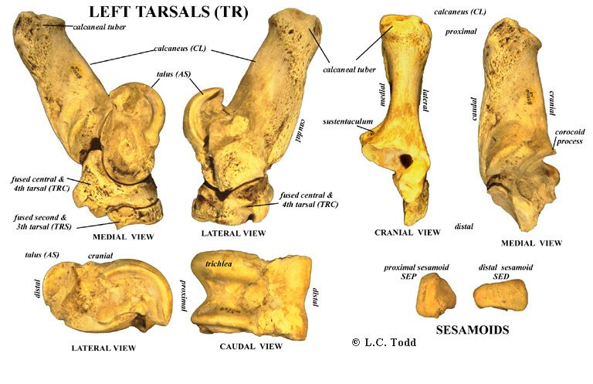
Tarsal Bone – OX-(Sheep and Goat
Similar to that of ox)

Slide 77
Horse-Tarsal Bone
The tarsus is composed of Six short bones arranged in below:
Lateral Medial
Proximal row Tibial tarsal Fibular tarsal
Central row Central
Distal row Fused 1st & 2nd tarsal 3rd Tarsal 4th Tarsal

Slide 78
Tarsal Bone- Horse-Conti….
In the tibial tarsal, the ridges of the trochlea curve obliquely downward and outward. The lateral face has no facets for the fibular tarsal.
The fibular tarsal is short and thick. It does not articulate with the lateral malleolus. The medial process is larger.
The central tarsal (scaphoid) is not fused to the fourth tarsal (cuboid). It is flat and irregularly quadrilateral. The proximal face is concave and articulates with the tibial tarsal. The distal face is convex and articulates with the third tarsal and the fused 1st and 2nd tarsal. The dorsal and the medial borders are continuous and rough. The lateral border is oblique and has two faces for the cuboid.
.

Slide 79
Tarsal Bone- Horse-Conti….
The fused 1st and 2nd tarsal (cuneiform parvum) is irregular in shape. The medial face is convex. The lateral face is concave. The proximal face is concave and has two facets for the central tarsal. The distal face articulates with the large and the medial small metatarsals. The plantar end is prolonged downward into a nodular projection.
The third tarsal (cuneiform magnum) is triangular in outline. The proximal face is concave and articulates with central tarsal. The distal face is convex and is for the large metatarsal. The medial border has no facet for the fused 1st and 2nd tarsal and the lateral has two facets for the fourth tarsal.
The fourth tarsal (cuboid) has six surfaces. It is not fused to the central tarsal. The proximal face is convex transversely and is for the fibular tarsal and the tibial tarsal. The distal face presents two facets separated by a sagittal ridge for the lateral small metatarsal bones. The medial face has facets for the central and the third tarsal. The dorsal, lateral and the plantar surfaces are convex and rough

Slide 80
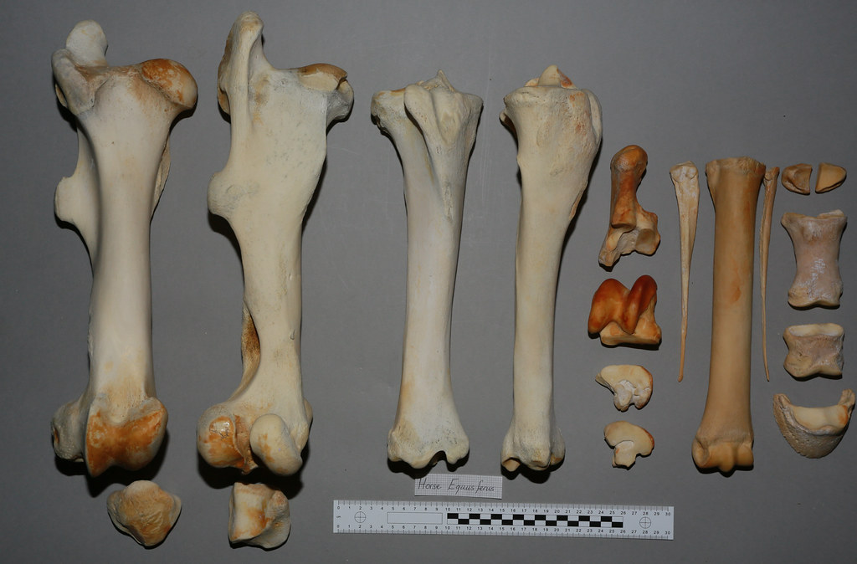
Femur, Tibia, Fibula, Patella, Tarsal, Metratarsal, Splint & Digits of Horse

Slide 81
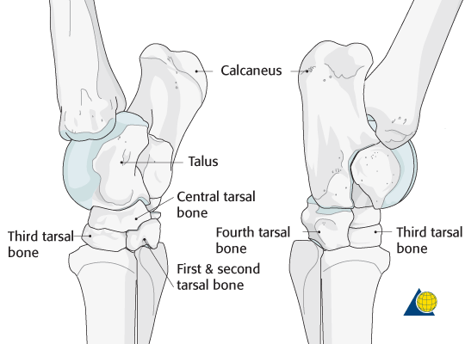
Tarsal Bone- Horse.

Slide 82
TARSAL - PIG
The tarsus is composed of Seven short bones arranged in below:
Lateral Medial
Proximal row Tibial tarsal Fibular tarsal
Central row Central Tarsal
Distal row 1st Tarsal 2nd Tarsal 3rd Tarsal 4th Tarsal

Slide 83
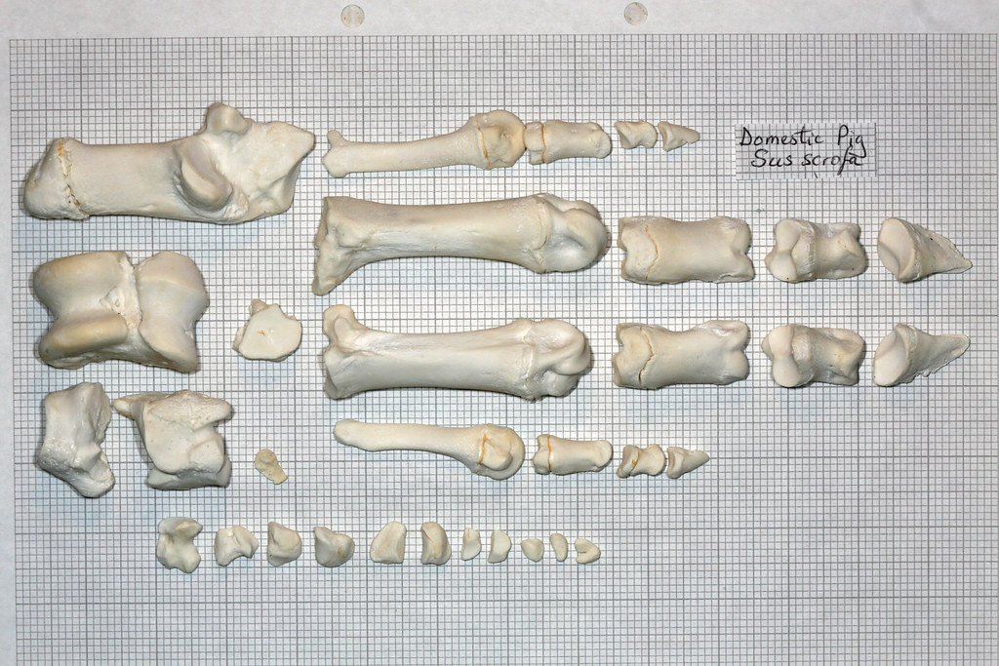
Tarsal, Metratarsal, & Digits of pig

Slide 84
TARSAL- Dog
The tarsus is composed of Seven short bones arranged in below:
Lateral Medial
Proximal row Tibial tarsal Fibular tarsal
Central row Central Tarsal
Distal row 1st Tarsal 2nd Tarsal 3rd Tarsal 4th Tarsal

Slide 85
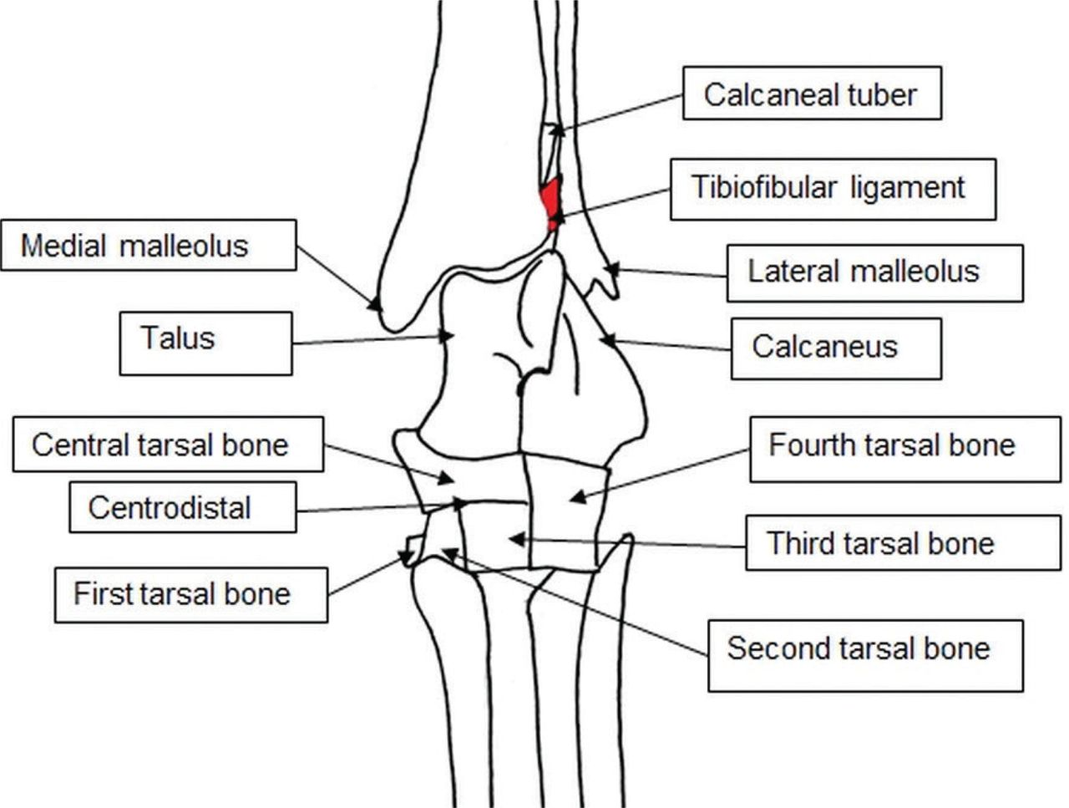
TARSAL BONE-DOG

Slide 86
TARSAL BONE - FOWL
Fowl
The tarsus bone is absent as such in the adult.
In the proximal row the embryonic elements fuse with the tibia and in the distal row with the metatarsus.

Slide 87
METATARSAL- OX
The metatarsus has two bones -the large (third and fourth) and the medial small (second) metatarsal bones.
Large metatarsal bone (third and fourth)
It resembles the large metacarpal except for the following differences
The bone is longer than metacarpal.
The shaft is four sided.
The dorsal metatarsal groove is deeper.
The plantar face presents a shallow groove. Commencing at the upper part of the groove is a vascular tunnel passing obliquely upward and forward through the proximal extremity to open on the articular face of the extremity behind and between the facets.
The proximal extremity presents a flattened facet laterally for the fused central and 4th tarsal and a large facet on the medial aspect for the fused 2nd and third tarsal behind which is another small facet for the first tarsal. At its postero medial aspect, this extremity presents a facet for the small metatarsal bone.
The dorso-medial aspect presents a tuberosity for the attachment of the tendon of the peroneus tertius.
The distal extremity resembles that of the large metacarpal.

Slide 88
SMALL METACARPAL-OX
Medial small metatarsal
The medial small metatarsal is disc shaped piece of bone situated at postero-medial aspect of the proximal extremity of the large metatarsal bone.
It presents small facet on its dorsal face for the large metatarsal. The rest of the bone is rough.

Slide 89
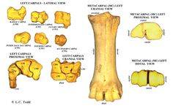
METATARSAL- SHEEP & GOAT SIMILAR TO THAT OF OX.

Slide 90
METATARSAL & SPLINT BONE- HORSE
It has three metatarsal -one large (third) and two small (second and fourth) medial and lateral metatarsals (SPLINT BONE) .
The large metatarsal resembles the large metacarpal.
The vertical groove presents in the ox are absent.
The proximal extremity presents facets for the third tarsal, the fourth tarsal and sometimes the second tarsal. The shaft is cylindrical.
The small metatarsals, each has two small facets in front for the large metatarsal.
The lateral (fourth) metatarsal is relatively massive, especially in its upper part.
The proximal extremity is large and outstanding and bears one facet above for the fourth tarsal.
The medial bone (second metatarsal) is much more slender than the lateral especially in its proximal part, which bears two facets above for the first the second tarsal and sometimes one for the third tarsal.

Slide 91
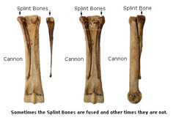
METATARSAL - HORSE

Slide 92
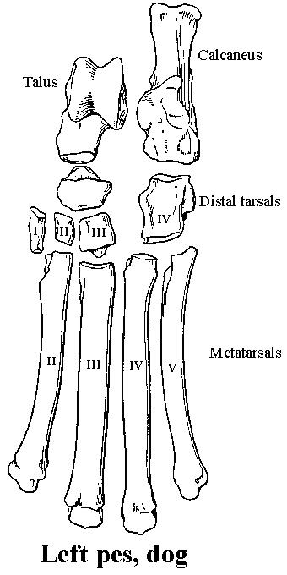
METATARSAL-DOG Five metatarsals are present.
The first is small and the other four are well developed and resemble the metacarpals.

Slide 93
METATARSAL- PIG FOUR IN NUMBER
The second and fifth are placed more towards the plantar aspect of the large bones

Slide 94
TARSOMETATARSAL- FOWL
The tarso-metatarsus is a single bone formed by the fusion of the distal row the tarsals with the second, third and fourth metatarsals.
The proximal extremity presents two glenoid cavities for the distal end of the tibio-tarsus.
The shaft is two-sided.
The first metatarsal is attached by ligament to the postero-medial border of the large metatarsus. In the male, a conical projection arises from the medial aspect of the body of the metatarsus and serves as a core for the horny spur or calcar.
The distal extremity divides into three processes.
Each process is in the form of an articular convexity. The medial one is the shortest and articulates with the second digit.
The middle one is the longest and articulates with the third-digit.
The lateral one articulates with the fourth digit.

Slide 95
FEMUR,TIBIAOTARSAL & TARSOMETATARSAL- FOWL

Slide 96
DIGIT – PHALANGES -OX
Ox
It has two digits -the third and fourth are fully developed and have three phalanges and three sesamoids each.
The second and the fifth are vestiges and are known as accessory digits or dew claws.
These are placed behind the fetlock. Each accessory digit contains one or two small phalanges, which do not articulate with the rest of the skeleton

Slide 97
PHALANGES -OX
First phalanx / os suffraginis
It is a long bone placed obliquely downward and forward between the large metacarpal above and the second phalanx below.
The shaft is four sided.
The dorsal face is convex and blends with the abaxial.
The volar face is flat and presents two tubercles, one on either side about the middle of its borders for ligamentous attachment. The axial face is flat.
The proximal extremity is larger than the distal. Its articular surface is divided by a sagittal groove into two areas (the abaxial being the larger and higher), which respond to the distal end of the large metacarpal and behind these are two facets for the proximal sesamoids. On the volar aspect are two tubercles for ligamentous attachment.
The distal extremity is smaller. Its articular surface is divided by a sagittal groove into two condyles (abaxial being the larger) which respond to the proximal extremity of the second phalanx.

Slide 98
PHALANGES-SECOND-OX
Second phalanx /os coronae
It is a long bone placed obliquely downward and forward between the first and third phalanges. The distal half of each is included within the hoof.
The shaft is three sided.
The volar face is encroached on by the distal articular surface.
The abaxial face is rough while the axial face is flat.
The proximal extremity is made up of two glenoid cavities, the abaxial of which is the larger. The volar aspect presents two tubercles for the attachment of the superficial flexor tendon.
The distal extremity is smaller and is divided by sagittal groove into two condyles, the abaxial being the larger. It articulates with the superior face of the third phalanx below and the distal sesamoid behind.

Slide 99
PHALANGES-THIRD-OX
Third phalanx / os pedis
It is a short bone entirely enclosed in the hoof.
It presents four surfaces and an angle.
The superior face is articular and presents two areas for the distal extremity of the second phalanx and a small facet along the volar border for the distal sesamoid.
The inferior face or solar surface is nearly flat, wide in the middle and narrowest in front. It is in contact with the sensitive sole in life.
The interdigital surface is smooth and grooved below and rough and porous above. It presents a large foramen near the extensor process, the volar foramen.
The laminar surface slopes from above downward and becomes steep posteriorly. Distally it is traversed by the preplantar groove with several foramina; the most posterior of these is the largest. The surface is covered by the sensitive lamina in life. At the extreme upper part of the dorsal border is the extensor process for the common digital extensor. The volar border is thick for the attachment of the deep flexor of the digit. The angle is a blunt process at the extreme posterior part of the laminar surface.

Slide 100
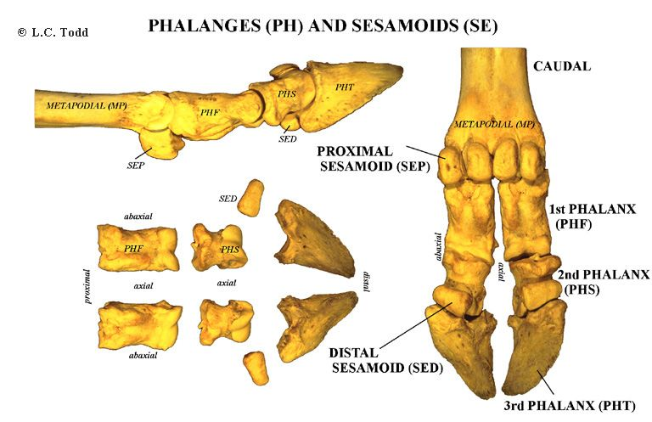
DIGIT – PHALANGES –OX
SHEEP GOAT SIMILAR TO OX

Slide 101
DIGITS-PHALANGES-HORSE
There is only one digit - the third and it consists of three phalanges and three sesamoids.
Each phalanx appears like the combined corresponding phalanges of the ox.
First phalanx, the volar face presents a “V” shaped area beginning from the proximal tuberosities and converging distally, which furnishes attachment to the distal sesamoidean ligament.
The proximal face is articular and is divided by a sagittal groove into two concave areas, the medical being the larger. The lateral face bear tubercles.
Second phalanx is a short bone being more wide than long.

Slide 102
DIGITS-PHALANGES-HORSE CONT..
Third phalanx has 3 surfaces, 3 borders and 2 angles.
The superior articular surface is adapted to the distal extremity of the second phalanx and distal sesamoid.
The volar face is divided by the semilunar crest into a larger concave solar surface and smaller semilunar flexor surface. The latter presents a central prominent area on either side of which is the volar foramen, which leads into semilunar canal within the bone.
The crest and the prominent area furnish attachment to the deep flexor tendon. The antero-superior orcoronary border bears about its middle the extensor process or the pyramidal process for the common extensor tendon. The postero-superior border is nearly straight and forms the posterior limit of the superior articular surface. The distal border is irregularly notched with a wider notch in front. The angles or wings project backward and are divided into upper and lower parts by a notch or a foramen. The proximal border of the angle carries the cartilage of the third phalanx

Slide 103
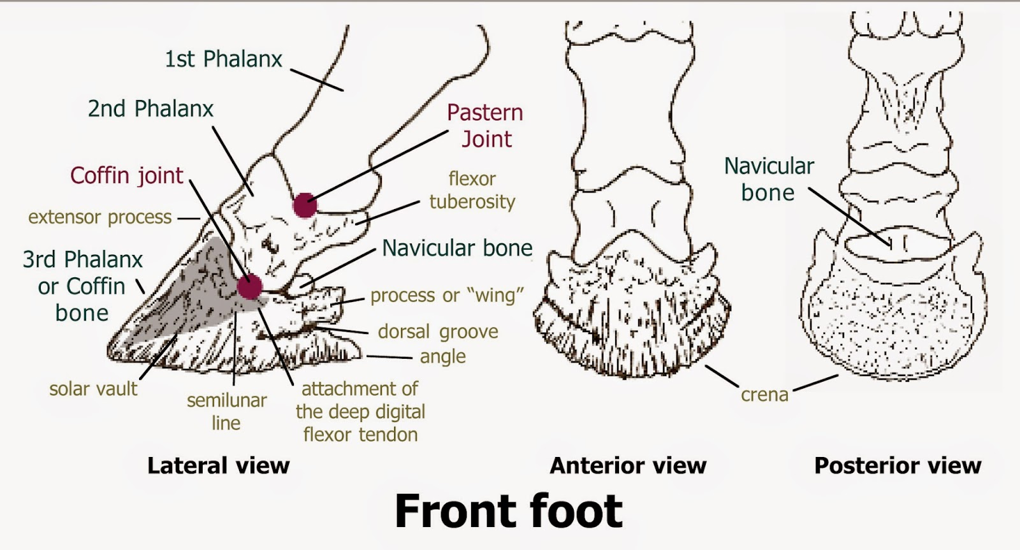
DIGITS-PHALANGES-HORSE

Slide 104
DIGITS-PHALANGES-PIG
DIGITS
Two chief digits (the third and fourth) consist of three phalanges each.
There are two accessory digits and the numbers of phalanges in each are similar to that of the chief digits.
PHALANGES
Each digit has three phalanges.
The phalanges of third and fourth are well developed.
The phalanges of second and fifth digit are small and generally donot reach the ground.
There are two proximal and distal sesamoid bones in each digit.

Slide 105
DIGITS-PHALANGES-PIG,CONTI..

Slide 106
DIGITS-PHALANGES-DOG
DIGITS
There are five digits.
The third and the fourth digits are the longest.
The first digit has two phalanges and does not come in contact with the ground.
The rest have three phalanges each
PHALANGES
The first digit has two phalanges and the other digits have three phalanges each.
The first phalanges of the chief digits have four sided shafts and the second phalanges about two thirds of the length of the first phalanges and their distal extremities are wider and flatter than those of the first.
The third phalanges correspond to the shape of the claws.
The proximal face or base responds to the second phalanx.
It is encircled by a collar of bone with which it forms a groove into which the proximal border of the claw is received.

Slide 107
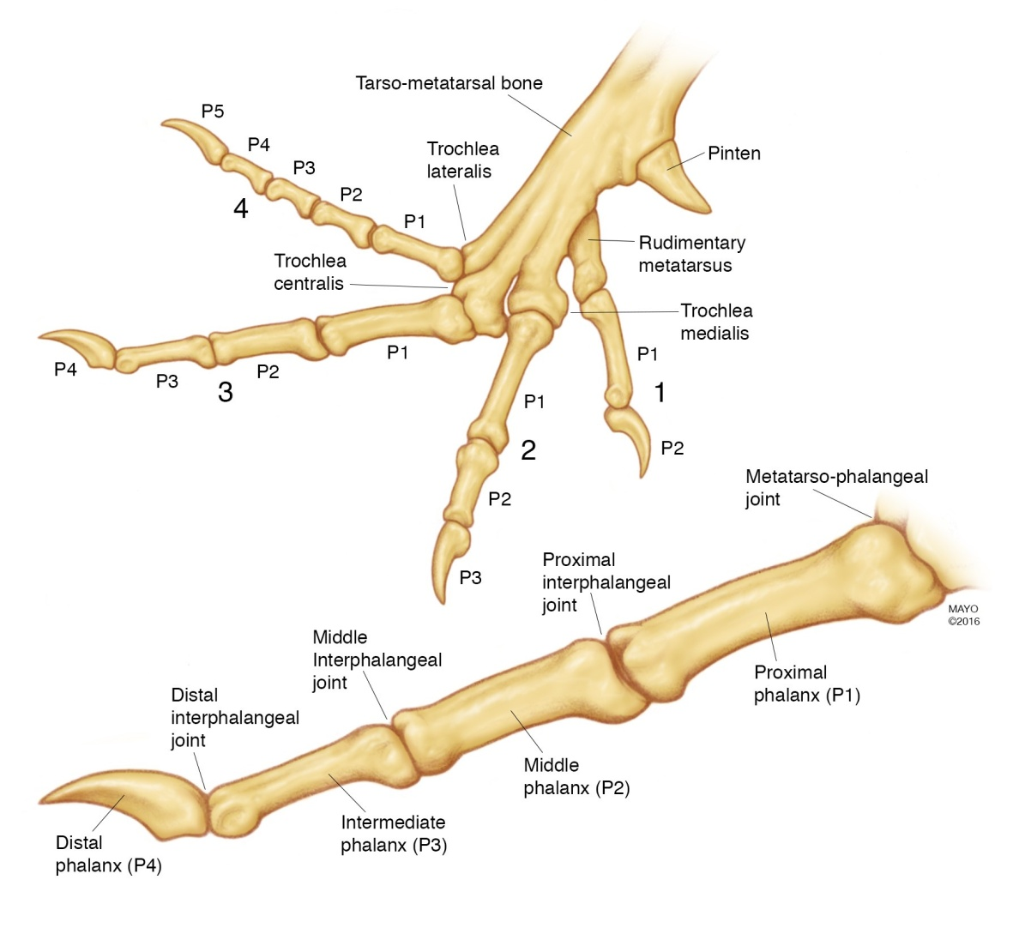
DIGITS-PHALANGES-DOG

Slide 108
DIGITS-PHALANGES-FOWL
The first and second digits have two phalanges each.
The third has only one phalanx

Slide 109
DISITAL SESAMOID BONE OX
The distal sesamoid is otherwise called as os navicularis.
It is placed behind the second inter-phalangeal articulation.
It presents two surfaces, two borders and two extremities .
The dorsal face is articular, faces upward and forward and presents two facets for the second phalanx.
The volar or flexor surface is broader and in life is covered by fibro-cartilage for the play of the deep flexor tendon.
The proximal border is grooved for ligamentous attachment.
The distal border bears a small facet about its middle for the os pedis. The extremities are

Slide 110
DISITAL SESAMOID BONE SHEEP,GOAT,HORSE,PIG,DOG,FOWL
Sheep and Goat
The number similar to that of an ox.
The flexor surface of the distal sesamoid forms a shallow groove not divided by a ridge.
Horse
The distal sesamoid is shuttle shaped and longer, with narrow extremities.
Pig
One distal sesamoid for each chief digit.
Absent in accessory digits.
Dog
The distal sesamoids are cartilaginous.
Fowl
They are absent

Slide 111
JOINTS OF THE HINDLIMB - OX
The joints of the hindlimb are as follows
Sacro-iliac joint between the articular surfaces of the ilium and sacrum.
Pelvic symphysis formed between the pubis and ischium of the two sides.
Hip joint between the acetabulum of os coxae and the head of the femur.
Stifle joint between the femur,tibia and patella.
Tibio-fibular joint between the tibia and fibula
Hock joint formed by the union of tarsal bones with tibia.
Fetlock joint between the metatarsal, 1st phalanx with proximal sesamoid.
The interphalangeal articulations are
  Pastern joint formed between the 1st and 2nd phalanges.
  Coffin joint formed between the 2nd and 3rd phalanges and the distal sesamoid.

Slide 112
SARCO ILIAC -ATRICULATION-OX
It is diarthrosis between the articular surfaces of the ilium and sacrum.
Ligaments
  Capsular ligaments
  Dorsal sacro-iliac ligaments –connects the dorsum of the sacral spines to the tuber sacrale. In t he spinal attachment it blends with supraspinous ligament.
  Lateral sacro-iliac ligament is a thick, irregularly quadrilateral sheet, placed above the sacro-sciatic ligament and below the dorsal sacro-iliac ligament. It is attached anteriorly to the tuber sacrale and the medial border of the ilium above the greater sciatic foramen and ventrally to the lateral border of the sacrum. Its lateral surface is in contact with the middle gluteus and biceps femoris and superficial gluteus muscle. Its deep face is related to dorsal and lateral coccygeal muscles.
  Ilio -lumbar ligament attaches the ilium to the transverse process of the lumbar vertebrae.

Slide 113
SARCO ILIAC -ATRICULATION-OX, CONTI..
  Sacro-sciatic ligament is a vast membranous expansion situated in the pelvis between the sacrum and the os coxae.
    It is irregularly quadrilateral in shape and forms the lateral wall of the pelvis.
    Its dorsal border is attached to the lateral surface of the sacrum and the first two or three coccygeal bones attaches it.
    Its inferior is attached to ischiatic spine and tuber ischii.
    It forms between these two attachments and the bones two foramina the greater and lesser sacro-sciatic foramina for the passage of structures out of the pelvic cavity.
    Its posterior border forms the lateral boundary of the pelvic outlet.
    The lateral face of this ligament is covered by the gluteus medius and biceps femoris, which derive part of their origin from it.
    The posterior part of the medial face gives origin to the retractor ani.
Motion-Is appreciable in this joint.

Slide 114
SARCO ILIAC -ATRICULATION-
Horse
The sacro-sciatic ligament is broader.
The greater sciatic foramen transmits the posterior gluteal vessels and nerves and the lesser sciatic foramen transmits the tendon of the obturator internus and is pyriform.
Dog
The sacro-sciatic ligament is a narrow thin band, which extends from the part of the lateral margin of the sacrum to the tuber ischii.

Slide 115
PELVIC SYMPHYSIS
Ox
It is amphiarthrosis formed between the pubis and ischia of the two sides.
The intervening cartilage gets ossified with increasing age.
The obturator foramen is covered in life by the obturator membrane called obturator ligament, leaving a space in front for the passage of the tendon of the obturator internus muscle and the obturator nerve.
Horse, Dog & Pig
No difference

Slide 116
HIP JOINT
Ox
Types- Ball and Socket, the coxo-femoral articulation is an enarthrosis.
Bone involvement acetabulum of os coxae and the head of the femur.
Ligaments
  Capsular ligament.
  Cotyloid ligament is a marginal cartilage, which deepens the acetabulum.
  That part of cotyloid ligament stretches across the cotyloid notch converting it into a foramen for the passage of structures and out of the joint is the transverse acetabular ligament.
  Round ligament is attached to the lateral lip of acetabular notch and to the fovea capitis, on the head of femur.
Motion
  Gliding, circumduction, adduction and abduction are possible, extension and flexion are most marked.

Slide 117
HIP JOINT
Horse
The cotyloid ligament is narrower.
There is an additional ligament, the accessory or pubic femoral ligament which arises from the prepubic tendon, passes outwards and upwards and then backwards lodged in the pubic groove, the acetabular notch and is inserted to the fovea capitis behind the round ligament. This ligament is peculiar to solipeds and it prevents abduction and limits side-kicking. The absence of the ligament in ruminants permits free abduction and this is the reason why ruminants can kick side ways, this movement being known as ‘cow kick’.
Dog & Pig
Resembles that of the Ox.

Slide 118
STIFFLE -JOINT
The stifle joint is composite joint composed of
A. Femoro-patellar articulation B. Femoro-tibial articulation
Femoro-Patellar joint-Ox
The femoro-patellar joint is gliding joint where the patella glides over the trochlea of the femur.
Ligaments
  The capsular ligament is loose. It forms a pouch under the insertion of the quadriceps muscle.
  The medial and lateral ligaments which arise from corresponding faces of the condyles of the femur to the lateral and medial angles of the patella.
  The straight ligaments of the patella are lateral, middle and medial, which extend from the patella and its fibrocartilage to the anterior tuberosity of the tibia.
  Bursae of the patellar ligaments are two. One is interposed between the middle ligament and the upper part of the trochlea; a smaller one occurs between the upper part of the same ligament and the apex of the patella.The second is interposed between the lateral patellar ligament and the lateral condyle of the femur.
Motion-The patella moves up and down the trochlea of femur.

Slide 119
Femoro-Tibial joint
Ox
Types-Ginglymus
Bone involvement- condyles of the femur and those of the tibia.
Ligaments
  The joint has a capsular ligament, two inter-articular cartilages called menisci, two collateral ligaments, two crucial ligaments and a posterior ligament.
  The capsular ligament is attached to the margins of articular surfaces of femur and tibia and also to the convex borders of the menisci and to the cruciate ligaments. There are two synovial sacs, partially divided by the menisci into upper and lower compartments. The two synovial sacs communicate with each other and the medial sac also communicates with femoro patellar joint.
Motion- Extension and flexion.

Slide 120
FEMRERO-TIBIAL JOINT. CONT….
  The menisci (inter-articular cartilages) are medial and lateral.
    They are ‘C’ shaped plates of fibro-cartilage interposed between the condyles of the femur and tibia.
    The lateral borders are thick and convex while their medial borders are thin and concave.
    The proximal faces are hollowed out for the condyles of the femur and the distal faces are flattened for the condyles of the tibia. These cartilages bring about congruence of the articular surfaces and are kept in position by ligaments called coronary ligaments.
    The lateral meniscus has three coronary ligaments one anterior and two posterior, of which one is superior attached to a depression on the medial aspect of inter-condyloid fossa of femur and other inferior attached to the tibia, lateral to the popliteal notch.
    .
.

Slide 121
FEMRERO-TIBIAL JOINT. CONT….
  The medial meniscus has two coronary ligaments one anterior and one posterior. These are attached to the depression in front and behind the tibial spine
  The collateral ligaments arise from the corresponding condyles of the femur. The lateral ligament is attached to the fibula and the medial is to the medial condyle of the tibia.
  The posterior ligaments are membranous, enclose the joint behind.
  The cruciate ligaments are anterior and posterior. The anterior arises from the tibial spine, extends upwards and backwards and ends on the lateral part to the inter-condyloid fossa of femur. The posterior is attached below the tubercle medial to the popliteal notch, directed upwards and forwards and is attached to the anterior part of the inter-condyloid fossa of femur.

Slide 122
STIFFLE -JOINT
A. Femoro-patellar articulation
Horse & Pig
- Similar to that of ox.
Dog- There is only one straight ligament.
B. Femoro-tibial articulation
Horse, Dog & Pig
-Similar to that of ox

Slide 123
HOCK JOINT
Ox
This is a composite joint consisting of
1. Tibio tarsal articulation
2. Proximal tarsal articulations
3.Inter tarsal articulations
4. Distal tarsal articulations
5.Tarso-metatarsal articulations.
The tibio tarsal articulation is a ginglymus. The rest are arthrodia.
The joint has common ligaments and special ligaments.

Slide 124
HOCK JOINT- Contin…..
Common ligaments
Capsular ligament may be divided into two parts-anterior and posterior.
  The anterior capsular ligament is membranous and encloses and tibio-tarsal joint in front.
  The posterior capsular ligament is also membranous and is attached to the tibial tarsal above, metatarsal below and blends with the lateral ligaments.
The lateral and medial collateral ligaments extending from the distal end of the tibia above, attached to the tarsal bones and the large metatarsal bone below.
Posterior ligament (calcaneo-metatarsal ligament) is on the postero-lateral aspect from the posterior border of tuber calcis passes down and is attached to the central and fourth tarsal and to the large metatarsal below.
.

Slide 125
HOCK JOINT- Contin…..
Dorsal oblique ligament is a narrow band placed at the antero-internal aspect of the joint. It extends from the medial side of the tibial tarsal, passed obliquely downwards and attaches on the fused central, fourth tarsal and the large metatarsal bones
Tarso- metatarsal ligament is on the plantar aspect of the joint. It is blended in front with plantar oblique capsular ligament and is adherent to all the tarsal bones. It also blends medially with the medial (collateral) ligament and laterally with planter tarsal ligament. Its plantar face is lines by synovial membrane and forms anterior wall of the tarsal sheath.

Slide 126
HOCK JOINT- Contin…..
Besides these ligaments, there are certain annular ligament which serve to bind the tendons of the muscles.
  On the dorsal aspect, there are two-proximal and distal.
  The proximal annular ligament is large and thick running across from medial to lateral malleolus. It binds fascia down the tendons of complex muscle.
  The distal annular ligament is thin, arises from fibular tarsal runs obliquely downwards inward is attached to the large metatarsal.
  The plantar or posterior annular ligament extends from the fibular tarsal and plantar ligament to the medial collateral ligament. This from the posterior wall of the tarsal sheath.
The tarsal sheath is formed in front by the tarso-metatarsal ligament (blended with plantar capsular ligament) and behind by the plantar annular ligament. The posterior and anterior faces respectively of these ligaments are lined by synovial membrane and this sheath for the tendon of the deep flexor, plantar arteries and nerves.

Slide 127
HOCK JOINT- Contin…..
Proximal tarsal articulation
  Between tibial tarsal and fibular tarsal bones.
  Ligaments
    one extends from the supero-posterior margin of the trochlea of tibial tarsal to fibular tarsal
    From sustentaculum tali to adjacent part of tibial tarsal on the medial aspect
    A lateral band from trochlear process of fibular tarsal to lateral ridge of the trochlea of tibial tarsus.
    An interosseous ligament.

Slide 128
HOCK JOINT- Contin…..
Proximal inter-tarsal articulation
  Between tibial and fibular tarsals above and central & fourth tarsal.
  Ligaments
    Interosseous between tibial and centrals
    Interosseous between fibular and central tarsals.
Distal inter-tarsal articulation
  Between central & fourth tarsal above fused second and third tarsal and first tarsal below.
  Ligaments
    From central tarsal to fused second and third tarsal on the dorsal aspect.
    Interosseous ligaments connecting fused central and fourth tarsal to fused second and third tarsal and to large metatarsal.

Slide 129
HOCK JOINT- Contin…..
Distal tarsal articulation
  Between fused second and third tarsal and first tarsal
  Interosseous ligament between fused second and third tarsal and first tarsal.
Tarsal metatarsal articulation
  Between central and fourth tarsal, second and third tarsal bones above and large metatarsal bone below.
  On the dorsal aspect extending obliquely from medial aspect of tibial tarsal, down to large metatarsal. Synovial membranes are four in member.
  Motion
    Extension and flexion in the tibio-tarsal and gliding in other joints.

Slide 130
HOCK JOINT- Contin…..
Horse
Minor differences due to the variation in number of bones.
Check ligaments are ill developed.
The supra tarsal ligament is vestigial and is represented by deep tarsal fascia, attached to both sides of tendo-achilles.
The sub tarsal ligament is the prolongation of the tarso-metatarsal ligament, which joins the deep flexor tendon.
Dog & Pig
Differences are present due to variation in the number of bones.

Slide 131
FETLOCK JOINT-METATARSO PHALANGEAL ARTICULATION
Ox
There are two such joints for each limb. Each is a ginglymus formed between the distal extremity of the large metacarpal, the proximal extremity of the first phalanx below and the proximal sesamoids behind.
Ligaments
  The joint has a capsular, collateral and sesamoidean ligaments.
  The capsular ligaments enclose the joints and adherent to the extensor tendons passing over the metatarsal.
  The collateral ligaments are in the form of axial and abaxial ligaments.
  The abaxial ligaments extend from the lateral aspects of the distal extremity of the large metatarsal to the abaxial sesamoids and the proximal extremity of the first phalanx below.
  .

Slide 132
FETLOCK JOINT-METATARSO PHALANGEAL ARTICULATION CONT……
The axial ligaments arise common from the cleft of the large metatarsal bone and each spreads out on the cleft of the large metatarsal bone. It then spreads out and attached to the proximal part of the interdigital space of the first phalanx, where its fibres blend with the superior interdigital ligament.
  The Sesamoidean ligaments are superior, inferior, collateral and inter sesamoidean.
  The superior sesamoidean or suspensory ligament (musculus interossei) arises from the volar face of the distal row of tarsal bones and the proximal extremity of the large metatarsal descends on the volar face of the latter and divides about its middle into two branches-anterior and posterior.

Slide 133
PASTERN JOINT
Ox-
The proximal interphalangeal articulations are two for each limb. Each is ginglymus formed between the first and second phalanges. It has a glenoid fibro cartilage behind, kept in position by ligament and confounded with the tendon of the superficial flexor.
Ligaments
  The capsular ligament
  Abaxial collateral ligament extends from axial face of distal extremity of first phalanx to abaxial face of proximal extremity of second phalanx
  Axial collateral ligaments extend from the axial face of distal extremity of first phalanx to the interdigital or axial face of the proximal extremity of the second phalanx. Fibres also extend downwards to be attached to the interdigital face of third phalanx.
  Volar abaxial and volar axial ligaments which extends from the first phalanx to the proximal extremity of the second phalanx on the corresponding aspects.

Slide 134
PASTERN JOINT- conti…..
  Proximal or superior inter digital ligament is a strong ligament of intercrossing fibres connects the axial faces of the shafts of the first phalanges in each limb.
  A strong band of fibres unite the rudimentary digits of the second phalanx.
  The distal or inferior inter-digital ligament (cruciate) consists of two strong bands attached above to the lateral tubercles at the proximal extremity of the second phalanx of each digit cross each other in the inter-digital spaces, behind and are inserted to the navicular bone of the other digit and axial face of the second phalanx and the navicular bone of the same digit to some extent.
  The two inter-digital ligaments prevent excessive abduction of the digits.
Motion- Extension and flexion.

Slide 135
PASTERN JOINT- conti…..
Horse
There is only one such joint in each limb.
Inter-digital ligaments crossing the volar face of the first phalanges restrict apart of the digits.
The 2nd & 3rd; 3rd & 4th; 4th & 5th are connected.
Dog & Pig
It has the glenoid cartilage which is united on its posterior surface to the tendon of the superficial digital flexor and is kept attached to the first phalanx.
It has one capsular ligament and two lateral ligaments.

Slide 136
COFFIN JOINT
Ox
The distal interphalangeal articulations are two for each limb. Each is a ginglymus formed between the second and third phalanges and the distal sesamoid.
Ligaments
  Capsular ligament
  Anterior elastic ligament which is attached above to the distal ends of the first phalanx crosses the dorsal face of the second phalanx and is inserted to the extensor process of the third phalanx.
  The abaxial and axial collateral ligaments.
    The abaxial collateral ligament is closely adherent to the proper digital extensor tendon.

Slide 137
COFFIN JOINT CONTIN……
    The axial collateral ligament extends from the distal extremity of first phalanx receives fibres from the second phalanx and is attached to the interdigital surface of the third phalanx.
  Volar collateral or Collateral sesamoidean ligaments. The volar abaxial ligament arises from the distal extremity of the first phalanx receives fibres from the second phalanx and are attached to the volar axial ligament extends from the lower end of the phalanx to the interdigital face of the third phalanx.
  The superior navicular ligament is formed by fibres from the two volar collateral and is attached to the upper border of the navicular bone.
  The inferior navicular ligament or phalango-sesamoidean ligament extends from the distal border of the navicular to the flexor surface of the os pedis.

Slide 138
COFFIN JOINT CONTIN……
Horse
There is only one joint for each limb.
The dorsal elastic ligament is absent.
In addition, it has three ligaments attaching the lateral cartilages to the phalanges.
Lateral cartilages of the third phalanx are rhomboid plates of hyaline cartilage.
The anterior end of each is attached to the distal extremity of the second phalanx by a short strong band.
The lower border is thick and is attached by another band to the angle of third phalanx.
The posterior end curves axially towards its fellow.

Slide 139
COFFIN JOINT CONTIN……
Dog & Pig
Each joint has a capsular and two lateral ligaments.
An elastic ligament attached above to the distal end of the second phalanx and below to the collar at the base of third phalanx aids in retracting the claw.

