Slide 1
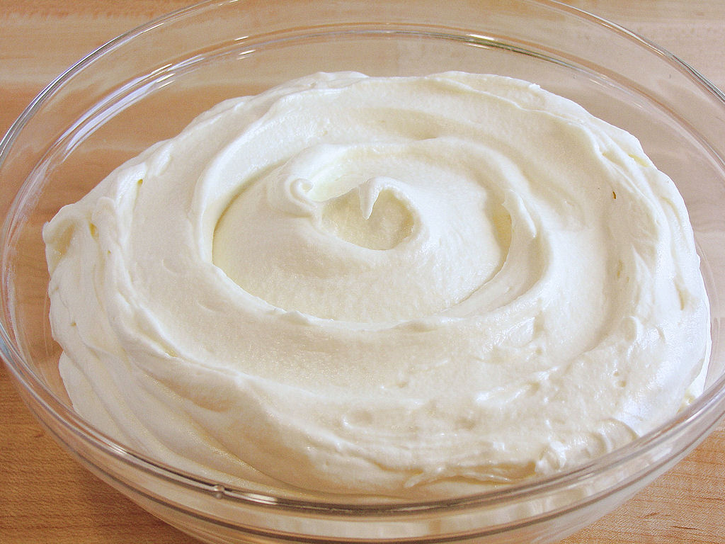
Class Lecture
STANDARDISATION, PASTEURISATION, NEUTRALISATION
OF CREAM
Dr. Sanjeev Kumar
Associate Professor
Department of Dairy Technology
SGIDT, Patna-14

Slide 2
STANDARDISATION
Standardisation of cream refers to the adjustment of the fat content in cream to the desired percentage.
The fat % in cream is adjusted using adequate amount of skim milk , calculated usually by Pearson's method.
PURPOSE:
1) To prepare consumer cream products with fat content to meet legal/quality standards.
2) To avoid economic losses accompanying excess fat content in prepared product.
3) To minimize fat losses in buttermilk.

Slide 3

Example: How much skim milk testing 0.1% fat must be added to obtain 40% fat in the standardised cream, given 1000 kg cream testing 50%?
SOLUTION:
From Pearson’s square, 39.9 parts by weight of 50% cream, when mixed with 0.1% skim milk, will give 49.9 parts by weight of standardised 40% cream with 10 parts by weight of milk.
50
39.9
40
0.1
10
49.9

Slide 4
PASTEURISATION
Pasteurization of cream refers to the process of heating every particle of cream to not less than 71°C and holding it at such a temperature for at least 20 minutes, or to any suitable temperature-time combination, using approved and properly-operated equipment.

Slide 5
OBJECTIVES OF PASTEURISATION
To destroy the pathogenic organisms in cream.
To destroy the undesirable micro organisms and inactivate the enzymes.
To complete the neutralization process in the manufacture of butter.
To eliminate some of the gaseous tainting substances.
To make possible the removal of some volatile off flavours by vacreation.

Slide 6
METHODS OF PASTEURISATION
HOLDER PASTEURISATION (71°C FOR 20 MINUTES)
HTST(Plate) PASTEURIZATION (95-100°C FOR 15-16 SECONDS)
VACCUM PASTEURISATION OR VACREATION
(high pressure steam is injected after diluting cream to 6 to 8 % fat)

Slide 7
NEUTRALISATION OF CREAM FOR BUTTER MAKING
Neutralization of sour cream for butter making refers to partial reduction in its acidity.
OBJECTIVE-
1.To avoid excessive fat loss in butter-milk ,due to churning of high acid pasteurized cream.
2.To guard against off flavors in cream.
3.To improve the keeping quality of butter made from high acid cream.
BUTTER IS GENERALLY STORED AT -23⁰C TO -29⁰C

Slide 8
PROCEDURE FOR NEUTRALISATION
1.ADOPTION OF DEFINITE STANDARD OF CHURNING ACIDITY
*Butter for long storage –cream acidity should be 0.06 to 0.08
*Butter for short storage-cream acidity should be 0.25 to 0.30.
2.Testing correctly for acidity
*take sample after thorough mixing
*heat cream to boiling point for one minute before testing for acidity
*first partially neutralize the cream with known amount of alkali and then treat as above (for acid cream)
*determine lactic acidity of cream by titration of a fixed weight (10g) with the standard alkali (n/9 NaOH solution), using phenolphthalein as an indicator.

Slide 9
Correct Amount Of Neutralizer To Be Added
Type of Neutralizer | Theoretical value (in kg) | Practical value (in kg)
Sodium bicarbonate | 0.93 | 0.83
Calcium hydroxide | 0.41 | 0.49

Slide 10
The practical value of sodium bicarbonate neutralizer used is lower than theoretical value due to the presence of variable amount of carbon-dioxide which raises the titrable value.
Carbon dioxide doesn’t react with sodium bicarbonate neutralizer and consequently results in over neutralization.
The actual neutralizing capacity of Lime is only 80 percent of the amount used, since nearly 20 % of it reacts with casein and phosphate, and so is not available for acid neutralization.

Slide 11
Characteristics of Neutralizers
Particulars | Lime | Soda
Purity | Low | High
Solubility | Low | High
Neutralizing speed | Low | High
Foam production | none | Variable
Cost | Low | High
Over neutralization effect | Limy flavor | Soapy flavor

Slide 12
Correct procedure for addition of Neutralizer
Should never be added dry
Should be diluted 10-15 times in clean portable water
Should be mixed uniformly and stirred vigorously
Temperature of cream should be around 29⁰C to 32⁰C, during addition of neutralizer
Stirring should be continued for 5-10 minutes after adding neutralizer
Then cream should be pasteurized

Slide 13
Double Neutralization of Cream with Lime and Soda
First use lime as neutralizer to bring the cream acidity down to 0.3 -0.4% L.A.
Next use soda neutralizer to bring the cream acidity to desired level.
Objectives
To reduce intense flavor effect of single neutralizer used whether lime or soda
To avoid production of excessive carbon dioxide by the use of sodium bicarbonate with high acid cream.
Notes:
Xksahsahkhcshdh fifoifoi

