Slide 1
CIRCOVIRIDAE
Dr Manoj Kumar

Slide 2
By Dr Manoj Kumar Department of Veterinary Microbiology, Bihar Veterinary College, Patna
Circoviridae

Slide 3
CHICKEN INFECTIOUS ANEMIA VIRUS
Family: Circoviridae
Genus: Gyrovirus
Chicken Anemia Virus, CAV (chicken)
Genus : Circovirus
Porcine Circovirus, PCV (pigs)
Psittacine Beak and Feather Disease
Virus, PBFDV (psittacines)
Pigeon Circovirus (racing pigeons )

Slide 4
Morphology (Chicken infectious anemia virus)
smallest known animal virus
spherical, icosahedron
60 capsid protein molecules
Non-enveloped virus
Diameter of 19 to 24 nm.
genome - circular single-
stranded molecule of DNA (1.8- 2.3 kb)
negative sense
rolling-circle replication

Slide 5
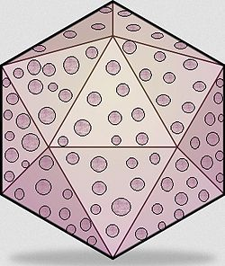
Morphology
Symmetrical structure
Cross section

Slide 6
Replication (in Nucleus)
Virus penetrates into the host cell.
Uncoating, the viral ssDNA genome penetrates into nucleus
Viral ssDNA is converted into dsDNA with the participation of cellular factors.
ds DNA transcription gives rise to viral mRNAs.
Viral mRNAs are translated to produce viral proteins.
Replication may be mediated by a Rep protein, and would occur by rolling circle replication producing ssDNA genomes.
These newly synthesized ssDNA can either a) be converted to dsDNA and serve as a template for transcription/replication b) be encapsidated by capsid protein and form virions released by cell lysis.

Slide 7
Cultivation
Embryonated specific pathogen free(SPF) eggs through yolk sac
Susceptible immunosuppressed chickens
MDCC-MSB-1 cell cultures
Lymphoblastoid cell line

Slide 8
Chicken infectious anemia (CIA)

Slide 9
Chicken infectious anemia (CIA) is a viral disease of poultry characterized by : i . Aplastic anemia, ii. Generalized lymphoid depletion, iii. Subcutaneous and intramuscular hemorrhages, iv. Immunosuppression. V. Increased mortality due to secondary complications.
Definition

Slide 10
Blue Wing Disease (BWD) Anemia Dermatitis Syndrome Avian Infectious Anaemia Haemorrhagic Aplastic Anaemia Syndrome Infectious Chicken Anaemia Chicken Anemia Agent Pale bird syndrome.
Synonyms

Slide 11
Susceptible Host

Slide 12
Chicken of all age group Young birds are more susceptible

Slide 13
Horizontal transmission by oral-faecal route
Transmission
Vertical transmission in seronagative hens

Slide 14
Economic losses
Diminished weight gains
Feed conversion
Marketability
Carcass condemnation

Slide 15
Pathogenesis
Virus multiplying in most lymphopoietic organs:
Other viruses
Birnaviruses
REV
Marek’s Disease viruses
1- Destruction of erythroblastoid cells .
2- Immunodeficiency due to depletion of cortical thymocytes .
3- Destruction of erythroid precursor cells in bone marrow.
i. Anaemia , Lymphoid atrophy
ii. Concurrent infections and to vaccination failures.
iii. Increased mortality
Immunosuppression

Slide 16
Pathogenesis and epizootiology
Dysfunction
of
T helper and Cytotoxic T cell .
CIAviruses infect
Corttex of thymuscells
B cell deficiency
Invades Bursa of Fabricius
Invades Bone marrow
Destruction of
erythroid precursor
cells
Vertical and horizontal transmission
of these viruses are proven.

Slide 17
Viruses Infect Bone marrow and thymus
Dysfunction of the haematopoesis and lymphocytosis of T lymphocytes leads to impaired formation of erythocytes and myeloid cells producing aplastic anaemia.
Anaemia
Lymphoid atrophy
Increased mortality

Slide 18
Symptoms

Slide 19
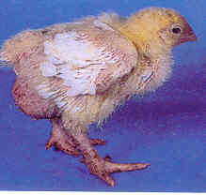
Anaemic and poor growth
Birds apears depressed and pale
Young chickens are depressed and huddle
Haemorrhagic Feathers
Anorexia
Depression
Poor pigmentation (Pale-bird syndrome)
Feed conversion - Mortality

Slide 20
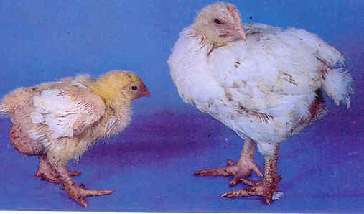
Stunts-Runts

Slide 21
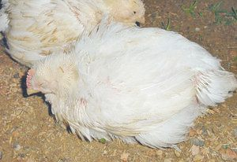
Depression & Anorexia

Slide 22
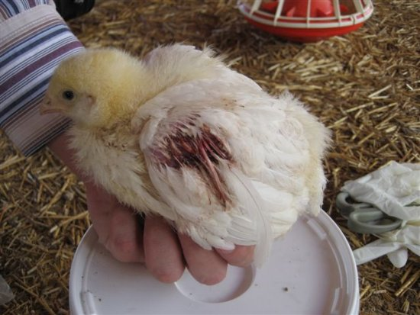
Haemorrhagic & Necrotic Wings

Slide 23
Post mortem Lesions

Slide 24
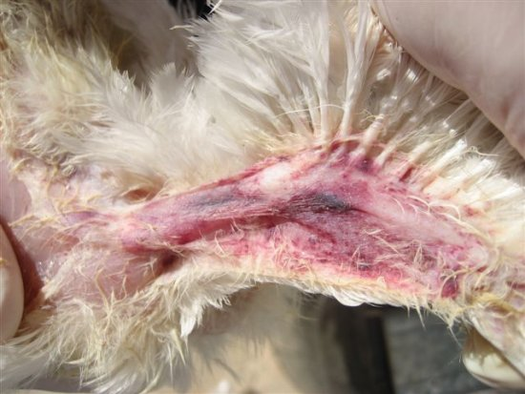
Subcutaneous harmorrhages

Slide 25
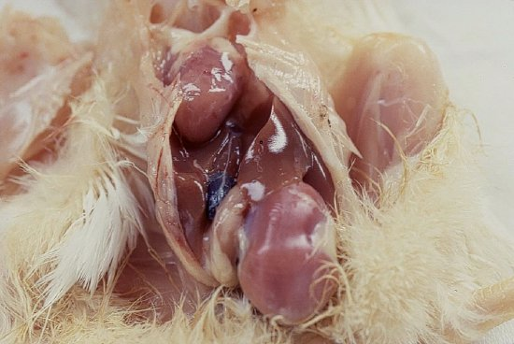
Pale carcass

Slide 26
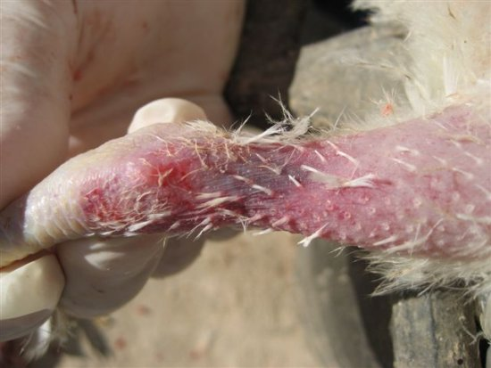
Hemorrhage & Cyanoses

Slide 27
Histopathological lesions

Slide 28
1- Decrease in the number haematopoietic cells is observed 4 – 6 days post infection followed by the appearance of large blastic cells
2- Haematopoietic tissue is replaced by adipose tissue; this gives the bone marrow a pale appearance.

Slide 29
3- Depletion of lymphocytes from the thymus, spleen, Bursa Fabricius and caecal tonsils followed by hyperplasia of reticular cells
4- Cortical lymphocytes disappearing in thymus and being replaced by reticular cells.
5- Medullar lymphocytes are also reduced

Slide 30
Diagnosis

Slide 31
Diagnosis on the basis of Clinical signs
- although very difficult.
clinical disease may present
itself in milder forms making it impossible to
make a proper diagnosis.
Post mortem findings are often not conclusive.

Slide 32
Laboratory Test

Slide 33
Antigen determination Immunofluoresence Virus neutralization test (VN) Enzyme linked Immuno Sorbent Assay (ELISA) Antigen-Capture ELISA
Isolation and identification of virus
Serological test
Antigen-Capture ELISA

Slide 34
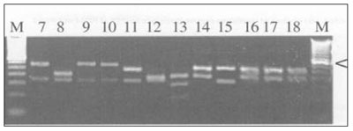
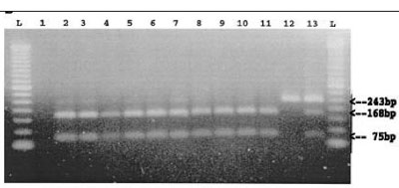
DNA-based virus detection- PCR
Restriction Fragment Length Polymorphism (RFLP)

Slide 35
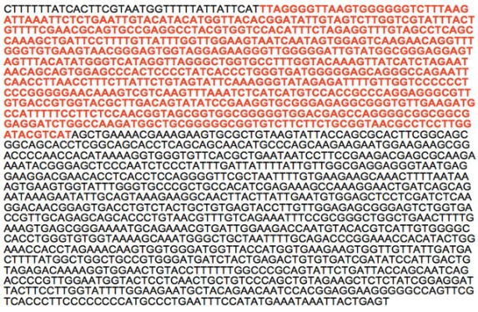
Sequencing

Slide 36
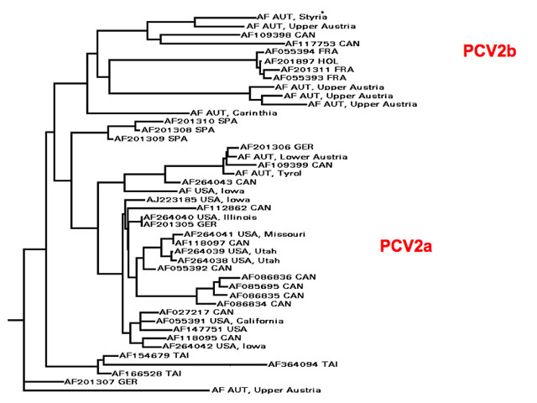
Phylogeny
CAV 1
CAV 2

Slide 37
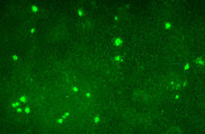
Fluorescent Antibody Assays (IFA)
Virus

Slide 38
Thank you

