Slide 1
AGEING AND MEAT PACKAGING ( MEAT SCIENCE) LPT- 321
Dr. SUSHMA KUMARI
ASST. PROF., DEPT. OF LPT, BVC
BIHAR ANIMAL SCIENCES UNIVERSITY,PATNA

Slide 2
AGEING
Ageing is the process during which microbes and enzymes act upon the meat to help breakdown the connective tissue to tenderise the meat.
There are two ways through which ageing can be accomplished:
Wet ageing by placing beef in a plastic bag under vacuum; or
Dry ageing by storing beef in a temperature and humidity controlled environment.
The main difference is that wet ageing results in little or no moisture loss, whereas dry ageing can result in up to 50% moisture loss.

Slide 4
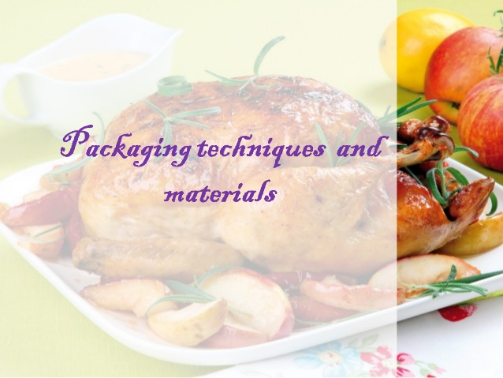

Slide 11
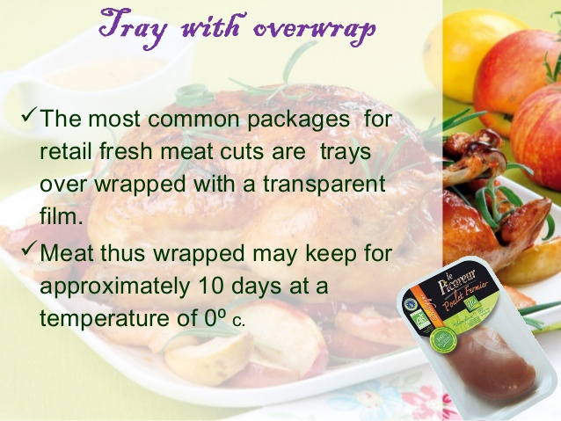
METHODS OF PACKAGING

Slide 12
Tray over wrap

Slide 14
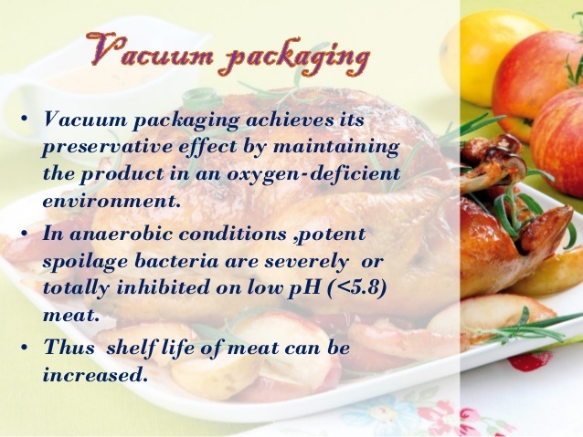

Slide 20
THANKS

