Slide 1
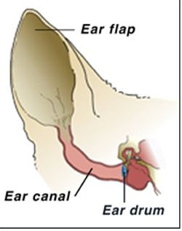
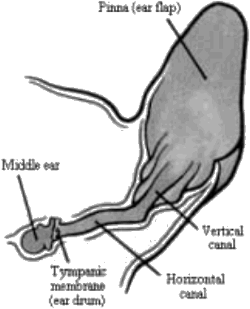
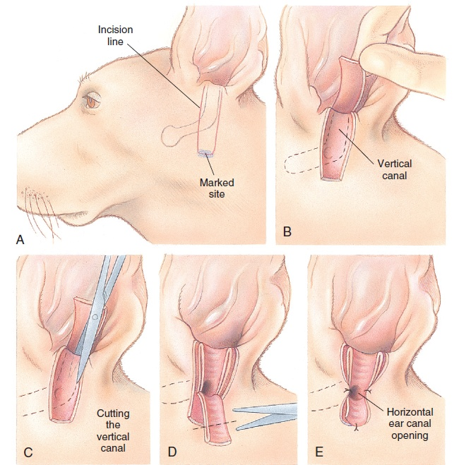
ANATOMY-EAR(DOG)

Slide 2
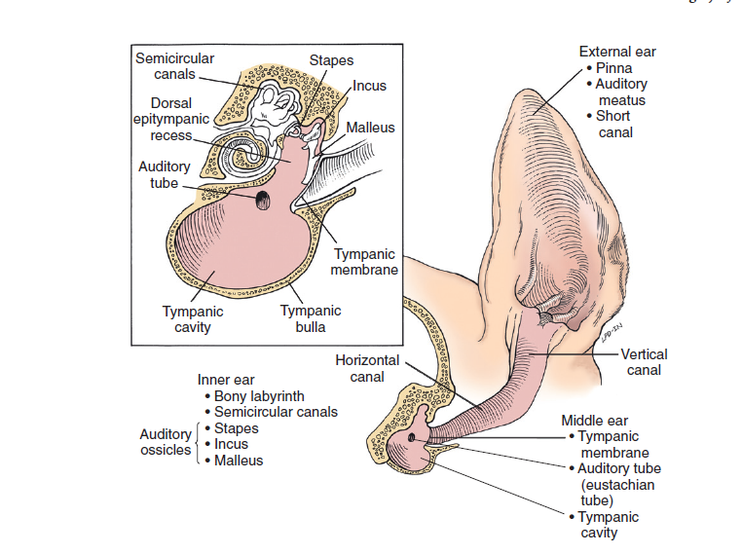

Slide 3
Types Of Ear Affections
Otitis externa-Inflammation of epithelium of the vertical or horizontal ear canal or both and surrounding structure
Otitis media -Inflammation of tympanic cavity &membrane
Otitis interna -Inflammation of inner ear that causes vestibular diseases in dogs
Presbycusis:Age related hearing loss.
Swimmer’s Ear: Otitis externa develop after swimming or Bathing

Slide 4
Factors-predisposed To Ear Infections
Long floppy ears
Abnormal ear conformation or anatomy
Water or hair in the ears
Allergies
Trauma
Tumors
Foreign material in the ears
Parasites
Autoimmune disease
Generalized skin disease
Ear infections can occur in dogs of any age breed or sex.

Slide 5
Clinical Signs
Scratching or rubbing the ears
Head shaking
Abnormal odor or discharge from the ear
Pain on opening the mouth
Redness and swelling of the external ear canal
Lack of appetite
Head tilt, circling
leaning to one side
Rolling
Stumbling
Vomiting
Side to side involuntary continuous eye movement (nystagmus)

Slide 6
Diagnosis
Clinical signs
Otoscopic examination
Radiography of skull
Antibiotic sensitivity – cultures from ear discharges collected aseptically
CT SCAN
MRI SCAN

Slide 7
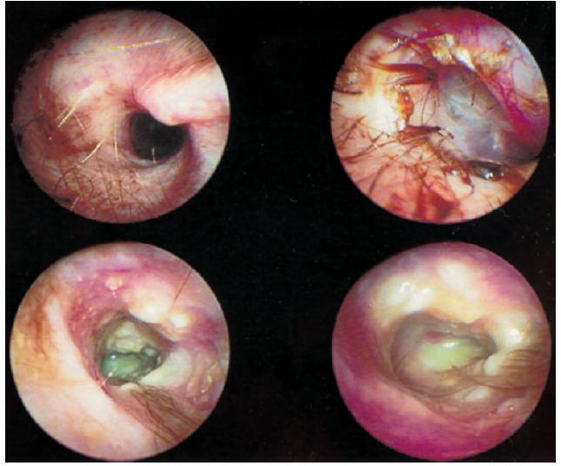
Otoscopy of Ear
Normal Ear canal
Inflamed Ear canal and ruptured Tympanic membrane

Slide 8
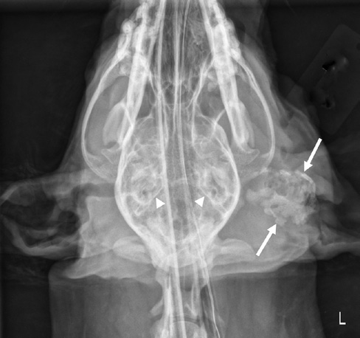
Radiography of skull
Calcification of Left ear canal (Arrow) and normal right ear canal (star)

Slide 9
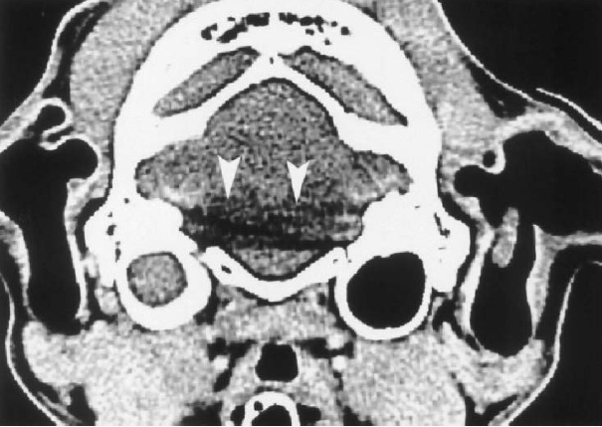
CT- SCAN
Fluid filled bulla and dense petrosal part of temporal bone-Left Ear

Slide 10
Flushing Solutions-ear
Incase of ruptured tympanic membrane
Do Use-
Tris-EDTA,ciprofloxacin,clotrimazole, miconazole,nystatin,ofloxacin,silver sulphadiazine, ticarcillin,tolnaftate
Don’t use
chlorhexidine 0.2%,nondiluted iodine/iodophores,ethanol,benzalkonium, aminoglycosides

Slide 11
Surgical Corrections
Its mainly to improve drainage and facilitate applying medications
Otitis externa
Lateral ear canal resection(Zepp method)
Vertical ear canal ablation
Total ear canal ablation
Otitis media &interna
Lateral bulla osteotomy
Ventral bulla osteotomy

Slide 12
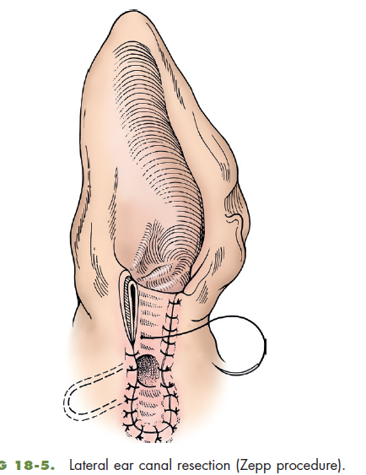
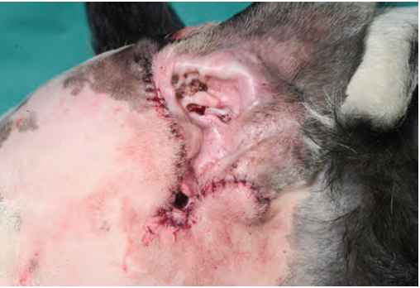
Lateral Ear Canal Resection
(Zepp Procedure)
Lacroix procedure

Slide 13
Zepp Drain Board
Lateral recumbency, head elevated
Stand vertical aspect of head
Vertical ear canal distance measured with forcep
Make the site one and half times the length of vertical canal
Two parallel incision from tragus,connect ventrally,reflect skin flap
Cut the vertical ear canal,upto exposing horozontal canal
Make a drain board then suture by simple interrupted

Slide 14
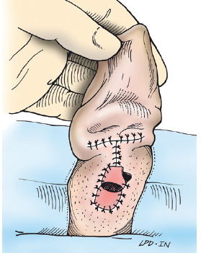
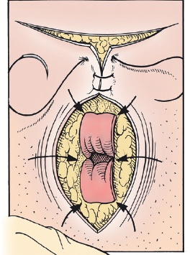
Vertical Ear Canal Ablation
When entire vertical canal diseased and horizontal canal normal

Slide 15
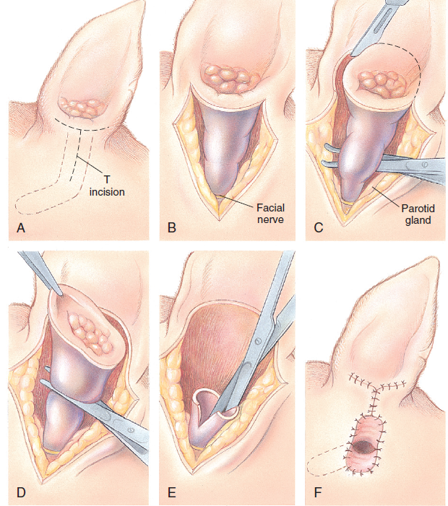
Total Ear Canal Abalation (TECA)
Chronic Otitis Externa with severe calcification and ossification of ear cartilage
Severe epithelial hyperplasia extend beyond pinna or vertical canal
Calcification of Left ear canal (Arrow) and normal right ear canal (star)

Slide 16
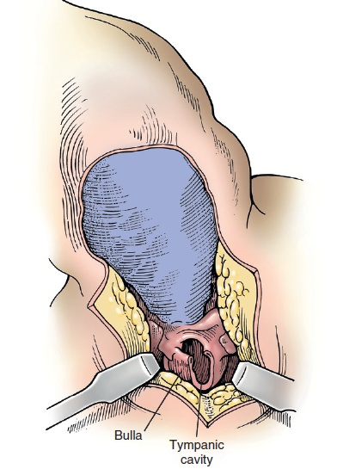
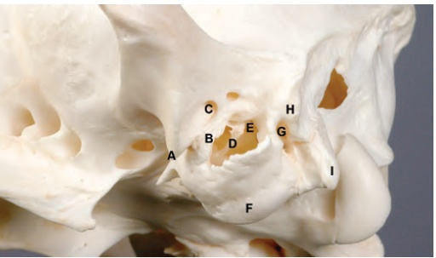
Lateral Bulla Osteotomy
To expose tympanic cavity for drainage of middle and inner ear secretion/exudate

Slide 17
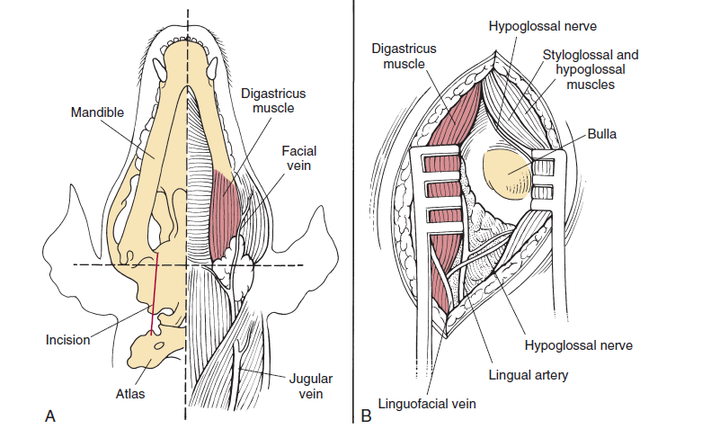
Ventral Bulla Osteotomy
Better exposure of tympanic cavity without TECA

Slide 18
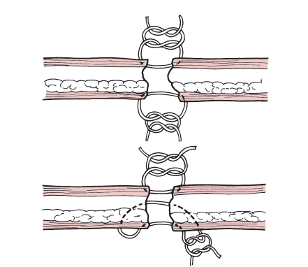
Pinna Laceration
Skin of both side sutured with simple interrupted suture pattern (Fig. Top)
OR
Vertical mattress pattern to appose the skin and cartilage on one side and simple interrupted pattern to appose the skin on the opposite site (Fig. Bottom)

Slide 19
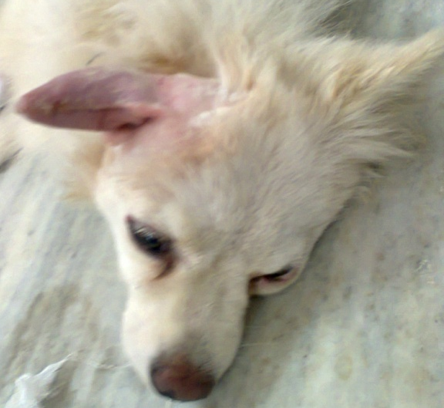
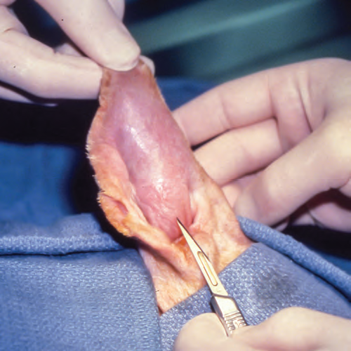
Aural Hematoma
An aural (Auricular) hematoma is a collection of blood within the cartilage plate of the ear characterized by fluctuant, fluid -filled swellings on concave surface of the pinna.
It occurs due to bleeding of the branches of caudal auricular artery within the fractured auricular cartilage rather than between the skin and cartilage
Head shaking may cause sinusoidal wave motion in the ear, resulting in fracture of the cartilage
History-Violent head shaking and acute or chronic otitis externa may be noted.
In Dog it mainly occurs due to bacterial infection in ear and O. cyanotis in cat.
The affected dog tries to shake their head and scratch at the ear due to irritation or pain associated with otitis externa that may predisposed to this condition

Slide 20
Surgical Correction
The goals of the surgery are to remove the hematoma, prevent recurrence, and retain the natural appearance of the ear (i.e., minimize thickening of the ear and scarring)
After aseptic preparation make an S-shaped incision on the concave surface of skin underlying hematoma covering full length of fluid filled area to remove the hematoma, its contents and irrigate the cavity.
S- shaped incision prevent twisting of the ear during healing, as longitudinal contraction less likely to occur.

Slide 21
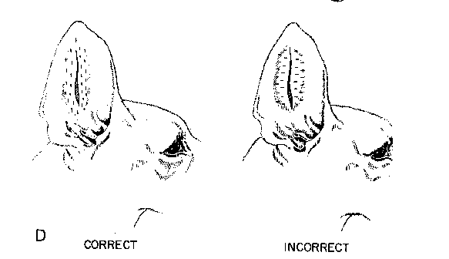
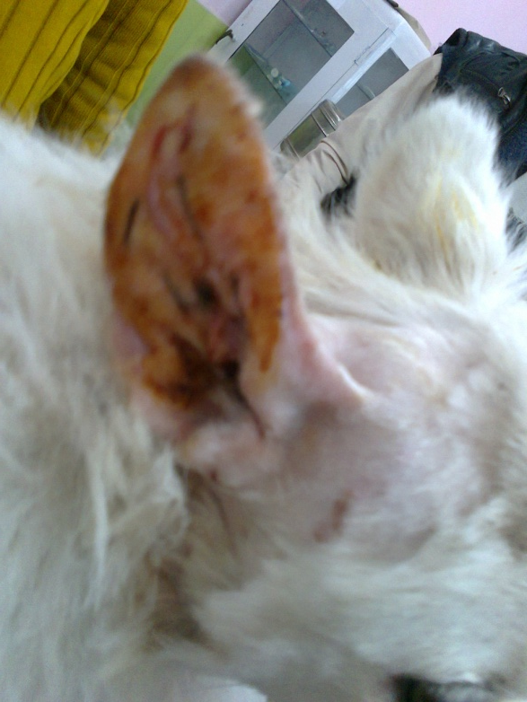
Place simple mattress suture incorporating cartilage between dorsal and ventral surface of skin and put final knot on dorsal surface of skin.
Place ample number of stitches so that no pockets are left in which fluid can accumulate.
Sutures should placed parallel to the line of incision and major vessels of ear.

Slide 22
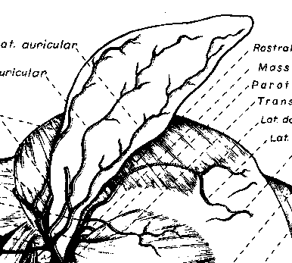
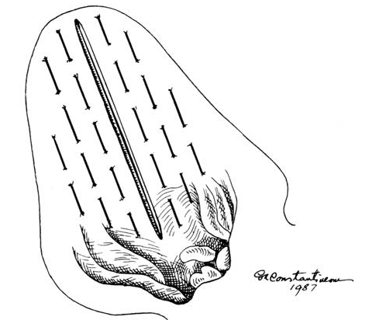
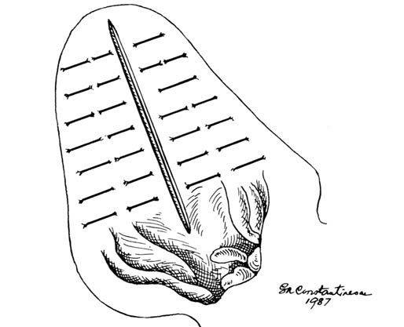
Suture Materials: Non-absorbable
Silk, Nylon, Polypropylene
Absorbable:
Polydioxanone, Polyglyconate
Incorrect method of suture placement
Blood vessels pattern of ear
Correct method of suture placement

Slide 23
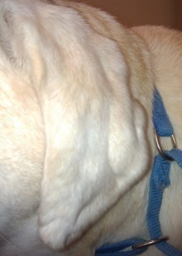
Sutureless Technique For Aural Hematoma
Possible disadvantage of suture technique:-
    Ear pinna thickening
    Wrinkling
    Cauliflower like appearance
These complication avoided by sutureless technique.
After aseptic preparation elliptical incision made on concave side to expose the hematoma cavity from end to end and lavage

Slide 24
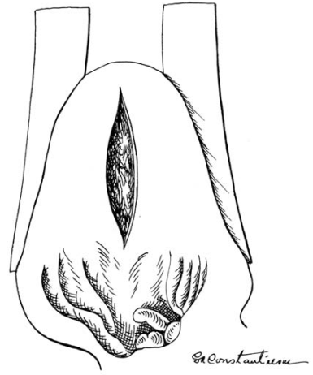
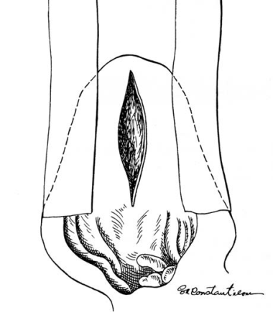
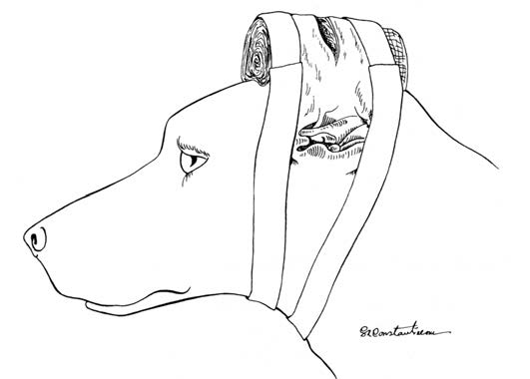
Tape placed on rostral and caudal border on convex surface of ear
Long tape placed on rostral and caudal border on concave surface of ear
Pinna reflected over large roll of cast padding to secure ear.

Slide 25
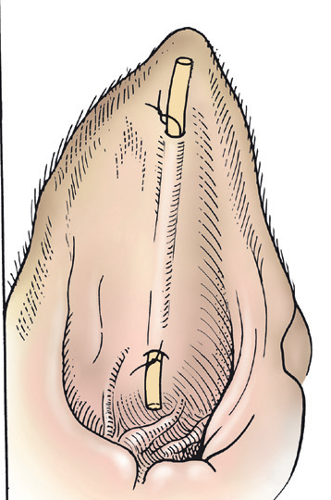
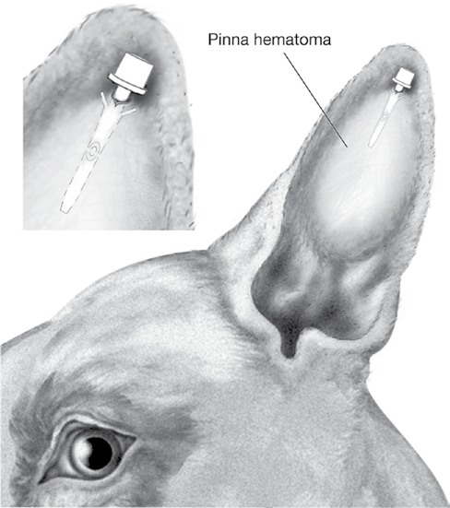
If minimal fibrin is present then teat cannula or fenestrated latex drain can be used.

Slide 26
Laser surgery: Carbon dioxide laser also used to drain hematoma then multiple incision made on hematoma to promote healing.
Major disadvantage : Prolong inflammation and post surgery ear swelling
Surgical Glue (Cyanoacrylate): Tissue glue also injected into hematoma to close the edges but formation of granuloma has been reported, so using surgical glue is unnecessary

Slide 27
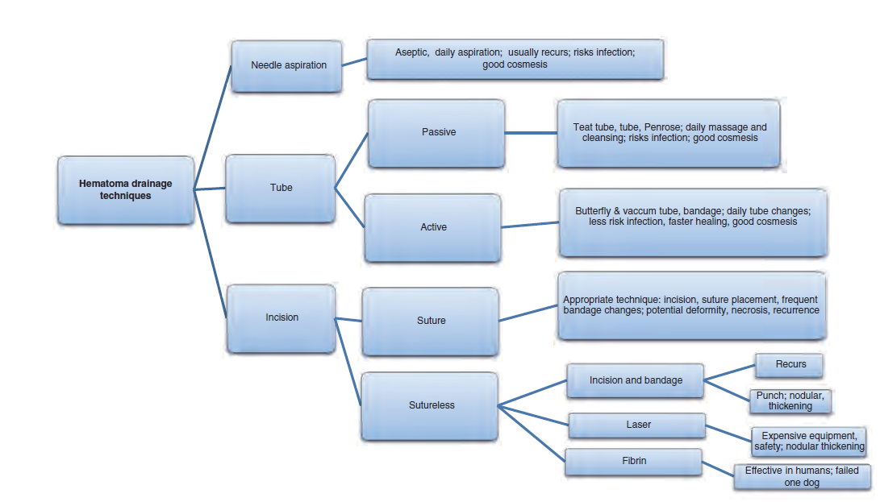

Thanks

