Slide 1
VETERINAY ANATOMY,
UNIT- 6,
TOPIC-Details Description Hip joint and STIFLE joint of different animals
Instructor- DR. SANJAY KUMAR BHARTI
HOD, VETERINARY ANATOMY

Slide 2
JOINTS OF THE HINDLIMB – Ox, SHEEP& GOAT , Horse, PIG,DOG & Fowl
The joints of the hind limb are as follows
Sacro-iliac joint between the articular surfaces of the ilium and sacrum.
Pelvic symphysis formed between the pubis and ischium of the two sides.
Hip joint between the acetabulum of os coxae and the head of the femur.
Stifle joint between the femur,tibia and patella.
Tibio-fibular joint between the tibia and fibula
Hock joint formed by the union of tarsal bones with tibia.
Fetlock joint between the metatarsal, 1st phalanx with proximal sesamoid.
The interphalangeal articulations are
  Pastern joint formed between the 1st and 2nd phalanges.
  Coffin joint formed between the 2nd and 3rd phalanges and the distal sesamoid.

Slide 3
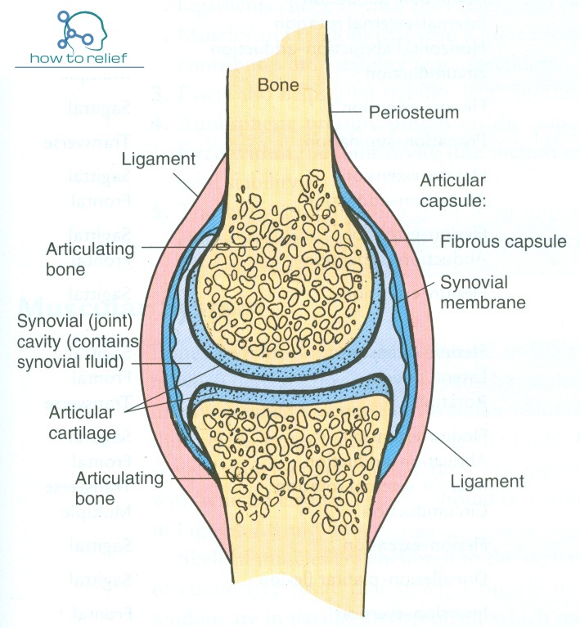
Common Structure of Joint

Slide 4
Hip &Stifle Joint – Ox, SHEEP& GOAT , Horse, PIG,DOG & Fowl
Ox
Types- Ball and Socket, the coxo-femoral articulation is an enarthrosis.
Bone involvement acetabulum of os coxae and the head of the femur.
Motion- Polyaxial
  Gliding, circumduction, adduction and abduction are possible, extension and flexion are most marked.
Ligaments
  A. Capsular ligament.
  B. Cotyloid ligament is a marginal cartilage, which deepens the acetabulum.
  That part of cotyloid ligament stretches across the cotyloid notch converting it into a foramen for the passage of structures and out of the joint is the transverse acetabular ligament.
  C. Round ligament is attached to the lateral lip of acetabular notch and to the fovea capitis, on the head of femur.

Slide 5
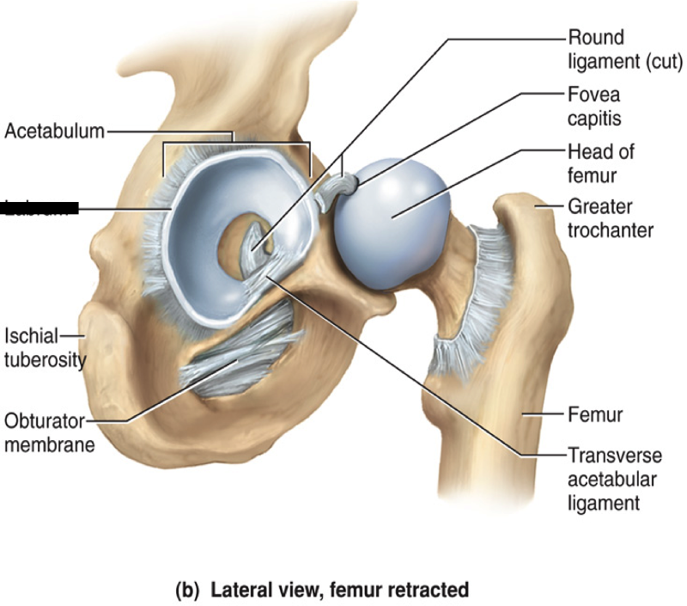
HIP JOINT STRUCTURE

Slide 6
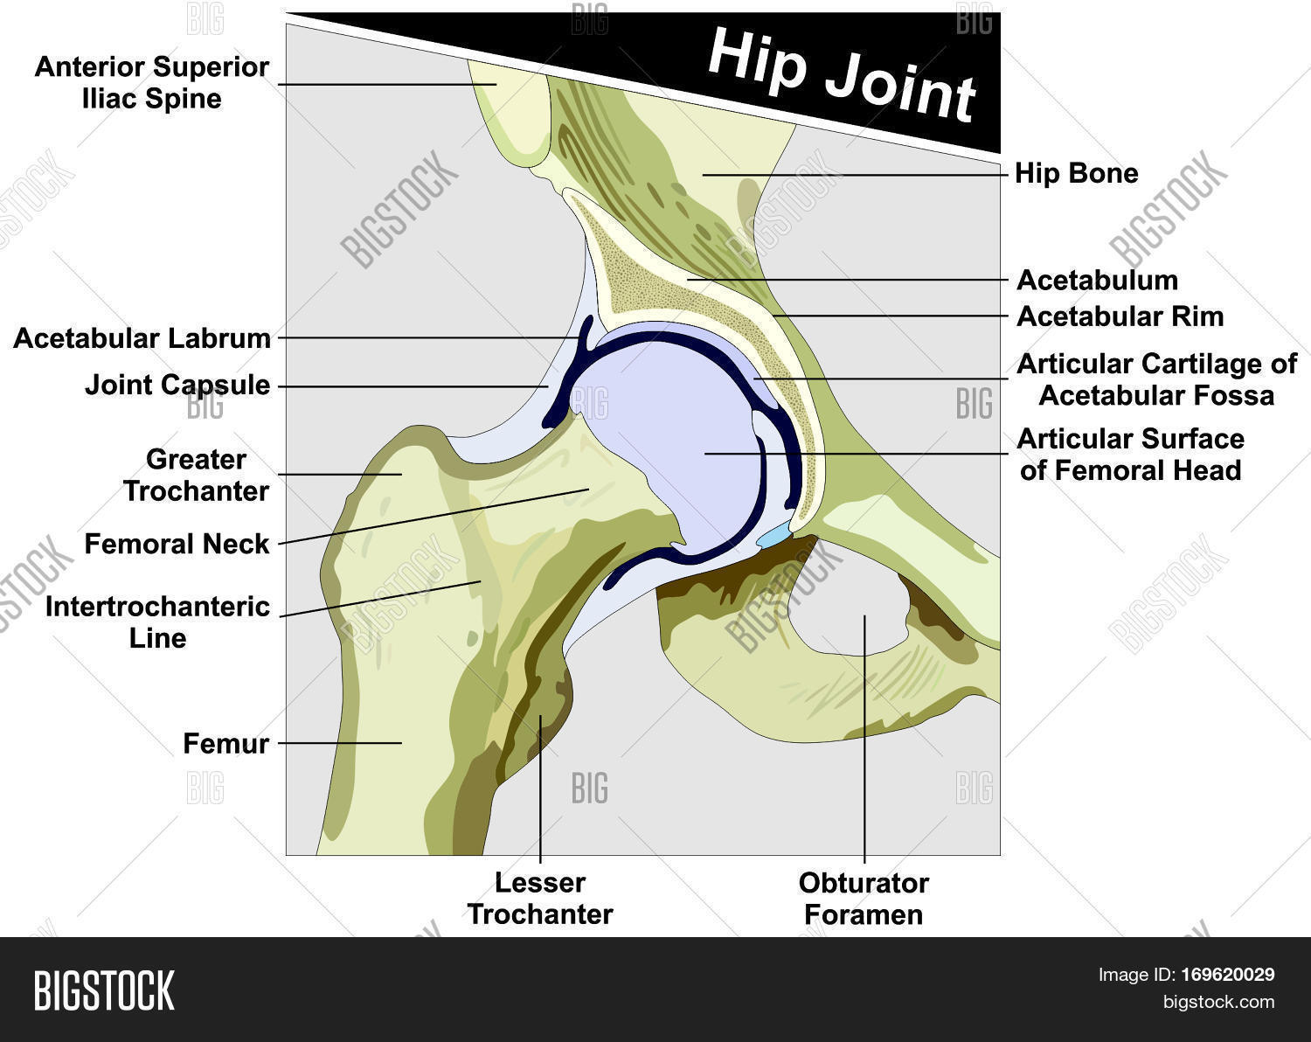
Structure of hip joint

Slide 7
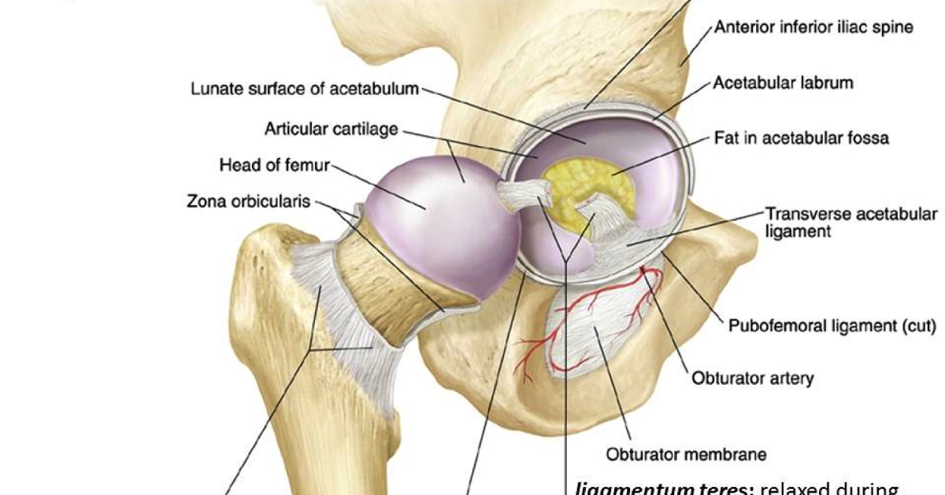
Structures of Hip Joint

Slide 8
HIP JOINT
Horse
The cotyloid ligament is narrower.
There is an additional ligament, the accessory or pubic femoral ligament which arises from the prepubic tendon, {What is prepubic tendon-?} passes outwards and upwards and then backwards lodged in the pubic groove, the acetabular notch and is inserted to the fovea capitis behind the round ligament.
This ligament is peculiar to solipeds and it prevents abduction and limits side-kicking. The absence of the ligament in ruminants permits free abduction and this is the reason why ruminants can kick side ways, this movement being known as ‘cow kick’.
Dog & Pig
Resembles that of the Ox.

Slide 9
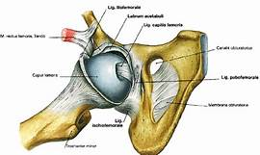
HIP JOINT OF HORSE

Slide 10
STIFFLE -JOINT
The stifle joint is composite joint composed of
A. Femoro-patellar articulation B. Femoro-tibial articulation
Femoro-Patellar joint-Ox
Type-gliding joint Bone Involvement- patella glides over the trochlea of the femur.
Motion-The patella moves up and down the trochlea of femur.
Ligaments-
  A-The capsular ligament is loose. It forms a pouch under the insertion of the quadriceps muscle.
  B-The medial and lateral ligaments which arise from corresponding faces of the condyles of the femur to the lateral and medial angles of the patella.
  C-The straight ligaments of the patella are lateral, middle and medial, which extend from the patella and its fibrocartilage to the anterior tuberosity of the tibia.
  Bursae of the patellar ligaments are two. One is interposed between the middle ligament and the upper part of the trochlea; a smaller one occurs between the upper part of the same ligament and the apex of the patella. The second is interposed between the lateral patellar ligament and the lateral condyle of the femur.

Slide 11
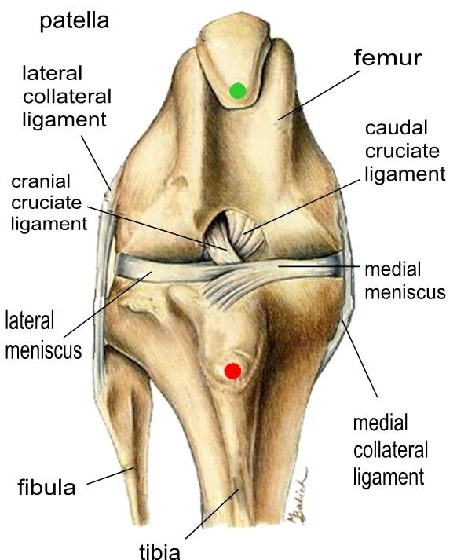
Femoro-Patellar joint-

Slide 12
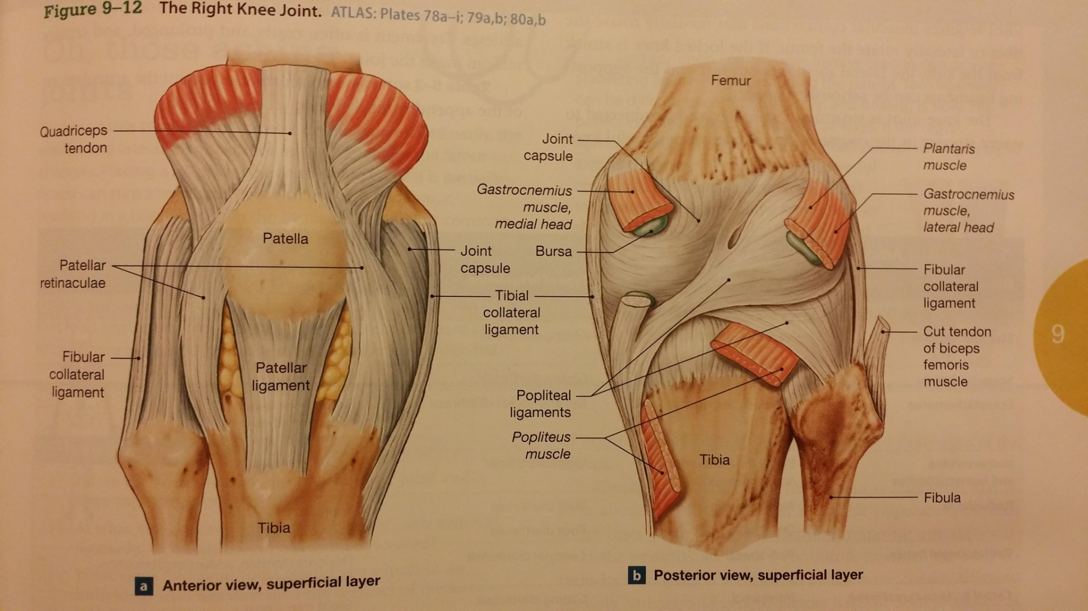
Femoro-Tibial joint CONTI..

Slide 13
Femoro-Tibial joint
Ox
Types-Ginglymus
Bone involvement- condyles of the femur and Proximal end of the tibia.
Motion- Extension and flexion.
Ligaments
  The joint has
  A. 1 capsular ligament,
  B. 2 inter-articular cartilages called menisci,
  C. 2 crucial or cruciate ligaments
  D. 2 collateral ligaments,
  E.1 posterior ligament.
  A-The capsular ligament is attached to the margins of articular surfaces of femur and tibia and also to the convex borders of the menisci and to the cruciate ligaments. There are two synovial sacs, partially divided by the menisci into upper and lower compartments. The two synovial sacs communicate with each other and the medial sac also communicates with femoro patellar joint.

Slide 14
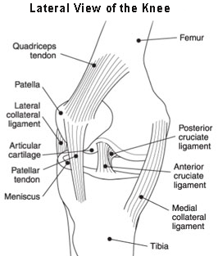
Femoro-Tibial joint CONTI..

Slide 15
Femoro-Tibial joint CONTI..

Slide 16
FEMRERO-TIBIAL JOINT. CONT….
  B-The menisci (inter-articular cartilages) are lateral (3- Coronay ligament 01-Anterior 2 posterior). medial (2- Coronary ligament 01-Anterior 01 posterior)
    They are ‘C’ shaped plates of fibro-cartilage interposed between the condyles of the femur and proximal articular surface of tibia.
    These cartilages bring about congruence of the articular surfaces and are kept in position by ligaments called coronary ligaments.
    The lateral meniscus has three coronary ligaments one anterior and two posterior, of which one is superior attached to a depression on the medial aspect of inter-condyloid fossa of femur and other inferior attached to the tibia, lateral to the popliteal notch.
    . The medial meniscus has two coronary ligaments one anterior and one posterior. These are attached to the depression in front and behind the tibial spine
.

Slide 17
FEMRERO-TIBIAL JOINT. CONT….
  C-The 2- cruciate ligaments (anterior and posterior).
  The anterior arises from the tibial spine, extends upwards and backwards and ends on the lateral part to the inter-condyloid fossa of femur.
  The posterior is attached below the tubercle medial to the popliteal notch, directed upwards and forwards and is attached to the anterior part of the inter-condyloid fossa of femur.
  D-The collateral ligaments (Lateral & Medial) arise from the corresponding condyles of the femur.
  The lateral ligament is attached to the fibula and the medial is to the medial condyle of the tibia.
  E-The posterior ligaments are membranous, enclose the joint behind.

Slide 18
STIFFLE -JOINT
A. Femoro-patellar articulation
Horse & Pig
- Similar to that of ox.
Dog- There is only one straight ligament.
B. Femoro-tibial articulation
Horse, Dog & Pig
-Similar to that of ox

