Slide 1
Instruments for Rheological Measurements
Dr. J. Badshah
University Professor – cum - Chief Scientist
Dairy Engineering Department
Sanjay Gandhi Institute of Dairy Science & Technology, Jagdeopath, Patna
(Bihar Animal Sciences University, Patna)

Slide 2
Instruments for Rheological Measurement of texture
Wire Cutting Devices
A wire driven at a constant speed to cut the sample is used for certain dairy products. An advantage is that the sample area in contact with the wire is constant throughout the test which minimizes the effect of friction and adhesion between the product and the test cell surfaces.
Circular Cutting Devices
The Cherry- Burrel Curd tension meter is used in the dairy industry to determine curd tension of milk and firmness of cottage cheese. A circular blade is driven at a constant speed of 2.54 cm per 7.5 sec. to cut the curd
Cone Penetrometer of Varying Dimensions
It consists of a cone of varying dimensions which is allowed to penetrate chhana, paneer, khoa or any other soft dairy product. The hardness values are read out on a mechanical linked graduated scale in terms of mm penetration.

Slide 3
Wire cutting Device

Slide 4
Circular Cutting Devices

Slide 5
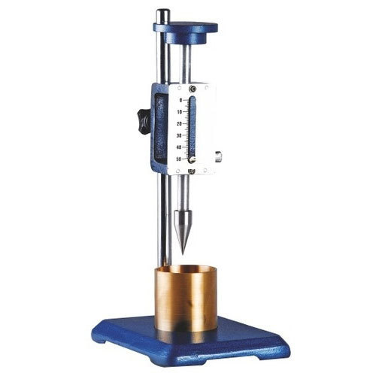
Cone Penetrometer

Slide 6
Instruments for Rheological Measurement of texture
Pea Tenderometer
It consists of a grid of shearing blades (test cell) rotated at constant speed through a second grid suspended, so that the force on the second grid is counter balanced by a pendulum which is displayed by a pointer on a graduated scale. It is widely used by the pea industry.
The Warner – Bratzler Shaler Test
A cylindrical sample usually 2.5 cm. in diameter is placed in a triangular hole in a thin blade of 0.25 cm thickness cut by pulling the blade through a slot and the shear force indicated by a spring scale. It is widely used for meat products.
Kramer Shear Press
It consists of a hydraulic press where the ram speed can be selected to complete its down stroke in 15 to 100 seconds. The ram operated by a hydraulic pump drives the moving components of the texture test cell into stationary component supported by the press frame. It is based on the principle of a multi- blade shear compression cell. Because of limitation of control by ram speed, the instrument does not give precise and accurate reading of force exerted.

Slide 7
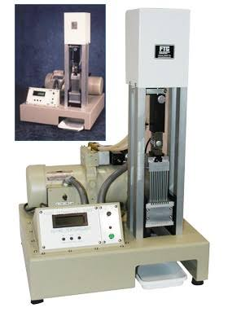
Pea Tenderometer

Slide 8
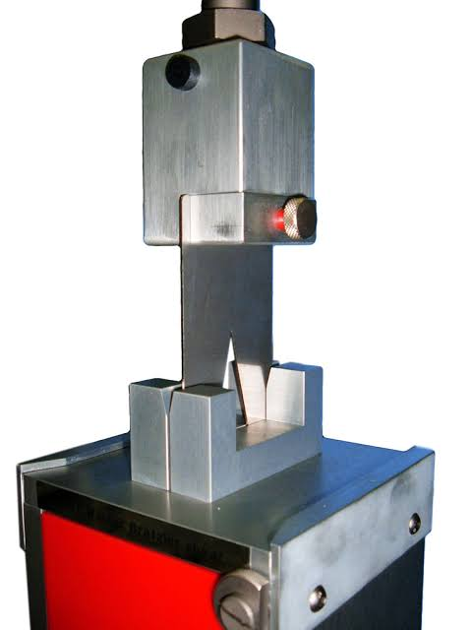
The Warner – Bratzler Shaler Test

Slide 9
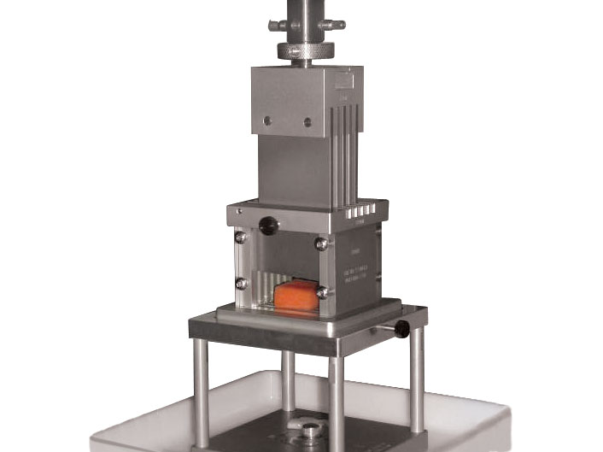
Kramer Shear Press

Slide 10
Instron Machine
It is a versatile instrument for application in research, development and quality control laboratories.
The Instron universal machine is an instrument for measuring texture through tension and compression testing within the force range of <1N to 5kN.
It comprises of a standard load frame and drive unit, a load weighing system and a microprocessor based control system. A beam carrying a load cell (moving cross head) is located between the base unit and the fixed crosshead at the top of the frame.
The crosshead moving in vertical direction at a selected speed is supported and driven by two lead screws.
It contains a force sensing and recording system which measures the force during the test and transmits them to a strip chart recorder.
The Instron can be programmed for automatic return, cycling and relaxation test etc.

Slide 11
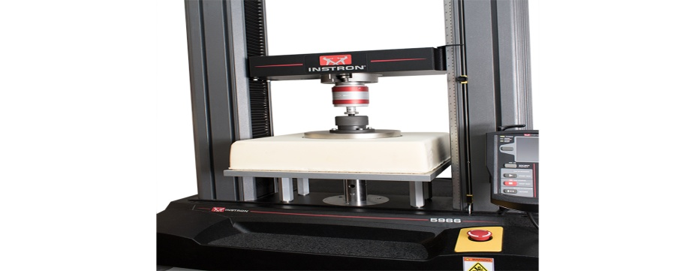
Instron Machine

Slide 12
The Ottawa Texture Measuring System
This machine is similar to the Instron Machine in design and operation except that it uses a single screw as drive instead of twin screws.
The Ottawa cell consists of a rectangular metal box containing 8 or 9 thin stainless steel rods.
The sample is compressed by a plunger and sheared and extruded through a wire-grid.
It offers operational flexibility for research and quality control laboratories.
It uses modern electronic system to record force, deformation and time precisely.

Slide 13
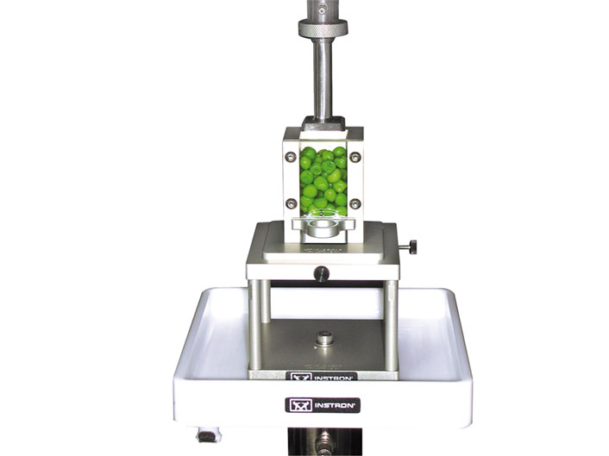

Slide 14
General Foods Texturometer & Other Instruments
General Foods Texturometer
This instrument imitates the chewing action of the mouth for mastication of foods. The chewing forces are detected by strain gauges with the help of a position transducer and displayed on an oscilloscope. This helps ascertain the force required for teeth penetration into the food, thus reflecting the food texture.
Other Instruments
The curd tension, curd firmness, consistency of cheese etc. can be determined by various techniques especially milk curcio-meter, containing a star shaped knife attached to a balance. Other texture measuring device employed for milk products include ball and needle penetrometers, extenders, gelographs.

Slide 15
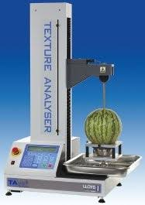
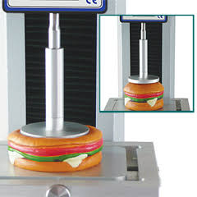
General Foods Texturometer

Slide 16
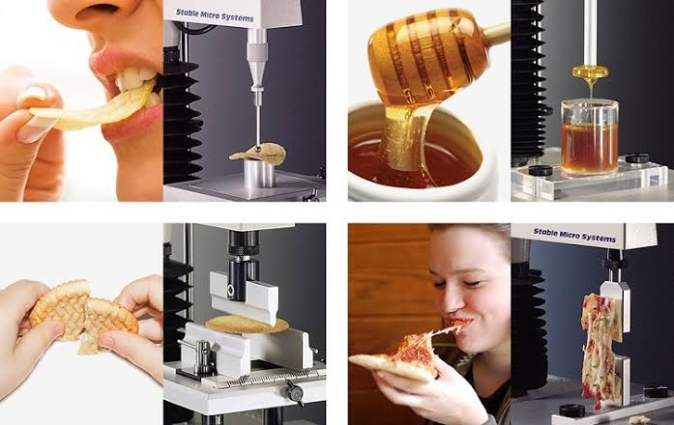
Other Instruments

Slide 17
THANK YOU

