Slide 1
COURSE TITLE- MEAT SCIENCE COURSE NO.- LPT-321 (6th SEMESTER)
Dr. SUSHMA KUMARI
DEPT. OF LPT
BVC, PATNA
BIHAR ANIMAL SCIENCES UNIVERSITY

Slide 2
Fraudulent substitution of Meat
Replacement of conventional meat by similar looking inferior quality or non-conventional sources is known as fraudulent substitution of meat or falsification of meat.
It may include
Mixing meat of different animals
Mixing or replacement of inferior/undesirable meat with superior/costly meat.
Eg. beef with horse flesh
Mutton with chevon
Rabbit meat with cat flesh etc.

Slide 3
Methods of Detection of Meat Falsification
1 Physical Examination
2 Chemical Examination
3 Serological Examination
4 Molecular Examination

Slide 5
Physical techniques: on the basis of
Colour
Texture
Odour
Presence of other body parts along with meat

Slide 6
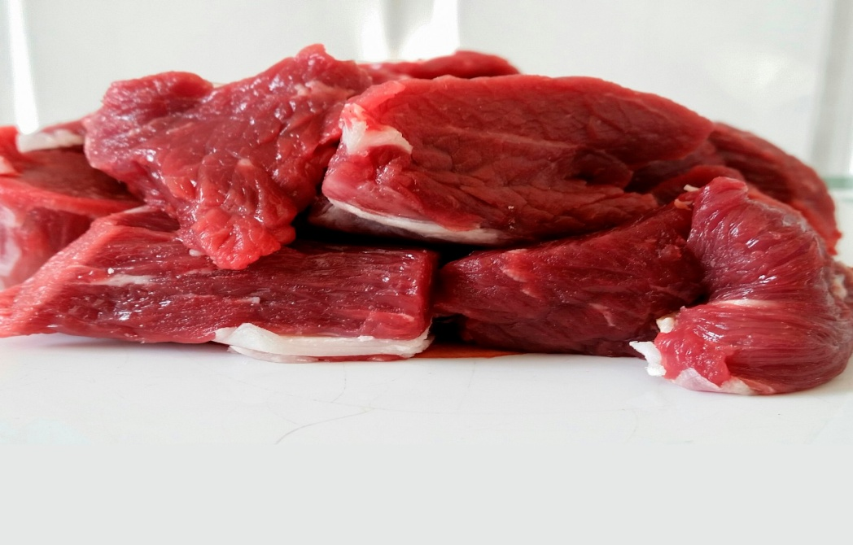
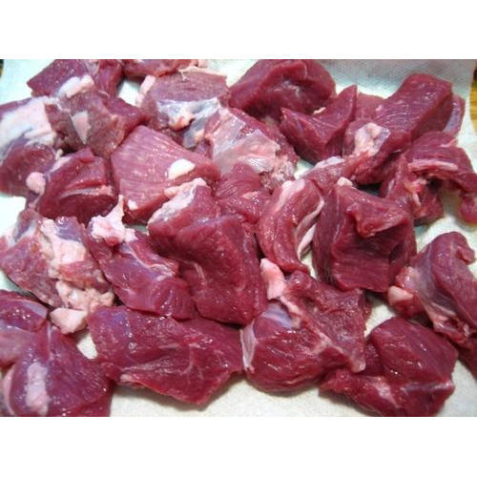
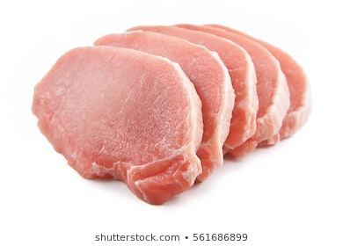
GOAT MEAT
SHEEP MEAT
BEEF
PORK

Slide 7
Anatomical techniques:
The typical dental formulations
Identification is on the basis of vertebrae
Ribs number present on the carcass.
Histological techniques:
Muscle fiber length
Diameter
Density
Pattern of the muscle fibers

Slide 8
2. Chemical Examination
Determination of fat in meat
Determination of ash in edible bone meal

Slide 10
3.Serological/Biological Examination:
Also known as Serological or Immunological methods.
Precipitation test
Chromatography
Electrophoresis

Slide 14
4. Molecular Examination
DNA based molecular techniques:
PCR based
Non PCR based

Slide 15
Species Identification by using Forensically Informative nucleotide sequencing (FINS)
PCR Based Techniques
Forensically informative nucleotide sequencing (FINS), a technique that combines DNA sequencing and phylogenetic analysis.
It is used to identify samples based on informative nucleotide sequences.
PCR amplification and sequencing of conserved gene is one of the first techniques for meat spp.identification.
Mitochondrial DNA is highly conserved, gene on it Cytochrome-b and 12S-r RNA used for meat spp.identification.

Slide 16
Advantage of PCR based techniques
Advantages of PCR based Techniques-
We can be detected the wide variety meat samples.
Fresh or processed meat can be easily detected.
Much reliable.
Very small amount of adulteration (up to 1%) can be easily identified.

Slide 17
Non PCR Based Techniques
Species identification by hybridization
Dot-blots hybridization technique has been applied to the detection of species-specific DNA fragments in the cooked meats of chicken, pig, goat, sheep, and beef.
The probes, biotin-labeled chromosomal DNA fragments, were hybridized to the sample DNA on nylon membranes.

Slide 18
Advantages-
Simple and quick
Easy to perform
Can be perform everywhere
Disadvantages
Costly
Heat sensitive
Species specific probe is required

Slide 19
THANKS

