Slide 1
Online Class
ANIMAL GENETICS & BREEDING
UNIT – II
Principles of Animal & Population Genetics
Lecture – 1
Population Genetics
Dr K G Mandal
Department of Animal Genetics & Breeding
Bihar Veterinary College, Patna
Bihar Animal Sciences University, Patna

Slide 2
Population Genetics
What is Genetics?
Branch of Genetics
Mendedion Genetics
Cytogenetics
3. Biochemical Genetics
4. Molecular Genetics
5. Quantitative Genetics
6. Biometrical Genetics
7. Population Genetics

Slide 3
Introduction to Population Genetics
Study of genetics at population level is known as population genetics. Population is the unit of study.
Study of genetic structure of a population is known as population genetics.
Gene frequencies & genotype frequencies of a population for a given locus constitute the genetic structure of a population.
Hence, the study of gene frequencies and genotype frequencies of a population in respect to a given locus is also known as population genetics.

Slide 4
What is a Population?
Population in general
Statistically
Biologically
Genetically
Limits, size and nature of a population
Limit of a population
Size of a Population
Nature of a Population
Types of Population
Subordinate Mendelian Population
Closed Population or Isolates
Idealized Population
Real Population

Slide 5
Objectives of the study of Population Genetics
It is trait specific
1. Qualitative traits
2. Quantitative traits
Qualitative traits: To know the frequency of genes and genotypes at a given locus. To determine the change of gene and genotype frequencies from generation to generation under the influences of certain forces.
Quantitative traits: To know the effect (magnitudes) of polygenes and their potentiality changing the mean (average), correlation, regression, heritability, repeatability and response to selection.

Slide 6
Qualitative traits Vs Quantitative Traits
SI. No. | Particulars | Qualitative Traits | Quantitative Traits
1 | Measurement of Characters | Countable | Measured/quantified thorough metric units kg, g, mt, cm, ml, lit, lbs etc.
2 | No. of genes involved | One, two or a few | Many more – polygenes polygenic traits
3 | Effect of gene | Major | Minor
4 | Variation | Discrete (Discontinuous) | Continuous
5 | Causes of variation | Genetic | Genetic & environment both
6 | Methods of analysis | X² (Chi-square) | Mean, SE, SD, CV%, variance, correlation, regression, ANOVA etc.

Slide 7
Genetic structure of a population Gene frequency:
Proportion or percentage of different alleles present at each locus in a population is known as gene frequency.
Frequencies of all the alleles together at a given locus is equal to one or 100% percent.
Genotype frequency:
Proportion or percentage of individuals that belong to each genotype in respect to a locus is known as genotype frequency.
Sum of the frequencies of all the genotypes for a given locus is equal to one or 100%.

Slide 8
Relationship between gene frequencies and genotype frequencies
_________________________________________________________
Genes Genotype
A1 A2 A1A1 A1A2 A2A2
Frequencies p q P H Q
__________________________________________________________
p + q = 1 & P + H + Q = 1
Hence,
Frequency of A1(p) = P + 1/2 H
Frequency of A2(q) = Q + 1/2 H

Slide 9
Hardy-Weinberg Law (1908)
In a large random mating population the gene frequencies and genotype frequencies tends to remain constant from generation to generation in absence of migration, mutation and selection, and genotype frequencies of the progeny is determined by the gene frequencies of the parents not by the genotypes frequencies.
Large Population?
Random mating population?
Mutation?
Selection?
Hardy- Weinberg equilibrium
A population with constant gene frequencies and genotype frequencies is said to be in Hardy-Weinberg equilibrium.
G. H. Hardy-An English mathematician, Wilhelm Weinberg : A German Physician

Slide 10
Conditions required for holding H-W Law
1. Population should be large & random mating
2. No selection at any stage
3. Genes should segregate normally at gametogenesis.
4. Equal gene frequencies in males & females
5. No migration of genes
6. Mutation is disregarded.

Slide 11
Proof of Hardy-Weinberg Law
1. By random union of gametes
2. By random mating of genotypes
1. By random union of gametes
It involves 4 steps:
i) From gene frequency in parents to gene frequency in gametes
ii) From gene frequency in gametics to genotype frequencies in zygotes
iii) From zygotes to adults
iv) From genotype frequencies to gene frequencies in progeny.

Slide 12
Gametic types, their frequencies and product of gametic frequencies
Female gametes & their frequencies.
Genotype of zygotes/ progeny and their frequency
Genotypes A1 A1 A1 A2 A2 A2
Frequency p2 2pq q2
 | A1 p | A2 q
Male gametes &their frequencies A1 p | A1 A1 p² | A1 A2 pq
A2 q | A1 A2 pq | A2 A2 q²

Slide 13
The gene frequency in the adult progeny can be found from the relationship between gene frequencies and genotype frequencies
Thus, the frequency of A1 is = p2+1/2 (2pq)
= p2+pq
= p(p + q)
= p since, p + q=1
Similarly, frequency of A2 is q2+1/2 (2pq)
= q2+pq
= q (q + p)
= q since, q + p=1
Hence, gene frequency in the progeny generation is the same as in the parent generation. This is proved HW law

Slide 14
Properties of equilibrium population
The genotype frequencies are determined by the square of the sum of the gene frequencies.
Frequency of A1= p, A2 = q, then
A1A1 A1A2 A2A2
(p + q)2 = p2 + 2pq + q2
(p + q + r)2 = p2 +q2 + r2 +2pq +2pr = 2qr
2. The relationship between gene frequencies and genotype frequencies are applied to a single generation only.
3. Genotype frequencies in the progeny depend only on the gene frequencies of the
parent, not on the genotype frequencies.
4. Maximum frequency of heterozygotes will be 50% at p = q = 0.5.
5. Frequency of rare allele occurs almost exclusively in the heterozygotes condition.
6. Proportion of heterozygotes is twice the square root of the product of frequency
of two homozygotes.

Slide 15
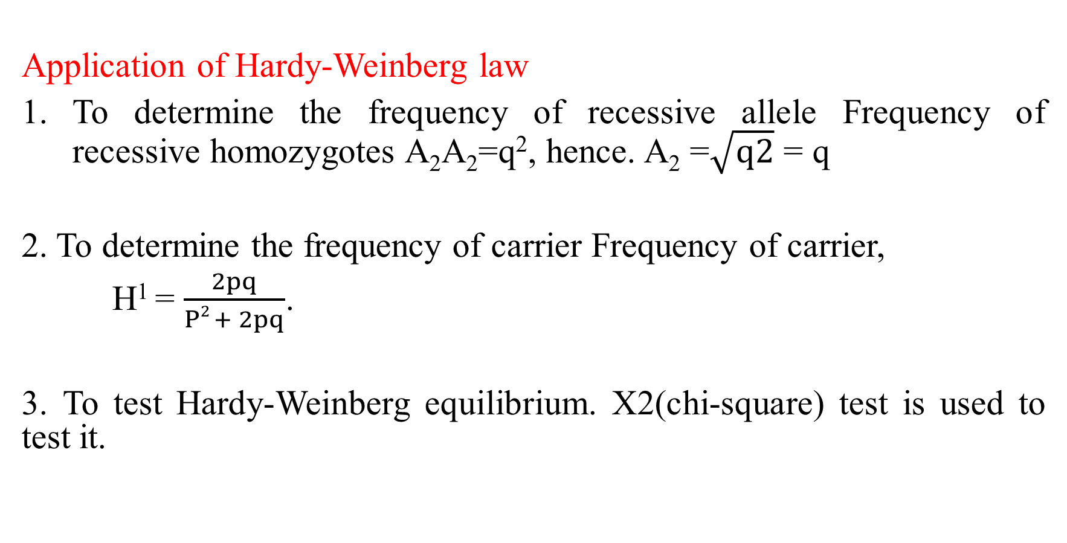
Application of Hardy-Weinberg law
To determine the frequency of recessive allele Frequency of recessive homozygotes A₂A₂=q², hence. A₂ =$\sqrt{q2}$ = q
2. To determine the frequency of carrier Frequency of carrier,
H¹ = $\frac{2pq}{P2 + 2pq}$.
3. To test Hardy-Weinberg equilibrium. X2(chi-square) test is used to test it.

