Slide 1
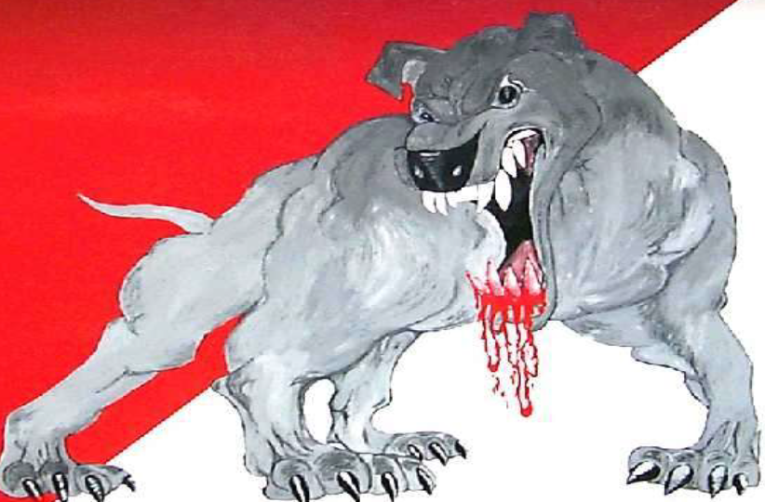
RABIES
Anil Kumar
Asst. Professor
Dept. of VCC
Unit-5

Slide 2
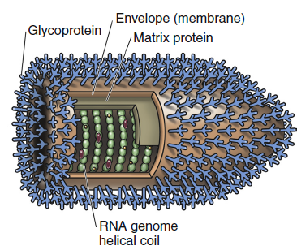
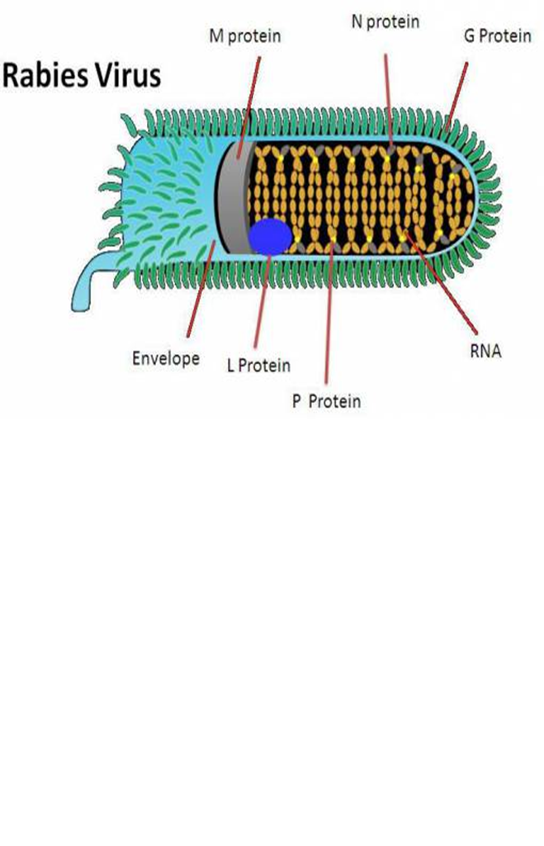
RABIES
Etiology
Bullet-shaped, enveloped RNA virus that belongs to the genus Lyssavirus, of Rhabdoviridae family
Rabies is a deadly, zoonotic, neurologic disease.
Readily inactivated by a variety of disinfectants, soaps, ultraviolet light, and heat.
There are seven lyssavirus genotypes, where classical rabies virus belongs to genotype 1.
The remaining six lyssavirus genotypes primarily infect bats and less frequently cause fatal human encephalitis, which is clinically indistinguishable from classical rabies

Slide 3
Host affected
All warm-blooded animals
Mode of transmission
Biting, with inoculation of saliva containing the virus
Highly susceptible hosts include wolves, foxes, coyotes, jackals, dogs, cattle, raccoons, skunks, bats, and mongooses.
Moderately susceptible hosts include cats, ferrets, primates, sheep, goats, and horses.
Large majority of the cases occur after a dog bite
Other routes of transmission corneal or solid-organ transplantation in human patients
Aerosol transmission, such as that occurring within caves containing large numbers of bats
Dogs, wild carnivores, and bats are considered the main natural reservoirs of rabies virus.
Ingestion of infected tissues or milk

Slide 4
Incubation Period
In dogs IP varies from a week to many months
The outcome after a bite from a rabid animal include:
The proximity of the bite site to the central nervous system (CNS)
The degree of innervation of the bite site
The age of the host (young animals are more susceptible)
The amount of virus inoculated, and
The neuro-invasiveness of the rabies virus variant involved
The course of rabies typically lasts 3 to 8 days in dogs
Most rabies cases in dogs develop within 21–80 days after exposure, but the incubation period may be shorter or considerably longer.

Slide 5
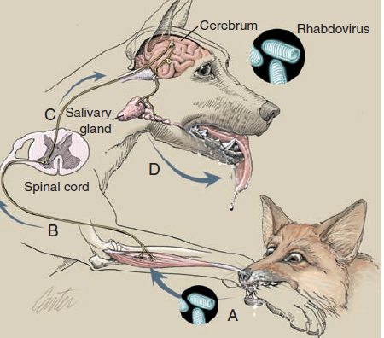

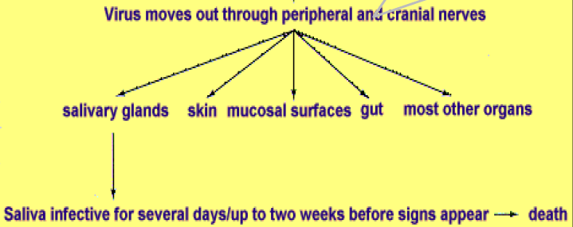
PATHOGENESIS:
Rabies virus enters peripheral nerves, or may replicate in myocytes and spread to motor nerve endings(A)
Retrograde intra-axonal (centripetal) spread to the CNS occurs in peripheral motor nerves (B)
Virus replicates in spinal cord neurons and spreads rapidly throughout the nervous system, causing progressive lower motor neuron paralysis(C)
Virus enters the brain, causing cranial nerve defi cits and behavioral changes
centrifugally
Hematogenous spread does not occur
(Art by Kip Carter © 2004 University
of Georgia Research Foundation Inc.)
Presence of virus in the saliva indicates that the CNS has been infected.

Slide 6
Types of Rabies virus
Street Virus
Fixed Virus
The virus isolated from natural occurring cases.
it is naturally occurring virus. It is found in saliva of infected animal.
It produces Negri bodies
Incubation period is long i.e. 2wkks to more than 1year.
It is pathogenic for all mammals
It Can’t be used for preparation of vaccine
The virus which has a short, fixed and reproducible incubation period
2. It is prepared by repeated culture in brain of rabbit such that its pathogenicity is reduced & fixed
3. It does not form Negri bodies
4. Incubation period is constant between 4-6 days
5. It can pathogenic for humans under certain conditions
6. Is used for preparation of antirabies vaccine

Slide 7
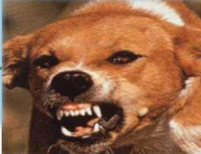
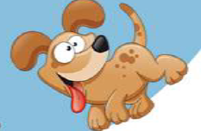
The classical course of canine rabies is divided into three phases:
Prodromal phase
Excitative (furious) phase
Paralytic phase (dumb rabies)
Prodromal phase:
Behavioural changes may occur.
Aggressive and highly strung dogs may become friendlier than usual and ordinarily friendly dogs may become shy and seek secluded areas or become snappy and irritable.
The temperature may rise slightly, the pupils may dilate and the nictitating membrane may cover the eye.
Excessive salivation may occur.
Clinical Signs

Slide 8
Excitative (furious) phase:
The dog becomes severely agitated and restless and sometimes develops the urge to roam. It is most dangerous at this stage because of its urge to bite anything that it encounters.
In most cases an altered phonation (a characteristic high pitched bark) develops, caused by paralysis of laryngeal muscles.
Spasms and paralysis of the pharyngeal muscles make swallowing difficult and lead to drooling.
If the dog does not die during one of the characteristic convulsive seizures the disease usually progresses to muscular incoordination, paralysis, coma and death.
The posture and expression is one of alertness and anxiety, with pupils dilated.
Noise may invite attack. Such animals lose caution and fear of people and other animals.

Slide 9
The paralytic phase (dumb rabies) :
Occurs when the exitative phase is extremely short or absent.
The most characteristic sign is the "dropped jaw“ caused by paralysis of the masseter muscles. Often, choking sounds as if a bone were stuck in the throat are made and attempts to remove this "bone“
Cattle
Furious rabies can be dangerous, attacking and pursuing people and other animals.
Lactation ceases abruptly in dairy cattle.
The usual placid expression is replaced by one of alertness.
The eyes and ears follow sounds and movement.
A common clinical sign is a characteristic abnormal bellowing, which may continue intermittently until shortly before death.

Slide 10
Horses and mules
Frequent distress and extreme agitation accompanied by rolling, may be interpreted as evidence of colic.
As in other species, horses may bite or strike viciously and, because of their size and strength, become unmanageable in a few hours. People have been killed outright by such animals.
These animals frequently have self-inflicted wounds.
Based on history and clinical signs
Immunofluorescence microscopy on fresh brain tissue (medulla oblongata and cerebellum ) , which allows direct visual observation of a specific antigen-antibody reaction, is the current test of choice.
Molecular testing, including real-time PCR
The WHO recommends methods for the detection of rabies virus antigens, amplicons, and antibodies
DIAGNOSIS

Slide 11
Management of wound
Cauterization or application of oil, turmeric etc on should be avoided
Not stitched the wound at least within 24-48 hr of injury
Tetanus toxoid and Antibiotics for wound healing.
All dogs and cats should be vaccinated for rabies at 3 or 4 months of age (depending on state legislation), with a booster dose 1 year later, then every 3 years with approved inactivated vaccines, or annually with recombinant vaccines
Dogs and cats less than 1 year of age are not considered immunized until 28 days after the initial vaccination
Oral vaccinia-vectored recombinant rabies vaccines, used in wild animals such as raccoons, coyotes, and gray foxes
Treatment
Prevention and Control

Slide 12
The modified live SAD B19 strain, the V-RG recombinant, and SAG2 vaccines
Post-exposure prophylaxis (PEP) is administered to humans after a bite from a known or suspected rabid animal.
It consists of an injection of human rabies immune globulin (H-RIG), ideally with at least half of the whole dose in the region of a bite site as soon as possible within the first 7 days of the bite, followed by vaccination by the intramuscular route on days 0, 3, 7, 14, and 28 in the upper deltoid muscle.
Oral Vaccination of Feral and Wild Animals
Human

Slide 13
