Slide 1
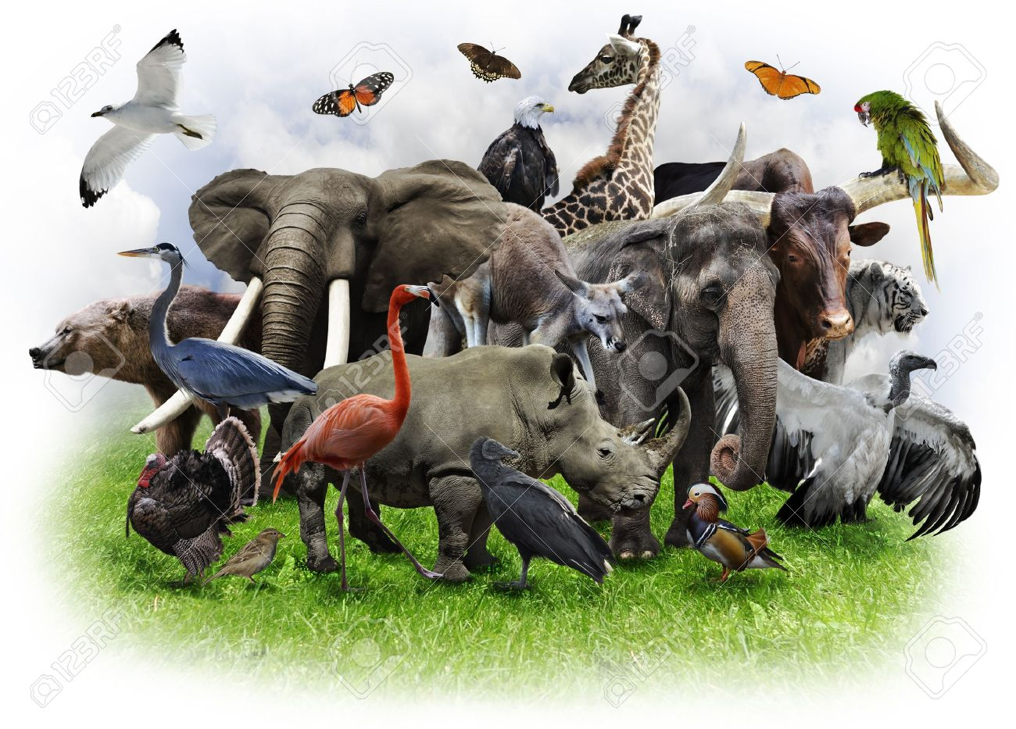
Role of animals in transmission of zoonotic diseases

Slide 2
Domestic Animals
A number of as pets, which besides providing companionship, serve utilitarian purposes protecting homes and property, destroying vermin and providing means of transport
Domestic/ companion animals | Examples of zoonoses
Dogs | Hydatidosis, Visceral larva migrans (VLM), Cutaneous larva migrans (CLM), Rabies, Leptospirosis
Cats | Rabies, Toxoplasmosis, Cat scratch disease
Birds | Psittacosis/ Ornithosis
Ornamental fishes | Erysipelas
Equines | Eastern equine encephalitis (EEE), Western equine encephalitis (WEE), Venezuelan equine encephalitis (VEE), Glanders, Hendra

Slide 3
Cattle | Foot and mouth disease (FMD), Rabies, Cow pox, Milker’s nodules, Bovine spongiform encephalopathy (Creutzfeldt-Jacob disease), Brucellosis, Leptospirosis, Campylobacteriosis, Anthrax
Sheep | Q-fever, Leptospirosis, Listeriosis, Brucellosis, Anthrax
Goats | Orf, Brucellosis, Leptospirosis, Anthrax
Pigs | Trichinosis, Erysipelosis, Salmonellosis, Anthrax, Swine influenza, Japanese encephalitis
Poultry | Avian influenza, Newcastle disease virus conjunctivitis, Listeriosis, Mycobacterium avium, Toxoplasmosis

Slide 4
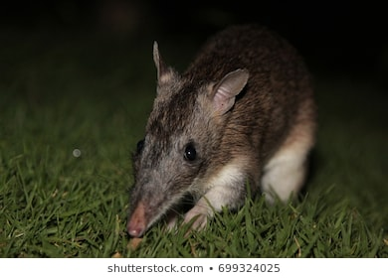
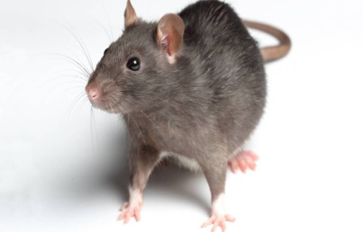
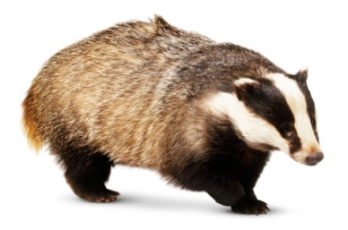
Domiciliated animals
These are animals which live in close contact with human dwellings
Maintenance of such animals
Increase in human population,
Inadequate sanitary measures,
Easy access to garbage dumps & food materials etc
Animal | Disease
Rats, Mice, bandicoots, badger etc. | TB, Leptospirosis, rat bite fever, Hantan fever, Plague, Tularemia, Murine typhus

Slide 5
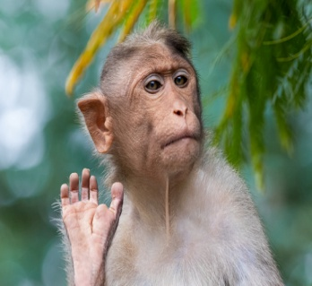
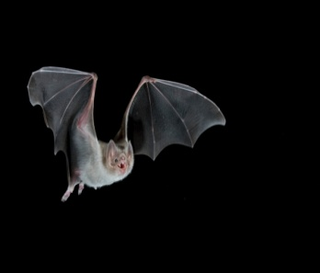
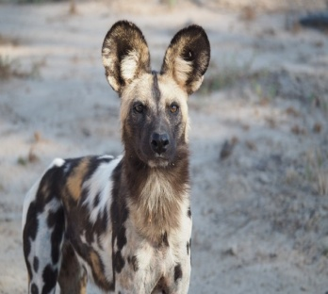
Wild Animals
Wild animals are the known host to a wide range of microorganisms
Alteration in ecology i.e. intrusion of human in forest area lead to emergence
Animals | Diseases
Monkeys | KFD , yellow fever in humans, tick typhus, CCHF, Q-fever, tularemia
Migratory birds | Avian influenza, West Nile virus, EEE, WEE
Skunks, ferrets, bats, foxes, wild dogs and cats | Rabies Hare: Brucellosis, Yersiniosis, Tularemia, Listeriosis, Leptospirosis
Bison | TB and Brucellosis
Wood mouse | Yersiniosis
Badgers | TB

Slide 6
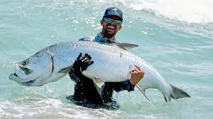
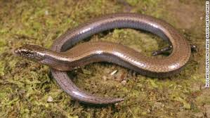
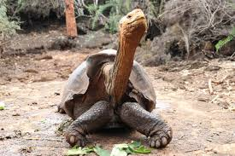
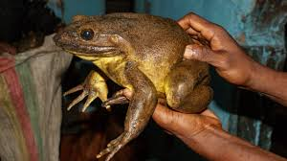
Cold-blooded animals
Fishes, lizards, snakes, toads, turtles and frogs:
Fishes:
Erysipelothrix insidiosa,
Clostridium botulinum type E, C. septicum, C. sporogenes and C. perfringens,
Listeria monocytogenes
Vibrio parahaemolyticus
Snakes and tortoises:
Salmonellae & Aeromonas
Lizards:
Tularemia, Brucellosis and Leishmaniasis

