Slide 1
Class Lecture
PRINCIPLES OF CHEESE MANUFACTURE
Dr. Sanjeev Kumar
Associate Professor
Department of Dairy Technology
SGIDT, Patna-14

Slide 2
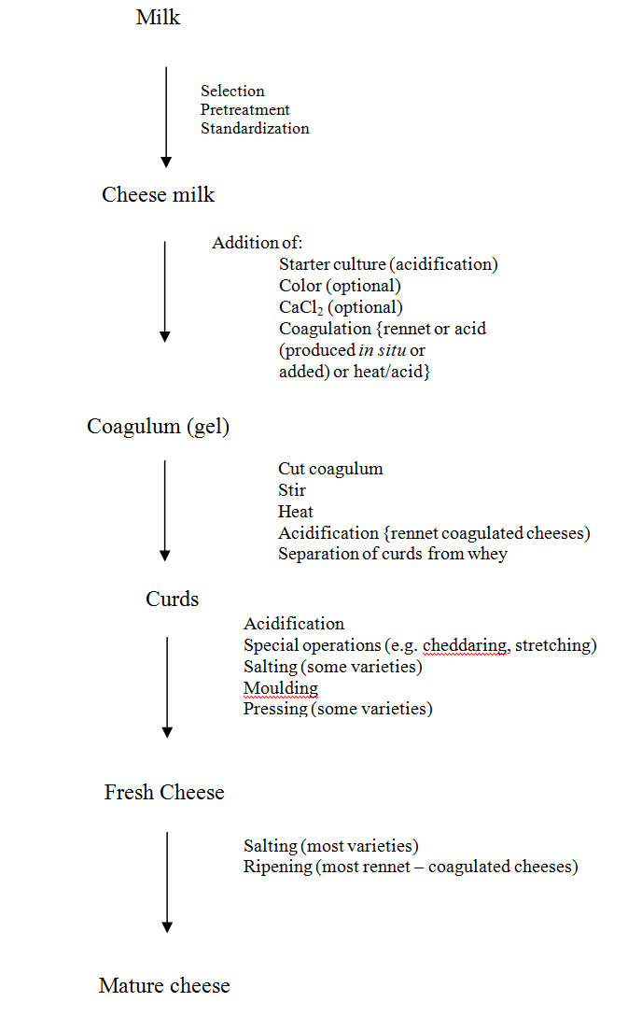

Slide 3
Selection of Milk
Cheese milk --- usually pasteurized or subjected to alternate treatments to render it free of pathogenic, food poisoning and/or spoilage bacteria
World famous cheeses ---- produced from sheep’s milk, e.g. Roquefort and Feta and Romano
Best Mozzarella --- made from buffalo milk
Mammals containing a higher proportion of C₆₋C₁₀ fatty acids would develop a characteristic peppery flavor, as seen in Roquefort---- always made from sheep milk

Slide 4
Inhibitory Substances in Milk
All cheeses depend on the growth of lactococci and all matured cheese depends on the development of lactobacilli
lactenin found in milk may inhibit the growth of certain streptococci.
lactenin --- two components, L1 and L2.
L1 --- present in colostrum and inactivated by heating to 70°C for 20 min
L2 present in mid-lactation milk and inactivated by heating to 70°C for 20 min.

Slide 5
Storage of Chilled Milk
Milk for cheese is normally chilled to 4-5°C immediately after milking
Standardization of Milk
Fat and casein together with moisture left in the curd control cheese yield, but fat also----- marked influence on appearance and feel of the curd and cheese.
Casein:fat ratio (C/F ratio) in milk --- generally about 0.7 for good quality cheese

Slide 6
Heat Treatment of Milk
Cheese made --- raw milk develops more intense flavor than that produced from pasteurized milk,
Thermization of cheese milk --- fairly widely practised on receipt at the factory to reduce the microbial load and extend the storage period.
Thermization (65°C/15 s) of cheese milk on arrival on factory --- common or standard practice in some countries
Objective ----- to control psychrotrophs and milk --normally pasteurized before cheese making

Slide 7
Ripening of Milk (Acidification)
Increase in acidity in the milk --- used for cheese making known as ‘ripening’ usually brought about by starter culture.
Acidification --- normally via in situ production of lactic acid,
Although preformed acid or acidogen (gluconic acid-δ-lactone) --- now used to directly acidify curd for some varieties, e.g. Mozzarella cheese, UF Feta and Cottage.
Add a culture (starter) of selected lactic acid bacteria to pasteurized cheese milk to achieve a uniform and predictable rate of acid production.

Slide 8
COAGULATION
Coagulation---- achieved by
• Limited proteolysis by selected proteinases (rennets)
Acidification to pH 4.6
Acidification to pH 5.2 and heating to 90°C.
75% of total production, ---- produced by rennet coagulation but some acid coagulated varieties, e.g. Quark and Cottage cheese,
Rennin --- an extremely powerful clotting enzyme; one part of pure rennin can clot more than five million parts of milk.

Slide 9
Optimum pH for rennin action on milk is 5.4 and for pepsin it is 2.0.
For hard cheese such as Cheddar, usually about 1.5 to 2.5 g of commercial rennet powder -- used for 100 l of milk.
In case of Meito rennet ---- 1.25g to 1.65 g/100 l milk.
Formation of curd depends upon the coagulation of the casein in milk.
With rennet coagulation occurs in two steps. The calcium caseinate in milk is first changed to the paracasein, which then combines with the calcium ions present in the milk to form an insoluble curd.
The addition of small amount (0.02%) of calcium chloride to the milk usually will restore the calcium ion balance and permit the normal functioning of rennin.

Slide 10
Cutting the Coagulum
The coagulum -- ready to cut after a period of from 25 min to 2 h,
Clear cleavage with green whey at the base of the cleft indicates that the curd -- ready to cut.
Soft irregular cleavage with white whey indicates that the curd is too soft.
When curd -- ready for cutting, it is first cut horizontally and then vertically.
Surface-active materials such as phospholipids and whey proteins accumulate on the cut surface and form a thin osmotic membrane. Membrane controls the whey expulsion during cooking.

Slide 11
Cooking
Cooking or scalding the curd causes the protein matrix to shrink and expel more whey
High acid curds (i.e. blue veined cheese curds) lose more calcium (92%) than low acid curds such as Edam (35%).
The aim of scalding the curd---- to shrink the curd to expel moisture and so firm up the curd to a state ready for texture formation, pressing or salting.

Slide 12
Curd Treatment
The manner in which the whey is drained from the curd varies with the kind of cheese:
1. Cream cheese, --- prepared by placing the curd on cloths which allow the whey to drain away
2. Sometimes the curd is placed in forms or hoops put on mats or coarsely woven screens which allow the whey to drain as in the manufacture of Brick cheese
3. In the making of Cheddar cheese, curd is allowed to sink in the vat and the supernatant whey is drawn off
4. In making Swiss cheese, the curd --- separated by placing a cloth under the curd and lifting it out of the vat or kettle.

Slide 13
Pressing
Last portion of the whey --- removed from the curd by pressing.
The pressure applied to the cheese should be per unit area of the cheese and not per cheese, which may vary with size
Cheese curd holds a volume of air before pressing, those cheeses requiring very closed curds (e.g. Cheddar) --- pressed under a vacuum of 85-95 kN/m² (25-28 in Hg).
Pressures---traditionally applied for 2-3 days to Cheddar cheese,

Slide 14
Treatment of Rind
Growth of mold on Camembert and Roquefort type cheeses,
Growth of yeasts and bacteria on Brick and Limburger cheeses.
Soft types of cheese acquire a rind during ripening, often as a result of the growth of molds and bacteria
Cheeses are ripe and ready for sale, the rind is simply coated with vegetable (olive) oil, which may be colored brown or black (e.g. Parmesan, Romano).
Gorgonzola ----- coated with Plaster of Paris as a protective coat inside a woven basket
Feta and similar cheeses-- packed in casks or drums filled with brine or salted whey

Slide 15
Salting
Salting of perishable foods --- among the most ancient and widely practiced techniques of food preservation
Common salt (NaCl) ----- an ingredient of practically every variety of cheese.
Actual level of salt in cheese varies with the type, ranging from 0.5% to about 3% (w/w)
Methods of salting
Three main techniques for salting of cheese: • Mixing of dry salt crystals with subdivided cheese curds prior to the moulding/pressing stage of manufacture, • Immersion of the moulded cheese in a brine solution, • Application of dry salt or salt slurry to the surface of the formed cheese.

