Slide 1
Zoonoses and their Socioeconomic Impact

Slide 2
The word 'zoonoses' (zoonosis, singular) was coined by a German physician Rudolf Virchow in 1885.
Greek word, ‘Zoo’ means animal and ‘noses’ means Disease.
The WHO defined zoonoses as "those diseases and infections which are naturally transmitted between vertebrate animals and man".

Slide 3
Human pathogens & Zoonoses
List is continuously expanding

Slide 4
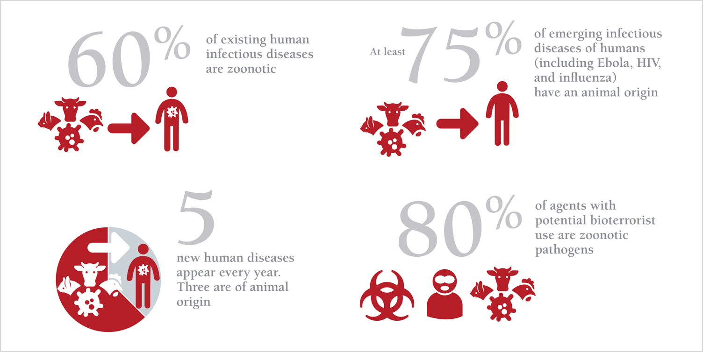
(OIE)

Slide 5
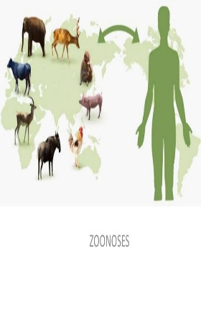
Socio-economic Impact of Zoonotic Diseases
Socio-economic conditions prevalent in an area- Occurrence and distribution of any zoonotic diseases

Slide 6
Illiteracy coincides with
Poverty,
Malnutrition,
Ill health,
High infant & child
mortality rates
It determines
Family size,
Standard of living,
Quality of life,
Purchasing power
The pattern of disease.
Imp. factor in seeking health care
Income & economic status
Nutrition
Education
Political system of the country
Effects the
Implementation of
health technologies
Decisions concerning
Resource allocation,
Manpower policy,
Choice of technology,
Availability & accessibility of the health services
Directly correlates with
Susceptibility to disease
Well nourished = less
prone to infections
Malnourished = More
prone to infections

Slide 7
Effects of Zoonoses
Zoonotic diseases have negative effects in the form of:
Loss to economy:
Loss of man-hour, man-day and labour productivity
Monetary loss due loss of animals, production and treatment
Restriction on and reduction in international trade of animals
Reduced travel and tourism to the affected areas
Loss of lives both animal and human

Slide 8
