Slide 1
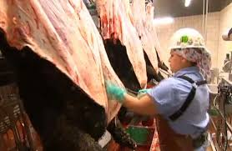
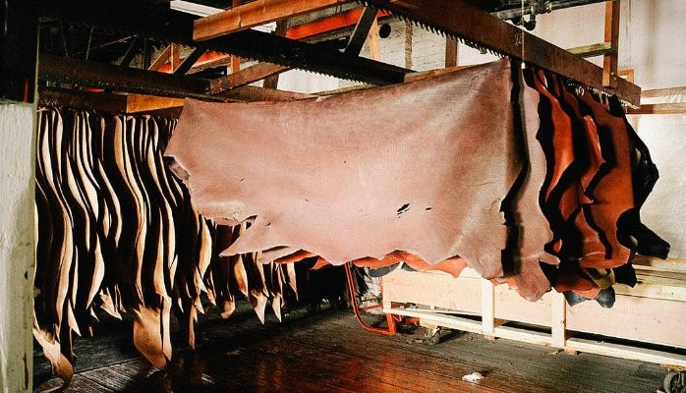
Utilization of Skin and Hides
(A part of Unit III- 3rd Prof. Year)
Dr. Gargi Mahapatra
Asst. Prof. cum Jnr. Sc.
Dept. of Livestock Products Technology
Bihar Veterinary College
BASU, Patna.

Slide 2
Hide vs. Skin (one of the most important by-products)
Hide
Skin of Large Animal
Large, Thick and Heavy
Wt. > 30 lbs/ 13.62 kg
Av. yield 7.0% of live wt.
Skin
Skin of Small Animal or very young calf
Small, Thinner and Tighter
Wt. < 20lbs/9.1 kg
Av. Yield 11.0% of live wt.

Slide 3
Source
Hide
Slaughtered animals
20-25 %
Fallen Animals
75-80%
* Fallen animals: Death due to natural
Skin
Slaughtered animals
80 %
Fallen Animals
20%
cause

Slide 4
Destination of Hide/ Skin
Hide/Skin
Drying/ Curing
Conditioning
Tanning
Post-Tanning Operations
Leather
(End Product)

Slide 5
Leather
Excellent tensile strength and flexibility
High resistance to puncture and tear
Insulation from weather
Good molding tendency hence versatile usage.

Slide 6
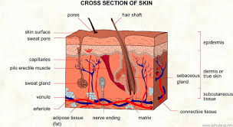
Cross-section of Hide/Skin
Epidermis- Outer pigmented zone
Dermis- a.k.a Corium, (elastin fibres+ reticular fibres+ collagen fibres)
Subcutis- Loose membrane network of fatty deposits.
*Inner portion of corium is interwoven with
bundles of collagen which makes up into leather.

Slide 7
Flaying
Process of skin removal from dead animal
Performed by skilled workers
Sharp flaying knives used.
Practiced on Pritch Plates :- Steel plates 120cms long, 60cms wide and 20 cms thick.
Animal secured on pritch plates by Pritch Bars: A metal rod.
Sometimes practiced on skining cradles, made from round steel/timber tublings.
https://www.youtube.com/watch?v=9y03R9WVnGY

Slide 8
Flaying of Large Animals
Hide opened from neck (ventral side)
Incision continued from middle of dewlap to belly up to the middle of tail
Cut created at knee joint and hock joint
Fore leg incision continued to breast bone
Hind leg incision continued to scrotum/udder
Hide separated from carcass from breast to neck and from breast to navel

Slide 9
Contd…
Incisions are moved towards the medial end of the carcass
The carcass is hung by hooks on its hind legs
The hide is removed from the tail
Carcass is raised high, the hide is pulled back to the hump, then to the shoulders and finally to the neck, separating the thick subcutaneous tissues
Hide is severed from the carcass by giving a cut behind the horns

Slide 10
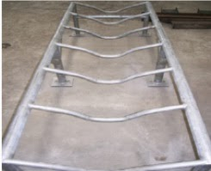
Flaying of Fallen Animals
Difficult due to harder connective tissue.
Coagulated blood capillaries stain the hide
Leads to inferior quality stained leather
Practiced on Flaying Cradles: Two poles 150cms long and 15cms in diameter, separated by a gap of 30cms

Slide 11
Flaying of Small Animals
Small incision in the hind leg on inner side of hock joints
Smooth and narrow wooden/steel rod (45cms) inserted from the incision to loosen connective tisue between skin and body
Rod removed, hand cut made around incision hole
Air pumped in the cut, carcass inflates like a balloon

Slide 12
Contd…
Carcass lifted from ground and hung on hind legs
Circular cut made around knee and hock joint and around neck to severe the head
Cuts made from the hock joint to scrotum, fingers inserted into the incision and the skin is pulled downwards, continued till worker reaches the chest
Worker grips the skin with both the hands and removes it with force, knife used where it is absolutely necessary
https://www.youtube.com/watch?v=lqqBU5T3Gas

Slide 13
Classification of Hides and Skin
Acc. to weight
Other factors
Name | Origin | Weight (lbs)
Slunk Skin | Unborn Calf | ---
Calf Skin | Immature Calf | 9-15
Kip Skin | Calf | 15-25
Heifer Skin | Heifer | 25-30
Cow Hide | Cow | >30
Light Cow Hide | Cow | <53
Heavy cow Hide | Cow | >53
Extreme Light Hide | Steer | 32-48
Light Steer Hide | Steer | 48-58
Heavy Steer Hide | Steer | > 58
Bull Hide | Bull | 60-100
Name | Description
Texas/Colorado hide | Hides branded on butt.
Native hides | Unbranded Hides
Slaughtered Hides | Flaying of slaughtered animals
Fallen/ Rendered/ Murrian Hides | Flaying of Fallen animals
Big Packers Hide | Flaying by highly skilled workers
Small Packers Hide | Flaying by less skilled workers

Slide 14
Goat Skin Classification
On the basis of weight and length
(Baba and Bhote, 1966)
FAO
(Aten, 1955)
Class | Wt. (kg) | Length (cms) | Region
Big Goat Skin | 1.3 | > 96.5 | Punjab, Kashmir, Odhisa , U.P.
Medium Goat skin | 0.91 | 76.2-96.4 | Rajasthan, Maharashtra, Andhra Pradesh, Kerela, Karnataka
Small Goat Skin | 0.86 | <76.2 | Eastern Part of India
Grades | Specification
First Grade | Shape/Pattern Regular and Symmetrical with minor scores/gouges
Second Grade | Good Shape and Pattern, 1/16 of area show concentrated scores/gouges
Third Grade | Irregular shape and Pattern; ½ of the area damaged by knife
Reject Grade | Irregular shape and Pattern; Extensive damage on back or butt

Slide 15
Defects in Hide/Skin
Ante-mortem Defects
Post -mortem Defects
Poor substance- Genetic Factor/ Species variation
Defects due to Disease -Pox, Mange, Dermatitis etc.
Grain Damage -Thorns or wire fence scratches, branding, abscess abrasion, tick damage, bacterial action
Bad Shape/ Pattern -Ground drying, Fallen hides etc.
Bad Flaying -Knife Cut
Curing Defect -Salt burns, improper application of salt
Smoke damage -Excessive exposure to smoke.

Slide 16
Preservation of Hides and Skin
First step in hide preservation-
Methods – Air Drying &
Practiced in areas where relative humidity is low
Techniques
Ground Drying
Suspension Drying
(Frame Drying, Line Drying &
Drying
Hide Curing
Done immediately after flaying
Techniques
Dry Salting
Wet Salting
Tent Drying)

Slide 17
Important points
Skin of sheep and long haired goats are washed on the flesh side up.
After drying the hides are conditioned and then sent to tanneries.
Green Hides- Fresh hides which have been flayed, fleshed, trimmed and washed. These are delivered to the tanneries as early possible.

Slide 18
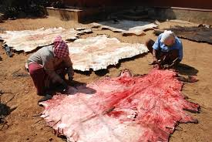
Ground Drying
Hides stretched out fleshed side up on the ground and air dried.
Advantages:
Cheap, Easily adaptable by rural population
Adequate for Fallen hides
Disadvantages:
Blemishes and Putrefaction at follicular level hence poor quality leather produced.
High temperature(summers) causes wrinkling

Slide 19
Suspended Drying
Hides are dried in suspended manner
Advantages
Simple, cheap and effective way of drying.
Easily adaptable in tropical countries.
Free circulation of air around the hide.
Skin becomes lighter thus cheaper to transport.

Slide 20
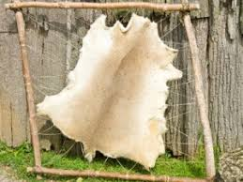
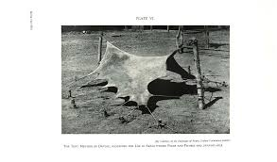
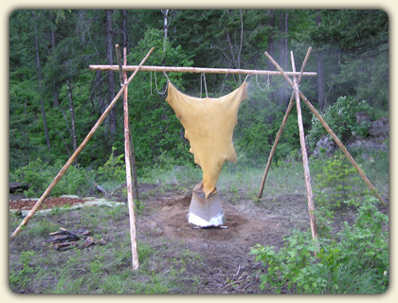
Suspended Drying Techniques
Frame Drying
Practiced on angled frames fixed on a tripod/stand
Line Drying
Skin suspended on horizontal chords with flesh side up, practiced for sheep and goat
Tent Drying
Hide supported on ground in shape of a tent by chords and wires
*Irrespective of the method of drying hide takes a minimum of 7 days to dry.

Slide 21
Hide curing
Dry Salting
(Hide retains 12% water)
Hides kept flesh side up
2-3 mm thick layer of fine salt applied
Weight of salt equal to weight of hide
Hides stacked on one another, to a max. height of stack 1m.
Practiced in rooms maintained at 15°C and 85-90% relative humidity.
Wet Salting
(Hide retains 35% water)
Curing solution prepared (23 kg salt+ 62 kg water for 100 kg of hides)
Hides soaked in pits, 1.25m deep.
Soaking times varies from 2 days for fleshed hides to 2 weeks for un-fleshed hides.
Brining liquid maintained at room temperature.

Slide 22
Conditioning of Hides
Washing and Soaking
(Hides soaked in zinc chloride+ soda ash+ borax Solution)
All proteins of blood and lymph removed
Hide rehydrates and restores its shape
Fleshing
Extra flesh stripped off with a serrated knife
Liming and Dehairing
Hides soaked in saturated lime solution with 0.1% sodium sulphide
Applied to loosen hair and epidermal cells

Slide 23
Contd….
Washing and Deliming
Hides washed with mild acid to neutralize the lime
Batting
Hides treated with proteolytic enzymes at pH 8.5
Results in soft and pliable pelt
Such pelts tanned by vegetable tanning
Pickling
Pelts pickled in bath of 1% Sulphuric acid and 10% salt in water, maintained at a pH of 2-2.5 for 2-3 hrs
Such pelts are tanned by chrome tanning process

Slide 24
Tanning
Process of conversion of hides/ skins to insoluble and non-putrescible leather without destruction of original structure.
Process requires approximately 5-6 hrs
Types
Vegetable Tanning
Chrome Tanning

Slide 25
Vegetable Tanning
Delimed pelts are immersed in natural tanning liquor of progressively stronger concentration. The tannin diffuses and imparts uniform colour
Used for heavy leather articles like belts, saddle, harness etc.
Tanning producing plants are
Avaran ( Cassia auriculata),
Babul (Acacia arabia),
Myrabalan (Terminalia chebula)
Konnan (Cassia fistula).

Slide 26
Chrome Tanning
A more modern, quicker and popular technique.
Yields softer, stronger and supple leather.
Types
Single Bath Process- Chrome salts prepared in a solution and then applied on skin. The strength of the solution is then gradually increased
Double Bath Process- Chemical interaction forming the chrome solution is practiced on skin itself.
Usually sodiumbichromate is reacted with maltose and sulphuric acid to get chromic sulphates.
Chromic sulphates are applied @ 1.5-2.0% at a pH of 2.5 , then increased to pH of 3.5.

Slide 27
Post tanning Operations
Setting out and Wiring
Hide passed between two large rollers
Remove excess of tanning liquor and moisture
Splitting and Shaving
Practiced to adjust leather thickness
Dyeing
To produce desired color
Fat Liquoring
Lubrication with oil to adjust firmness

Slide 28
Contd…
Staking
Makes the leather more pliable
Buffing
Smooth the grain surface of leather for better appearance
Final product is called buffed leather
Glazing
Done in case of chrome tanning
Glass cylinders are rolled on the surface of the buffed leather
This process produces high luster on the grain surface

Slide 29
