Slide 1
Adaptation of Animals to cold climate
Dr Pramod Kumar
Asstt. Professor
Dept. of Vety. Physiology
Bihar Veterinary College, Patna

Slide 2
Temperature stress is a physiological stress induced by excessive heat or cold that can impair functioning and may cause injury or death. Exposure to intense cold decreases body temperature and pulse rate. Headaches, nausea, disorientation, fainting, and unconsciousness also may occur. The initial symptom of cold stress is pain in exposed areas. Continued exposure may lead to numbness, mental confusion, lethargy and irregular heartbeat.

Slide 3
Body heat is a type of thermal energy that is a by-product of metabolism in higher animals, especially in birds and mammals, which exhibit a close control of their body temperature during environmental fluctuation. Birds and mammals can conserve body heat by fluffing up feathers or erecting their hairs and by reducing blood flow to the exterior surface and extremities. They can increase body heat by shivering and exercise. Body heat is maintained by minimizing exposure of the body surface to the surroundings.

Slide 4
Bergmann’s rule states that endothermic animal subspecies living in colder climates have larger bodies than that of the subspecies living in warmer climates. Individuals with larger bodies are better suited for colder climates because larger bodies produce more heat due to having more cells and have a smaller surface area to volume ratio compared to smaller individuals, which reduces heat loss. Bergmann’s rule can be applied to mammals and some birds when the latitude and temperature between groups differ widely.

Slide 6
Allen`s rule is a biological rule that says the limbs of endotherms are shorter in cold climates and longer in hot climates. Limb length affects the body’s surface area, which helps with thermoregulation. Shorter limbs help to conserve heat, while longer limbs help to dissipate heat. This can be observed in polar animals having shorter limbs than other animals use to live in hot areas and are laterally built.

Slide 7
The mammals have two methods of thermogenesis, which produces heat to raise the core body temperature.
Shivering - occurs in less hairy/feathered animals/birds when the ambient air temperature is under 25 °C (77 °F). It is limited by the amount of glycogen available in the body.
Non-shivering - occurs in having brown adipose tissue

Slide 9
Factors involving in survival to extreme condition
Acclimatization - When the animals are exposed to certain climates for extended periods of time, physiological changes occur to help the individual adapt to hot or cold climates. This helps the body conserve energy.
Culture - Social adaptations enable to occupy environments with temperatures that were drastically different areas that would otherwise be uninhabitable.
Genetic adaptations - There has been very little research done in the genetics behind adaptations to cold stress.

Slide 10
Behavioral adaptations - Huddling (Herd) can reduce heat loss by up to 50%.
Physical adaptations – having thick, windproof or waterproof coats. Emperor penguins have four layers of scale-like feathers. The layers overlap each other, forming a good protection from the wind, even in blizzard conditions.
Whales, seals and some penguins have thick fat layers. These fat layers act like insulation, trapping body heat in.
Hibernation – Polar bears etc.

Slide 11
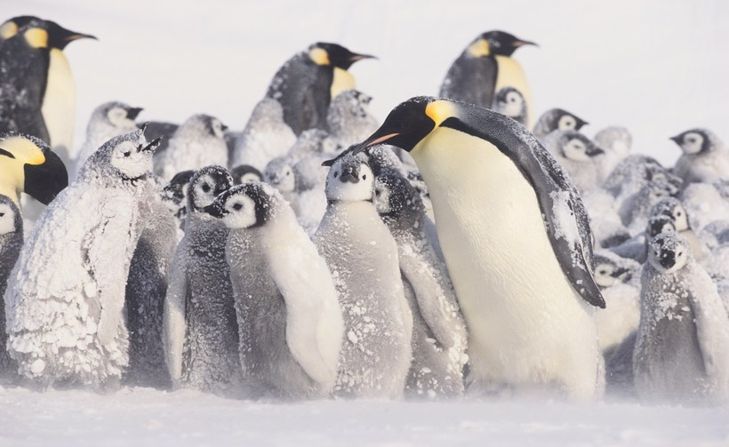
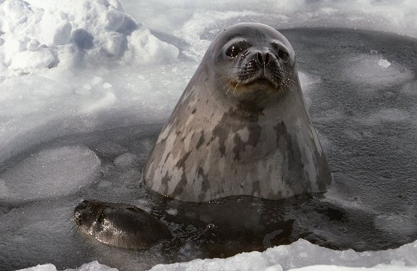
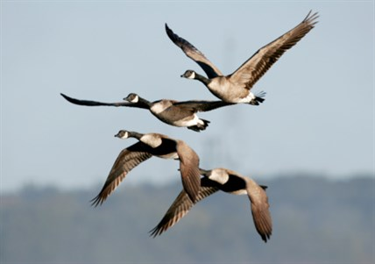

Slide 12
Animals have many adaptations to survive in this harsh environment;
Animals need shelter and insulation in the Tundra. The animals here tend to have thicker and warmer feathers and fur. Many of them have larger bodies and shorter arms, legs and tails which helps them retain their heat better and prevent heat loss.
Many of the birds of the tundra have two coats of feathers to help keep them warm. Many animals of the Tundra have feet that are lined with fur to help keep them warm. Many also migrate to warmer climates during the harsh winter months.

Slide 13
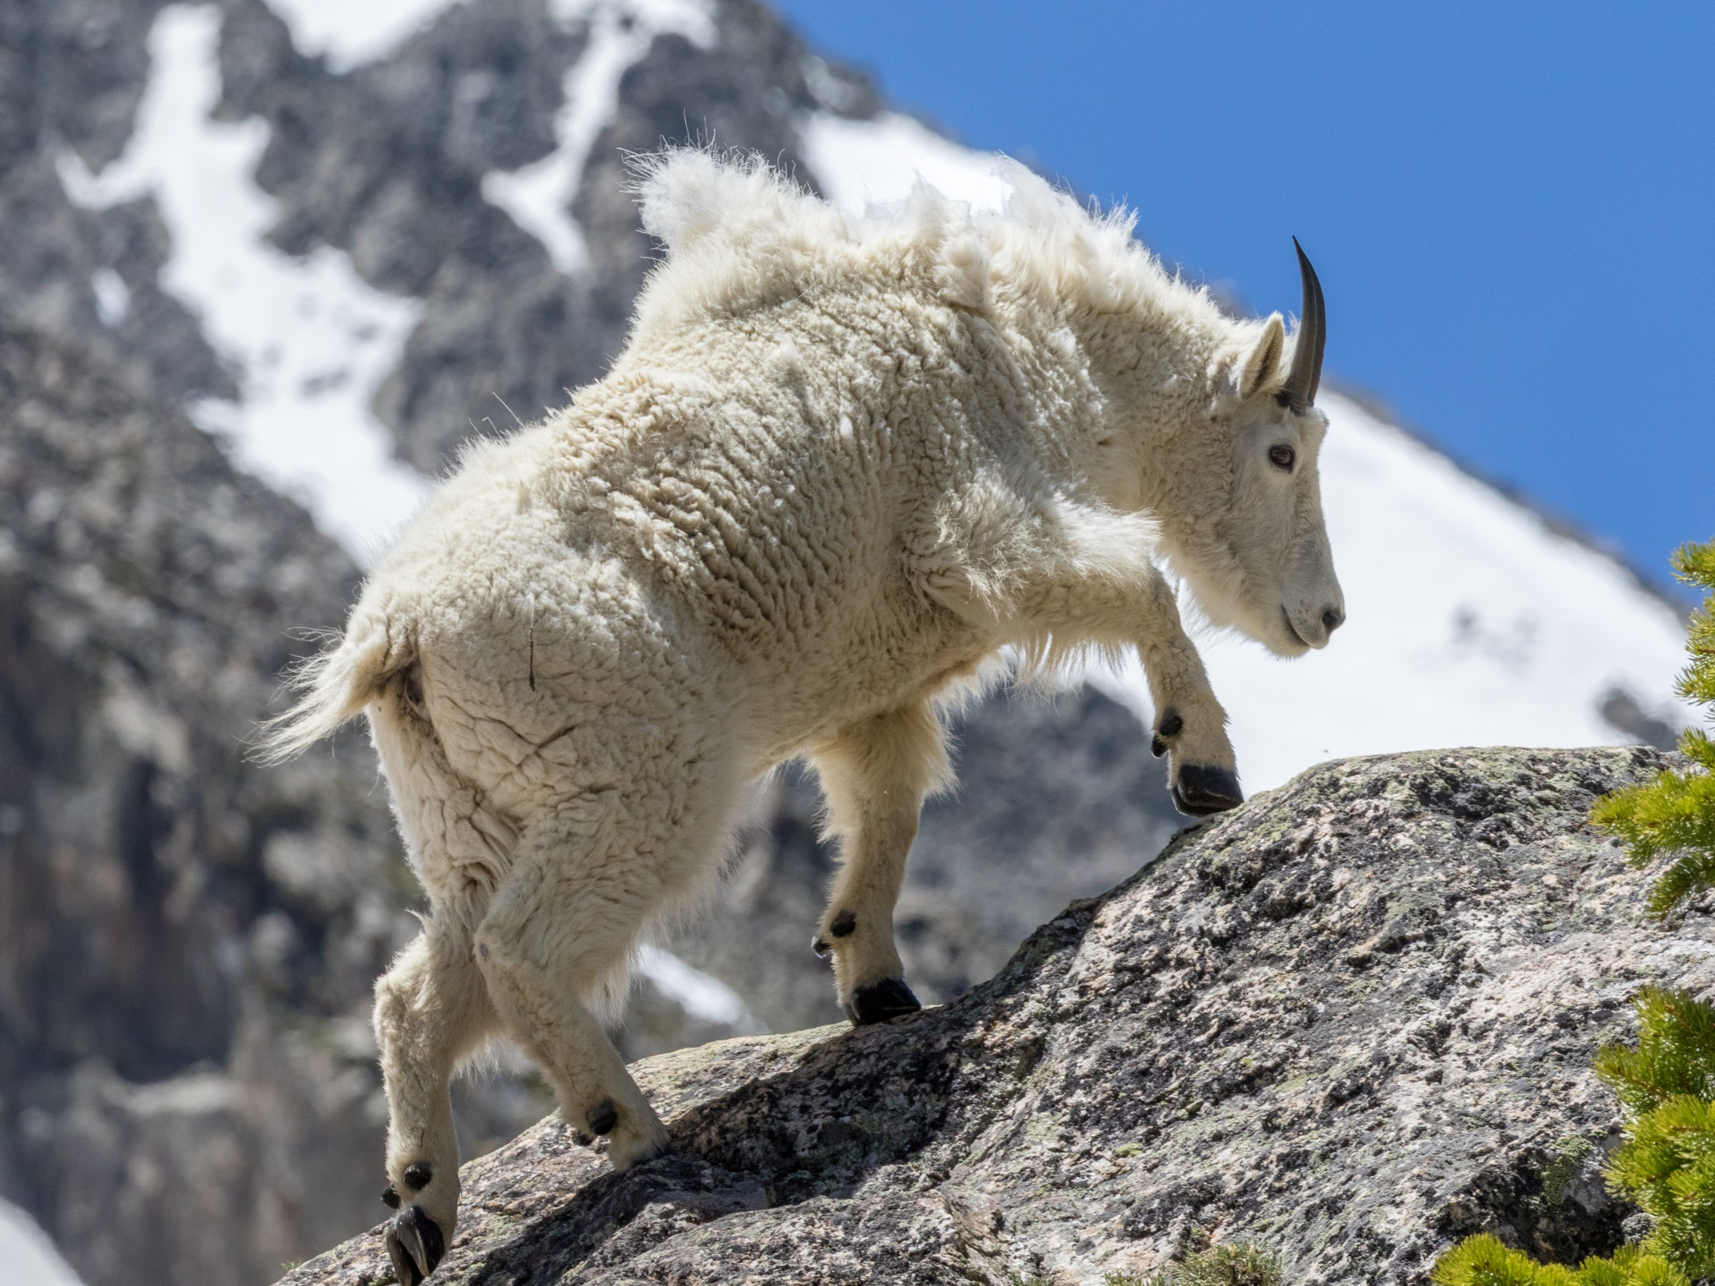

Slide 14
Some of the animals of the Tundra (bears, marmot, arctic squirrels) will hibernate for the winter and others will burrow (lemmings, ermine).
Many of the insects of the Tundra will spend their entire life buried in the soil, rocks or plants which acts as a shelter for them.

