Slide 1
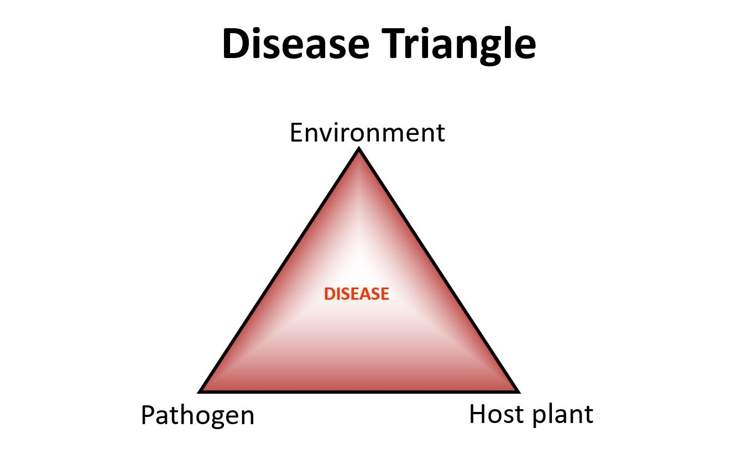
Ecology of diseases-II

Slide 2
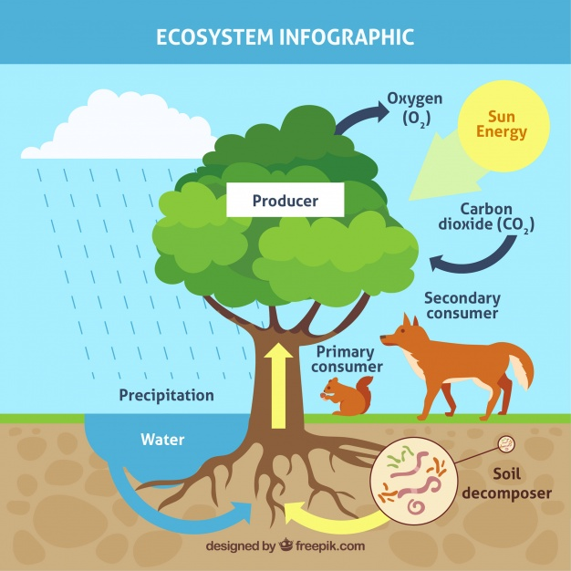
Ecosystem
Animals and plants that occupy them, and by their physical and climatic features. This unique interacting complex is called an ecosystem
Types: According to their origin
Autochthonous ecosystems
Anthropurgic ecosystems
Synanthropic ecosystems

Slide 3
Ecosystem
Autochthonous ecosystems
Greek word: autos: itself
chthon: the earth or the land
ous: deriving
Ex. Tropical rain forest, desert
Anthropurgic ecosystems
Greek word: anthropos: man
rooterg: to creat, to produce
Ex. Cultivated Pasteur & town
Synanthropic ecosystems
Greek word: syn: along with
anthropos: man
Ex. An example is a rubbish tip, harboring a variety ofvermin
(Leptosirosis)

Slide 4
Ecosystem
Biotope:
A biotope is the smallest spatial unit providing uniform conditions for life
An organism's biotope therefore describes its location
A biotope can vary in size
Ex. Caeca of a chicken for coccidia,
an area of poorly drained land for Fasciola hepatica infection of cattle
Different from niche which describes the functional position of an organism
Biocenosis
A biocenosis is the collection of living organisms in a biotope
The organisms include plants, animals and the microorganisms in the biotope
Major biotic communities are biomes

Slide 5
Ecosystem
An ecological climax
An ecological climax traditionally is said to have occurred when plants, animals, microbes, soil and macroclimate have evolved to a stable, balanced relationship
Infection is there: Endemic infection
The balance between host and parasite: In-apparent infection
If balance break: Epidemic infection
Ex. Bluetongue, in-apperent infection in indigenous sheep in South Africa due to ecological complex. The importation of exotic sheep (European breed) represented a disturbance of the stable climax

Slide 6
Ecosystem
Ecological interfaces
An ecological interface is a junction of two ecosystems
Infectious diseases can be transmitted across these interfaces
Ex: Transmission of yellow fever
The virus is maintained in apes in Africa in an autochthonous forest
ecosystem
Aedes africanus: transmits the virus between apes
A. simpsoni: bridges the interface between the autochthonous forest
ecosystem & the anthropurgic cultivated savannahs

Slide 7
Ecosystem
Ecological mosaics
An ecological mosaic is a modified patch of vegetation, created by man, within a biome that has reached a climax
Infection may spread from wild animals to man
Ex. The helminth infection loiasis is transmitted by arthropods between man, living in small forest clearing, and canopy-dwelling monkeys.
Ex. Clearing of the forest canopy encourages a close cover of weeds on the ground, creating conditions that are favourable for the incursion of field rats with mites infected with scrub typhus, which form mites infected with scrub typhus, which form mite islands and the resulting local areas of endemic scrub typhus

Slide 8
Landscape epidemiology
The study of diseases in relation to the ecosystems in which they are found is landscape epidemiology
Similar terms: Medical ecology
Horizontal epidemiology
Medical geography
Investigations are: qualitative in nature
Involves the study of ecological factors that effects the occurrence, maintenance, and transmission of disease

Slide 9
Landscape epidemiology
Nidality:
foci were natural homes of these diseases & were called nidi (Latin: nidus = nest)
Many arthropod transmitted infections present in the steppes were also limited to distinct geographical areas
The presence of a nidus depends on its limitation to particular ecosystem
An area that has ecological, social, & environmental conditions that can support a disease is a nosogenic territory
Nosoarea: is a nosogenic territory in which a particular disease is present

Slide 10
Landscape epidemiology
Objectives:
Prediction about the occurrence of disease
Facilitates the development of appropriate control strategies
Ex. Leptospirosis
Tularemia
Kyasanur Forest disease

