Slide 1
Systemic histology and ultrastructure
VAN-607
TOPIC- HISTOLOGY OF MALE GENITAL-TUBULAR PART URETHRA PENIS & PREPUCE
Dr. SANJAY KUMAR BHARTI
HEAD,VETERINARY ANATOMY

Slide 2
SYSTEMIC HISTOLOGY AND ULTRASTRUCTURE- VAN-607
TOPIC- HISTOLOGY OF MALE GENITAL ORGANS
Male Genital Organs Contains following organs 1.-One Pair Gonads 2.- Tubular Organs
A.- Testis.
B.- Epididymis.
C.- Ductus diference.
D.- Ejaculatory Part- Urethra
E.- Penis
F.- Accessory sex glands- Seminal Vessicle Prostate and Bulbourethral.

Slide 3
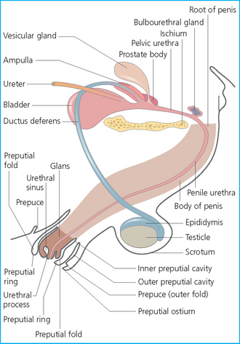
Male Genital Organs -

Slide 4
HISTOLOGY OF URETHRA
- Long muscular tube extends from- UB to Glans penis.
- Made up of 2 parts-
A- Pelvic Part- Prostatic part.
B- Extra Pelvic Part- Penile Part.
A- Pelvic Part- Prostatic part.
- The VD,SV, & Prostate gland opens into urethra in its initial part.
-Further behinds this part Bulbo-urethral or cowpers glands are opens.

Slide 5
A- Pelvic Part- Prostatic part.
Histology
TM- LEM- Transitional epithelium in all domestic animals except cat, dog,& in buck stratified columnar epithelium.
LMM- absent
LP+TSM- A. Urethral glands having areolar CT & Cavernous tissue. B. Glands of litters having branched tubuloalveolar glands & Cavernous tissue.
TMM- Inner longitudinal layers and Outer circular layers.
TA- Having more glands and erectile tissue. Which play major role in errction of penis

Slide 6
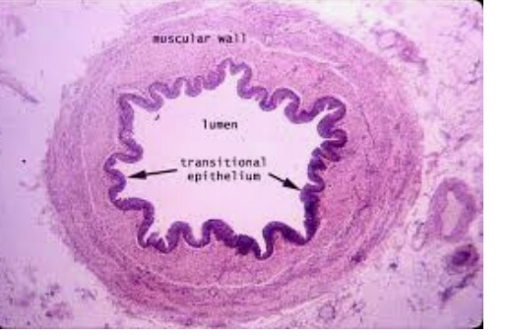
Pelvic Part- Prostatic part.
Histology Conti..

Slide 7
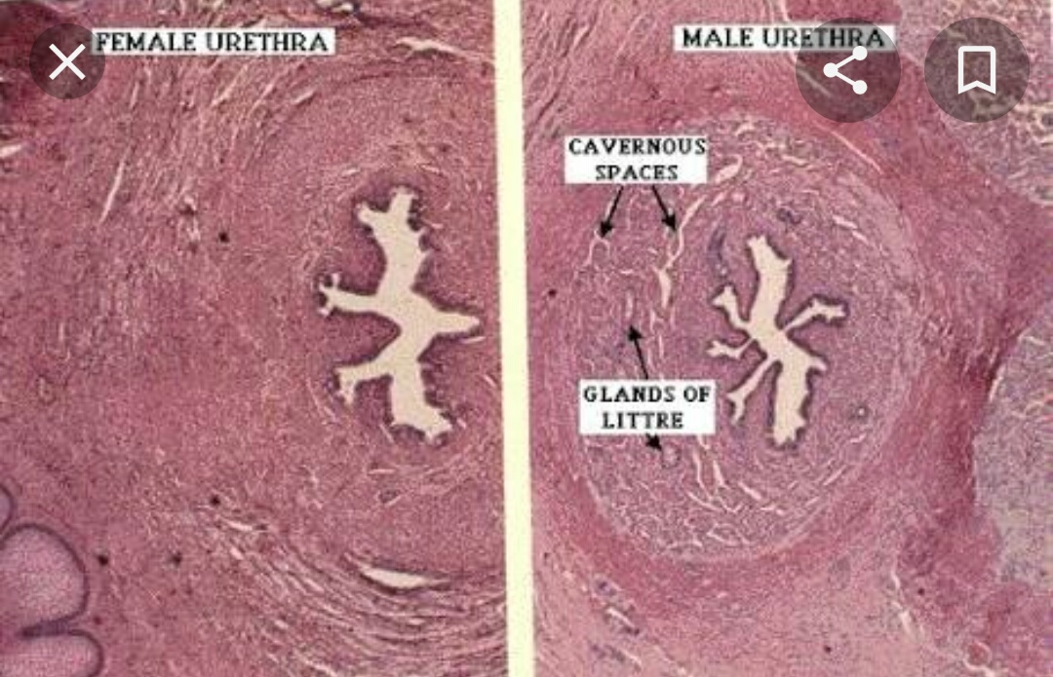
HISTOLOGY OF Urethra

Slide 8
A- PENILE Part- penile part.
Histology
TM- LEM- Transitional epithelium in ruminant and at the urethral opening it becomes stratified squoamous epithelium in others animal having stratified cuboidal epithelium.
LMM- absent
LP+TSM- having dense irregular CT , elastic tissue, smooth muscle fibers & cavernous tissue.
TMM- Inner longitudinal layers and Outer circular layers along with more numbers of bulbo cavernousus muscles.
TA- having loose dense CT , BV Nerves and Lymphatics

Slide 9
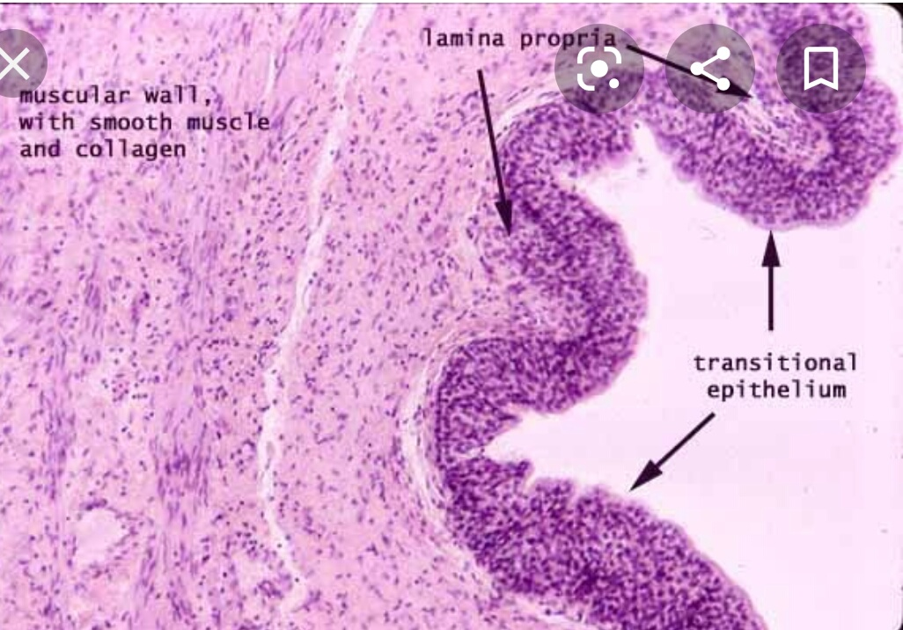
HISTOLOGY OF Urethra

Slide 10
HISTOLOGY OF PENIS
- Common outlet for semen and urine
- having 3 parts- Root, Body & Glans.
Root & Body –Its LEM having Transitional Epithelium.
-Corpus spongiosum, surrounding the corpuscovernous tissue along with more number of erectile tissue & SMF on their dorsal surface.
- Fibro-elastic types in ruminants and boar while in equine carnivores and in human mainly consisted of elastic fibers, erectile tissue, SMF and sinuses.

Slide 11
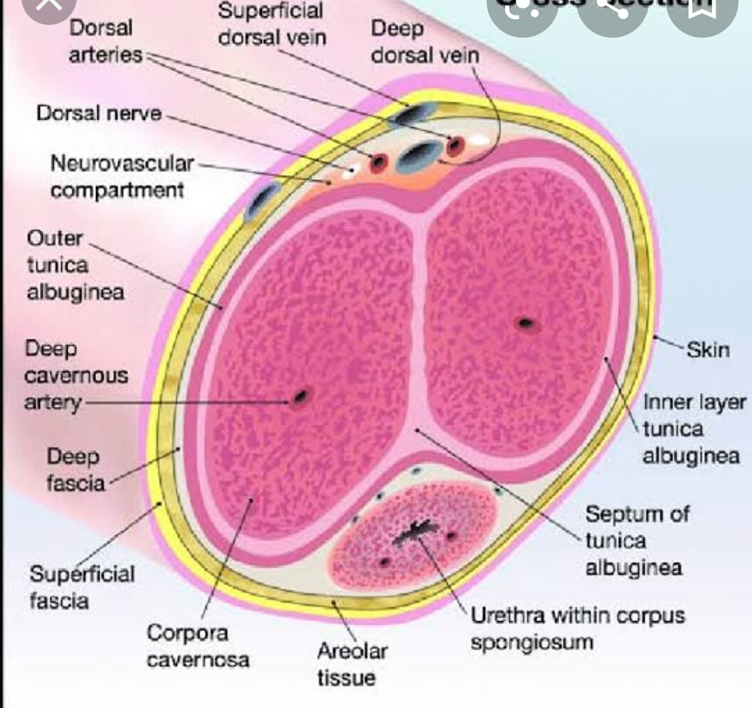
Cross section OF Glans PENIS

Slide 12
HISTOLOGY OF Glans PENIS
- Well developed in Horse, Dog & Man and is
covered by penile portion of prepuce.
-In Equine and Man- It contains more numbers or erectile and vascular tissue while in canine bony tissue and in ruminant fibro-cartilagenus tissue.
TM-LEM-Stratified Squamous epithelium
LMM- absent
LP+TSM- loose CTF
TMM-Erectile tissue TA- BV, Nerves and Lymph.

Slide 13
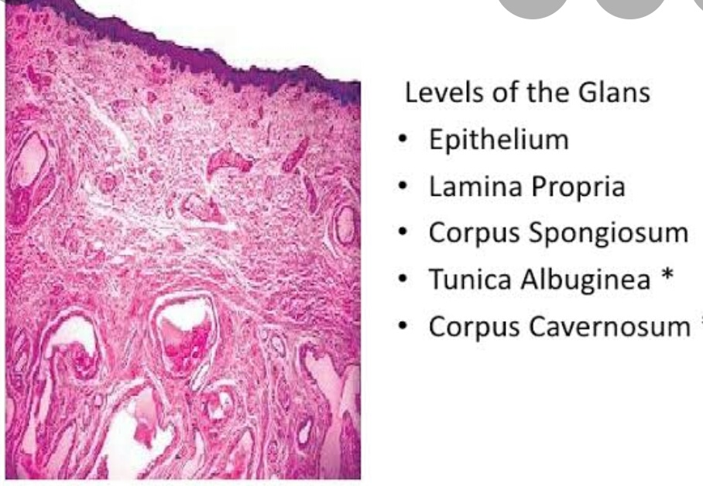
HISTOLOGY OF Glans penis

Slide 14
HISTOLOGY OF prepuce(sheath)
- Tube like fold of skin that’s surround the cranial part penis and glans penis.
Composed of 2 layer External & Internal layer.
-External Layers- more numbers of sebaceous glands.
Internal layer- LEM- Keratinized stratified squamous epithelium, BV, Nerves and Lymphatics.
Near and around the corona glandis in Horse secretory product is called- Smegma

Slide 15
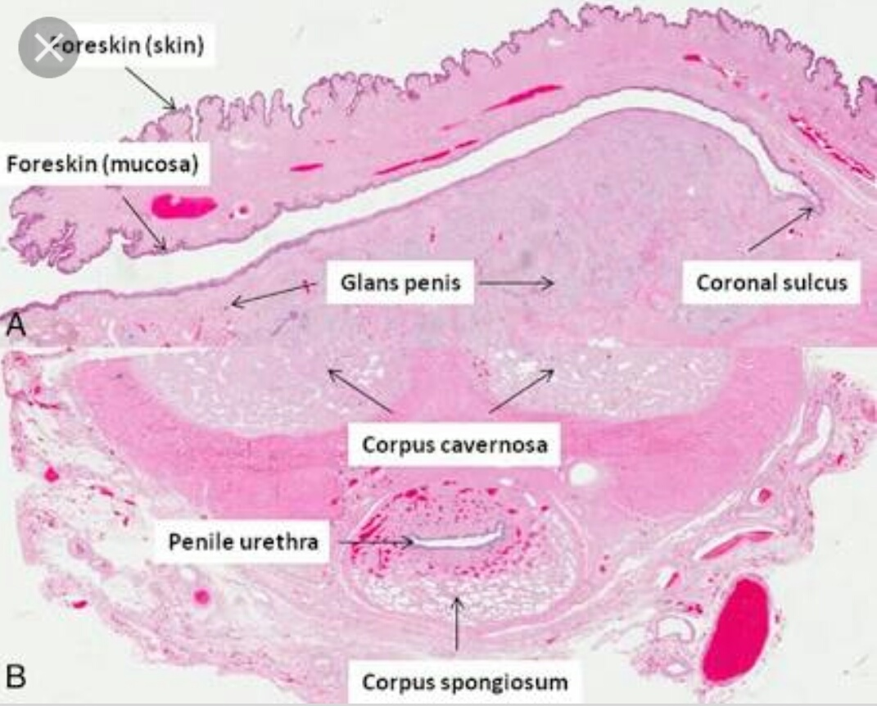
HISTOLOGY OF glans PENIS & prepuce(sheath)

