Slide 1
Department of Veterinary Medicine Bihar Veterinary College, Patna – 800 014 (BASU, Patna)
Hypomagnesaemic Tetany
(Lactation Tetany, Grass Staggers, Grass Tetany)
Dr. Ranveer Kumar Sinha Assistant Professor cum Junior Scientist
E-mail: ranveervet@rediffmail.com

Slide 2
INTRODUCTION
Highly fatal metabolic diseases of lactating ruminants, characterized clinically by hyperaesthesia, tetany, convulsions & death
Incidence :
(a)Species incidence : Cattle (sometimes sheep )
(b) Age incidence : 7-10 years old (5-8 Lactation)
(c) Time incidence : 2-4 months after parturition

Slide 3
INTRODUCTION
(B) Occurrence:
(a) Lactating cattle grazing on lush pastures and green cereal crops ( High potassium levels decreases Mg absorption ).
(b) Lactating cattle fed diet intoxicated with potassium fertilizers or urea (reduces availability of soil magnesium).

Slide 4
PREDISPOSING FACTORS
(a) Starvation : 24-48 hours depress serum magnesium significantly.
(b) Diarrhoea : Reduce magnesium absorption from intestines
(c) Cold weather stress : Increase urinary excretion of magnesium.
(d) Long transport: Depress serum magnesium and calcium.

Slide 5
ETIOLOGY AND PATHOGENESIS
Basic biochemical finding in lactation tetany is hypomagnesaemia 0.5-1.5 mg/dL ( N 1.8 – 2.3mg/dL ).
Mg is a co-factor for certain enzyme like Thiamine
A decrease in Mg:Ca ratio will stimulate secretion of ACh esterase which is responsible for tetanic sign like hyperthesia, muscular tremor, convulsion etc.

Slide 6
CLINICAL SIGNS
(A) Acute form:
1- Sudden onset of hyperaesthesia and muscle twitching
2- staggering in gait followed by falls down with tetany and convulsions.
3- During episodes (attack) there are:
Opithotonus (back-head).
Nystagmus (Rotation of eye ball).
Champing of jaw.
Frothing at from mouth.

Slide 7
CLINICAL SIGNS
(A) Acute form
Between episodes animal lie quiet but any noise or touch starting other attack .
Pulse and respiration accelerated.
Temperature moderately elevated (due to muscular spasm).
Death from respiratory failure.
B) Subacute form :
Same signs of acute but onset gradual and course longer.
(C) Chronic form :
Animal have low serum magnesium but shows no symptoms.

Slide 8
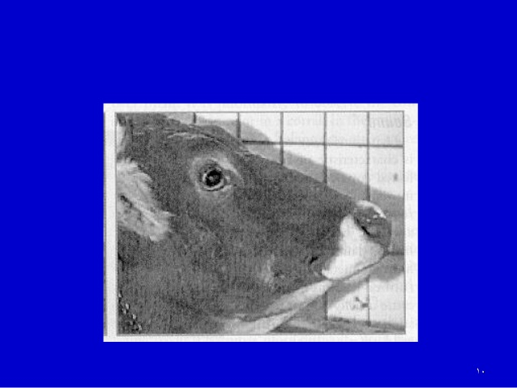

Slide 12
DIAGNOSIS
History:
Clinical signs:
(C) Laboratory diagnosis:
(a) Serum magnesium level
(b) Low urine magnesium level.
(c) Low CSF magnesium level.
(d) Bone biopsy from ribs commonly revealed disturbed Ca: Mag. ratio.
(D) Diagnostic therapy (Therapeutic diagnosis):
Diseased animals respond well to calcium-magnesium therapy.
Differential diagnosis
BSE
Rabies
Encephalomyelitis
Poisoning

Slide 13
TREATMENT
Contraindicated to use Mg compounds alone (may cause cardiac arrest).
Safe therapy to use combined calcium- magnesium preparations as follow:
1- Calcium borogluconate 15% (I/V 500 ml).
2- Followed by: Magnesium lactate 15% (S/C 250 ml).
3- Followed by: Magnesium sulphate (oral 125 gram).

Slide 14
PREVENTION OF THE DISEASE
1- Magnesium supplementation of diet with crude magnesium 60 gm/head which can be mixed with molasses:
2- Magnesium Bullets placed in reticulum for slow liberation of constant traces of magnesium daily for long period as long as several months or even years.

Slide 15
THANKS YOU !

