Slide 1
MAMMOGENESIS Dr Pramod Kumar Bihar Veterinary College Bihar Animal Sciences University Patna

Slide 2
Estrogen stimulates development of mammary ducts, and progesterone and estrogen stimulate proliferation of secretory tissues. Sensitivity of individual cells to progestational inhibition may decrease variably which may be interdependent upon relative increases in estrogen, prolactin, corticoids, and growth hormone to cause asynchronies among them at calving.

Slide 3
Mammary Glands
Mammogenesis continues until termination of pregnancy and overlaps till onset of lactation
Hyperplasia of the ductal and alveolar tissue
Pigmentation of the nipple and the areola

Slide 4
Role of estrogens
Causes the ductal system of the quarter to grow and branch.
Stroma of the udder increase in quantity and large quantities of fat are laid in the stroma.
Growth hormone, adrenal glucocoticoids, prolactin & insulin are also needed for ductal growth.

Slide 5
Circulating estrogens
Increases the number of gap junctions between myometrial cells
Production of prostaglandins
Increase in myometrial contractile proteins
Increase in number of oxytocin receptors

Slide 6
Effect of cortisol
Increase in cortisol formation in the fetus
CRH secretion by the fetal hypothalamus increases cortisol
Increased placental production of CRH.
This increases circulating ACTH in the fetus

Slide 7
Role of progesterone
Acts synergistically with estrogen causes additional growth of the mammary lobules
budding of alveoli
development of secretory characteristics in alveoli cells

Slide 8
Development of mammary gland
Estrogens are primarily responsible for proliferation of mammary ducts
Progesterone are primarily responsible for the development of the lobules
Prolactin is also required for mammary glands development at puberty
Increased prolactin levels, and high levels of estrogens and progesterone (and possibly hCG) cause lobulo-alveolar development during pregnancy
Cortisol, insulin and growth hormone are necessary for mammary development

Slide 9
Growth of mammary gland

Slide 10
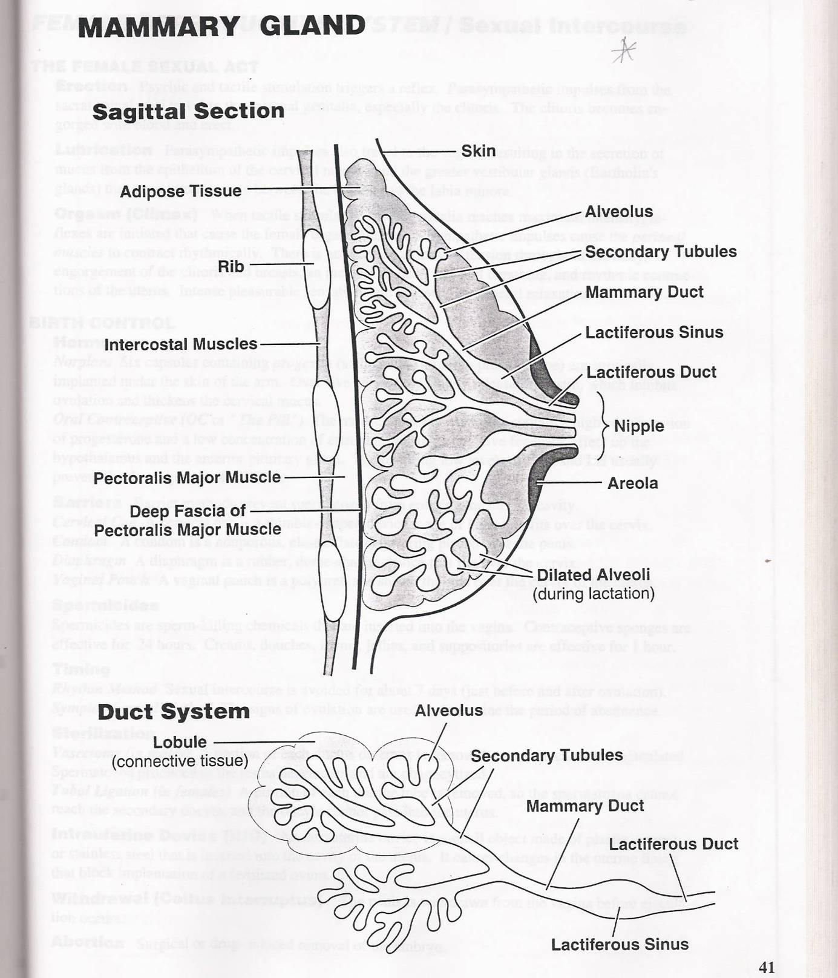
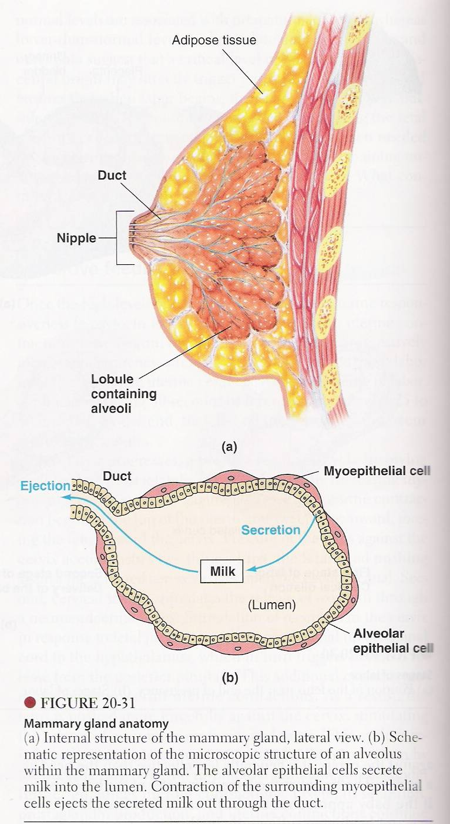

Slide 11
Prolactin – Synthesis and Control
Produced by the lactotrophs cells of the anterior pituitary gland
Under stimulatory control of thyroid releasing hormone
Increased release at night
In females - increased release during puberty
Prolactin levels are high during pregnancy - oestrogen causes an increase in numbers of lactotrophs
During lactation, suckling of the quarter results in an increased release of prolactin ( decreased PIH and increased PRH)
Response to suckling declines with time post-partum, may well remain above normal for 18 months or more if suckling frequency is maintained at a high level basal levels

