Slide 1
Metacentric Height of a Floating Bodies
Dr. J. Badshah
S. G. Institute of Dairy Technology,
Patna -14
(Bihar Animal Sciences University, Patna)

Slide 2
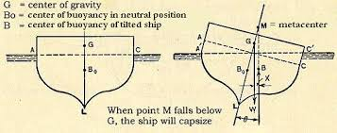

Slide 3
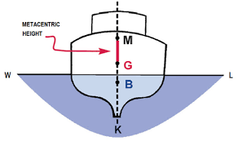
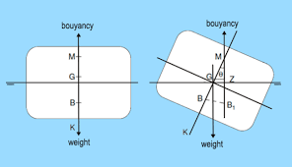
Images showing Metacentric height

Slide 4
Metacentric Height
The metacentric height is a measure of the statical stability of floating Body such as ship.
The distance between centre of gravity G and metacentre M i.e. GM is metacentric height on rolling the stability body by a small angle along the longitudinal or transverse axis.
For a ship to be stable, the metacentric height must be positive.
The magnitude of metacentric height is obtained as under:
If G is above B, MG = BM – BG
If G is below B, MG = BM + BG
The magnitude of the righting Couple = W (MG) Sin θ which determines the stability of ship. To avoid large no. of oscillation, it is desirable that the metacentric height should not be very large. It is therefore, a compromise has to be made between these two.

Slide 5
Metacentric Height
For proper design of ships or other floating vessel, care should be taken that the metacentre is above the centre of gravity for all angles of heel which may be encountered in its use.
As a floating body can be tilted in any direction, it is required to consider tilting about both the longitudinal (ROLLING) axis and transverse (pitching) axis. Usually the tilting about the longitudinal axis is more critical.

Slide 6
Calculation of Metacentric height
If the ship rotates about point O, but for small angle θ,It may be assumed to rotate about M. The volume of the wedge is moving its position and therefore the weight W of the wedge is given by:
W = ϒ ½ L b/2 . b/2 tan θ
As the wedge shifts its position, its centre of gravity moves by a distance 2/3 b. The moment caused by the movement of the wedge is M₁ = W 2/3 b = ϒ ½ L b/2 . b/2 tan θx 2/3 b
= ϒ Lb³/12 tan θ = ϒ I tan θ , where moment of Inertia I = Lb3/12

Slide 7
Calculation of Metacentric Height
The moment M₁ must be equal to moment M₂ caused due to movement of the upward thrust from B to B₁. If V is the volume of water displaced by the ship, U = ϒ V = weight of the ship
The movement caused by movement of upward thrust by a distance BB₁ M₂ = ϒ V . BB₁ = ϒ V . BM tan θ ( because BM/BB1 = tan θ )
When, M1 = M2
ϒ I tan θ = ϒ V . BM tan θ
Therefore BM = I /V and MG= BM – BG, if G is above B and
If G is below B, Metacentric height MG = BM + BG
If the sides are not vertical and plan of the ship is not rectangular, divide the plan into small rectangles and the individual moment of inertias of all small parts are added to get the value of I. or I = k Lb³/12

