Slide 1
Microscopy of excretory system

Slide 2
The urinary system consists of the glandular organs, the kidneys and the excretory passages, the ureter, the Urinary Bladder and the Urethra.
The kidneys are embedded in fat and each kidney is covered by a capsule of dense collagenous fibres and a elastic fibres.
The glandular part consists of peripheral cortex and an inner Medulla.
The Medulla is in the form of renal pyramids whose bases are in contact with the cortex and apices form the renal papillae. The glandular part surrounds a cavity adjacent to the hilus called the renal sinus in which lies the renal pelvis, the dilated origin of ureter.
Microscopy of urinary system

Slide 3
The renal pelvis divides into primary divisions or Major calyces, which in turn divide into minor calyces. Each minor calyx receives a renal papila and the tip of the papilla shows small openings called the area cribrosa.
The cortex forms the outer zone but cortical tissue also projects down into the medulla between the bases of the renal pyramids as the renal columns of Bertini.
The cortical region is subdivided into a pars convoluta or cortical labyrinth containing convoluted tubules and glomeruli and a pars radiata or medullary rays, which are columns of straight tubules, which radiate out ward from the medulla. capsule and the glomerulus together form the Renal or Malphigian corpuscle.
The kidneys are compound tubular concerned with excretion of urine. It consists of excretory or uriniferous tubules, which produce urine, conducting tubules, which convey urine form the kidney to the renal pelvis, and blood vessels

Slide 4
The cortical region is subdivided into a pars convoluta or cortical labyrinth containing convoluted tubules and glomeruli and a pars radiata or medullary rays, which are columns of straight tubules, which radiate out ward from the medulla.
The renal pelvis divides into primary divisions or Major calyces, which in turn divide into minor calyces. Each minor calyx receives a renal papila and the tip of the papilla shows small openings called the area cribrosa.
The cortex forms the outer zone but cortical tissue also projects down into the medulla between the bases of the renal pyramids as the renal columns of Bertini.

Slide 5
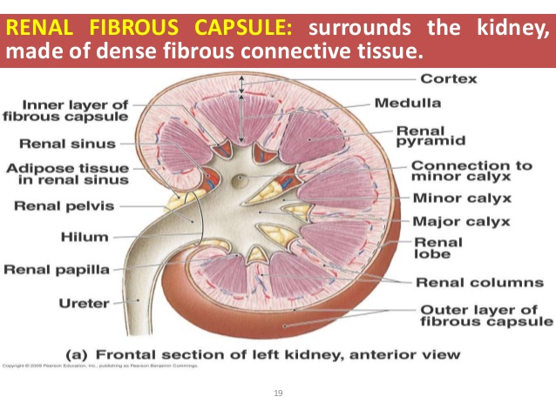
Cross section of kidney

Slide 6
The parenchyma of the kidney consists of uriniferous tubules and related blood vessels and collecting tubules between which are a scanty amount of interstitial tissue.
The structural and functional unit of the uriniferous tubule is called a nephron. Each nephron begins as a spherical expansion known as as Bowman’s capsule, which encloses a tuft of capillaries – the glomerulus.
The Bowman’s capsule and the glomerulus together form the Renal or Malphigian corpuscle. These are distributed in the pars convoluta of the cortex.

Slide 7
Apart from the Bowmans’ capsule the nephron consists of the following segments
Proximal convoluted tubule - a highly tortuous tube in the cortical labyrinth, which passes down into the medulla
The Descending limb of Henle which extends for varying distances into the medulla
The loop of Henle after which it passes up into the cortex
The Ascending limb of Henle.
This reaches the renal corpuscle of its nephron, attaches itself to its vascular pole and is then continued as the distal convoluted tubule in the cortical labyrinth

Slide 8
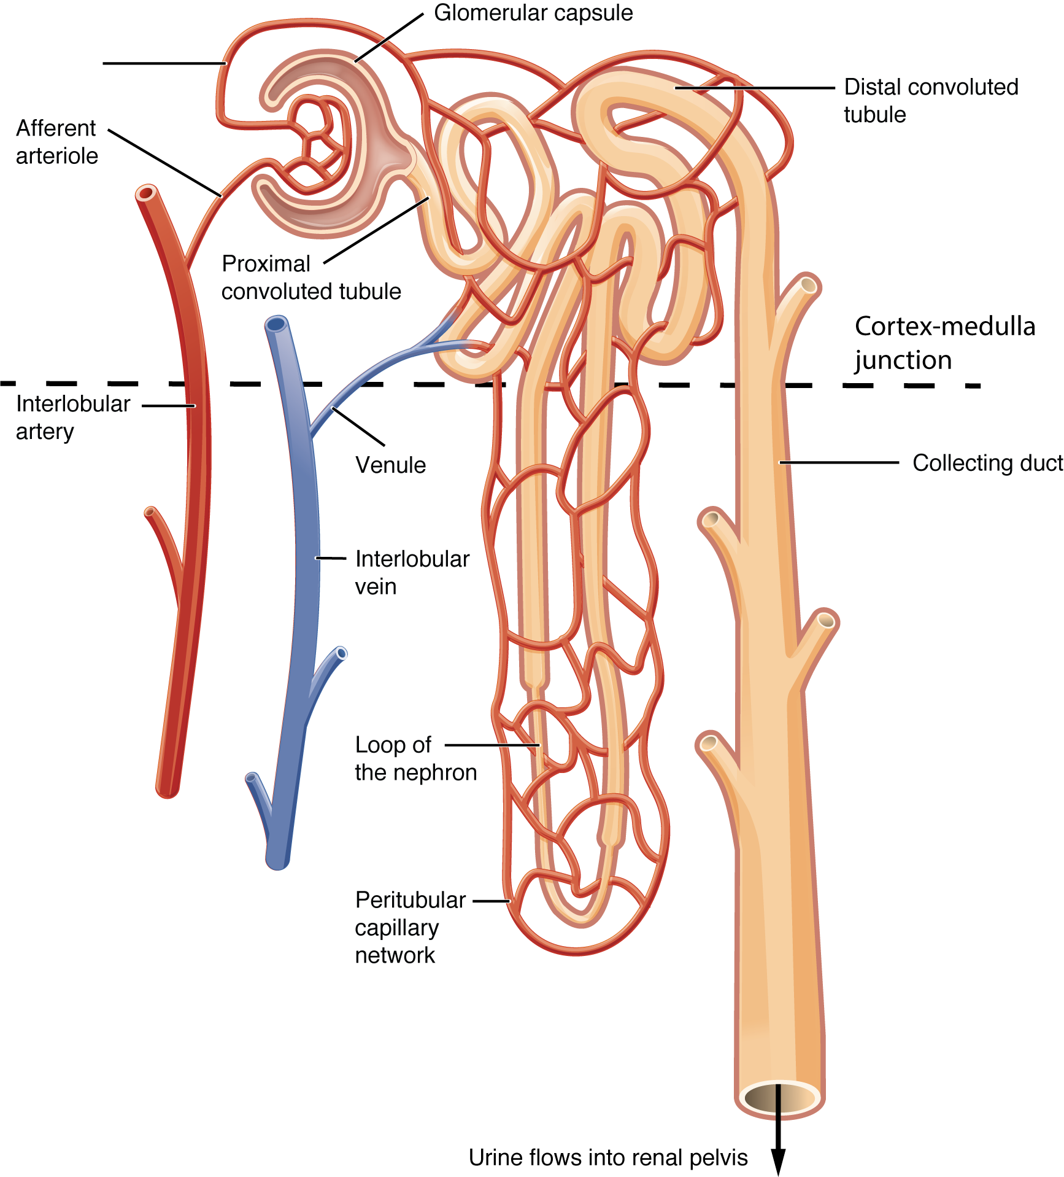
Structure bof nephron

Slide 9
The glomerulus consists of a number of separate capillaries connecting an afferent arteriole with an efferent arteriole. These vessels are usually closer together where they enter and leave the glomerulus and this end is known as the vascular pole of the renal corpuscle.
The endothelial cells of the glomerular capillaries are extremely thin and the cytoplasm is fenestrated. The endothelium rests on a basement membrane, which fuses with the basement membrane of the visceral layer of Bowman’s capsule, which closely invests the glomerulus
The nephron or secretory segment of the renal tubule opens into arched collecting tubule in the cortical labyrinth.
These arched collecting tubules open into straight collecting tubules, located in the pars radiata of the cortex, which pass down the medulla and reach the apex of the renal pyramid and form the papillary ducts of Bellini, which open through the area cribrosa of renal papilla into a minor calyx.

Slide 10
The Bowman’s capsule consists of two layers of epithelium, a visceral layer closely investing the glomerulus and a parietal layer made up of simple squamous epithelium.
Between the two layers of capsule is a space where provisional urine, first formed as glomerular filtrate collects.
The visceral layer of the capsule is made up of cells whose nuclei project into the capsular space and their cytoplasm shows numerous foot-like processes, which are in contact with the basement membrane.
Hence these cells are termed as podocytes. The arrangement of podocytes with the fenestrated endothelium of glomerular capillaries, leave only the basement membranes as the barrier between the blood in the capillaries and capsular space

Slide 11
The afferent arterioles of the glomerulus show special features.
It lacks a distinct tunica adventitia and there is no internal elastic membrane.
In the tunica media instead of plain muscle are myoepithelioid cells having pale staining afibrillar cytoplasm.
These cells exhibit granules demonstrable by special techniques.
These are referred to as the Juxta-Glomerular cells or apparatus (JG cells).
It is now established that these JG cells secrete a substance known as Renin, which acts on hypertensinogen in the blood to form hypertensin (angiotensin), which produces vaso-constriction of blood vessels and increases blood pressure.

Slide 12
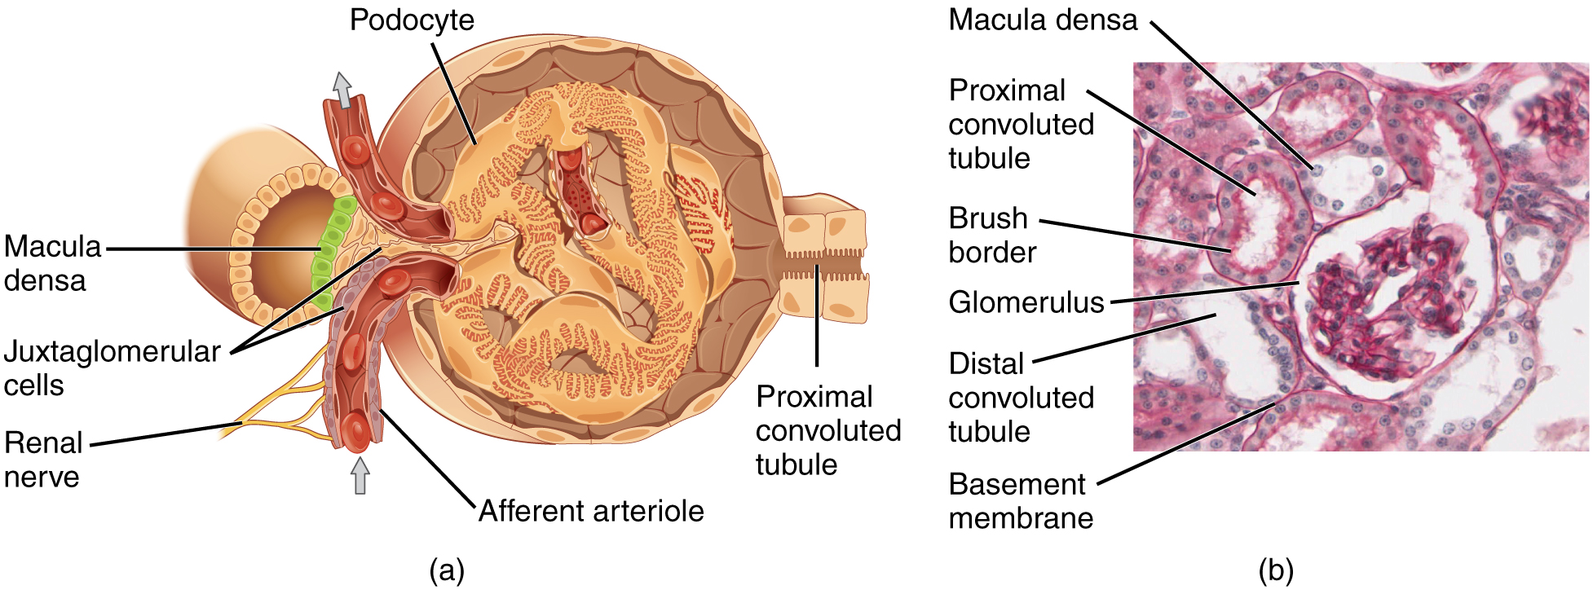
Juxta glomerular cells

Slide 13
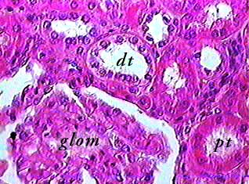
Cortex

Slide 14
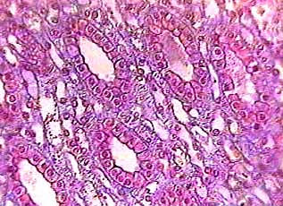
Medulla

Slide 15
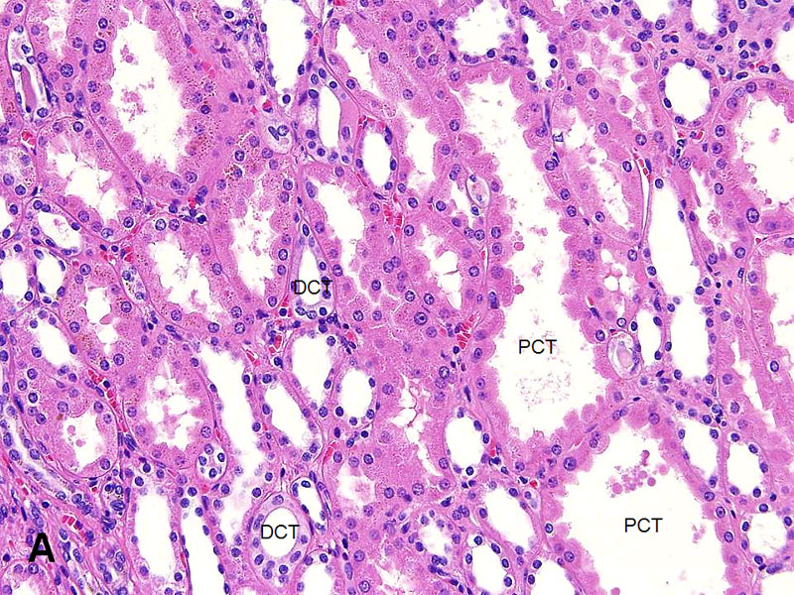
Proximal collecting tubule

Slide 16
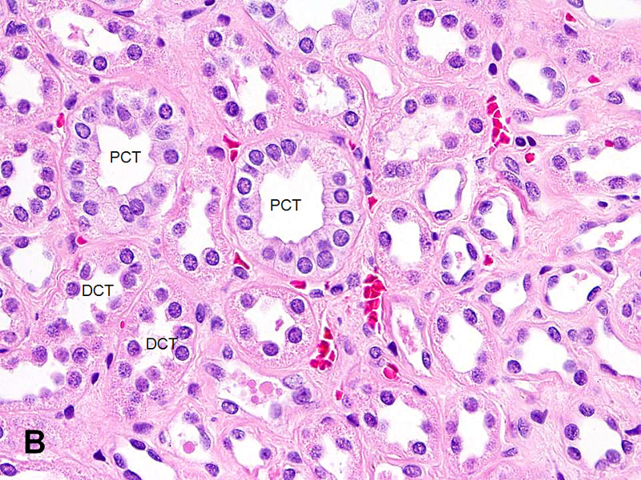
Distal collecting tubule

Slide 17
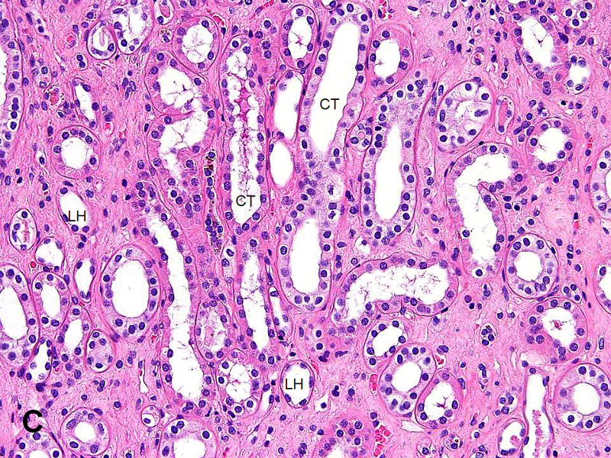
Loop of henle

Slide 18
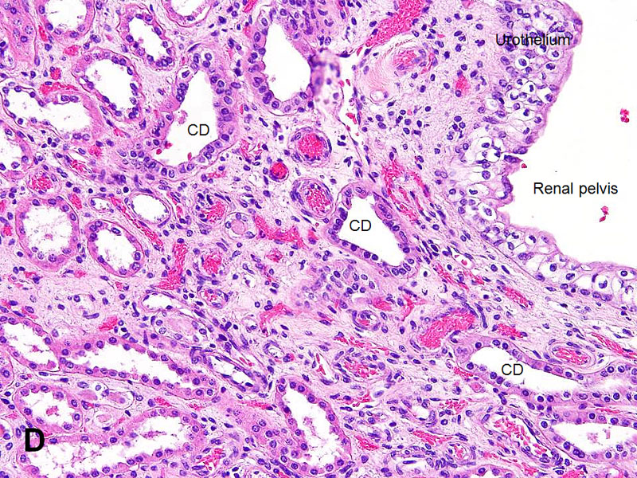
Collecting duct

