Slide 1
Plasmodium
Dr. AJIT KUMAR
HoD
Department of Parasitology
Bihar Veterinary College
Bihar Animal Sciences University
Patna-800014
Image source: Google image

Slide 2
Family: Plasmodiidae
Heteroxenous parasites.
Schizogony occurs in vertebrates and gametogony and sporogony in invertebrates.
Pigment (haemozoin) is usually formed in the host cell except Leucocytozoon spp.
Genus : Haemoproteus, Leucocytozoon and Plasmodium)

Slide 3
Plasmodium
Members are commonly called malarial organism of birds, mammals and man.
Culicine mosquitoes act as vector of bird malaria whereas Anopheline mosquitoes act as vector of mammalian and human malaria

Slide 4
Plasmodium species found in birds & animal
Species | Definitive host | Vector
Plasmodium gallinaceum | Chicken | Culex, Aedes spp.
Plasmodium relictum | pigeon | Culex, Aedes spp.
P. bubalis | Buffalo | Unknown

Slide 5
Zoonotic species of Plasmodium
Species | Definitive host | Vector
P. cynomolgi | Monkey and man | Anopheles spp.
P. knowlesi | Monkey and man | Anopheles spp.
P. simium | Monkey and man | Anopheles spp.

Slide 6
Species of Plasmodium found in man
Species | Vector | Disease
P. falciparum | Anopheles spp. | Malignant tertian malaria or falciparum malaria or Subtertian malaria
P. vivax | Anopheles spp. | Benign tertian malaria or vivax malaria
P. malariae | Anopheles spp. | Quartan malaria
P. ovale | Anopheles spp. | mild tertian malaria

Slide 7
Plasmodium
Sporozoite is the infective stage.
Cryptozoite is called first generation pre-erythrocytic schizonts.
Second generation pre-erythrocytic schizonts are metacrytozoites whereas phaenerozoites are called exoerythrocytic schizonts.
By exflagellation process 6-8 flagella like microgamete occur from macrogametocyte in the mosquito gut.

Slide 8
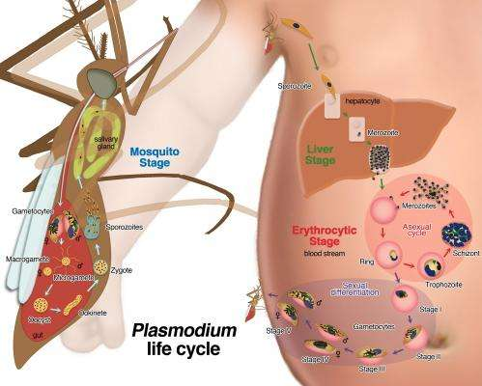
Life- cycle of Plasmodium
Image source: Google image

Slide 9
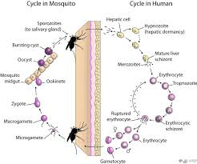
Life- cycle of Plasmodium
Image source: Google image

Slide 10
Plasmodium
A mosquito once infected remains infected for its life span, transmitting malarial parasites every time if it takes a blood meal.
Release of merozoite from RBCs is associated with fever in case of human malaria.

Slide 11
Plasmodium
Fever does not appear to be a characteristic syndrome in avian hosts.
On entering the RBC of vertebrate hosts, the merozoite rounds up to form a trophozoite then signet ring form developed inside the R.B.C.

Slide 12
Plasmodium
Pathogenesis and clinical signs:
Chickens are more susceptible than adult birds.
Symptoms consists of progressive emaciation, anemia, paralysis, cerebral stroke etc.

Slide 13
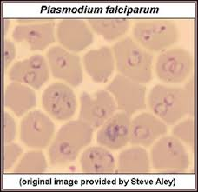
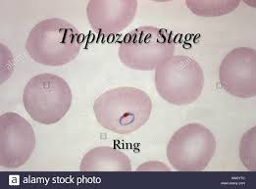
Plasmodium
Diagnosis:-
On the basis of clinical signs.
By demonstration of trohozoites inside the RBCs.
Image source: Google image

Slide 14
Plasmodium
Treatment:
Primaquine
Chloroquine,
Pyrimethamine etc.

Slide 15
Plasmodium
Control:
Primaquine
Chloroquine,
Pyrimethamine etc.

Slide 16
Plasmodium
Control:
Mosquitoes control by regular spraying suitable insecticide at breeding places of mosquitoes.
Avoid water logging around poultry houses as well as human habitats to prevent mosquitoes breeding.
By using prophylactic drug like chloroquine to check the Plasmodium infection.

Slide 17
THANK YOU

