Slide 1
Introduction To chemotherapy Problems That Arises With The Use Of Antibiotics
Dr. Rashmi Rekha Kumari
Asstt. Prof. cum Jr. Scientist
Deptt. Of Vety. Pharmacology and Toxicology
B.V.C, BASU,Patna

Slide 2
Problems That Arises With The Use Of Antibiotics
Toxicity- Local irritancy & Systemic toxicity
Hypersensitivity reaction
Drug resistance
Superinfection
Nutritional Deficiencies
Masking of an infection

Slide 3
Toxicity
Local irritancy: Practically all antimicrobial agents, especially erythromycin, tetracyclines and certain cephalosporins and chloramphenicol are irritants
Systemic toxicity
Drugs having Very Low Therapeutic Index: Used in condition where no suitable alternative is available
Drug | Toxicity
PolymyxinB | Neurological and renal Toxicity
Vancomycin | Hearing loss, Kidney damage
Amphotericin B Kidney, Bone marrow and neurological toxicity

Slide 4
Drugs having lower therapeutic index
Drugs | Toxicity
Aminoglycosides | 8th cranial nerve and kidney toxicity
Tetracyclins | Liver and kidney damage,antianabolic effect
chloramphenicol | Bone marrow depression
Drugs having high therapeutic index: doses upto 100 foldrange may be given without appartent damage to host cell
Example: Penicillin, Erythromycin, cephalosporin

Slide 5
Hypersensitivity/Allergic reaction
These are unpredictable and unrelated to dose
The whole range of reaction from harmless rashes to severe reaction (anaphylactic shock, haemolysis,allergic liver damage and bone marrow depression) can be produced.
The most commonly involved AMAs are-penicillins, cephalosporins, sulphonamides and fluoroquinolones
Penicillin, the commonest cause of drug induced anaphylaxis, produce this response in an estimated 1 in 50,000 patient exposed
Some example of haemolytic reactions are: haemolytic anaemia(sulphonamide), agranulocytosis(sulphonamide, chloramphenicol

Slide 6
Drug Resistance
It refers to unresponsiveness of a microorganism towards an AMA.
Natural Resistance: Some microorganism have always been resistant to certain AMA. Example: Gram –ve bacilli are generally unaffected by Penicillin G. Anaerobic bacteria are resistant to gentamycin.
Acquired Resistance: It is development of resistance by microorganism (which was sensitive before) due to use of an AMA over a period of time.
This can happens with any microbes and is a major clinical problem
Development of resistance is dependent on the microorganism as well as on drug
Some bacteria are notorious for rapid acquisition of resistance eg; staphylococci, coliforms, tubercle bacilli. While Strept. Pyogens have not developed significant resistance to penicillin even widespread use for > 50 years.

Slide 7
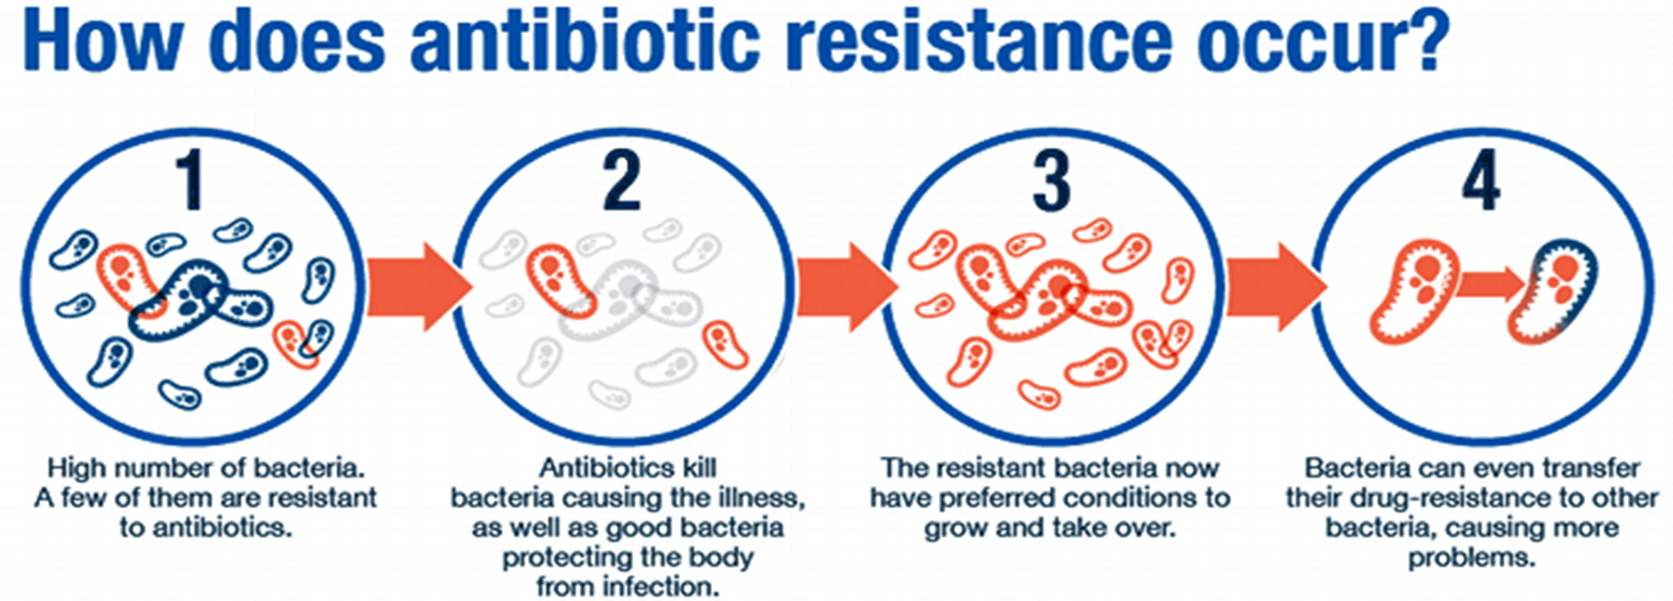
Development of resistance
Resistence may be developed by mutation or gene transfer
Mutation: Stable and heritable genetic change that occur that occurs spontaneously and randomly among microorganism.

Slide 8
Mutation and resistance may be i) Single step ii) Multistep
Single step: A single gene mutation may confer high degree of resistance; emerges rapidly, e.g. Enterococci to streptomycin, E.coli and Staphylococci to rifampin
Multistep: A number of gene modification are involved; sensitivity decreases gradually in a stepwise manner. Resistance to erythromycin, tetracyclines and chloramphenicol is developed by many organism in this manner
Sometimes mutational acquisition of resistance is accompanied by decrease in virulence.

Slide 9
Antibiotic resistance in bacteria spreads at three levels
By transfer of bacteria between people
By transfer of resistance gene between bacteria (usually on plasmids)
By transfer of resistance gene between genetic elements within bacteria, on transposons
Plasmids :are extrachromosomal genetic element that can replicate independently and can carry gene coding for resistance to antibiotics. Such plasmids refered as R plasmid.
The main method of transfer of R gene from one bacterium to other is by conjugative plasmid, which can cause the bacterium to make connecting tube between bacteria through which plasmid itself can pass.

Slide 10
Gene transfer
Resistance may also occure by horizontal transfer of r gene between the bacteria by i) conjugation ii) Transduction iii) transformation
Conjugation: Sexual contact through the formation of a bridge or sex pilus is common among gram –ve bacilli of the same or another sp. This may involve chromosomal or extrachromosomal (plasmid) DNA
The gene carrying the resistance or R factor is transferred only if another resistance transfer factor is also present. Conjugation frequently occur in colon where large variety of gram negative bacteria come in close contact.
Even non-pathogenic organism may transfer R factor to pathogenic organism which may become widespread by contamination of food or water.

Slide 12
A less common method of transfer of R gene is by Transduction i.e. the transfer of an r-gene carrying plasmid into a bacterium by a bacteriophage.
The R factor is taken up by bacteriophage and delivered to another bacterium which it infect
Many Staph aureus strain have acquired resistance by transduction
Transformation: A resistant bacterium may release the resistance carrying DNA into the medium and this may be imbibed by another sensitive strain becoming unresponsive to drug. This mechanism have no clinical significance.

Slide 14
Resistant organism can be of thee type-
Drug tolerant: Loss of affinity of target biomolecule of the microorganism for a particular AMA. e.g., certain penicillin resistant pneumococcal strains have altered penicillin binding proteins.
Drug destroying: Resistant microorganism elaborate an enzyme which inactivate the drug. Beta lactamase for β lactam antibiotics, Acetyl transferase which inactivate chloramphenicol, Kinases inactivates Aminoglycosides.
Drug impermeable: Many hydrophilic antibiotics gain access into the bacterial cell through specific channel formed by protein called porins or need specific transport mechanism. These may be lost by the resistant strain. Bacteria may aquire plasmid directed efflux protein in their cell membrane.
Notes:
The resistant

Slide 17
Prevention of drug resistance
No indiscriminate and inadequate or unduly prolonged use of AMAs should be made.
Prefer rapid acting and selective(narrow spectrum) AMA whenever possible
Use combination of AMAs whenever prolonged therapy is undertaken, e.g. tuberculosis, SABE.
Infection by organism notorious for developing resistance, e.g. Staph aureus, E. coli, M. tuberculosis, Proteus etc must be treated extensively.

Slide 18
Thank You

