Slide 1
Structure of Muscle
(A part of Unit IV- 3rd Prof. Year)
Dr. Gargi Mahapatra
Asst. Prof. cum Jnr. Sc.
Dept. of Livestock Products Technology
Bihar Veterinary College
BASU, Patna.

Slide 2
What is muscle?
It is a tissue of the body which is composed of cells/fibres and has the ability to contract and expand. This capability when stimulated becomes the reason for its primarily function which is:-
“Movement”

Slide 3
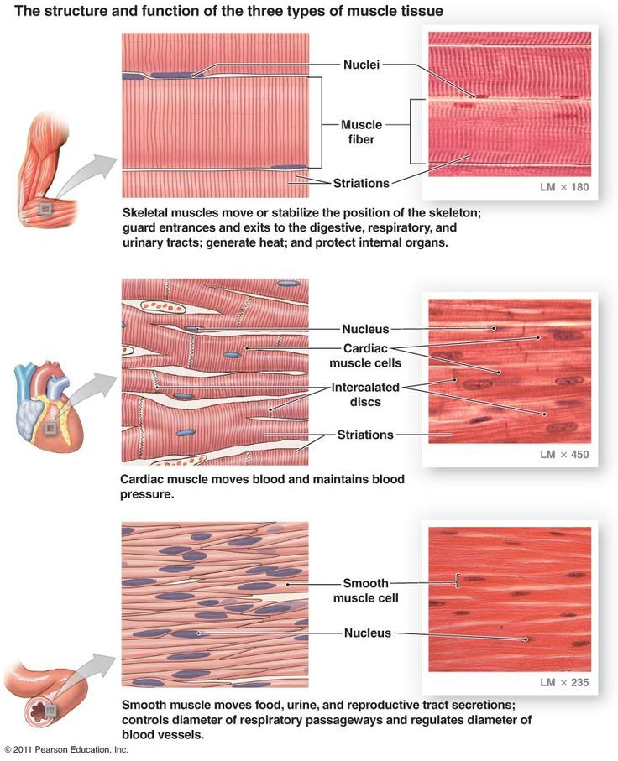
Types of Muscles
Depends upon its position and functioning.

Slide 4
Biochemical Composition of Muscle Tissue
Water
(75%)
Protein Lipids Miscellaneous
(19%) (2.5%) (2.3%)
Carbohydrates Vitamins
(2.5%) (minute quantities)

Slide 5
Contd…
Water 75% | Protein 19% |  |  | Lipids 2.5% | Carb. 2.5% | Miscellaneous 2.3% |  | Vitamins Minute qu.
 | Myofibrillar 11.5% | Sarcoplasmic 5.5% | Connective tissue 2.0% | Neutral lipids | Glycogen | Nitrogenous subst. | Inorganic subst. | Water sol. | Fat Sol
 | Myosin 50-55% | Haeme pigment (Myolobin) | Collagen |  |  | Creatinine | Macro Elements | Vitamin B complex | Vitamin A
 | Actin 20-25% |  |  | Phospholipids | Glucose-6-phosphate
 | Tropomyosin 8-10% | Oxidative enzymes
 |  |  |  |  |  | Ionosine Phosphate | Micro Elements |  | Vitamin D
 | Troponin 8-10% | Mitochindrial oxidative enzymes | Reticulin | Cerebrosides | Glucose
 | C protein 2-2.5%
 | M protein 4.0% | Lysosomal enzymes |  |  |  | Nucleostides | Trace Elements |  | Vitamin E
 | Alpha actinin 2-2.5% | Nucleo-proteins | Elastin | Cholesterol | Lactic Acid | Carnosine
 | Beta Actinin 1-1.5% |  |  |  |  | Anserine etc. |  |  | Vitamin K

Slide 6
Macroscopic and Microscopic Structure of the Muscles
The muscles (bundle) is connected to the bone via tendon
Each muscle(bundle) is covered by a sheath known as epimysium
A septa of connective tissue known as perimysium penetrates and surrounds the bundle of muscle fiber (fasculi). This bundle contains major blood vessels and nerves.
Each muscle fiber individually is surrounded by a connective tissue layer called the endomysium
Part I

Slide 7
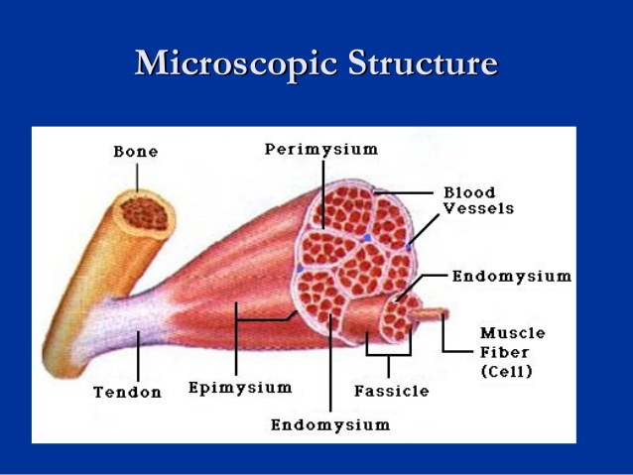
Macroscopic and Microscopic Structure of the Muscles
Beneath the endomysium is the delicate muscle cell membrane known as the sarcolemma.
Under the sarcolemma are the nuclei and sarcoplasm. In this sarcoplasm myofibrils are embedded
Part II

Slide 8
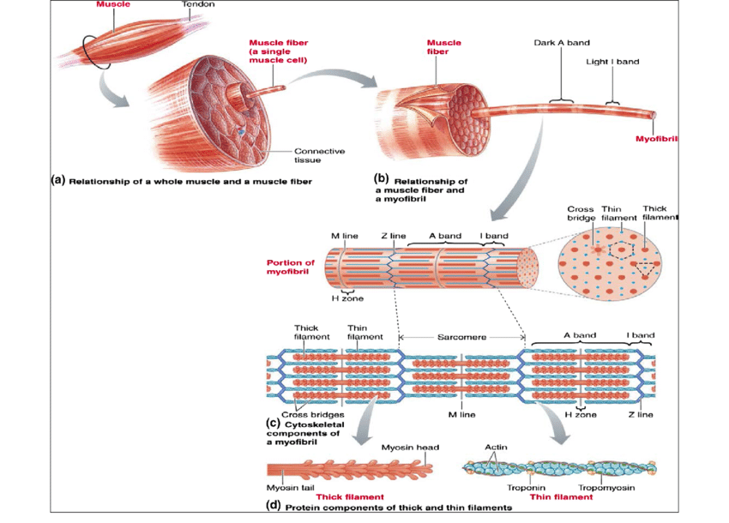
Sarcomere is the unit of the muscle fibre and it’s the distance between two z lines
Detailed
Microscopic
Structure
of
the
Sarcomere

Slide 9
Terminologies of Muscle Structure
Thick Band: The myosin molecules are known as thick filaments
Thin Band: The thin bands consist mainly of actin molecules.
Dark Band: The portion in sarcomere where both the actin and myosin overlap one another.
Light Band: The portion in sarcomere where only the actin molecule is present.
H Zone: The portion in the sarcomere where only the myosin molecules are present.
M Line: An imaginary line bisecting the H zone.
Z Line: An imaginary line bisecting the actin molecule.

Slide 10
Important Points
Smooth Muscles
Myofibrils are homogenous and do not show alternating light and dark bands.
There is no Z line or M line.
The sarcoplasmic reticulum is not much developed
Cardiac Muscles
Myofibrils depict striations similar to skeletal muscles.
Sarcoplasm shows a large number of mitochondria.
Intercalated discs are present at the position of Z-Line

Slide 11
Thank
YOU

