Slide 1
VAN-608 EMBRYOLOGY
Topic - General embryology
(Implantation of Embryo
& Development of Placenta)
Course Instructor – Dr. Manoj Kumar Sinha
Department of Veterinary Anatomy

Slide 2
DEVELOPMENT OF PLACENTA Recall the previous classes and start from zygote formation : to the placenta formation

Slide 3
DEVELOPMENT OF PLACENTA
The placenta is a foetomaternal composite structure formed by the association of embryo and extra embryonic membrane with uterine tissue for exchange of food materials , oxygen and waste materials
Placenta develops from two sources:
Foetal part – From chorio-allantoic membrane
Maternal part – From Endometrium (decidua basils)
Placenta begins to develop upon implantation of the blastocyst into the maternal endometrium (That means development of placenta starts when blastocyst attached to the endometrium)
Once blastocyst is embeded in the endometrial wall, endometrium changed into Decidua and secretory activity of endometrium started, glycogen and lipids are stored and vacuole appear into the stroma
Placenta grows throughout the pregnancy

Slide 4
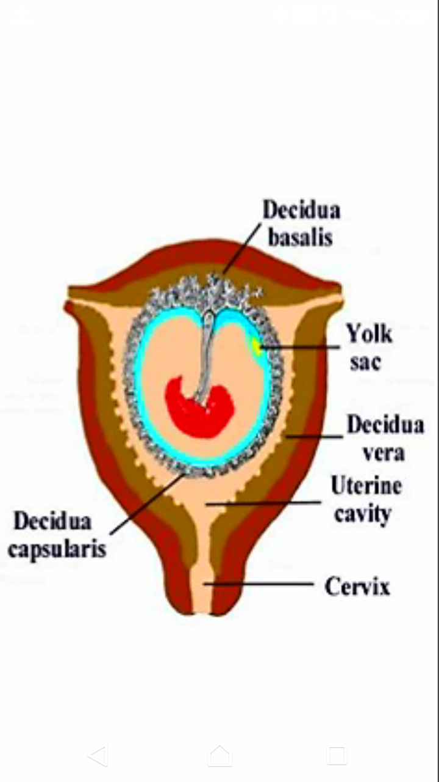
Decidua
Decidua (cells loaded with lipid and glycogen) is the term for the uterine lining (endometrium) during a pregnancy (endometrium changes into functional part which is more vascular and more fuctional called decidua)
Three layer:
Decidua basils : where the implantation takes place and the basal plate is formed
Decidua capsularis : lies like a capsule around chorion
Decidua Parietalis/vera : on the opposite uterus wall
1.
3.
2.

Slide 5
Implantation
The embryo along with extra-embryonic membranes are called Conceptus and attachment of conceptus to the endometrium is Implantation
Implantation occur in three phases: Apposition
Adhesion and
Attachment
Embryo got nourishment in uterine tube by its own yolk and secretion from oviducts
In uterus embryo derive nutrition from uterine fluid , uterine fluid consists of cellular debries, extravasated poly-morphonucleocutes and secretion of endometrial gland called uterine milk (histotrophs)
Implantation is slow and gradual process in domestic animals
There is marked species difference in time of implantation, gestation period and litter size

Slide 6
Species | Time of implantation | Gestation period (in days) | Litter size
Cow | 28-35 | 282 (277-290) | 01
Ewe | 17-20 | 148 (144-152) | 1-2
Sow | 17-24 | 114 (110-116) | 08-12
Mare | 49-70 | 338 (330-345) | 01
Bitch | 14-21 | 61 (58-64) | Multiple
Cat | 14-21 | 64 (60-68) | 04

Slide 7
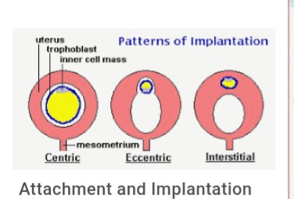
Types of Implantation
Three types of Implantation:
Superficial/Central: The chorionic vesicle remain within uterine cavity and expands to fill its lumen Ex. Domestic Animals
Ecentric : The chorionic vesicle become partially embeded in pockets of the uterine wall Ex. Rat , Squirrel
Interstitial : The blastocyst penetrate into the wall of uterus and develops there until parturition Ex. Primates
1.
2.
3.

Slide 8
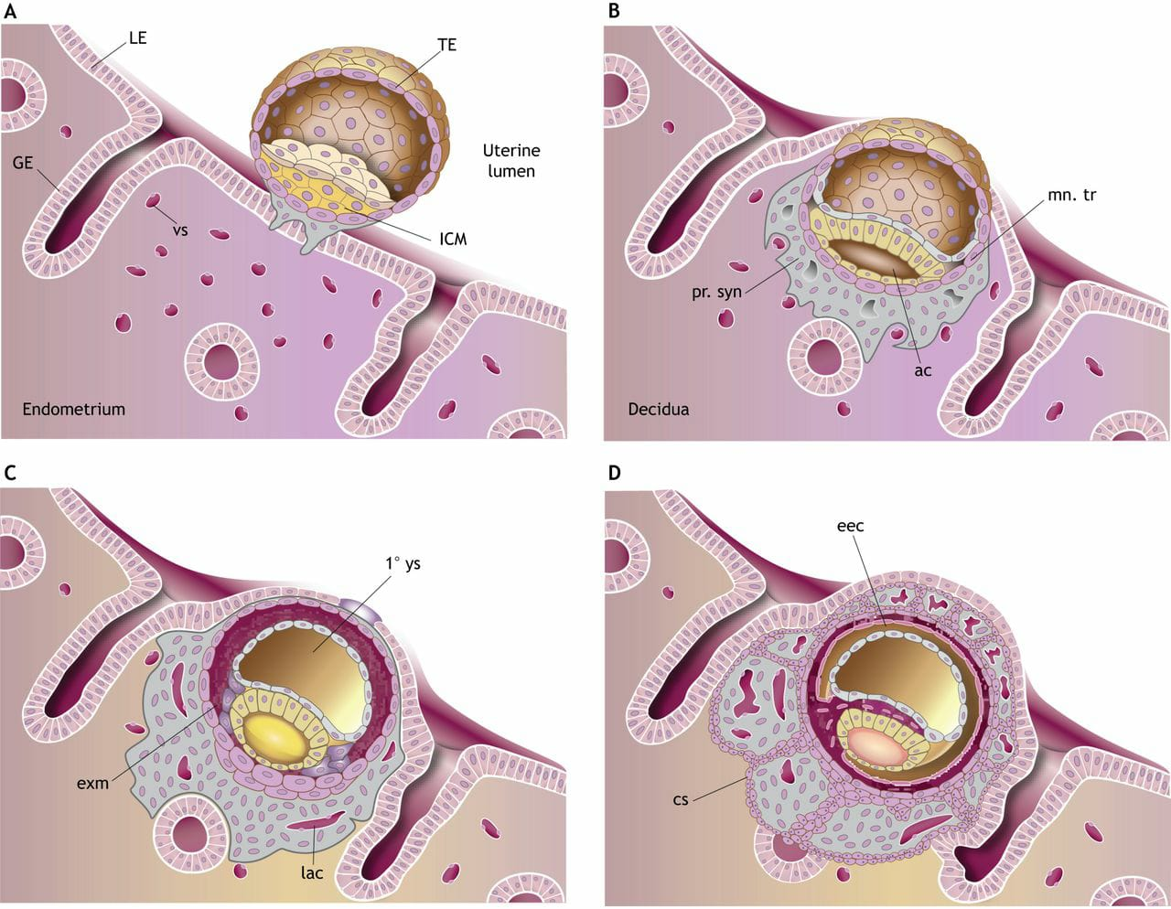
Implantation

Slide 9
Continue..
At the time of implantation Zona pellucida becomes disappear
The trophoblastic layer differentiates into two parts:
Inner layer - Cytotrophoblast
Outer layer - Syncytotrophoblast
Syncytotrophoblast proliferates into multilayered, multinucleated protoplasmic mass
Cytotrophoblast differentiates into layer of primary mesoderm
Cytotophoblast
Syncytotrophoblast
Primary mesoderm
CHORION

Slide 10
Continue..
Inside syncytotrophoblast a number of lacunar spaces appear and syncytial cells form cords between the lacunar space, called Trabeclae
Cords of cytotrophoblast invade the trabeculae and convert into Primary chorionic villi , lacunar space are now called intervillous space
Primary chorionic villi are transformed into Secondary chorionic villi when primary mesodermic layer invade into the primary villi
Secondary villi are transformed into Tertiary villi when the foetal blood vessels appear within primary mesoderm and their branches project into secondary villi
Later on within primary mesoderm vacuoles are appeared subsequently they coalase to form extra-embryonic coelome between amniotic cavity and primary mesoderm

Slide 11
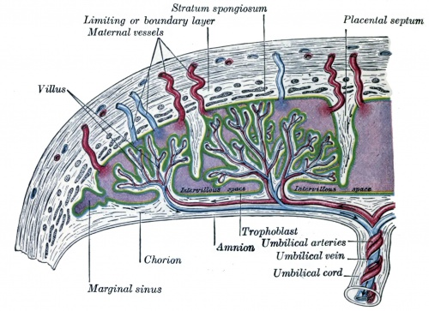

Slide 12
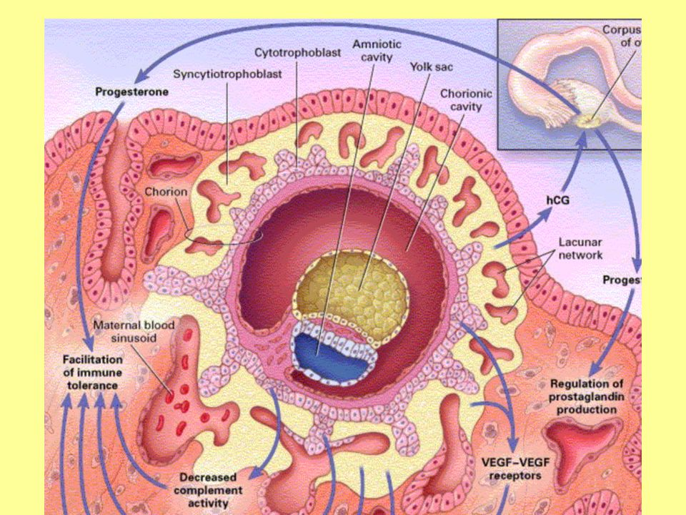

Slide 13
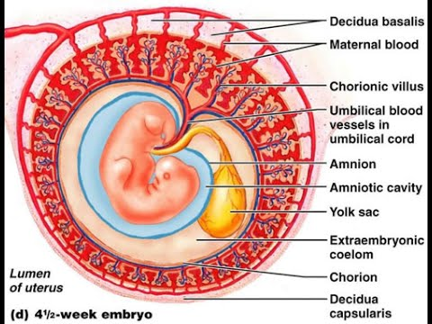

Slide 14
Continue…
In Birds and in some Farm animals like Cattle, Sheep, Goat and Pig the allantoic vesicle expands into the extroembryonic coelom and surrounds the whole amniotic cavity
It occupies the space between the amnion and the chorion (serosa), the outer wall of amnion fuses with chorion and therefore forms Chorioallantioic Type of Placenta
The amniotic cavity contains Amniotic fluids within which embryo becomes float. Amniotic fluid contains salt, water, protein and sugar . It gives protection to the foetus by neutralizing shock and pressure. It also acts as lubricants at the time of birth
At the time of birth the placenta is discarded along with the amnion and referred as Afterbirth

Slide 15
Continue…
In Bovines, attachment between maternal and foetal membranes occur throughout the endometrium of the horn in the sporadic manner as per distribution of cotyledones
In Sow and Mare the union of chorion and uterine wall is superficial and their separation at the time of birth without injury to maternal tissue this type of placenta is called Deciduate placenta
In Carnivores The villi occupy on the girdle like band around the middle of chorionic sac
In Humans, The chorionic villi develop rapidly at the embryonic pole of blastocyst called chorionic frondosum
In Primates The union between foetal and maternal tissue is so intimate and damage of uterine tissue at the time of birth, that's why there is extensive bleeding at the time of birth in primates

Slide 16
Continue…
Exchange of metabolites occurs directly through foetal and maternal blood circulation
There is no direct mixing of foetal and maternal blood in placenta
The chorio-allantoic placenta directly absorb nutrition from maternal blood is called Haemotrope
Therefore placenta formation (contact between foetal membrane and endometrium) occurs in various zones which differs characteristically depending upon the species
Types of placenta in next class……

Slide 17
THANK YOU
For your kind attention….

