Slide 1
VBC-605
UNIT I
Mechanisms: Enzyme activation energy and reaction co-ordination, acidbase, covalent, metal ion, Proximity and orientation effects, Preferential transitional state binding

Slide 2
Reaction Rates and the
Transition State
♦Enzymes speed up reactions enormously.
♦To understand how they do this, examine
the concepts of activation energy &
the transition state.
♦In order to react, the molecules involved
are distorted, strained or forced to have
an unlikely electronic arrangement.
♦That is the molecules must pass through a
high energy state.

Slide 3
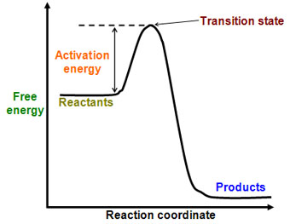
♦This high energy state is called
the transition state.
♦The energy required to achieve it is called
the activation energy for the reaction.
♦The higher the free
energy change for the
transition barrier,
the slower the
reaction rate.
Most stable product is the one with the lowest energy
Energy diagram for a
single-step reaction

Slide 4
Transition state
high energy, unstable state in which a molecule is best suited to undergo a chemical reaction; state in which chemical bonds are being broken and formed.
Linus Pauling postulated that the only thing that a catalyst must do is bind the transition state more tightly than the substrate
Old bonds break and new ones form
Substance is neither substrate nor product
Unstable short lived species with an equal probability of going forward or backward
Strained intermediate

Slide 5
Enzymes lower energy
barrier by forcing the
reacting molecules
through a different
transition state.
This transition state
involves interactions
with the enzyme.
Enzyme

Slide 6
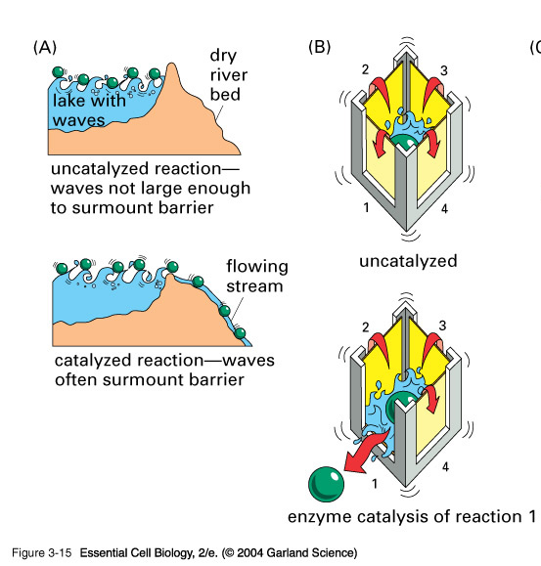
Floating ball analogies for enzyme catalysis

Slide 7
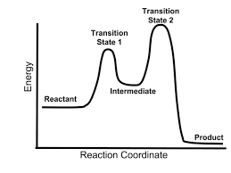
Energy diagram for
reaction with intermediate
Intermediated occurs in between the two transition states
In this case, the rate determining step in the forward direction is formation of the second transition state

Slide 8
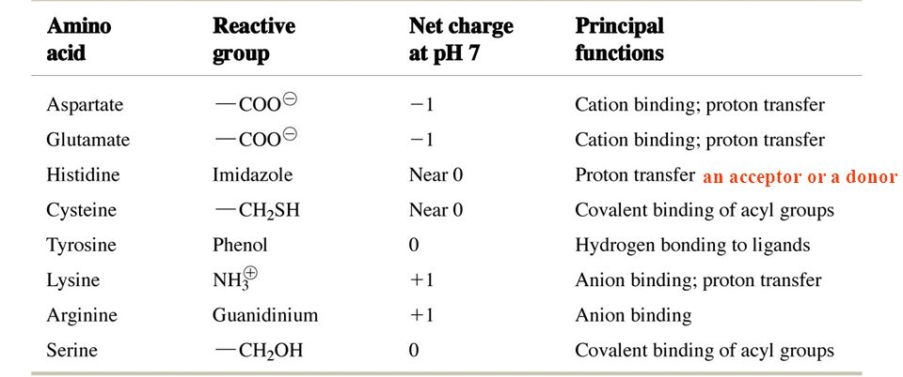
Catalytic functions of reactive groups of ionizable amino acids

Slide 9
Reaction intermediate--- transient chemical species
Rate limiting step
Lowering activation energy is by binding energy

Slide 10
Modes of Enzymatic
Enhancement of Rates
1) general acid and general base
catalysis-- good proton donors
& acceptors positioned just right.
2) covalent catalysis- unstable intermediate
– cysteine, serine, histidine
3) metal ion catalysis
- electron donor or acceptor

Slide 11
Acid- Base Catalysis
General base catalysis- acceleration of a reaction by transfer of a proton
B: = base (proton acceptor)
BH+ = conjugate acid (proton donor)
A general base (B:) can act as a proton acceptor to remove protons from OH, NH, CH or other XH
This produces a stronger nucleophilic reactant (X:-)

Slide 12
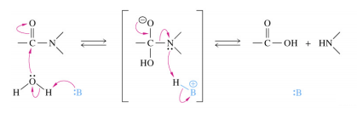
Specific Base Catalysis
can remove a proton from water and thereby generate the equivalent of OH- in neutral solution
General Acid Catalysis/ Specific Acid Catalysis
Proton donors can also catalyze reactions
Many biochemical reactions require acid base catalysis
Hydrolysis of peptides
Reactions with Phosphate groups
Tautomerizations
Additions to carboxyl groups

Slide 13
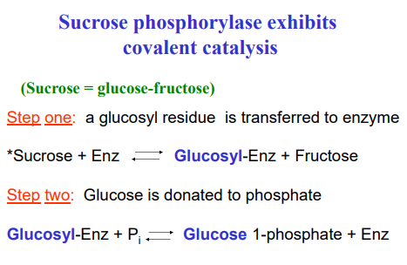
Covalent catalysis
involves the formation of a transient covalent bond between the catalyst and the substrate
Group X can be transferred from A-X to B in two steps via the covalent ES complex X-E

Slide 14
Metal ion catalysis/electrostatic catalysis
either assist in the catalyic reaction,
activate the enzyme to begin the catalysis
can inhibit reactions in solution
Common metals that take part in metal ion catalysts are copper and zinc ion
They participate in one of three ways:
a. They bind substrates to orient them for catalysis
b. Through redox reactions gain or loss of electrons
c. electrostatic stabilization or negative charge shielding
It can stabilize the unstable transition state
Metal ions are effective catalysts because unlike protons they can be present at higher concentrations at neutral pH and have charges greater than 1.

Slide 15
Proximity & Orientation Effects
Substrate binding has additional effects that enhance reaction rates
Most obvious is proximity & orientation
Reactants must come together with the proper spatial relationship for a reaction to occur
Proximity effects (minor) are most readily observed by comparing equivalent inter- and intramolecular reactions
Intramolecular reactions are typically 10-100 fold more rapid Orientation effects are more significant though difficult to quantify

Slide 16
Preferential Transition State Binding
Enzymes bind the transition state with higher affinity than the substrate or product
explains why reactions proceed and products are released
explains why transition state analogues are excellent competitive inhibitors
together with proximity and orientation effects, accounts for bulk of rate enhancement in many enzymes
Enzyme mechanically strain substrates towards transition states (rack mechanism)
rate enhancement can be expressed in terms of enzyme affinity for transition state compared relative to substrate
explains why good and bad substrates typically have similar Km value but different kcat values
A good substrate does not need to bind tightly to the enzyme but must bind tightly when activated to the transition state

Slide 17
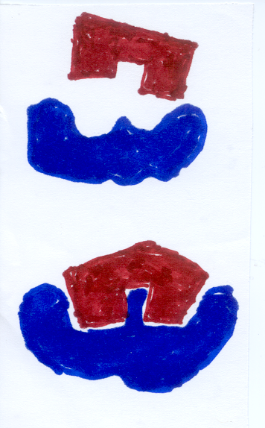
Models of Enzymatic reaction
Lock & Key Model- Fischer
Induced fit- Koshland
enzyme changes its
conformation to accept the transition state
of substrate/product well.
Substrate strain theory
♦Enzyme conformational
change simultaneous, works to distort and strain substrate forcing it into transition state

Slide 18
Enzyme Units
Expressed in terms of the activity
One International Unit- the amount of Enzyme that catalyzes the formation of 1 micromole of product in 1 minute
Katal- amount of enzyme catalyzing the conversion of 1 mole of substrate to product in 1 second
1 katal = 6 X 10⁷ international units

