Slide 1
Mycotoxicosis in Poultry VPP 610
Imran Ali
Asst.Professor
Veterinary Pathology
Bihar Veterinary College, Patna

Slide 2
Salmonella infections
The fungi has been known to secondary toxic metabolites i.e. mycotoxicosis
Compound of such toxin leads to development of disease syndrome is known as mycotoxicosis

Slide 3
Pullorum Disease
Sources: Ground nut cake and maize are most common source of mycotoxicosis.

Slide 4
AFLATOXICOSIS
Aflatoxins are highly toxic mycotoxins produced by various species of fungus Aspergillus. The fungus
produces aflatoxin in warm, high humidity conditions, such as rainy season. Aflatoxins can withstand extreme environmental conditions and are very heat stable.
Aflatoxin contamination is therefore more common in
grains in a tropical country like ours. Young birds are more sensitive to aflatoxin than adults.

Slide 5
Harmful Effects of Aflatoxin
Affects weight gain
Affects feed intake
Affects feed conversion efficiency
Affects egg production
Affects male and female reproductive performance
Increases susceptibility to infectious diseases due to immuno suppression. That is, suppression of the
immune response.

Slide 6
Egg size, yolk weight, and yolk as percentage of total egg size, are decreased.
Even less than 100 ppb in broilers, can result in poor feed conversion and reduced
weight gain, which may be due to liver damage and reduced nutrient absorption.

Slide 7
Pathogenesis
Aflatoxin are observed in intestinal tract.
Liver cells take up the AF from blood .
Liver show fatty changes, congestion, necrosis and proliferation of bile duct epithelium.
Fibrosis may developed.
Kidney may also show swelling,necrosis and glomerulo filtration.

Slide 8
Bursa of Fabricious may be atrophied.
Heart muscle haemorrhages.
AF symptoms the immune system leading to increase susceptibility to disease.

Slide 9
Symptoms
In growing birds, there is decreased growth and poor feed conversion.
There is also marked decrease in the resistance of birds to infections, such as coccidiosis and IBD due to immuno suppression.
Affected hens have decreased egg production.
Also, the hatchability of eggs is reduced.

Slide 10
Postmortem Findings
Liver is greatly enlarged, yellow and friable (easily broken)
Small haemorrhages may occur due to increased fragility of minute blood vessels.
known as 'bloody thigh syndrome'.

Slide 11
Diagnosis
Symptoms and postmortem findings would indicate aflatoxicosis. Confirmation requires identification of the level of toxin present in the feed.

Slide 12
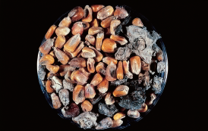
.
Contaminated corn showing severe fungal infection.

Slide 13
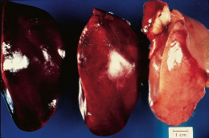
Aflatoxicosis. Note pale liver of a chicken (on right)
receiving 200 ppb aflatoxin in feed. Compare it with the normal liver on the left.

Slide 14
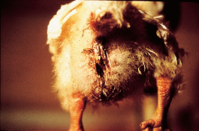
Diarrhea in chick fed fusariotoxin (Courtesy of Dr. Fred Hoerr)

