Slide 1
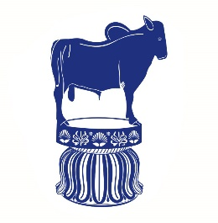
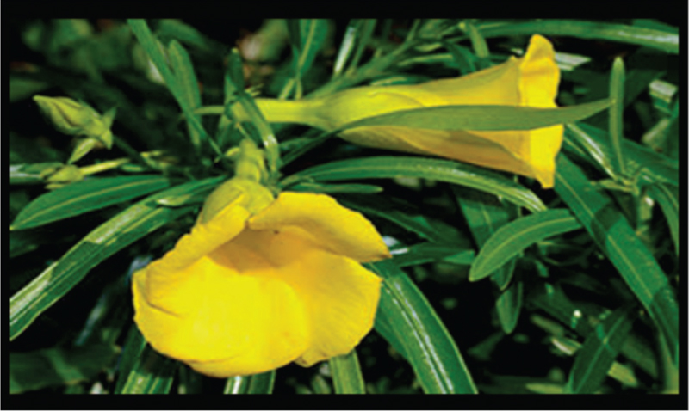
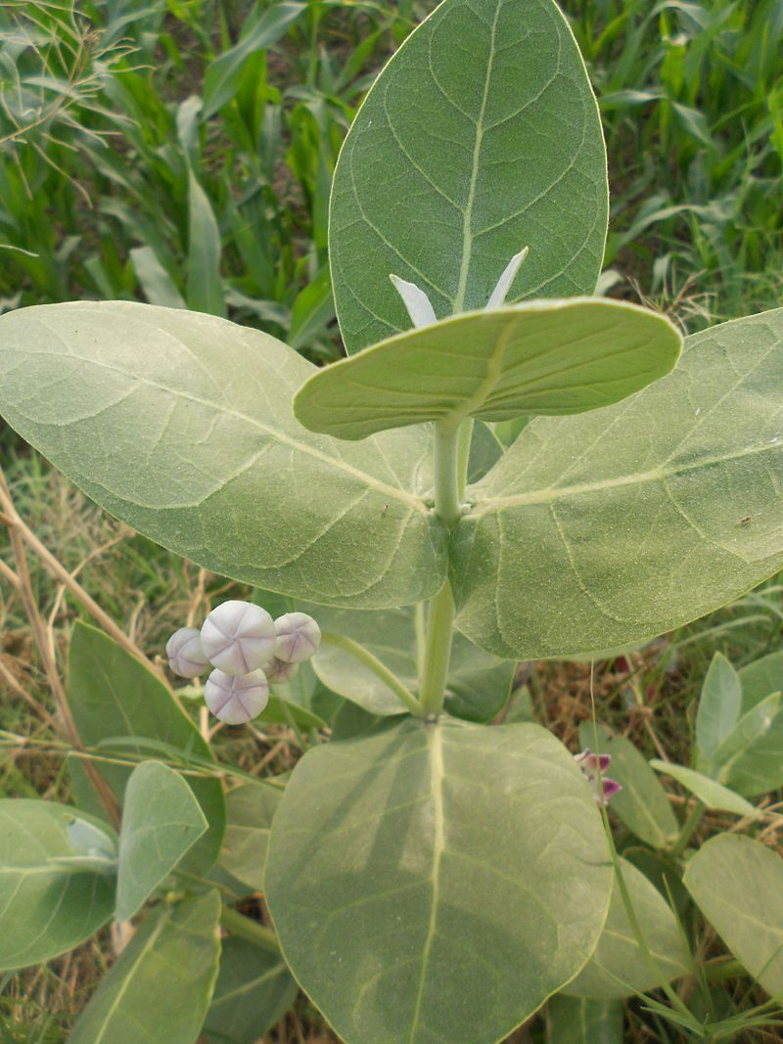
Plants containing cardio toxic glycosides
Dr.Kumari Anjana Assistant Professor Deptt. of Veterinary Pharmacology & Toxicology
Bihar Veterinary College, Bihar Animal Sciences University, Patna

Slide 2
Nerium oleander, N. indica (Kaner)
Nerium oleander, (Kaner): these are medium shrubs with sweet scented white, pink or other colours of flowers, mainly grown as an ornamental plant in temperate climates.
Poisoning occurs by ingesting (scarcity periods) the leaves or pods (seeds).
Another species of oleander are N. Indicum (kaner) and Thevetia peruviana (Yellow oleander, pilla kaner).
All parts of the plant are toxic.
The plant is highly poisonous and the milky juice which exudates from all parts of the plant contains high concentration of toxic principles.

Slide 3
The seeds of yellow oleander Thevetia peruviana or Cerebera thevetia are highly poisonous to both man and animals (used for malicious killing of animals and for homicide purpose).
They contain cardiotoxic glycosides thevetin and cereberin causes toxicity similar to N. oleander.

Slide 4
Toxic principle
Toxicity is mainly due to presence of cardiotoxic digitalis- like glycosides: oleandroside,
nerioside,
oleandrin,
neriodrin,
folinerin
digitoxigenin.
The plants also have alkaloids pseudocurarine, neriene and neriantine.
The cardiotoxic glycosides are found in all parts of the plant parts, but growing tops and leaves are most toxic.

Slide 5
Toxicity
Oleander is toxic to all animals and birds.
Poisoning is mostly seen in horses, cattle and sheep.
Many cases of poisoning have been noted in human beings, particularly in children.
Toxic doses are approximately 0.005% of body weight in horses and cattle, and 0.015% in sheep.
Mature cattle and horses may be killed after eating 30-50g of oleander leaves.
One leaf can kill an adult human and 2-3 leaves can kill an adult sheep.

Slide 6
Mechanism of action
The oleander glycosides have action on heart similar to digitalis.
Poisoning is of acute type and death results from failure of contraction of myocardium.
They interfering with Na⁺/K⁺- ATPase enzyme system (sodium-potassium pump) resulting in increased intracellular sodium and serum potassium concentrations and paralysis of sympathetic nerve supply to heart.
This results in progressive decrease in electrical conductivity through the heart causing conduction block and eventual asystole.
The leaves/pods/seeds also cause intense gastroenteritis.

Slide 7
In low doses, they may have beneficial therapeutic effects like digitalis by increasing the force of contraction, slowing heart rate and enhancing cardiac output.
In toxic doses, most cardiac glycosides cause a variety of arrhythmias and conduction disturbances that results in decreased cardiac output and death. There is also due to initial stimulation followed by paralysis of vagus nerve .

Slide 8
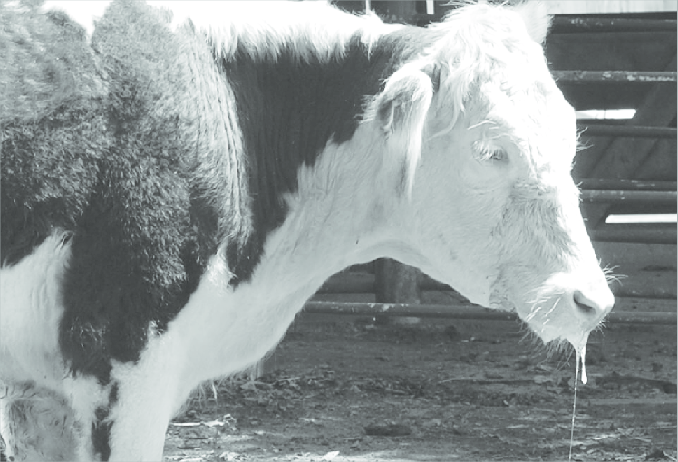
Signs
The toxicity signs are vomiting, abdominal pain, diarrhoea, tenesmus, cardiac arrhythmia (bradycardia, premature systoles, tachycardia, and heart block), laboured breathing, muscular tremors, convulsions, paralysis and death.
Milk from poisoned cows may also cause toxicity in man (salivation, vomiting, diarrhoea, muscular weakness, visual difficulty and even convulsions).

Slide 9
Treatment
Treatment is symptomatic.
Remove the source and reduce the absorption (emetics: apomorphine, osmotic or saline purgatives, gastric lavage and demulcents).
Administer atropine along with propranolol, sedatives/tranquilizers etc.
Infusion of calcium containing fluids is contraindicated (aggravates cardiac arrhythmia).

Slide 10
Calotropis procera/gigantea
Calotropis procera/gigantea:
Used for malicious killing of animals.
A shrub usually found on the boundaries of crop fields and in waste lands.
All parts of plant are toxic.
The plant is not palatable, hence not usually eaten by the animals.

Slide 11
The toxic principles are :
cardiotoxic glycosides
The latex is an irritant to skin and mucous membranes, if placed in eye causes conjunctivitis and extreme cases blindness.
calotroxin,
calactin,
gigantin,
uscharin

Slide 12
Following oral ingestion its leaves or fruit cause severe gastroenteritis and cardiac arrhythmia and death is due cardiac arrest.

Slide 13
Thank You

