Slide 1
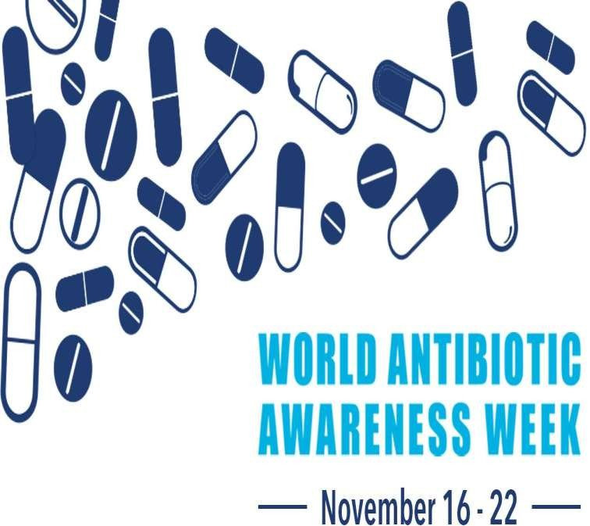
Antimicrobial Resistance
(AMR)
Mr. Bhartendu Vimal
Dept. of Aquatic Animal Health Management
College of Fisheries, Kishanganj
BASU, Patna

Slide 2
Antimicrobial Resistance
Antimicrobial resistance (AMR) is one of the most serious public health threats of the twenty-first century .
Resistance to antimicrobial agents has become a major source of morbidity and mortality worldwide.

Slide 3
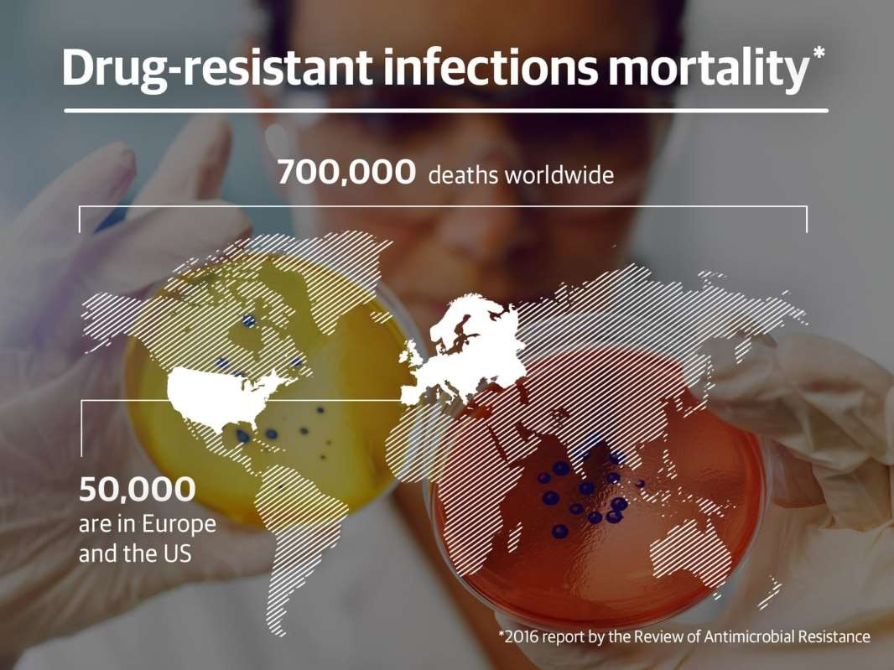
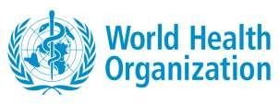
Nearly 700,000 people around the world die every year due to drug- resistant infections.

Slide 4
Antimicrobial agents
 Antimicrobial agents can be divided into groups based on the mechanism of antimicrobial activity.
Agents that inhibit cell wall synthesis.
Depolarize the cell membrane.
Inhibit protein synthesis.
Inhibit nuclei acid synthesis.
Inhibit metabolic pathways in bacteria.

Slide 5
Antimicrobial Resistance
 Most pathogenic microorganisms have the capability of developing resistance to at least some antimicrobial agents.

Slide 6
Factors contributing to Antibiotic Resistance
Environmental Factors.
Drug Related Factors.
Host Related Factors.
Prescriber Related Factors.

Slide 7
1. Environmental Factors
Huge populations and overstocking
Rapid spread – Raceways and RAS
Poor sanitation
Increases community acquired resistance
Ineffective infection control program
Increasing national and international unaunthicated seeds.
Widespread use of antibiotics in animal husbandry and agriculture and as medicated cleansing products.

Slide 8
2- Drug Related Factors
Fake drugs.
Quality of the drug.
Soaring use of antibiotics.
Over the counter availability of antimicrobials.
Irrational fixed dose combination of antimicrobials
Counterfeit and substandard drug causing sub-optimal blood concentration

Slide 9
3. Host Related Factors
Poor adherence of dosage Regimens
Lack of sanitation concept.
Lack of education.
Misconception.

Slide 10
4-Prescriber Related Factors
Inappropriate use of available drugs.
Increased empiric poly-antimicrobial use.
Overuse of antimicrobials.
Inadequate dosing.
Lack of current knowledge and training.

Slide 11
So also just remember , there is natural resistances of bacteria against antibiotics
, so it is not fault on these four factors.

Slide 12
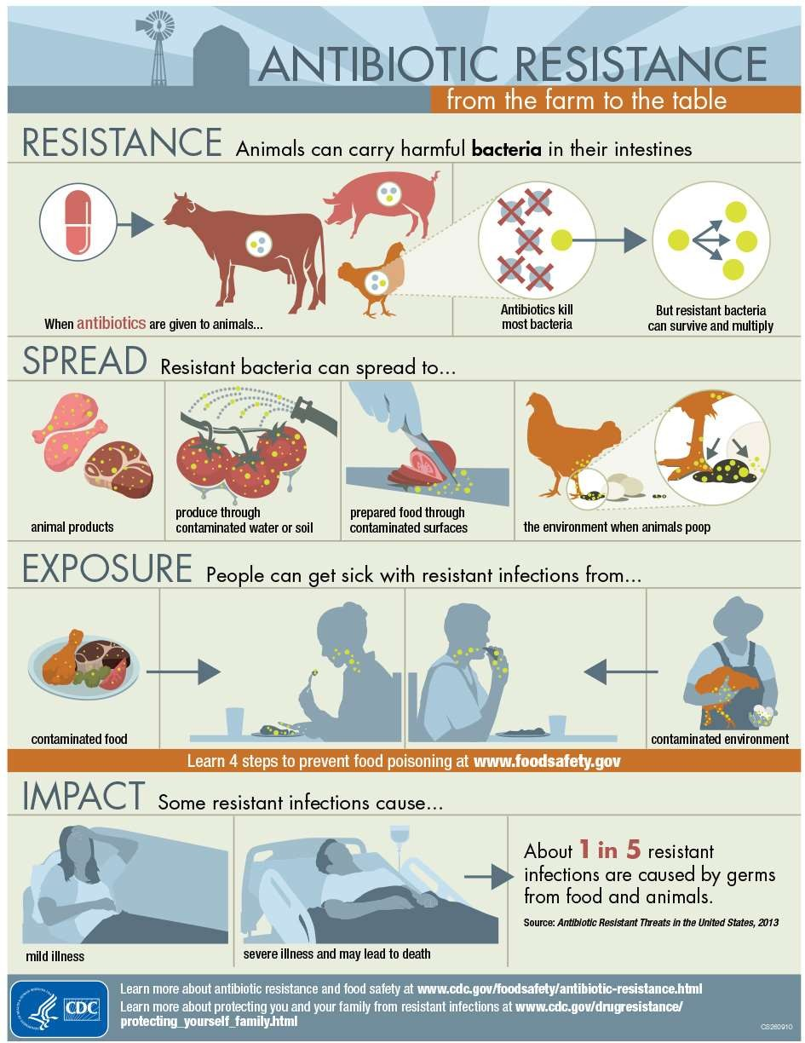

Slide 13
Bacteriostatic vs. Bacteriocidal
Static antibiotics include: Chloramphenicol, Macrolides, Clindamycin, Sulfa, Trimethoprim, Tetracyclines
Cidal antibiotics include: Aminoglycosides, Beta- lactams, Vancomycin, Quinolones, Rifampin, and Metronidazole.

Slide 14
ANTIMICROBIAL RESISTANCE
Antimicrobial resistance can be of two types, intrinsic and acquired.

Slide 15
 Intrinsic or natural (always expressed in the species), It is the innate ability of a bacterium to resist a class of antibiotics.
 The most common bacterial mechanisms involved in intrinsic resistance are reduced permeability of the outer membrane (LPS) and the natural activity of efflux pumps.

Slide 16
b) Acquired resistance whereby a naturally susceptible microorganism acquires ways of not being affected by the drug.
 Bacteria acquire any genetic material: transformation, transposition, and conjugation (all termed horizontal gene transfer-HGT), plus, the bacteria may experience mutations to its own chromosomal DNA.

Slide 17
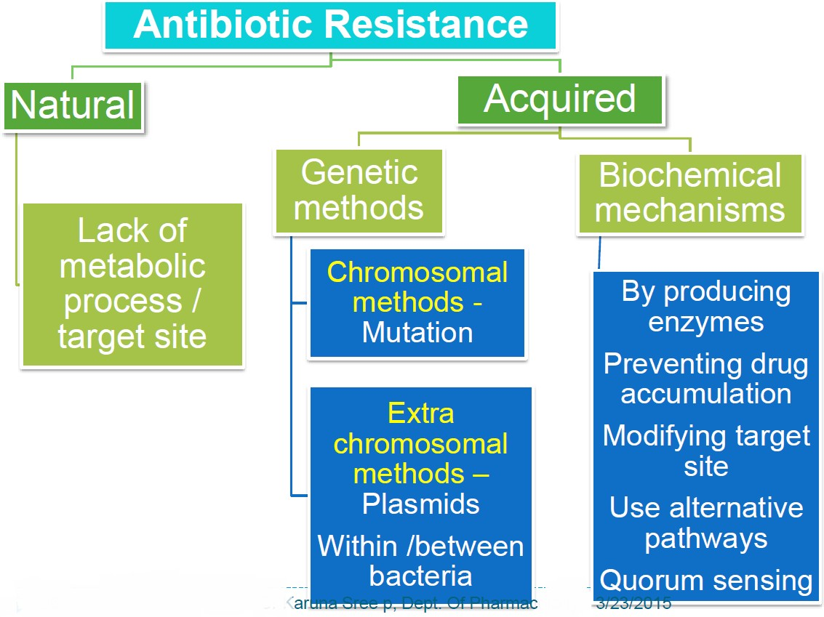
Non-genetics

Slide 18
Mechanism of Antimicrobial Resistance
 Bacteria develop antimicrobial resistance by several
mechanisms.
Limiting uptake of a drug. (natural)
Modification of a drug target.
Inactivation of a drug.
Active efflux of a drug.

Slide 19
Mechanism of Antimicrobial Resistance
Because of differences in structure, there is variation in the types of mechanisms used by Gram negative bacteria versus Gram positive bacteria.
Gram negative bacteria make use of all four main mechanisms, whereas Gram positive bacteria less commonly use limiting the uptake of a drug (don't have an LPS outer membrane), and don't have the capacity for certain types of drug efflux mechanisms.

Slide 20
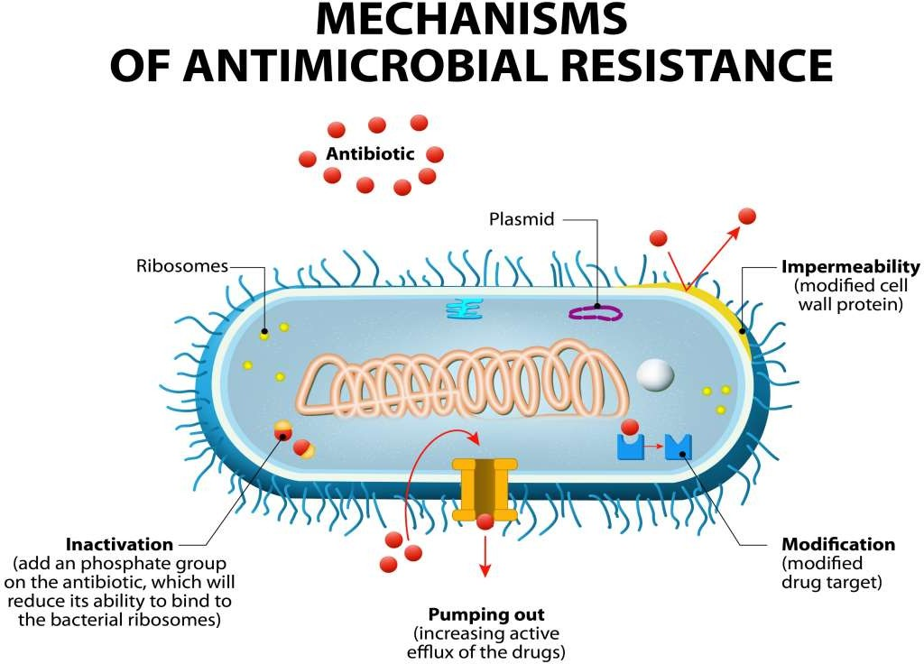
1
3
2
4

Slide 21
1. Limiting uptake of a drug.
There is a natural difference in the ability of bacteria to limit the uptake of antimicrobial agents.
The structure and functions of the LPS layer in G- bacteria provides a barrier to certain types of molecules.

Slide 22
Certain bacteria modify their cell membrane porin channels; thereby preventing the antimicrobials from entering into the cell. (genetics)
There are two main ways in which porin changes can limit drug uptake: a decrease in the number of porins present, and mutations that change the selectivity of the porin channel.

Slide 23
 This strategy has been observed in many Gram- bacteria such as Pseudomonas, Enterobacter and Klebsiella species against drugs such as imipenem, aminoglycosides and quinolones.

Slide 24
Gram positive bacteria, Staphylococcus aureus, recently has developed resistance to vancomycin. Of the two mechanisms that S. aureus uses against vancomycin.
S. aureus produce a thickened cell wall which makes it difficult for the drug to enter the cell and Provides an intermediate resistance to vancomycin. These strains are designated as VISA strains. (non-genetic)

Slide 25
2. Modification of a drug target.
 There are multiple components in the bacterial cell that may be targets of antimicrobial agents and there are just as many targets that may be modified by the bacteria to enable resistance to those drugs. (genetic)

Slide 26
 One mechanism of resistance to the β-lactam drugs used almost exclusively by G+ bacteria is via alterations in the structure and/or number of PBPs (penicillin-binding proteins).
 PBPs are transpeptidases involved in the construction of peptidoglycan in the cell wall.

Slide 27
 A change in the number (increase in PBPs that have a decrease in drug binding ability, or decrease in PBPs with normal drug binding) of PBPs impacts the amount of drug that can bind to that target.

Slide 28
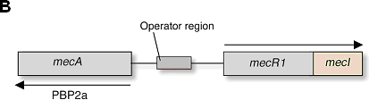
 A change in structure (e.g. PBP2a in S. aureus by acquisition of the mecA gene) may decrease the ability of the drug to bind, or totally inhibit drug binding.

Slide 29
The glycopeptides (e.g. vancomycin) also work by inhibiting cell wall synthesis and lipopeptides (e.g. daptomycin) work by depolarizing the cell membrane.
Resistance to vancomycin has become a major issue in the enterococci (VRE—vancomycin-resistant enterococci) and in Staphylococcus aureus (MRSA- Methicillin-resistant Staphylococcus aureus).

Slide 30
 Resistance is mediated through acquisition of van genes which results in changes in the structure of peptidoglycan precursors that cause a decrease in the binding ability of vancomycin.
 Daptomycin requires the presence of calcium for binding. Mutations in genes (e.g. mprF) change the charge of the cell membrane surface to positive, inhibiting the binding of calcium, and therefore, daptomycin.

Slide 31
Resistance to drugs that target the ribosomal subunits may occur via ribosomal mutation (aminoglycosides)
,ribosomal subunit methylation most commonly involving erm genes, or ribosomal protection (tetracyclines).
These mechanisms interfere with the ability of the drug to bind to the ribosome.

Slide 32
 Selective toxicity (antibiotics) , the only affect the bacterium not human, due to affect the specific genes that only bacteria.

Slide 33
 For drugs that target nucleic acid synthesis (fluoroquinolones), resistance is via modifications in DNA gyrase (G- bacteria e.g. gyrA) or topoisomerase IV (G + bacteria e.g. grlA).
 These mutations cause changes in the structure of gyrase and topoisomerase which decrease or eliminate the ability of the drug to bind to these components.

Slide 34
3. Inactivation of a drug.
 There are two main ways in which bacteria inactivate drugs; by
Actual degradation of the drug, or by
Transfer of a chemical group to the drug.

Slide 35
 1-Actual degradation of the drug, or by
The β-lactamases are a very large group of drug hydrolyzing enzymes .Another drug that can be inactivated by hydrolyzation is tetracycline, via the tetX gene.

Slide 36
2-Transfer of a chemical group to the drug.
Drug inactivation by transfer of a chemical group to the drug most commonly uses transfer of acetyl group.
There are a large number of transferases that have been identified. Acetylation is the most diversely used mechanism, and is known to be used against the aminoglycosides.

Slide 37
4. Active efflux of a drug.
Bacteria possess chromosomally encoded genes for efflux pumps. Some are expressed constitutively, and others are induced or overexpressed (high-level resistance is usually via a mutation that modifies the transport channel) under certain environmental stimuli or when a suitable substrate is present.
The efflux pumps function primarily to rid the bacterial cell of toxic substances, and many of these pumps will transport a large variety of compounds (multi-drug [MDR] efflux pumps).

Slide 38
Most bacteria possess many different types of efflux pumps.
There are five main families of efflux pumps in bacteria classified based on structure and energy source:
The ATP-binding cassette (ABC) family,
The multidrug and toxic compound extrusion (MATE) family, 3-The small multidrug resistance (SMR) family,
The major facilitator superfamily (MFS), and
The resistance-nodulation-cell division (RND) family.

Slide 39
 Efflux pumps found in G + bacteria may confer intrinsic resistance because of being encoded on the chromosome (natural).
There are also G + efflux pumps known to be carried on plasmids (aquarid).
These pumps include members of the MATE and MFS families.
Efflux pumps found in G -bacteria are widely distributed and may come from all five of the families, with the most clinically
significant pumps belonging to the RND family.
39

Slide 40
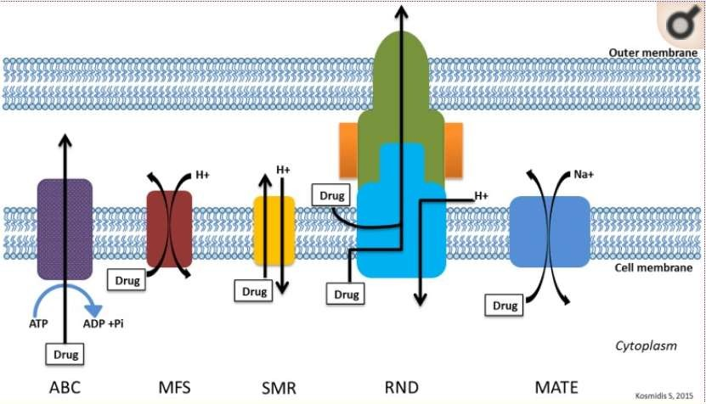
Figure: General structure of main efflux pump families.

Slide 41
What is the difference between antibiotic and antimicrobial resistance?
Antibiotics are medicines used to prevent and treat bacterial infections. Antibiotic resistance occurs when bacteria change in response to the use of these medicines. Bacteria, not humans, become antibiotic resistant. These bacteria may then infect humans and are harder to treat than non-resistant bacteria.
Antimicrobial resistance is a broader term, encompassing resistance to drugs to treat infections caused by other microbes as well, such as parasites (e.g. malaria), viruses (e.g. HIV) and fungi (e.g. Candida).

Slide 42
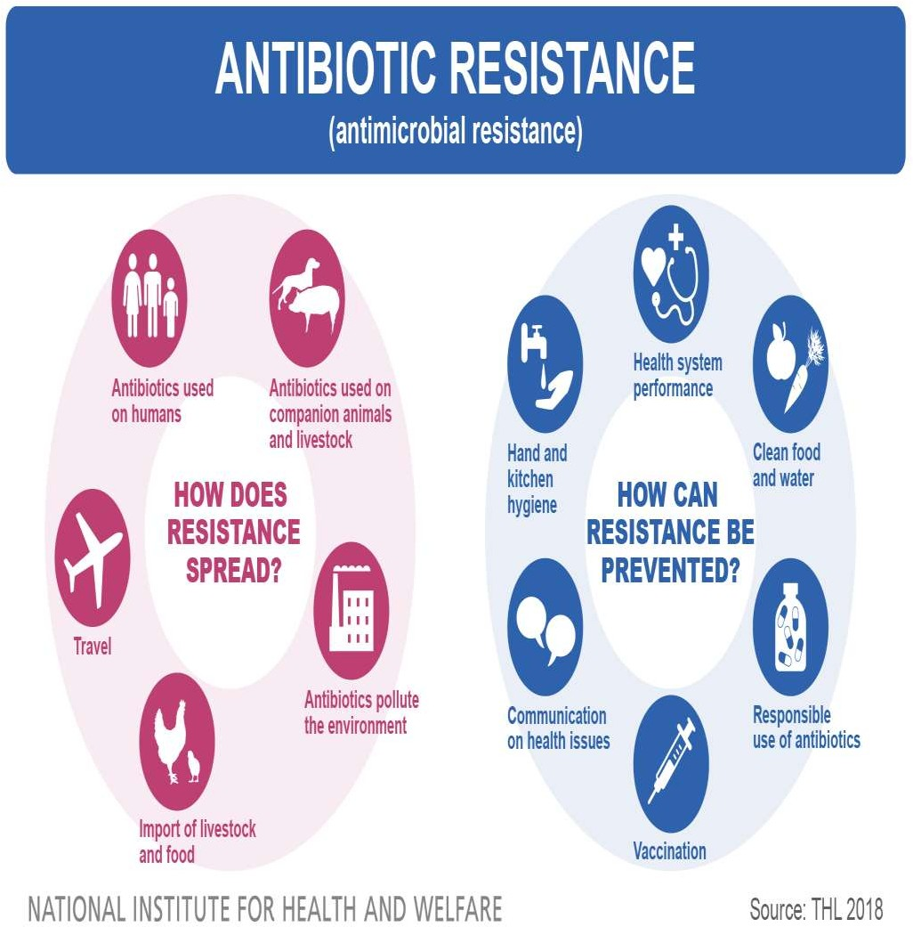

Slide 43
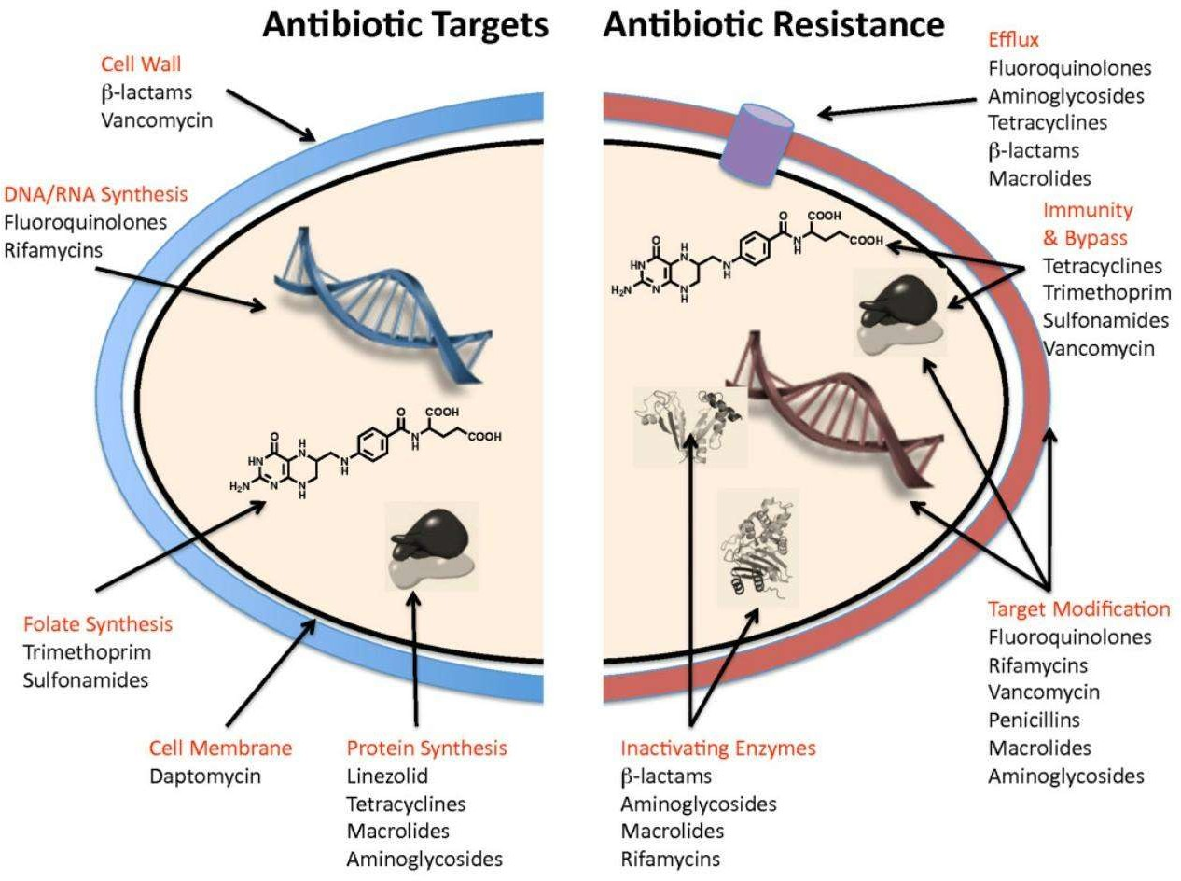
Summary

Slide 44
References
 An overview of the antimicrobial resistance mechanisms of bacteria ,2018, doi: 10.3934/microbiol.2018.3.482.
 A Review on Antibiotic Resistance: Alarm Bells are Ringing,2017, doi: 10.7759/cureus.1403
 WHO,2018
 CDC,2018

