Slide 1
LPT 606: SLAUGHTER HOUSE BYPRODUCTS TECHNOLOGY (2+1) UNIT I – Utilization of intestine as slaughter house by product
Dr. R. K. Jaiswal
Asstt. Prof.-cum-Jr. Scientist
Dept. of Livestock Products Technology
Bihar Veterinary College
Bihar Animal Sciences University
Patna-800014 (Bihar)

Slide 2
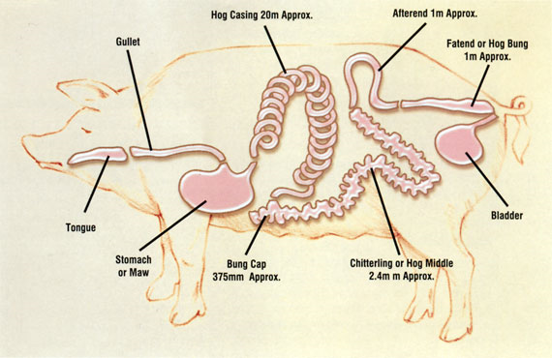
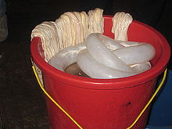
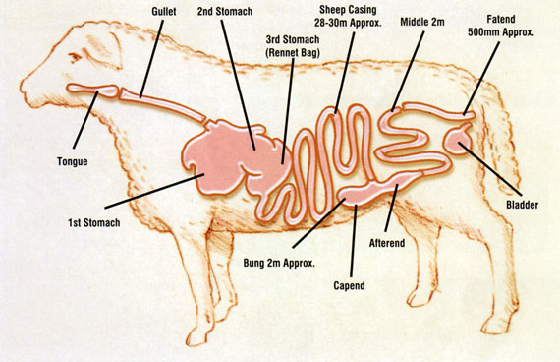
Casing from pig intestine
Casing from sheep intestine

Slide 3
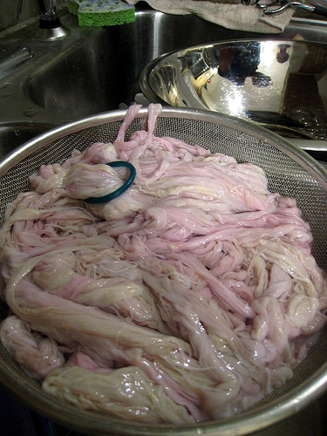
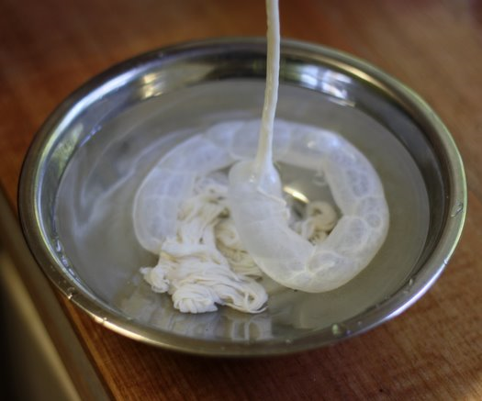
Edible use: When part of the processed intestine used as food container called casing
Non edible use: this may be in the form of cat gut, strings for racket and musical instruments

Slide 4
TYPE OF CASING
Natural: Obtained form animal (sheep, goat, pig, cattle/buffalo) intestine, urinary bladder, oesophagus (weasand)
Characters:
Variable strength & length
Low cost
Best smoke penetration
Stored in salted condition
Most tender
Breakage during processing
Suspected quality (hole/tear, microbial)

Slide 5
ARTIFICIAL CASING
Artificially produced from collagen & cellulose
Collagen
Uniform, high cost
Very good smoke penetration
Presented in dried form
Fair shelf life
Good microbial quality
Less tender
Cellulose
Uniform & standardized length
Lowest cost
Good smoke penetration
Peeled during consumption
Best printability
Best storage

Slide 6
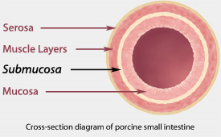
Submucous coat (Tela submucosa) , composed of dense connective tissue (collagen) used for casing preparation

Slide 7
FACTORS EFFECTING CASING QUALITY
Cleanliness: Clean & sound, stain free, devoid of fat, parasite nodules, ulcer , defects
Strength: Strong enough to withstand pressure during filling, stuffing & processing
Length: Standardized (sheep & hog-91.4 m, beef round-18 m)
Caliber (thickness): Sheep-14 mm, hog-35 mm, beef-35 mm
Curing: Two types, salted & cleaned, some time it may be dried
Packaging: Mainly wooden and plastic container

Slide 8
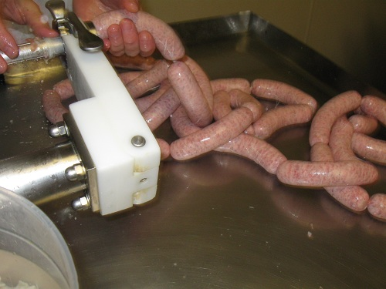
STEPS IN CASING PREPARATION
Removal
Pulling/running(separation of mesenteric membrane)
Chilling (at 10º C)
Stripping
Flushing
Fatting (removal of fat)
Fermentation (for 1-2 days, at 20ºC)
Turning (turn inside out)
Sliming (removal of mucous lining)
Measuring (in inflated condition)
Inspection & grading (checking of color, cleanliness, pin hole, cuts etc.)
Preservation (sheep, goat-in wet salted; cattle-dried)
Packing (tin cans lined with polyethylene)

Slide 9
IMPORTANT TERMINOLOGY
Round/runner: from small intestine mainly of cattle, sheep, goat, pig
Middle: from large intestine of cattle or some time pig
Weasand: from oesophagus of cattle
Bung: from cattle caecum
Bladder: from urinary bladder of pig, cattle
Chitterling/black gut: from part of large intestine of hog
Hank: set of sheep, goat, hog casing 91.4 m long
Bundle: set of beef casing of 18 m long

Slide 10
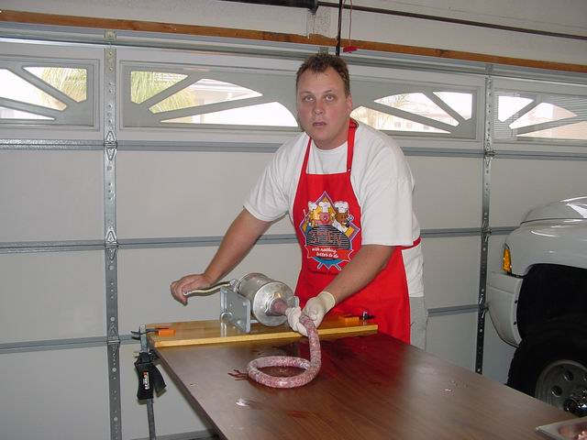
Basic requirements for gut processing
Raw materials from healthy animals
Gut should be free from ulcer, parasitic
infestation with nodules
Sanitary handling
Graded as per Indian standards adopted by
Agmark(IS: 1981-1962, animal casings grading and marking rules, 1964)
Required equipments
Plastic/wooden scrapper
Gut cleaning table
Fermentation & chilling tank
Stripper with rubber roller
Bronze crusher

Slide 11
DEFECTS COMMON IN CASING
Dull color: grayish or greenish instead of white or milky
Nodules: it may be due to round worm in intestine
Holes & laceration: formed due to negligence or rough handling
Salt burn: due to long storage in salt or due to loose packing, leaving air inside
Defective grading
Twisting of gut (kink)
Black spot (due to bacterial purification)
Cicatrices (scar of healed up wound)
Domestics (grease spots)

Slide 12
THANK YOU

