Slide 1
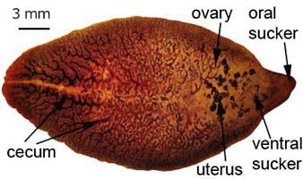
Schistosomiasis
Dr. Bipin Kumar
Assistant Professor
Department of Veterinary Medicine
Bihar Veterinary College, Patna
(Bihar Animal Sciences University, Patna)

Slide 2
Trematodes Schistosomes: Blood flukes
Family: Schistosomatidae
Genus: Schistosoma
For animals(ruminant & horses) : Sch. bovis, sch. Mattheei, sch. Spindale, sch. nasalis, Sch. margrebowiei
Disease : Bilharziasis or Schistosomiasis

Slide 3
Introduction
Fascioliasis is called as liver fluke disease or liver rot
Fasciola hepatica: Mostly found in temperate and cooler area of high altitude in tropical and subtropical countries
Fasciola gigantica: Mostly in tropical countries
Morphology
Broad-leaf like body
Host affected
Natural host: Cattle, Buffalo, Sheep, Goat and Other ruminants
Unusual host: Horse & Man
Location
Immature flukes: Small intestine, peritoneal cavity and liver parenchyma
Mature flukes: Bile duct

Slide 4
S. nasale inhabits blood vessels of the nasal mucosa and causes "snoring disease" in cattle.
symptomless in buffaloes though extruding its eggs in nasal discharge.
intermediate host is a freshwater snail Indoplanorbis exustus.

Slide 5
Life Cycle, Transmission, and Epidemiology
Schistosomes live in the mesenteric and hepatic veins (except for S nasale, nasal veins).
Eggs passed in the feces releases miracidia, which invade suitable water snails and develop through primary and secondary sporocysts to become cercariae.
When fully mature, the cercariae leave the snail and swim freely in the water, where they remain viable for several hours.
Animals are infected with cercariae through skin, although infection may be acquired orally while animals are drinking.
During penetration, cercariae develop into schistosomula, which are transported via the lymph and blood to their predilection sites.

Slide 6
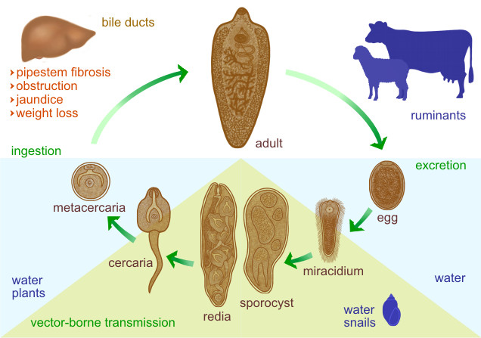

Slide 7
Signs and symptoms
Visceral Schistosomiasis:
The disease is characterized by diarrhea, weight loss, anemia, hypoalbuminemia, hyperglobulinemia,
Severe eosinophilia that develop after the onset of egg excretion.
Severely affected animals deteriorate rapidly and usually die within a few months of infection.
Less heavily infected develop chronic disease with growth retardation.

Slide 8
Nasal Schistosomiasis
cauliflower-like growth or granuloma in the nasal cavity.
"snoring" sound and profuse mucopurulent.

Slide 9
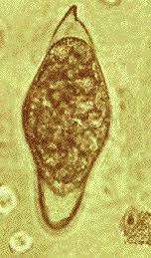
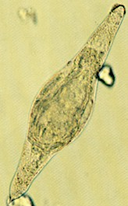
Diagnosis
By eggs in the faeces.
Microscopic examination of the mesenteric veins for the presence of adult worms.
Microscopic examination of scrapings of the intestinal mucosa or of crushed liver tissue (both for eggs).
Eggs of S bovis, S curassoni, and S mattheei are spindle-shaped.
Eggs of S nasale are boomerang-shaped while oval type of S japonicum.

Slide 10
Treatment&Control
Anthiomaline was the drug of choice, but this leads to relapse of the symptoms after two months of the treatment.
Praziquantel@25mg/kg proved better than any other drug.
Triclabendazole @10mg/kg.
Snail control.

