Slide 1
HISTOLOGY OF GENITAL ORGANS PART-2

Slide 2
The mucosa of the vas deferens forms low longitudinal folds. It is lined by a pseudostratified columnar epithelium. Similar to the epididymis, cells have long stereocilia. The lamina propria is unusually rich in elastic fibres. The muscularis is well developed (up to 1.5 mm thick) and consists of a thick circular layer of smooth muscle between the inner inner and outer longitudinal layers. The muscularis is the structure which makes the vas deferens palpable in the spermatic cord. The vas deferens is surrounded by an adventitia, which is slightly denser than usual.
Vas deferens

Slide 3
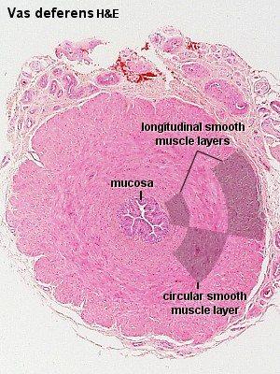
STRUCTURE OF VAS DEFERENS

Slide 4
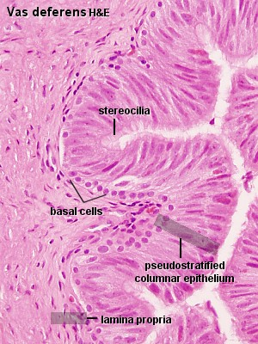
STRUCTURE OF VAS DEFERENS MAGNIFIED VIEW

Slide 5
The prostate is the largest accessory tubuloalveolar sex gland which empty into 15 - 25 independent excretory ducts. These ducts open into the urethra. The glands are embedded into a fibromuscular stroma, which mainly consists of smooth muscle separated by strands of connective tissue rich in collagenous and elastic fibres. The muscle forms a dense mass around the urethra and beneath the fairly thin capsule of the prostrate. The secretory alveoli of the prostate are very irregularly shaped because of papillary projections of the mucosa into the lumen of the gland. The epithelium is cuboidal or columnar. Basal cells are again present, and the epithelium may look pseudostratified where they are found.
Prostrate

Slide 6
The secretory cells are slightly acidophilic and secretory granules may be visible in the cytoplasm.
Small extensions of the apical cytoplasm into the lumen of the alveoli may represent cells which release their secretory products (secretion is apocrine/merocine).
The secretion of the prostate contains citric acid, the enzyme fibrinolysin (liquefies the semen), acid phosphatase, a number of other enzymes and lipids. The secretion of the prostate is the first fraction of the ejaculate.

Slide 7
The secretory ducts of the prostate are lined by a simple columnar epithelium, which changes to a transitional epithelium near the openings of the ducts into the urethra.
A characteristic feature of the prostate is the appearance of corpora amylacea in the secretory alveoli. They are rounded eosinophilic bodies.
Macroscopically the prostrate can be divided into lobes, but they are inconspicuous in histological sections. In good histological sections it is possible to distinguish three concentric zones, which surround the prostatic part of the urethra.
The peripheral zone contains large, so-called main glands, whose ducts run posteriorly to open into the urethra.
The internal zone consists of the so-called submucosal glands, whereas
the innermost zone contains mucosal glands.

Slide 8
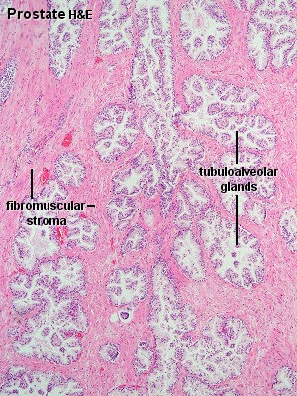
STRUCTURE OF PROSTRATE GLAND

Slide 9
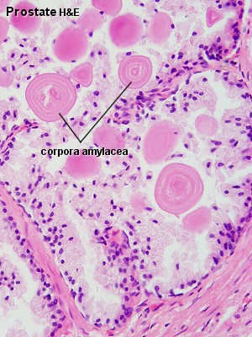
PROSTRATE GLAND

Slide 10
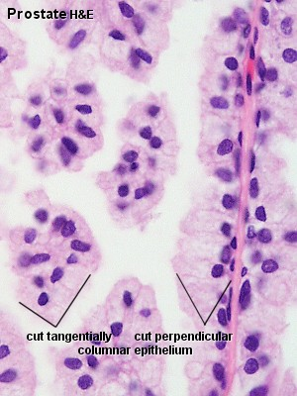
MAGNIFIED VIEW OF POROSTRATE GLAND

Slide 11
SEMINAL VESICLES
The seminal vesicles develop from the vas deferens. Their histological organisation resembles to some extent that of the vas deferens. They are elongated sacs (about 4 cm long and 2 cm wide), which taper where they unite with the vas deferens.
Each seminal vesicle consists of one coiling tube and the lumina visible in sections of the seminal vesicle are in continuity in the intact organ.
The mucosa shows thin, branched, anastomosing folds. The structure of the epithelium is variable appearing columnar or pseudostratified columnar .
The lamina propria of the mucosa is fairly thin and loose.
The muscularis consists of inner circular and outer longitudinal layers of smooth muscle.
The secretory product of the columnar cell, which may be seen in the lumen of the seminal vesicles, is strongly acidophilic. It contains large amounts of fructose which the spermatozoa utilise as a source of energy

Slide 12
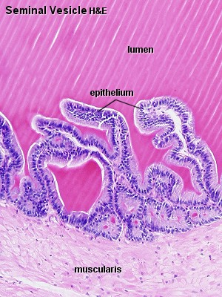
STRUCTURE OF SEMINAL VESICLES

Slide 13
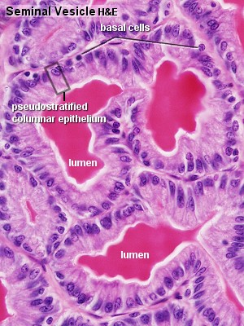
STRUCTURE OF SEMINAL VESICLES

Slide 14
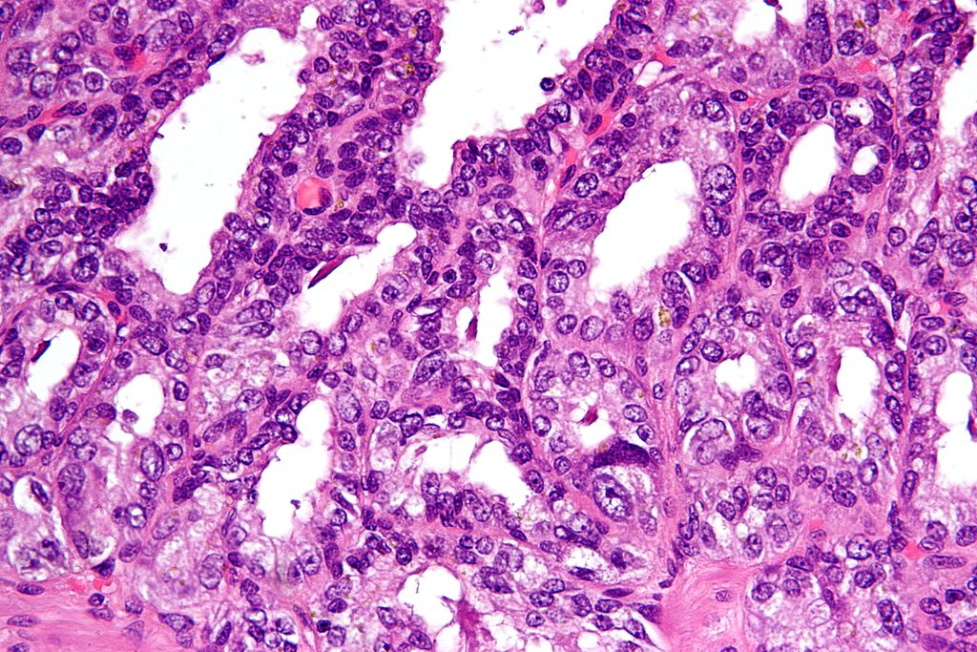
SEMINAL VESICLES

Slide 15
The bulbourethral (Cowper's) gland is a paired structure about 0.5 cm in size
BULBOURETHRAL GLAND
It is located on either side of the urethra in the urogenital diaphragm below the prostate in males
It consist of small mucinous glands surrounded by bulbocavernosus muscle and draining via a duct.
The epithilial lining is made up of transitional epithelium

Slide 16
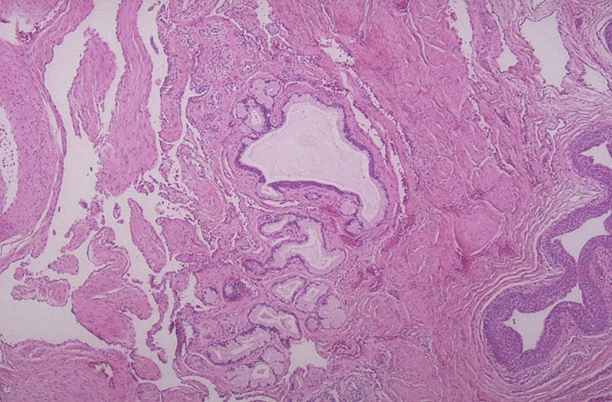
STRUCTURE OF BULBOURETHRAL GLAND

Slide 17
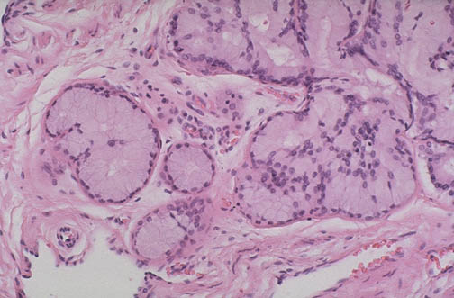
STRUCTURE OF BULBOURETHRAL GLAND

