Slide 1
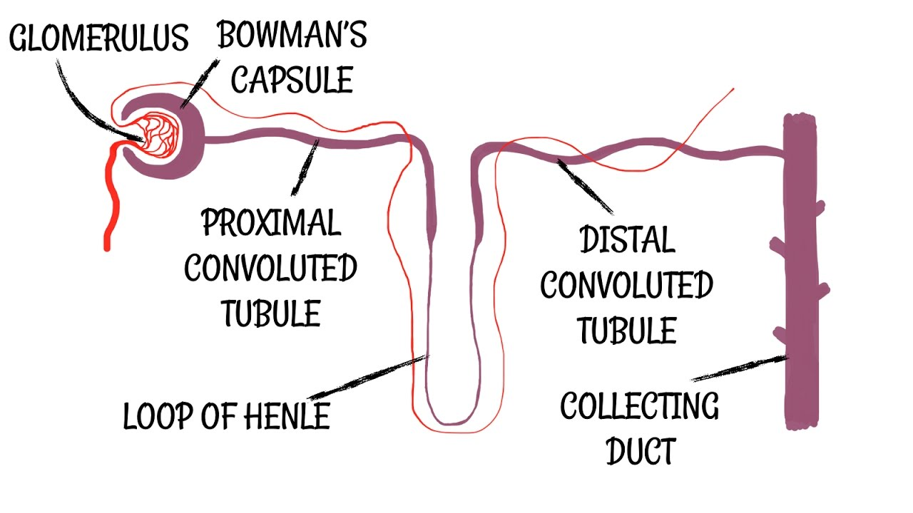
Non Excretory functions of Kidney
Dr Pramod Kumar
Asstt. Professor
Department of Vety. Physiology

Slide 2
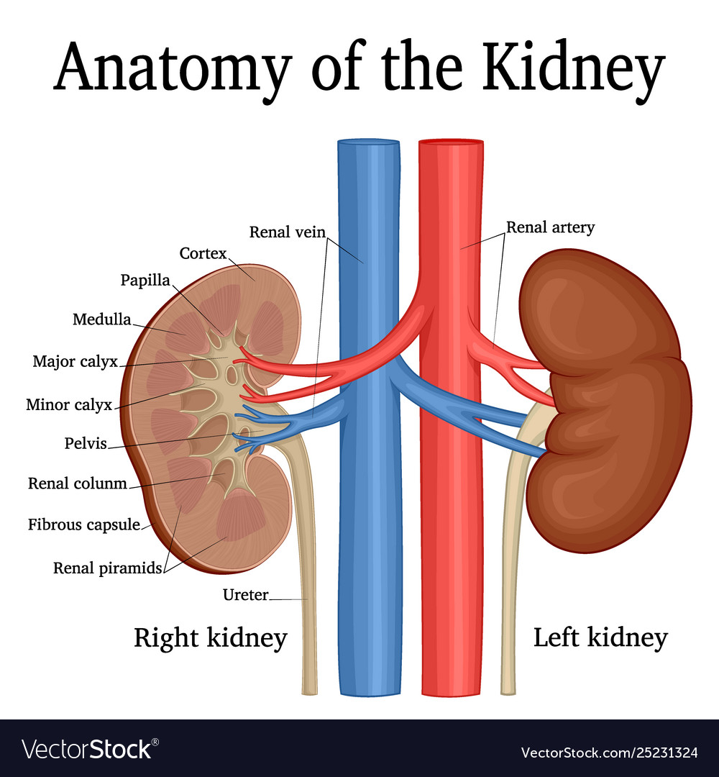
INTRODUCTION
Gross structure of Kidney
Bean shaped
Hilus
layers (outer cortex and inner medulla)

Slide 3
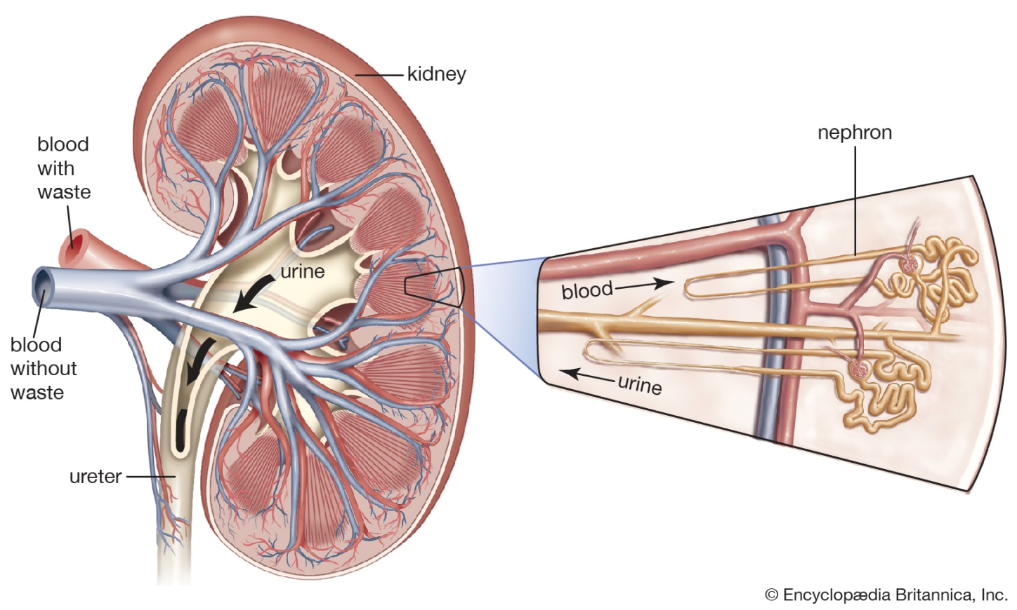
Nephron
Structural and functional unit of the kidneys
Each kidney has 1 million nephrons
Each nephron is about 5 cm long
Total length of nephrons is about 100 kms

Slide 4
Filtration surface
composed of the loops of the capillaries
Arises from the afferent arteriole of each nephron
Glomerular capsule is the bowman’s capsule
Glomerulus and the Bowman’s capsule together called the malpighian body
Endothelial wall shows fenestrations of 40-100nm in dia. prevents the large molecules to escape into the filtrate
after reabsorption and secretion, fluid becomes urine.

Slide 5
Proximal convoluted tubules
first portion of the tubule
lined by the cells, look like truncated pyramids
large no of microvilli to filtrate by active transport
absorbs 2/3 of the glomerular filtrate.

Slide 6
loop of Henle
PCT narrows abruptly to continue loop of Henle
majority of nephrons originate in the cortex the loops of Henle are short
the nephrons, originate in the junction of cortex and medulla have long loops of henle.

Slide 7
Distal convoluted tubules
metabolic activity is moderate
reabsorbs less than 15% of the filtrate
poor permeability
reabsorbs against high electrochemical gradients
Important part in final composition of the urine
macula densa is the small part of the DCT near the afferent areteriole

Slide 8
Collecting ducts
proximal part of collecting tubules are very similar to the distal part of the distal tubule
become columnar and less mitochondria are present
less hormone mediated reabsorption of the filtrate.

Slide 9
Non excretory function
Secretion of hormones
Secretion of erythropoietin
Secretion of renin
Secretion of the active form of vitamin D (calcitriol) and prostaglandins.

Slide 10
Gluconeogenesis
Kidney produces glucose from lactate, glycerol and glutamine.
responsible for gluconeogenesis in fasting condition.
Regulates glucose production through insulin
catecholamines and other hormones.
Renal gluconeogenesis takes place in the renal cortex.

Slide 11
Homeostasis
homeostatic control through renal excretion
action of ADH and ANP
abnormal excretion of Na imply glomerular dysfunction.
Urinary excretion rate = Filtration rate – Reabsorption rate + Secretion rate

Slide 12
Steps for formation of urine
Filtration
Reabsorption
Indirect reabsorption
Bicarbonate
Hormones
Secretion

Slide 13
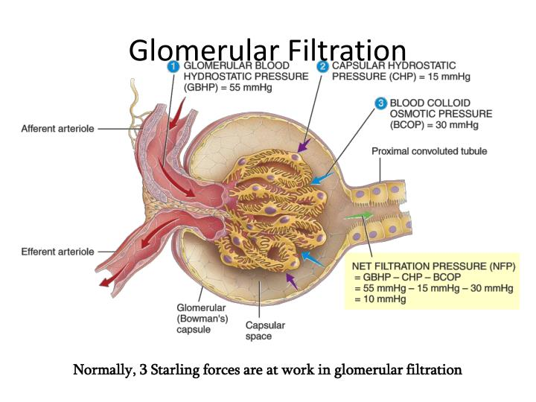
Filtration
blood is filtered by nephrons – ultrafiltration enter Bowman's space.
filtration is driven by Starling forces to form urine.

Slide 14
Reabsorption
It is the process by which solutes and water are removed from the tubular fluid and transported into the blood.
Reabsorption - once absorbed in the intestines
Two step process active or passive extraction
transport processes - Starling forces

Slide 15
Indirect reabsorption
H⁺ combines with HCO₃⁻ to form carbonic acid (H₂CO₃)
Luminal carbonic anhydrase enzymatically converts H₂CO₃ into H₂O and CO₂
CO₂ freely diffuses into the cell
Cytoplasmic carbonic anhydrase converts the CO₂ and H₂O into H₂CO₃
H₂CO₃ readily dissociates into H⁺ and HCO₃⁻

Slide 16
Hormones – regulates water reabsorption are:
aldosterone - stimulate active Na reabsorption
ADH - stimulates passive water reabsorption
Both hormones exert their effects on the collecting ducts
Secretion - Tubular secretion is the transfer of materials from peritubular capillaries to renal tubular lumen.
Active transport - only few substances are secreted those are present in great excess or natural poisons.
Many drugs are eliminated by tubular secretion

