Slide 1
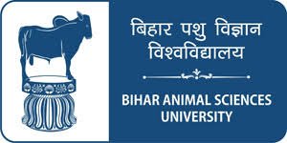
Thyroid Gland Part - I
Dr Ravindra Kumar
Director Research
Bihar Animal Sciences University
Patna

Slide 2
Thyroid Gland
Thyroid gland is a unique gland as its’ only tissue in the body, which is able to accumulate iodine in great quantities and combine it in to a hormone.
Located immediately below the larynx on either side and anterior to trachea.
Composed of large number of follicles, filled with secretary substance called colloid and lined with the cuboidal epithelial cells that secrete into the interior of the follicles.

Slide 3
Thyroid Gland ----
Major constituent of the colloid is the large quantities of glycoprotein thyroglobulin, which contains the thyroid hormones with in its molecules.
Once the secretions has entered the follicles, it must be absorbed back through the follicular epithelium in to the blood before it can function in the body.
Thyroid gland has blood flow about five times the weight of the gland each minute, which makes it maximum vascularized area, with exception to adrenal cortex.

Slide 4
Iodine requirement for formation of thyroxine
Approximately 50 mg of ingested iodine is required
OR
1 mg/week in human beings for formation of optimum quantity of thyroxine.
The main function of the thyroid gland is to accumulate iodine (I₂) and cause its attachment to tyrosine in order to form thyroid hormones.

Slide 5
Iodine metabolism
The main function of the thyroid gland is to accumulate I₂ and cause its attachment to tyrosine in order to form the thyroid hormones.
This process takes place under influence of TSH.
The use of ¹³¹I has helped in further investigating iodine metabolism. As ¹³¹I has half life of 8 days and emits gamma radiation, which can be monitored externally.

Slide 6
Iodine Pump
The concentration of inorganic iodine ( I⁻) is ordinarily very low in plasma but is transported to thyroid gland against concentration gradient, to the ratio of 20:1 in normal animals
And after TSH stimulation the concentration with in the thyroid gland may be 300 to 500 times that of plasma.
Accumulation of iodine in the thyroid gland is called as trapping of iodine. The ability of the thyroid gland to trap iodine may be increased 10 to 20 times by maintaining the animal on iodine fee diet, that helps the animal to overcome the iodine deficiency.
cont……..

Slide 7
Iodine Pump…..
Whereas administration of excess of iodine will depress the iodine trapping and similarly certain anti thyroidal drugs can inhibit the iodination of tyrosine thus inhibit the iodine trapping.
The animal body contains only one part of iodine to 3 million pasts of body weight, hence its referred as trace mineral. Most of iodine is concentrated inthyroid gland and remaining in circulation as thyroxine.

Slide 8
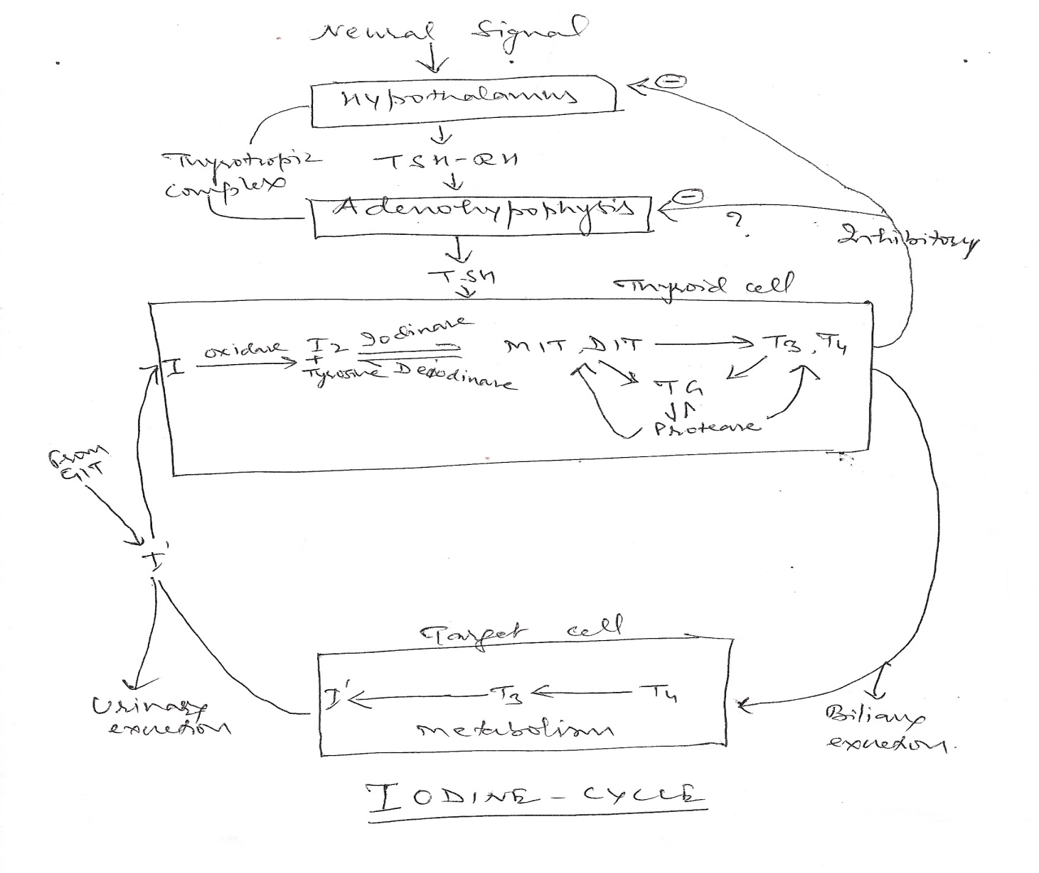
Iodine Cycle

Slide 9
Biosynthesis of thyroglobulin ( TG)
Thyroglobulin is an iodine containing glycoprotein with molecular weight of 6,70,000.
Molecule contains about 5800 amino acids residues plus about 350 carbohydrate residues.
In addition thyroglobulin contains four types of iodoamino acids
3-monoiodotyrosine,
3,5 diiodotyrosine
3, 5 , 3’ triiodothyronine (T₃)
tetraiodothyronine (T₄).

Slide 10
Biosynthesis of thyroglobulin ( TG) …….
TG is synthesized from endoplasmic reticulum and golgi apparatus.
Synthesis of thyroglobulin is a complex process, which involves first the building of protein portion of TG.
This consist of amino acids entering the basal end of the thyroid cell, where they assembled into polypeptide chains on the endoplasmic reticulum.

Slide 11
Biosynthesis of thyroglobulin ( TG) …….
From there the protein migrates to the apical portion of the cell, while CHO moieties are added by ER and gogli apparatus.
At the apical end of the thyroid cell, the iodination of the tyrosyl group of thyroglobulin molecule occurs.
Thyroglobulin acts as substrate for iodination reaction, which first leads to formation of MIT, then DIT followed by coupling of MIT and DIT or DIT and DIT, with in the thyroglobulin molecule.

Slide 12
THYROID HORMONE TRANSPORT
Protease in the follicle cells acts to break the T4 and T3 from thyroglobulin complex stored in the follicular colloid cells.
Hormones then moves through the cells, enters the blood stream and quickly bound by serum proteins (TBG).
Proteins to which it is bound and the degree of binding vary from species to species.
In cattle, swine, sheep and equines it is bound primarily to the α – globulin. Variation in activity of T3 as compared to thyroxine appears to be dependent on the strength of union between the respective hormones and plasma proteins.

Slide 13
THYROID HORMONE TRANSPORT……
Only the free hormones are able to diffuse into cell and exert its effect.
Strength of binding interferes with passage of the hormone to the site of the tissue activity, thereby determining, which hormone is more effective in a particular species. Ex. T₃ is more active in rats than T₄, as TBG is more than T₃.
Determination of PBI in blood is used as test for amount of circulating T₃ and T₄, which reflect thyroid gland activity, however with advent of RIA, PBI estimation has become obsolete.

Slide 14
Thanks

