Slide 1
Systemic histology and ultrastructure VAN-607 TOPIC- HISTOLOGY OF FEMALE GENITAL SYSTEM
Dr. SANJAY KUMAR BHARTI
HEAD,VETERINARY ANATOMY

Slide 2
SYSTEMIC HISTOLOGY AND ULTRASTRUCTURE- VAN-607 TOPIC- HISTOLOGY OF FEMALE GENITAL ORGANS
Female Genital Organs Contains following organs 1.-One Pair Gonads 2.- Tubular Organs
A.- OVARY.
B.- FALLOPIAN TUBE OR OVIDUCT.
C.- UTERINE TUBE .
D.- VAGINA.
E.- URETHRA
E.- VULVA, VESTIBULE & CLITORIS
F.- Accessory sex glands-.

Slide 3
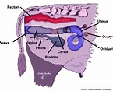
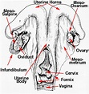
Gross Position of Female Genital organs-cow

Slide 4
The Ovaries
The ovaries have two functions - "production" and ovulation of oocytes and the production and secretion of hormones.
The ovary is attached to the broad ligament by a short fold of peritoneum, called the mesovarium (or ligament of the ovary),
through which vessels and nerves pass to the ovary and enter it at the hilus of the ovary.

Slide 5
HISTOLOGY OF OVARY
TM-LEM is lined by cuboidal epithelium, also called germinal epithelium.
It is continuous with the peritoneal mesothelium. Fibrous connective tissue forms a thin capsule, the tunica albuginea, immediately beneath the epithelium.
Like so many other organs the ovary is divided into an outer cortex and an inner medulla.
The cortex consists of a very cellular connective tissue stroma in which the ovarian follicles are embedded. The medulla is composed of loose connective tissue, which contains blood vessels and nerves.

Slide 6
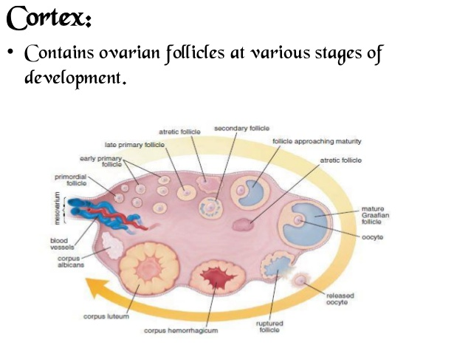
Cortex and Medulla part of ovary

Slide 7
Cortex and Medulla part of ovary
In a mature or adult animal, the cortex will contain ovarian follicles, in various stages of development and regressions. Smaller follicles with the ovum surrounded by a layer of follicular cells are located near the periphery.
They pass deeper into the ovary as they become larger and develop further but the matured follicle again approaches the surface.
The follicle are described as primary, secondary, Graafian and mature Graafian follicles.

Slide 8
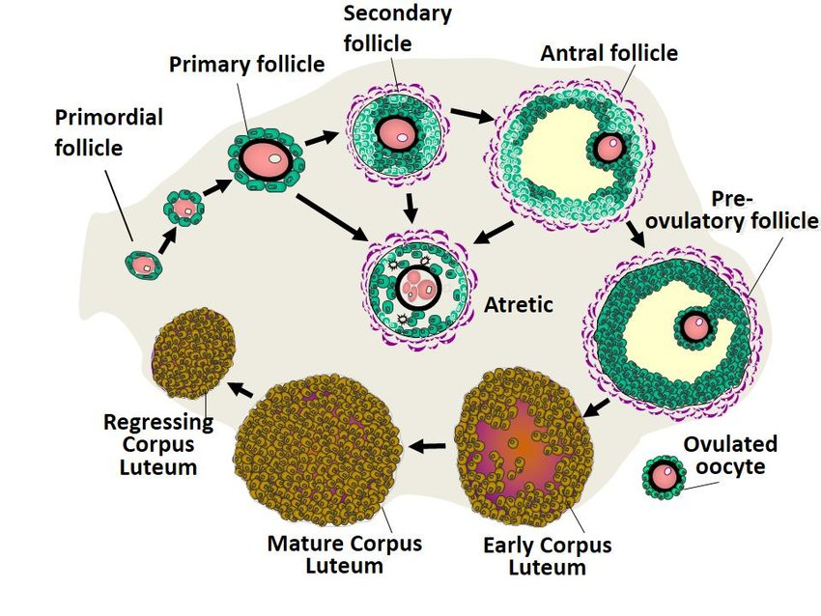
Cortical regions shows different stages of development of follicles

Slide 9
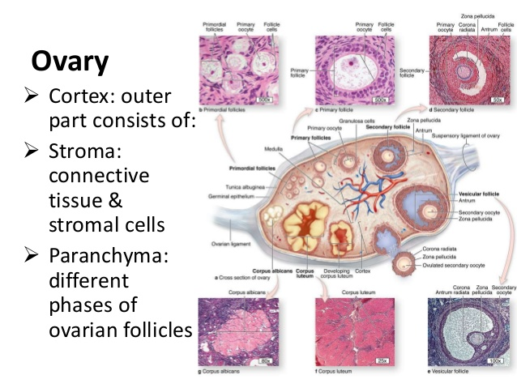
Histology of ovary conti..

Slide 10
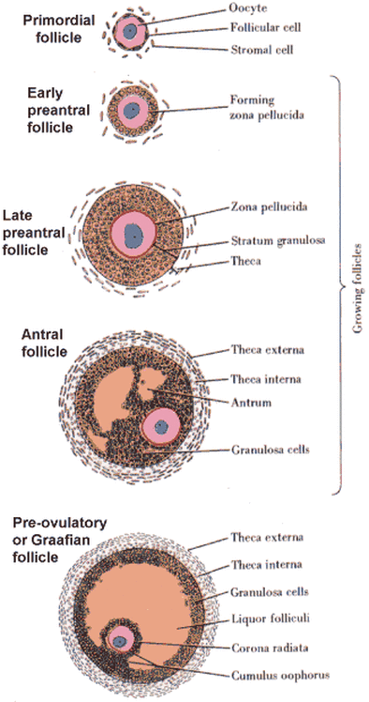
Different developmental follicles

Slide 11
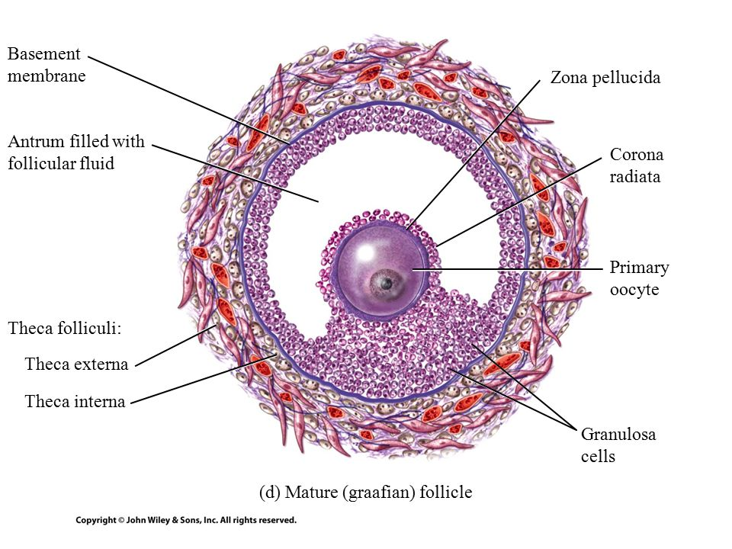
Matured Follicle or Graffian follicle

Slide 12
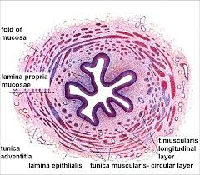
Histology of fallopian tube

Slide 13
Histology of Fallopian tube

Slide 14
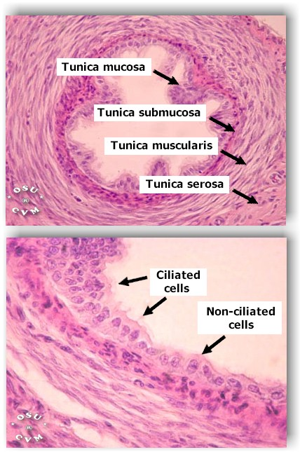
Histology of fallopian tube

Slide 15
Histology of fallopian tube conti..
Play major roles for transportation of eggs and fertilization takes place.
Having 3 parts Infundibulum, Ampula & Isthmus.
Mucosa is highly folded i.e.-Primary Secondary and Tertiary types.
TM-LEM- Simple Columnar epithelium, Pseudostratifeied Ciliated Columnar in (Ruminanat & Swine) More cila in infundibulum. – LMM- absent, LP+SM- Loose CTF with Reticular fibers
TMM- I/C,O/L-Thickest in isthmus & Thinnest in Ampulla. TA/TS-Highly vascular, LCT covered with preritoneal mesothelium

