Slide 1
Animal Cell Culture
VPB-321
(Animal Biotechnology)
Anil Gattani/Ajeet Kumar

Slide 2
Stem
Make proteins:
and cancer
commercial
cells
scale
CELL CULTURE
Primary Human
Antibody
and animal
production:
Cell culture
Why do it ?
monoclonals
Gene
Embryo
Therapy
culture

Slide 3
Cell Culture
Cell culture is the process by which cells are grown under controlled conditions, generally outside of their natural environment.
Tissue or cell Culture is the general term for the removal of cells, tissues, or organs from an animal or plant and their subsequent placement into an artificial environment for growth

Slide 4
History
Year | Achievement
1885 | Roux maintained embryonic chick cells in a saline culture
1907 | Harrison cultivated frog nerve cells in a lymph clot and observed the growth of nerve fibers in vitro for several weeks He was considered by some as the father of cell culture
1911 | Lewis and Lewis made the first liquid media
1916 | Rous and Jones introduced proteolytic enzyme trypsin
1952 | Gey established a continuous cell line from a human cervical carcinoma known as HeLa (Helen Lane) cells Dulbecco developed plaque assay for animal viruses using confluent monolayers of cultured cells
1975 | Kohler and Milstein produced the first hybridoma cell
1978 | Sato established the basis for the development of serum-free media

Slide 5
Major development’s in cell culture technology
First development was the use of antibiotics which inhibits the growth of contaminants.
Second was the use of trypsin to remove adherent cells to subculture further from the culture vessel
Third was the use of chemically defined culture medium.

Slide 6
Primary culture vs Cell line
Primary culture freshly isolated from tissue source
Cell line
Finite cell line: dies after several sub-cultures
Continuous cell line: transformed ‘immortal’

Slide 7
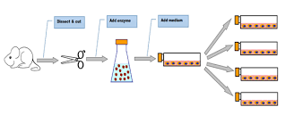

Slide 8
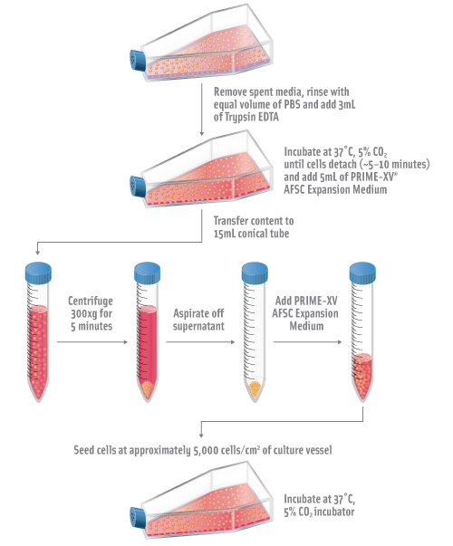
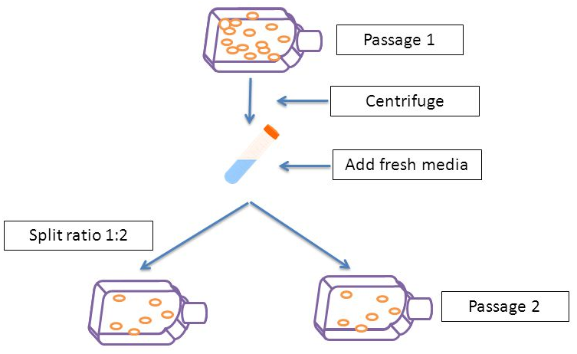
Sub culturing of cells
Suspension Cells
Adherent Cells

Slide 9
Primary culture
Establishment of primary culture includes:
Source of material
Isolation of cells
Explant cultures
Substrate for attachment
Culture conditions

Slide 10
Source of material:
Normal or tumor derived
Adult or embryo (age at isolation)
Species
Animal or human
Legislations : Animal ethics committee(AEC)
Office of Animal Welfare in USA
Home Office in UK
Use of embryos or fetuses beyond 50% gestation or
incubation – Animal Experiments act of 1986
Human biopsy samples: Local hospital ethics committee
Evidence of ethical consent

Slide 11
Isolation of cells :
Cells in circulation- easily obtained from blood ,separating cell type of interest (Separation of PBMCs)
Solid tissue: release of cells and purification of cells of interest by disaggregation
Method of disaggregation depends on:
Nature of the tissue
Amount of material
Disaggregation by enzymatic or mechanical method

Slide 12
Enzymatic disaggregation:
Incubation of tissue in proteolytic enzymes
Trypsin, Collagenase, Elastase, Hyaluronidase, Pronase, Dispase or combination of these
Collagenase : effective for fibrous tissue
Collagenase and dispase : less damage to cells as compared to trypsin
Trypsinization :
Warm trypsinization
Cold trypsinization

Slide 13
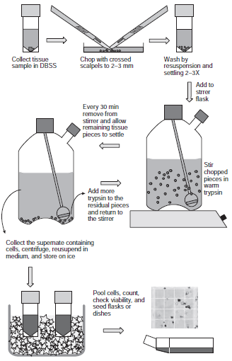
Warm Trypsinization
Rapid (minimum exposure )
Short period of incubation at 37°C
Used for whole embryo
Disaggregation of large amount of tissue in shorter time.

Slide 14
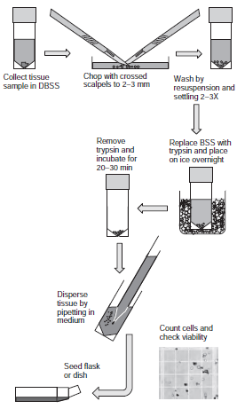
Cold Trypsinization
Slow
Long period of incubation at 4°C
Lesser cell damage
Higher cell yield
Mouse embryonic tissue : wider variety of different cell types

Slide 15
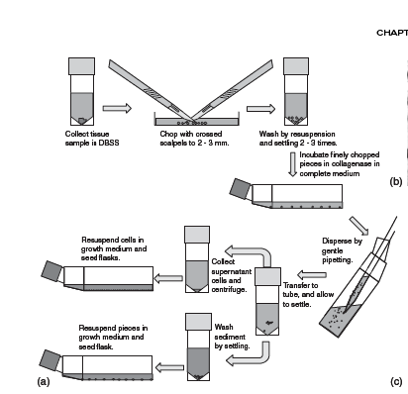
Enzymatic digestion using collagenase
too fibrous or too sensitive tissue
Suitable for the culture of human tumors, mouse kidney, human adult and fetal brain, liver, lung, and many other tissues, particularly epithelium

Slide 16
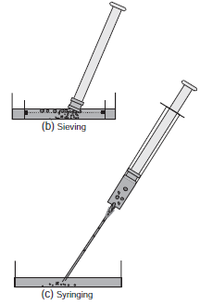
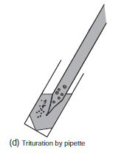
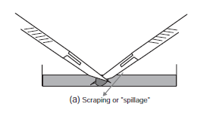
Mechanical disaggregation
Mechanical means
Faster than enzymatic
More damage
Low recovery rates
Soft tissues like brain and spleen
Sieving
Scraping or "spillage"
Syringing
Trituration by pipette

Slide 17
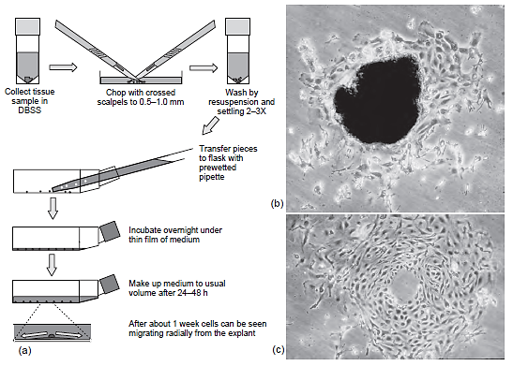
Explant cultures:
Used for small amount of tissue
Usually established for punch biopsies
PEC:mouse squamous skin carcinoma;
explant 3 days after explantation
Outgrowth after removal of explant,
about 7 days after explantation

Slide 18
Substrate for attachment :
Anchorage dependent cells requires a substrate to grow
Specialized substrates :
Micro carrier beads/fibers for large sacle culture of adherent cells
Disposable plasticwares (polystyrene)
Coating with matrix proteins Collagen, laminin, gelatin, fibronectin
Change charge of the surface-- Poly-L-lysine

Slide 19
8 well culture dish.
Allows comparison of 8 samples:
can have different stains or
are fixed at different times.
THEN- remove wells and gasket.
Leaves ONE slide with 8
separate samples for easy
microscopic analysis
of (stained) cells
96 well plate
Allows comparison of many
culture conditions.
Samples often in triplicate.

Slide 20
Culture conditions:
Type of medium
Selection against some cell types
Mixture of cells
Stromal fibroblast
Hydroxyproline, phenobarbitone suppress fibroblast growth
D-valine - selection of epithelial cells
Serum free media for specific cell types

Slide 21
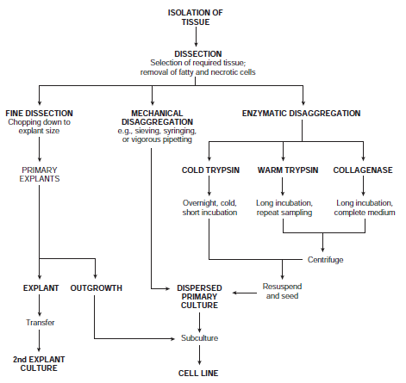

Slide 22
Types of primary cell culture (according to cell source)
Epithelial cells
Mesenchymal cells
Neuroectodermal cells
Haematopoietic cells
Gonads
Stem cells

Slide 23
Epithelial cells
Cover organs and line cavities (i.e. skin) cobblestone morphology, form monolayer, anchorage dependent, need solid substratum
Epidermis
Cornea
Mammary gland
Cervix
Gastrointestinal Tract
Liver
Pancreas
Kidney
Bronchial and Tracheal Epithelium Oral Epithelium
Prostate

Slide 24
Fibroblast
Spindle-shaped, often striated, form parallel lines as they attach to substrate
contaminant in other slow growing primary cells.

Slide 25
Muscle cell
Follows a series of differentiation steps from precursor cells (myoblasts), leading to cell fusion, form multinucleate complex
Mature cells don’t grow well, but are used to study cell differentiation

Slide 26
Nerve cell
Transmit electrical impulses
Can grow embryonic neurons, not adult
Addition of nerve growth factors cause the formation of outgrowths called neurites

Slide 27
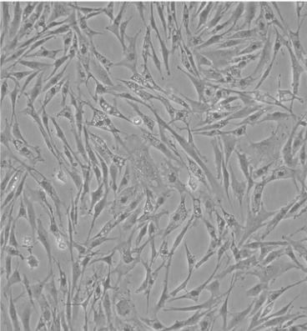
Embryonic fibroblast culture
Chicken Embryonic fibroblast culture
Source of mesenchymal cells – cell proliferation analysis
Easier to dissect
Common source of feeder layers
Virus propagation
Generate specific cell types
8-13 days old chick embryos used

Slide 28
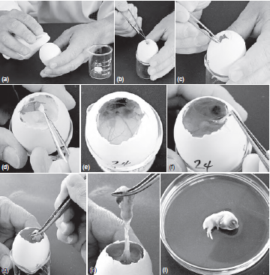
Isolation of chick embryo

Slide 29
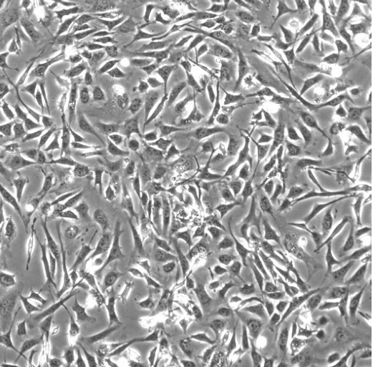
Mouse Embryonic fibroblast culture
Mouse embryo is source of undifferentiated mesenchymal cells
Full term: 19-21 days
Optimal age for preparing cultures from a whole disaggregated embryo : 13days
Isolation and handling of embryo beyond 50% gestation requires license so 9-10 day embryo preferred
Common source of feeder layers

Slide 30
Isolation of mouse embryo
Swabbing the abdomen
Tearing the skin and opening of abdomen
Revealing the uterus in situ
Removing the uterus

Slide 31
Dissecting the embryos from uterus
Removal of membranes
Removal of head
Transferring the pieces to typsinization flask (warm trypsinization)
Chopping the embryos
Transferring the pieces to typsinization flask in ice(cold trypsinization)

Slide 32
Kidney cell culture
Structurally complex organ
Morphologically distinct cell types
Cellular heterogeneity - challenge to isolate pure or highly enriched cell populations
Several approaches to culture specific cells
Density gradient methods
Used to isolate enriched populations of enzyme-digested tubule segments
Effective in establishing proximal tubule cell cultures
Microdissection
Collection and explantation of specific nephron or collecting duct segments

Slide 33
MDCK (Madin-Darby Canine Kidney Cells)
A canine kidney cell line isolated in the late 1950s from normal cocker spaniel tissue.
To study protein trafficking and the establishment of cell polarity in epithelia, but also have more applied uses such as viral production for the vaccine industry
Susceptible to viruses like Vesicular stomatitis (Indiana strain), vaccinia, coxsackievirus B5, reovirus 2 and 3, adenovirus 4 and 5, vesicular exanthema of swine, and infectious canine hepatitis
Human Embryonic Kidney 293 cells(HEK 293, HEK-293, 293 cells, or HEK cells)
specific cell line originally derived from human embryonic kidney cells grown in tissue culture.
Very easy to grow and transfect very readily
Involve transfecting in a gene (or combination of genes) of interest, and then analyzing the expressed protein

