Slide 1
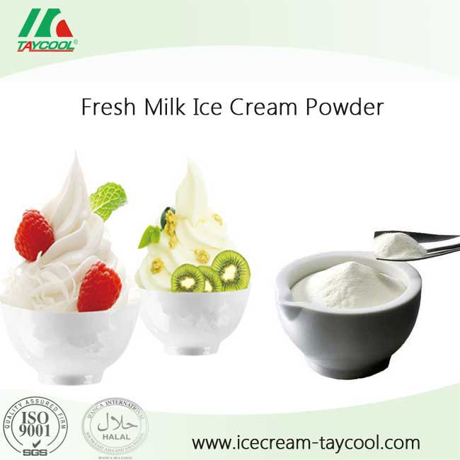
Department : Dairy Technology Course Title : Ice Cream & Frozen Desserts Course No. : DTT -222 Semester- 4th Course Teacher: Dr. Bipin Kumar Singh
DRIED ICE CREAM MIX

Slide 2
Introduction
Ice cream is a delicious, wholesome,frozen dairy product and is liked equally by the people of all age groups. Ice cream is obtained with the addition of milk, cream, sugar in certain proportions and freezing. During lean season, there is a acute shortage of milk and milk products. Significant advancements in drying techniques have overcome this difficulty by manufacturing ice cream mix powder during flush season and using it during lean season for the ice cream manufacture. The advantages claimed for dried ice cream mix are reduction in volume with a consequent saving in storage space, ease of packaging and handling, lesser perish ability,refrigerated storage space not necessary and lower transportation costs due to reduction in weight.

Slide 3
Composition of Dried Ice Cream Mix
SNO. | Constituents | Percentage%
1 | Moisture(Max.) | 4.0
2 | Milk Fat(Max) | 27.0
3 | Milk Protein(Max) | 9.5
4 | Sucrose(Max) | 40.0
5 | Stabiliser & Emulsifier(Max) | 1.25

Slide 4
Manufacture of Dried Ice Cream Mix
A typical mix would be prepared in the following manner:
Liquid ingredients are weighed/metered into the process vessel. Heating follows to aid melting of the fat and dissolving/hydration of subsequent ingredients.
Powdered ingredients - skim milk powder, sugars, whey powder, etc. are added to the liquid and mixed until dispersed.
Stabilizing and emulsifying agents are added. These may be dry premixed with other ingredients, (e.g. sugar) to reduce particle agglomeration and “weight” the powder to aid incorporation into the liquid.
Fat is added. Butter or other solid fats may be melted in a separate vessel before addition to the mix.
The mix is pasteurized at around 185ºF (85ºC).
The mix is homogenized, usually by passing through a high pressure homogenizer.
The product is then “aged” in a holding (or ripening) tank to allow the stabilizing agents to hydrate and the fat to crystallize.
Flavor and coloring may be added at this stage.
The finished mix is frozen in special freezers which whip a controlled amount of air into the mix.

Slide 5
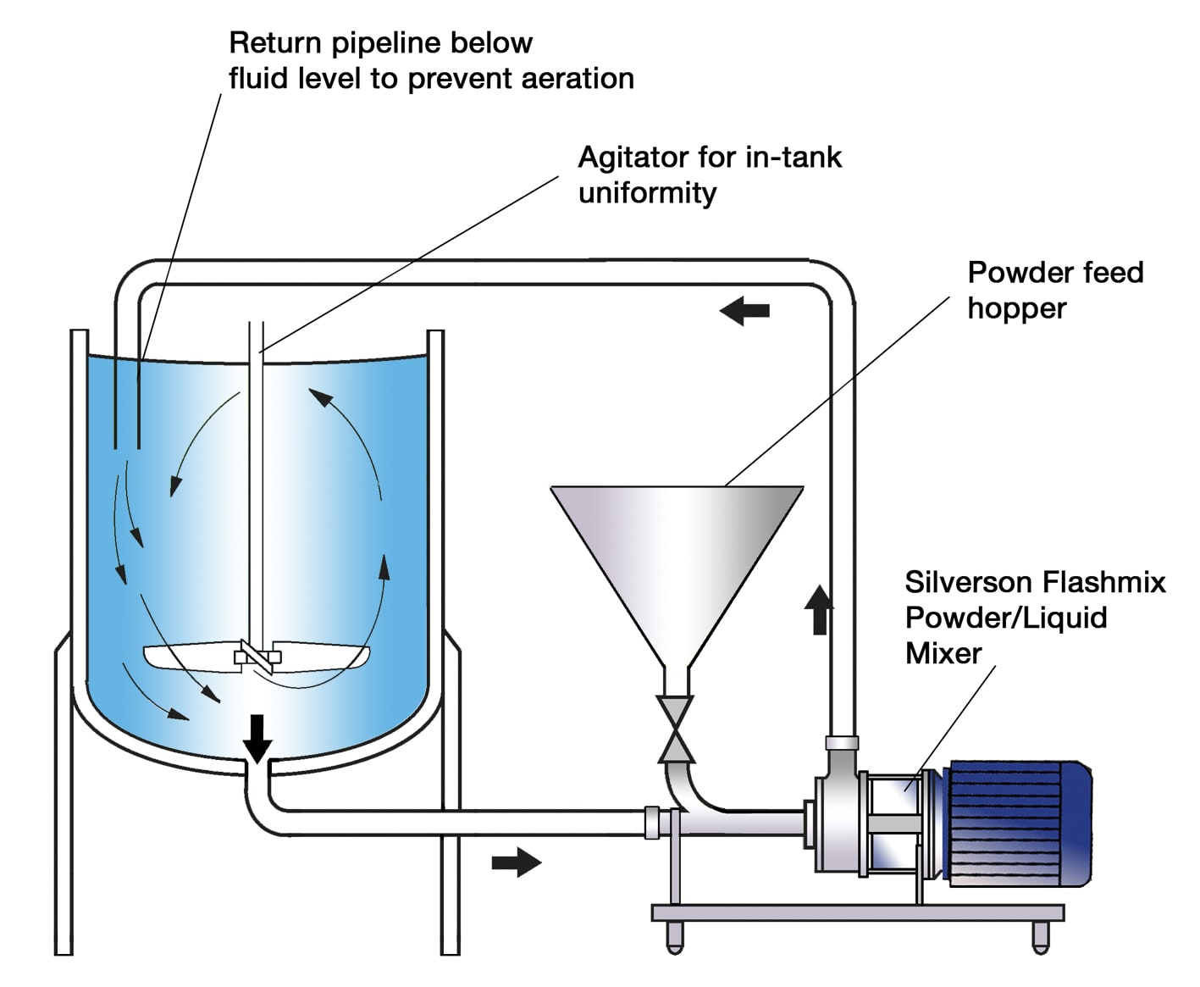

Slide 6
The Problem
Mixing powders into liquids is one of the most difficult mixing operations. The process is subject to a number of problems when using conventional powder/liquid wetting systems and agitators:
Powder must be added at a controlled rate to reduce agglomeration of particles.
Premixing of powders increases labor costs and process time.
SMP, whey powder and cocoa powder (used in chocolate ice creams) are very cohesive, making handling and controlled powder addition difficult.
Stabilizing and emulsifying agents have an even greater tendency to agglomerate and require special handling.
Conventional systems do not produce sufficient shear to break down agglomerates.
Long processing times are required to complete dispersion and achieve a satisfactory consistency.
Cocoa (where used) needs to be thoroughly wetted and “cooked” to prevent it imparting a “gritty” or “floury” texture to the ice cream.

Slide 7
The Solution
Stage 1
The high speed rotation of the rotor blades creates a powerful suction which draws the liquid and solid/powdered ingredients into the workhead. These can be added without the need for pre-mixing.
Stage 2
The materials are subjected to intense shear in the confined area of the workhead. Agglomerates are broken down in the gap between the rotor blades and stator wall.

Slide 8
Contd..
Stage 3
A lump-free mixture is rapidly obtained. The product is forced out of the stator as fresh material is drawn into the workhead. A circulatory mixing cycle develops in which all the material passes through the workhead.

Slide 9
The Advantages
Premixing of powdered ingredients is not necessary.
Agglomerate-free mix.
Stable emulsion.
Rapid mixing times.
Maximized yield of raw materials as thickening agents are fully hydrated and other ingredients are properly dispersed.
Uses:
It is convenient to use as a value added product.
Soft serve ice cream manufacturers have a great utility of this product.

Slide 10
LIQUID VS. POWDER ICE CREAM MIX
LIQUID ICE CREAM MIX
THE PRODUCT -
Liquid ice cream mix creates the quintessential soft serve ice cream, the type of product you remember eating as a child. The taste and texture are similar to that of the large chains that carry soft serve, like Dairy Queen. In more technical terms, liquid ice cream mix is dairy-based and the butterfat content is higher (4-6%), creating a smoother ice cream with fewer ice crystals.
DISTRIBUTION, STORAGE & PRICE -
Liquid ice cream mix must be kept refrigerated below 40℉ and has a short shelf life, requiring rapid distribution and quick use. Not every distributor has the ability to distribute liquid mix, due to its short shelf life. Therefore, liquid soft serve mix is not available everywhere.
These requirements make transporting this kind of ice cream difficult, putting a strain on distribution and transportation on all levels. Thus, liquid mix is recommended for shops, restaurants, and those making ice cream on-site and where the distribution of the liquid mix is available.
Liquid ice cream mix will run you a few more dollars than powder, due to the higher fat content. Fat equals money, in this case, and higher fat content means a more expensive product.

Slide 11
Contd…
POWDER ICE CREAM MIX
THE PRODUCT -
Did you ever eat ice cream at the county fair as a kid? You probably enjoyed ice cream made from powder mix then! Powder ice cream mix is usually nondairy. Compared to liquid mix, powder ice cream mix has a little bit more crystallization.
DISTRIBUTION, STORAGE & PRICE -
Powder mix has a stable shelf life and is easily transportable, making it effective and efficient for distribution. These features allow the mix to be shipped anywhere, making powder mix convenient for those without liquid mix distribution.
Easy transportation also allows the customer to make ice cream virtually anytime and anywhere - ice cream machine and electricity withstanding.
For these reasons, powder mix is great for fairs and festivals or for any seller that needs to travel with their product. Powder mix will also cost you less, due to a lack of fat in the mix. And that's a plus for everyone!

Slide 12
Benefits of Dry Mixes
Free recipe support
Simple to use Hydrate with milk Long Shelf Life Low Shipping Costs Cost Effective
Easy to Store
No refrigeration required

