Slide 1
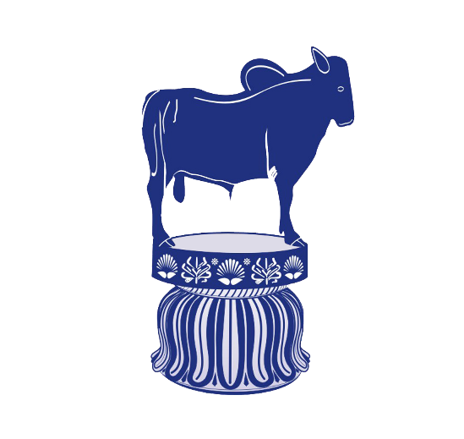
General information of Horse and its Management
Presented by
Dr. Ravikant Nirala
Assistant Professor
Livestock Production Management
Bihar Veterinary College, Patna - 14

Slide 2
Position of horse in Animal kingdom
Kingdom: Animalia
Phylum: Chordata
Class: Mammalia
Order: Perissodactyla
Family: Equidae
Genus: Equus
Species: Equus caballus (Horse)
Equus asinus (Ass)
The horse has evolved over the past 45 to 55 million years from a small multi-toed creature, Eohippus, into the large, single-toed animal of today.
It is an odd toed ungulate mammals.

Slide 3
Diagrammatic anatomical presentation of Horse

Slide 4
Diagrammatic presentation of Horse

Slide 5
Horse and Donkey

Slide 6
Common terminology associated with Horse
Species: Equus
Adult male: Stallion
Adult male breeder: Stud
Adult female: Mare
Young born male/ female : Foal
Young male upto 3 yrs: Colt
Young female upto 3 yrs: Filly
Gestation period: 336 days
Age of Maturity: 15-24 months
Breeding life 18 years
Estrous length: 21 days + 5days
Estrous Period: 4 to 6 days
Normal temp.: 99.5-101.3 F
Male: Female= 1:30-40
RR: 8-16/m
HR: 32-44/m
Av. Productive life: 20-25 yrs

Slide 7
Castrated male: Gelding
Castrated female: Spayed
Female with offspring: Suckling
Young weaned male/ female :
weanling
Act of Parturition: foaling
Act of mating: Covering
Sound: Neigh
Chromosome No. Horse: 64
Donkey: 62
Meat of Horses: Kinophagia
Volume of Semen: 75 -150 ml
Sperm count: 150 millions/CC
Best breeding season: Early spring
First heat after Parturition: 4-14 d
House of Horse: Stable

Slide 8
Milk composition
C : 6.1 %
P : 2.7 %
F : 1.6 %
M : 0.51 %
Water: 90 %

Slide 9
Introduction
The equine comprises Horses, donkeys (Ass) and their crosses like Mule and Hinny.
They are used for cart/ draught, pack, transport, meat and riding purposes.
It used every where from plain, desert to hill.
The riding horses have use in carrying urgent messages and win the battles in warfare.
It is symbol of royalty.
There is sharp decline in its number due mechanization.
The population of horses and donkeys are more in western parts of India in which wild asses are found in Rann of Kutchh.
Horses are mainly used for riding, but asses and mules are used for transport.
Indian asses are donkeys, wild asses and kiang in Sikkim and laddakh.

Slide 10
Horses are adapted to run, allowing them to quickly escape predators, possessing an excellent sense of balance and a strong fight-or-flight response.
Related to this need to flee from predators in the wild is an unusual trait.
horses are able to sleep both standing up and lying down, with younger horses tending to sleep significantly more than adults.
Female horses, called mares, carry their young for 11 months and foal, can stand and run shortly following birth.
Training under a saddle or in a harness between the ages of two and four.

Slide 11
Horse breeds are loosely divided into three categories based on general temperament: spirited
Hot bloods" with speed and endurance;
Cold bloods", such as draft horses and Ponies, suitable for slow, heavy work; and
Warmbloods", developed from crosses between hot bloods and cold bloods, often focusing on creating breeds for specific riding purposes, particularly in Europe.
There are more than 300 breeds of horse in the world today, developed for many different uses.
Horses and humans interact in a wide variety of sport competitions and non-competitive recreational pursuits, as well as in working activities such as police work, agriculture, entertainment and therapy.
Many products are derived from horses, including meat, milk, hide, hair, bone, and pharmaceuticals extracted from the urine of pregnant mares.
Humans provide domesticated horses with food, water, and shelter, as well as attention from specialists such as veterinarians and farriers.

Slide 12
The height of horses is measured at the highest point of the withers, where the neck meets the back.
In English-speaking countries, the height of horses is often stated in units of hands and inches:
One hand is equal to 4 inches (101.6 mm). The height is expressed as the number of full hands, followed by a point, then the number of additional inches, and ending with the abbreviation "h" or "hh" (for "hands high").
Thus, a horse described as "15.2 h" is 15 hands plus 2 inches, for a total of 62 inches (157.5 cm) in height.
The size of horses varies by breed, but also is influenced by nutrition.
Light riding horses usually range in height from 14 to 16 hands (56 to 64 inches, 142 to 163 cm) and can weigh from 380 to 550 kilograms.
Larger riding horses usually start at about 15.2 hands (62 inches, 157 cm) and often are as tall as 17 hands (68 inches, 173 cm), weighing from 500 to 600 kilograms.
Heavy or draft horses are usually at least 16 hands (64 inches, 163 cm) high and can be as tall as 18 hands (72 inches, 183 cm) high. They can weigh from about 700 to 1,000 kilograms.
The largest horse in recorded history was probably a Shire horse named Mammoth, who was born in 1848. He stood 21.2 ¹⁄₄ hands (86.25 inches, 219 cm) high and his peak weight was estimated at 1,524 kilograms.
The current record holder for the world's smallest horse is Thumbelina, a fully mature miniature horse affected by dwarfism. She is 17 in (43 cm) tall and weighs 57 lb (26 kg)

Slide 13
Ponies are taxonomically the same animals as horses. The distinction between a horse and pony is commonly drawn on the basis of height, especially for competition purposes.
However, height alone is not dispositive; the difference between horses and ponies may also include aspects of phenotype, including conformation and temperament.
The traditional standard for height of a horse or a pony at maturity is 14.2 hands (58 inches, 147 cm).
An animal 14.2 h or over is usually considered to be a horse and one less than 14.2 h a pony.
Horses exhibit a diverse array of coat colors and distinctive markings, described by a specialized vocabulary.
Often, a horse is classified first by its coat color, before breed or sex.

Slide 14
They have the largest eyes of any land mammal.
They have lateral-eyed, meaning that their eyes are positioned on the sides of their heads.
This means that horses have a range of vision of more than 350°, with approximately 65° of this being binocular vision and the remaining 285° monocular vision.
Horses have excellent day and night vision, but they have two-color, or dichromatic vision; their color vision is somewhat like red-green color blindness in humans, where certain colors, especially red and related colors, appear as a shade of green.
Their sense of smell is much better than that of humans, is not quite as good as that of a dog.
It is believed to play a key role in the social interactions of horses as well as detecting other key scents in the environment.
Horses have two olfactory centers.
Horses have a great sense of balance, due partly to their ability to feel their footing and partly to highly developed.

Slide 15
Terminology in Equine Production
Mare: A mature female horse of four years of age and given birth of a foal.
Stallion: A mature uncastrated male horse of four years of age.
Gelding: A castrated male horse of all ages.
Colt: A young uncastrated male horse.
Filly: A young female horse under 3-4 years of age. After foaling………. mare.

Slide 16
Foal: A young horse of either sex under the age of one year such as Colt foal and Filly foal.
Foaling: The act of giving birth by mare.
Foal at foot: A suckling foal running with its dam/mare.
Covering: Mating in horses.
Broodmare: A mare that is used for horse breeding.

Slide 17
Stud: An establishment where pedigreed stallion being kept for breeding.
Stud Book: A list of horses of a particular breed whose parents are known.
Hand: A measurement of the height of a horse. One hand is equal to 4 inches. The measurement is usually taken from the ground to the withers.
Pony: A horse breed that typically measures shorter than 14.2 hands (58 inches, 147 cm). it is used in sport of polo.
Horses: Individual animals of breeds that typically measure over 14.2 hands (148 cm, 58.27 in) of height without shoes and over 14.2½ h (149 cm, 58.66 in) (just) with shoes. Cut off height: 14 hands

Slide 18
Jack: An uncastrated male donkey or ass.
Jennet/Jenny: A female donkey.
Jockey: The rider of a horse in horse racing.
Mule: Hybrid offspring of a male donkey and a horse mare. Almost always sterile. Mules are noted for their sure-footedness.
Hinny: The sterile hybrid offsprings of horse stallion and female donkey.
Zebroid: Hybrid offspring of a zebra crossed on another equine.

Slide 19
Neigh: A sound made by a horse.
Stable: A building in which horses are kept.
Grooming: Cleaning horses for hygienic, practical or esthetic reasons.
Doping: Illegal use of medicines to improve a horse's performance in racing/showing or to harm an animal to perform poorly by an opponent.
Farrier: A professional hoof care specialist who does hoof trimming and horse shoeing.

Slide 20
Horses
Family: Equidae Scientific name: Equus caballus
Odd-toed ungulate mammal.
Important role in transportation, agriculture, sports and warfare.
Light riding horses: 14.0-16.0 hands weighing 386-540 kg. Ex. Arabians, Morgans, Quarter Horses.
Larger riding horses: 15.2-17 hands weighing 540-680 kg. Ex. Thoroughbreds, American Saddlebreds, Warmbloods.
Heavy/draft horses: 16.0-18.0 hands weighing 680-900 kg. Ex. Clydesdale, Belgian, Percheron and Shire.

Slide 21
Pony
Shorter than 14.2 hands (58 inches, 147 cm).
Ponies often exhibit thicker manes, tails and overall coat.
Proportionally shorter legs, wider barrels, heavier bone, shorter and thicker necks and short heads with broad foreheads.
Calmer temperaments than horses and high level of equine intelligence.

Slide 22
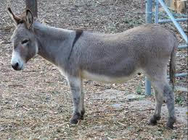
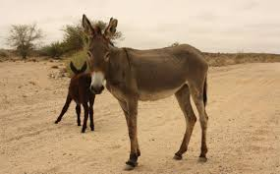
Donkey
Donkeys' ears are much longer in proportion to their size.
Straighter necks and back due to lack of true wither.
Coarse mane and tail.
Smaller and rounder hooves with more upright pasterns.
Characteristic brassy bray sound.
Colors from gray shades of gray-dun to brown, black, light-faced roan.
Sizes: 36" and under (Miniature Mediterranean), 36.01-48" (Standard), 48.01" to 56" (Large Standard).

Slide 23
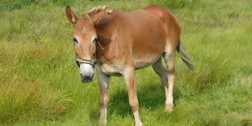
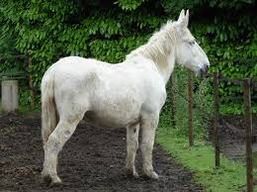
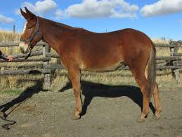
Mule
Body of a horse with the extremities of a donkey.
Grow taller than both parents due to hybrid vigour.
Stronger than horses.
Long ears, short thin mane, tail with shorter hairs.
Legs like the donkey with small and upright hooves.
Stubbornness and bad-tempered but highly intelligent.

Slide 24
Thanks

