Slide 1
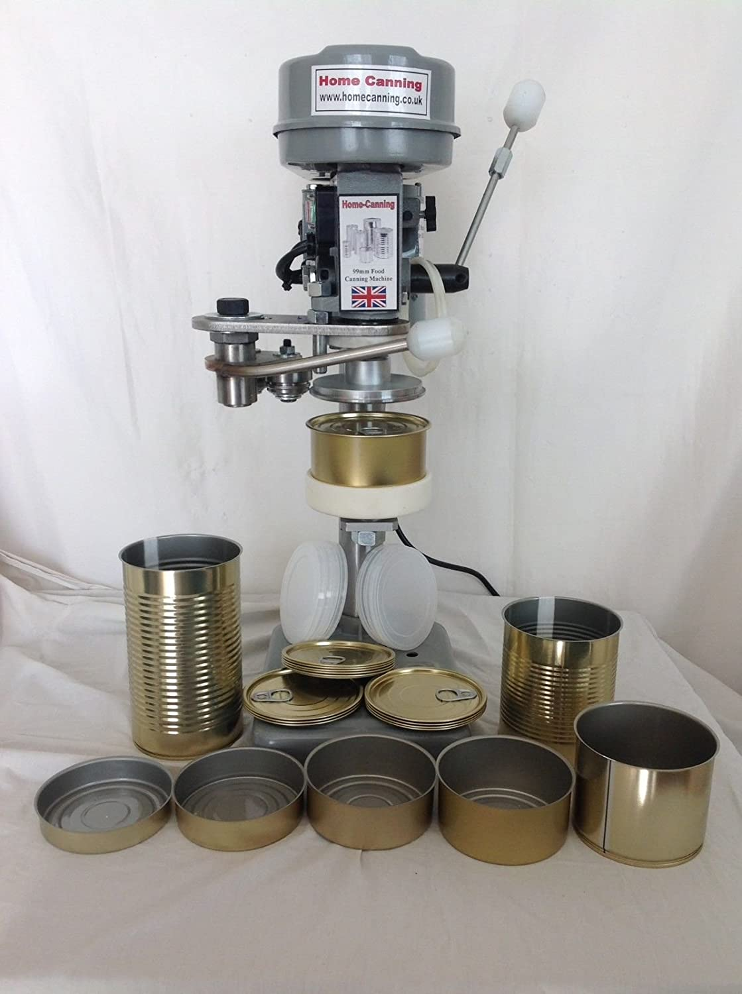
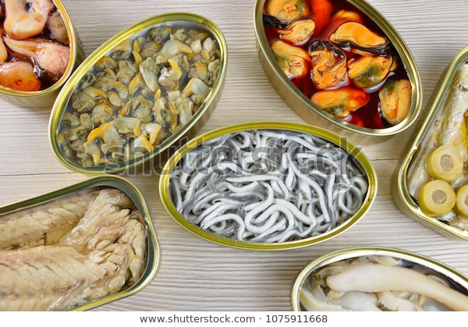
Canning Operation
By
Dr. Abhishek Thakur
(Assistant Professor)
College of Fisheries, Kishanganj
BASU, Patna

Slide 2
Introduction
Principles of canning
The principles behind canning is that application of sufficient amount of heat to food in an air tight container in such a way that food is free from spoilage as well as pathogenic microorganism. This technique is given by Nicholas Appert, 1809.
There are three essential maxims of canner safety –
Container seal integrity- Faulty seal recontaminate the container.
Adequate thermal process lethality- Which required to effectively eliminate the most dangerous & heat resistant pathogen (C. botulinum).
Scrupulous post-process hygiene- Use chlorinated cooling water to prevent recontamination.

Slide 3
Steps involved in canning
Selection and Preparation of Fish
Salting/Blanching/Precooking
Can filling
Exhausting
Can Coding
Can Seaming
Can Washing
Thermal Processing
Cooling the container& contents, drying, labelling & storing

Slide 4
Selection and Preparation of Fish
Fresh uncontaminated fish should be used as the raw material for canning.
Dressing needs depend on type of fish & the type of end product desired:
Bivalve (Clams, Mussel, Oyster)- Depuration.
Tuna – Bleeding.
Shrimp – Peeled & Deveined.
Small fishes (Sardine) - Beheading, Gutting, Scaling & Removal of fin & tails

Slide 5
Salting/Blanching/Precooking
Salting/Brining & its purpose: -
It consists of keeping or immersing the cut pieces of fishes in saturated salt solution at required length of time.
Its purpose is-
To give a salty taste.
To make a texture of fish firmer i.e., to improve the texture.
For appearance of the product. It will clean the blood & slime.
It also removes the problem of curd formation in canned product.

Slide 6
Salting/Blanching/Precooking
Blanching brine/precooking in steam & its function: -
Dressed fish is generally blanched in cold or hot brine or precooked in steam.
The main functions of this process are-
Causes sufficient shrinkage of fish to enable adequate filling in the cans.
Imparts firm & proper texture to the meat making its handling easy.
Cleanses the fish meat, reduces bacterial load.
Inhibits enzymatic action & maintains nutrition value by retarding browning reactions.
Sets the natural color & removes the raw flavor of fish.
Expels the respiratory gases from the tissues thus helping to improve vacuum in the can.
To reduce moisture content (15-30%) of fish (Hot Blanching).

Slide 7
Salting/Blanching/Precooking
Precooking & its purpose: -
It generally consists of cooking of fish in steam either after packing into the can or before packing outside the can.
Its purpose is –
To improve quality of fish.
To reduce moisture content (15-30%) of fish.
To make the texture firmer.
Helps to pack more quantity of fish.
Also helps in reducing the curd & thus improving overall appearance of the product.
Inhibits enzymatic action.
Expels the respiratory gases from the tissues

Slide 8
Can filling
The blanched material is filled in clean cans.
Then it is covered with a liquid medium like hot brine, oil or sauce.
The cans are filled in such a way that a uniform headspace (6-9mm) & ratio of solid to liquid should be uniform.
The can ends are clinched to the can body.

Slide 9
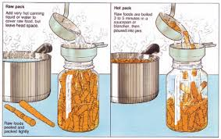
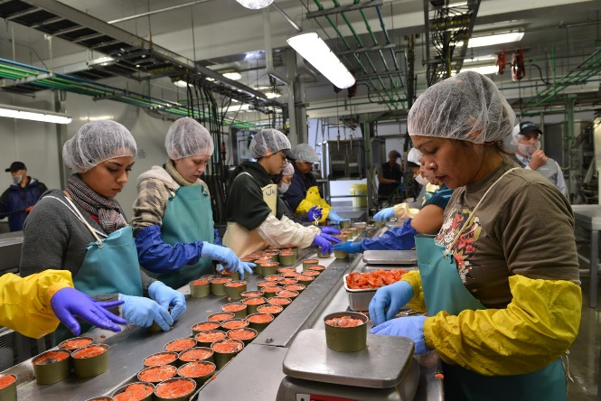
Can filling
Filling medium helps in improving taste, texture & flavour & most important role is helps in proper heat penetration in product during heat processing.
Double refined deodorised vegetable oil is the principal filling medium used in fish cans.
Tomato sauce ( Solid percentage 30%) is an important additives in canned sardine, mackerel, oyster etc.
Other additives used are CMC, MSG, Spices, Sugar etc. in specific case.

Slide 10
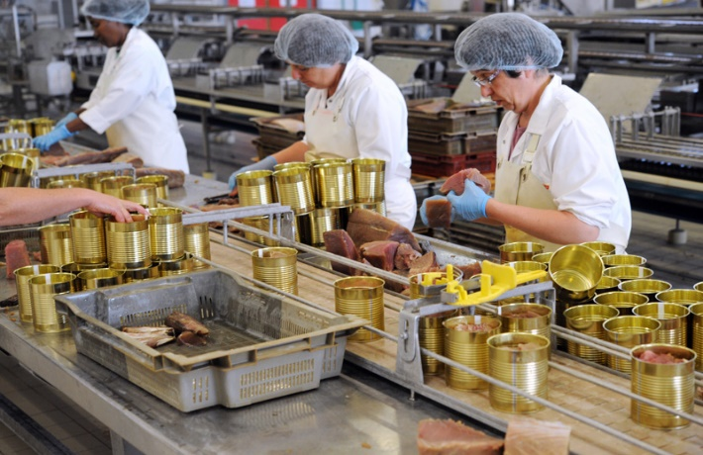
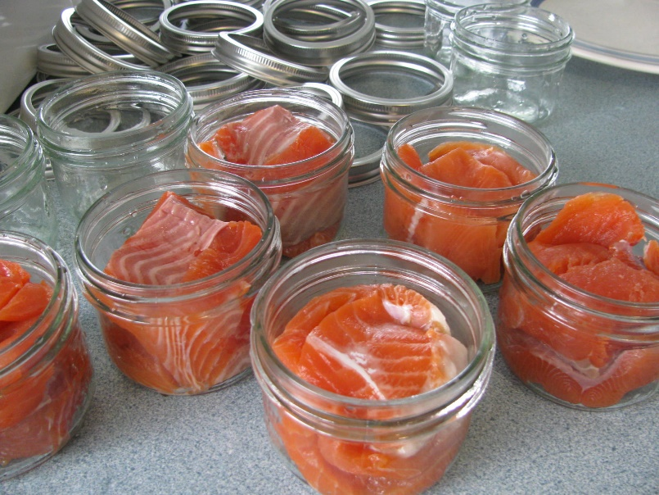
Can filling
During heat processing internal pressure is generated by
Expansion of can contents.
Increase in water vapour pressures.
Expansion of air and other gases in the fish.
Completely filled can would be subjected to excessive strain (Bulge) & cause uneven sterilization.
There should not be any air pocket.
Ratio of solid to liquid should be uniform.

Slide 11
Can filling
Yield rate & canning yield:
Yield rate (Y.R.) =
Case is the unit of can & normally we use 48 cans/case (i.e., in a box).
Canning yield (C.Y.) =
Weight of raw material x No. of cans/case
No. of cans produce
Packed weight x No. of Cans
Weight of raw material

Slide 12
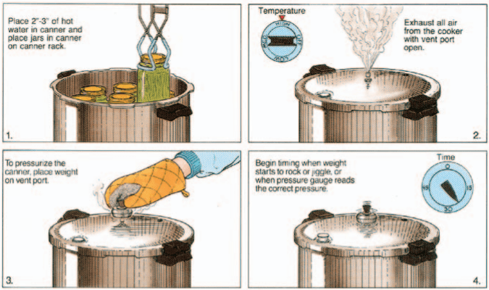
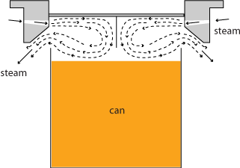
Exhausting
Exhausting is the process by which air from the contents & head space of a filled can is removed before seaming the can.
Its functions are-
Minimized the strain on the cans & seam due to expansion of air during heat processing.
Removes oxygen which accelerates internal corrosion of the can.
Creates a vacuum when the can is cooled.
Preserve Vit-C in fruit cans.

Slide 13
Exhausting
Different methods of exhausting are-
Heat exhaust (best method)- The contents of the can are heated at the required temperature before sealing can be done by two ways
(i) Heat the contents immediately before filling into can & to seal it quickly.
(ii) Contents may be cold filled into the can then passed through a steam exhauster (core temperature 80-85˚C) before sealing.
Mechanical exhaust- Can be filled with cold material & then sealed using vacuum sealing machine. Most commonly used where a vacuum sealing machine is used.
Steam injection- A blast of steam is injected into the headspace of the can as the lid is being positioned for sealing.

Slide 14
Can Coding
It is a statutory requirement to stamp the can ends with a code denoting the contents, date of manufacture & other details as demanded under food law.
For identification of can manufacture.
After exhausting can should be codded in figure & letters using an embossing machine.

Slide 15
Can Seaming
Cans are seams immediately after exhausting or along with exhausting.
The objective of can seaming is to get an air tight seal between cover and the body.
A good quality tinplate, adequate sealing compound and an efficient can closing machine combine to produce a strong hermetic double seam.
Sealed can are also subjected to pressure testing for checking the perfection of the seam.

Slide 16
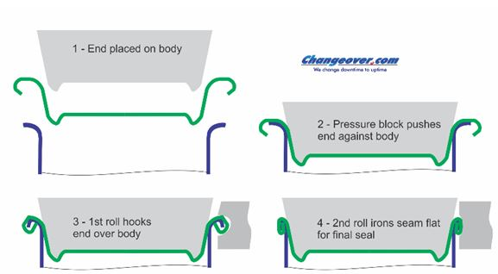
Can Seaming
Double seaming:
It is an operation, in which the curl of the lid and the flange of the can body are hooked, rolled and pressed by machine in two successive operations, so that an air tight joint is formed.

Slide 17
Can Seaming
Double seaming machine: -
Basically, consists of three parts-
Base plate- Which support the can & raised it with the end in position causing the chuck to fit firmly in countersink in the end.
Chuck- Which rotates on their own axis, causes the can with the end also to rotate.
Seaming roll- Which rotates on its own axis
first seaming roll with deep groove comes into operation & pressing tight & revolving at high speed round the curled rim of the end and tucks it under the flange of the body.
The second seaming roll with a shallow groove comes into operation & which tightly presses & flatten together the hooked edge of the can end & can body against the chuck thus forming final hermetic structure.

Slide 18
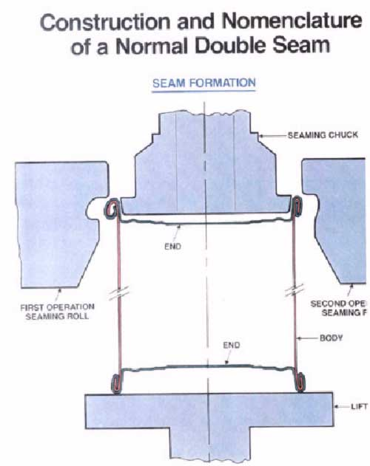
Can Seaming

Slide 19
Can Seaming
Cross section of seam

Slide 20
Can Seaming
Parts of seam
Seam thickness (T): distance from inner edge of the seam to outer edge of the seam.
Seam length/ width (W): distance from top edge of the seam to the bottom edge of the seam.
Cover/end hook length: length of the end seaming panel curl.
Body hook length: length of the portion of body flange, which is turned down during double seaming.
overlap: distance where the body hook and cover hook are overlapped.
Counter sink: distance from top edge of the finished seam to the can end.
Seam Gap: distance between the can body and cover end at the top of the double seam

Slide 21
Can Seaming
Seam Dimension:
the seam thickness depends on the thickness of the plate. The thickness of the tin plate differs from one can manufacturer to the other.
Finished double seam consist of five thickness of metal.
Where it concides with body seam: seven thickness of metal.
If blank is not notched, the double seam where it meets the lock seam will consist of eleven thickness of metal
Average seam dimensions:
width: 0.117 to 0.125” upper limit.
Counter sink: 0.125- 0.128”
Body hook length: 0.075-0.085”
Cover hook length: 0.075-0.085”
Seam thickness: 0.05- 0.06”

Slide 22
Can Seaming
Formula for thickness of seam:
Basically 5 metal parts are involved in seam thickness.
T=3tc+2tb+gap(G)
Tc = thickness of cover tin plate
Tb = thickness of body tin plate
G = gap (6-10% of 5 metal parts)
Free Space= T-(3te+2tb)
T= Seam Thickness
tb=Body plate thickness
Te=End Plate thickness
If tc = tb ;
T = 5t+Gap

Slide 23
Calculation of overlap or over lap percentage:
Take a cross section and measure under can seam projector or microscope
In direct method:
Actual overlap = EH + BH+1.1 te –L (length of over lap)
Note: 1.1 te is taken, since while bending the tin plate, the thickness will increase
EH= End Hook
BH=Body Hook
te= End plate thickness
L=Seam Length

Slide 24
For a length/ width of seam (w- 2.2 te +1.1 tb) the length of over lap is (BH + CH + 1.1 tc -w) overlap % = BH + CH + 1.1 tc –w ×100 w- (2.2 te + 1.1 tb)
Calculation of overlap or over lap percentage:
from width (w) 2 plate thickness of can cover / lid and 1 plate thickness of body, to get the actual width/ length of the seam.
%Body hook butting= BH-1.1tb x 100
L-1.1(2te+tb)
It should be >70%

Slide 25
Can Washing
Cans leaving the seaming machine may have pieces of fish, sauce or oil adhering to the surface – may contaminate the retort, clog it & becomes source of contamination for next batch.
Fish pieces sticking- when removed after retorting_ peeling lacquer_ exposing potent area for corrosion.
Sealed cans are washed before retorting in hot detergent solution_ 1-1.5% sodium phosphate @ 80˚C.
Then rinsed in hot water to remove any detergent residue (corrosion).

Slide 26
Thermal Processing/Sterilization
The sealed cans are heated for a predetermined time-temperature schedule in saturated steam.
Thermal processing should take care:
Consumer safety.
Ensuring non-spoilage under ordinary conditions of storage and distribution.
Proper cooking of the product.
Retention of organoleptic characteristics.
Complete sterility is not the aim of heat processing _ may affect wholesomeness & render the product organoleptic unacceptable.

Slide 27
Thermal Processing/Sterilization
Bacteria, spores forming and non spore former, can be present in canned foods and may not spoiled the contents under the normal condition of storage.
The dormancy of the bacteria is favoured by fat that encapsulates & renders them insensitive to heat.
So as long as the product is free from pathogens _ can be considered hygienically acceptable.
This has given rise to the concept of “commercial sterility ”

Slide 28
Thermal Processing/Sterilization
Commercial Sterility:
A condition achieved in a canned food by application of heat that renders the food free of viable forms of micro-organisms having public health significance as well as any micro-organism having no public health significance capable of reproducing in the food under the normal non-refrigerated conditions of storage & distribution.
This implies that the food may contain viable spores of thermophilic organisms & is in the strict sense, not sterile.

Slide 29
Thermal Processing/Sterilization
Commercial Sterility:
FAO/WHO codex Alimentarius commission defines commercial sterility as a condition achieved by the application of heat, sufficient alone, or in combination with other appropriate treatments, to render the food free from microorganisms capable of growing in the food at normal, non-refrigerated conditions at which the food is likely to be held during distribution & storage.
This implies that the recommended process does not kill all microorganisms, some spores of thermophilic strain may remain & hence the food is not bacteriologically sterile.

Slide 30
Thermal Processing/Sterilization
The important consideration in canned fish is preventing the growth of Clostridium botulinum , a food poisoning bacteria that can produce a highly lethal toxin under anaerobic condition.
A sterilization process which ensures destruction of Clostridium botulinum spores will kill most of the organisms which can spoiled can fish under the normal condition of handling and storage.
A reduction in the population of Clostridium botulinum by a factor of 10¹² is considered essential in canned fish

Slide 31
Thermal Processing/Sterilization
In order to kill Clostridium botulinum spores, the centre of low acid pack must attain a temperature of 121˚C for a minimum of 2.52 minutes.
This is the minimum “botulinum cook” necessary to reduce the probability of spores survival to 1 in 10¹² cans.

Slide 32
Thank You

