Slide 1
Fish Hatchery Management for Maintaining the Genetic Quality
Course Instructor: Dr. V. P. Saini
Presented by: Mr. Bhartendu Vimal
Guest Faculty-Assistant Professor
CoF, Kishanganj, BASU, Patna

Slide 2
Introduction
Artificial propagation of fish species in hatcheries has been conducted on a large scale for several decades
In recent years, conservation hatcheries aims not only to produce fish for supplementing wild populations but also to preserve the genetic diversity and integrity of threatened or endangered species
Important considerations are maximizing genetic diversity and effective population size while minimizing inbreeding and adaptation to captivity

Slide 3
Objective
To maintain the genetic diversity, effective population size and to minimize inbreeding
Genetic management options for developing fish conservation hatcheries

Slide 5
Genetic technologies can be utilized in aquaculture for a variety of reasons, although the main use is to improve production
The short term gains are usually immediate, within two generations, and generally not cumulative
whereas the long term programmes such as selective breeding produce gains that accumulate each generation
Genetic improvement programmes provide
short-term or
long-term gains

Slide 6
Long-term Genetic Improvement Strategies
Natural selection and selective breeding can both cause changes in animals and plants.
The difference between the two is that natural selection happens naturally, but selective breeding only occurs when humans intervene hence, sometimes called artificial selection.
Growth rate is the characteristic most often improved in selective breeding programmes and increases of up to 20% per generation have been reported.
Other traits have been shown to have additive genetic variance and therefore, amenable to improvement.
Traits such as disease and stress resistance, timing of maturity and flesh quality are now being increasingly included in selective breeding programmes.
1. Selective breeding

Slide 7
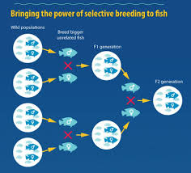
Main steps involved
Decide which characteristics are important enough to select
Choose parents that show these characteristics
Choose the best offspring from parents to produce the next generation
Repeat the process continuously

Slide 8
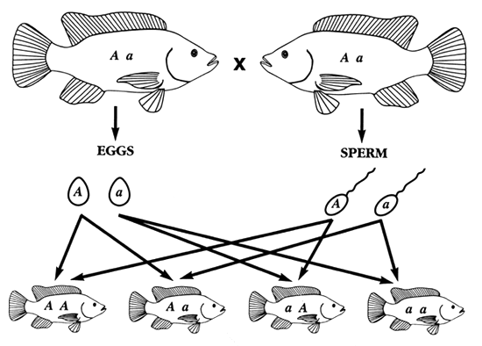
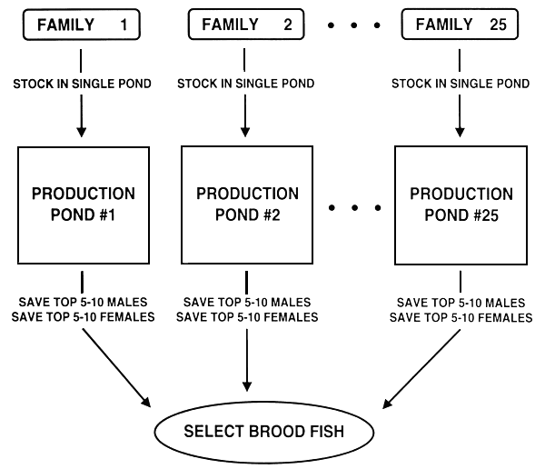

Slide 9
Examples include Atlantic cod, Atlantic salmon, common carp, gilthead seabream, hybrid striped bass, Lake Malawi tilapia, Mediterranean sea bass, Nile tilapia, red sea bream and rohu
On disease resistance, the adoption of domesticated and genetically improved white-leg shrimp Penaeus vannamei resulted in a drastic increase in shrimp aquaculture output but also posed serious risks of persistent infections, e.g. with viral pathogens that can be passed from broodstock to postlarvae.
Another potential application of genetic selection techniques is in the area of enhancing feed utilization, i.e. to determine whether carnivorous fish with natural capacity for protein utilization as main energy source can be genetically selected

Slide 10
2. Genetic engineering
Transgenesis is the introduction of exogenous genetic material (DNA) into a host genome, resulting in its stable maintenance, transmission and expression.
The first successes in producing genetically modified transgenic fish occurred in 1984 and 1985 with rainbow trout and goldfish.
Since then, transgenic individuals in more than 35 aquatic animal species have been produced.
Fish are very tolerant of genetic manipulations, especially in the early stages of development.
There are various methods for foreign gene insertion, such as microinjection, electroporation and sperm-mediated gene transfer.
The process involves the introduction of a DNA construct containing genes for the desired trait(s) into the pronuclei of fertilized eggs.
Followed by in vitro or in vivo incubation of the injected embryos and subsequent maturation into a fully developed transgenic organism.
Production of transgenic fish

Slide 11
Other examples of genetic engineering or manipulation
Genetically engineered yeast for production of important feed ingredients such as fish growth hormone and carotenoid pigments;
Pre-processing techniques of plant material to reduce the effects of antinutritional factors,
Breeding of plants with a better amino acid profile and less antinutritional factors, and
Converting low grade land animal by-products into high-value protein
Transgenic fish has been produced since the mid 1980s with most research focused on the transfer of growth hormone genes.

Slide 12
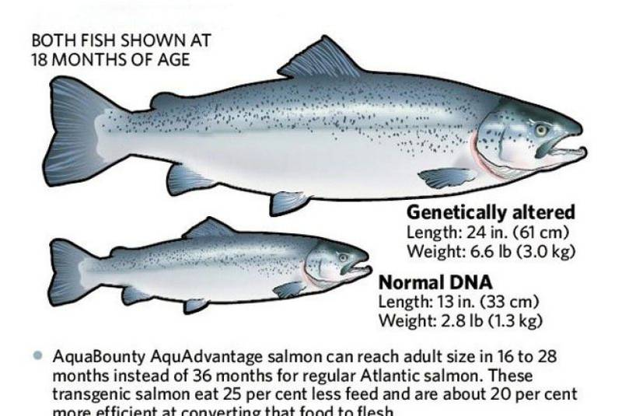
In 2015, the FDA approved genetically engineered AquAdvantage® Salmon for human consumption.
In March of 2019, they lifted their import ban on the fish, pending finalization of labeling guidelines for bioengineered foods.
Salmon is now the first genetically modified fish (and, incidentally, the first GM animal) to be approved for human consumption.

Slide 13
Short-term Genetic Improvement Strategies
Short-term genetic improvement techniques may not require the same level of record keeping nor management
Impart significant gains with simple technologies in a short period of time.
Crossbreeding and hybridization can be utilized to combine favourable qualities from two genetically different groups and to take advantage of hybrid vigour (heterosis)
Interspecific hybridization has resulted in fish with improved growth rates, manipulated sex ratios, sterile animals, improved flesh quality, increased disease resistance, improved tolerance to environmental extremes and other altered traits
1. Hybridization and crossbreeding

Slide 15
2. Chromosome set manipulation
Manipulation of chromosome-sets (polyploidization) has been accomplished for many aquatic species through thermal and chemical shocks to developing embryos.
Triploid organisms are useful because they are sterile and therefore able to put more energy into the growth process rather than into maturation and reproduction.
Whilst chromosome-set manipulations have not resulted in many commercial applications for finfish, the use of triploids has become an important part of the oyster farming industry and may have similar potential in other shellfish.
For example, triploid Pacific oysters have shown 14 - 159% growth improvement over diploid controls.
At the same time, sterility reduces the risk of breeding with native species which may be of importance in stocking programmes such as the use of grass carp for vegetation control or to address environmental impacts of fish escaping from farms.

Slide 16
3. Sex manipulation
Manipulation of sex can be of advantage in species with sexual dimorphism in important traits or when reduced chance of reproduction is desired.
Monosex male stocks have considerable commercial benefit in a number of species, most notably in tilapia due to problems of both precocious maturation and unwanted reproduction within the production system exhibited by this species
Also, female trout and salmon grow better and female sturgeon produce caviar.
The sex of fish can be easily manipulated using hormonal treatments, but there has been concern about the use of hormones in animal production
Functional sex reversal from female to male is carried out by using 17α-methyltestosterone, 19-norethynyltesto-sterone, methylandrosterone, 11-ketotestosterone or androsterone
Phenotypical feminization is induced successfully by using estradiol-17β, Estrone, diethylstilbestrol or ethynylestradiol

Slide 17
4. Emerging technologies
A number of new genetic technologies are now beginning to be applied in cultured aquatic species.
Genome technologies include DNA marker, novel sequencing, gene discovery, genome mapping (showing the relative positions of genes along a chromosome) and genome expression technologies that examine how genes actually function in the organisms.
These technologies will be useful to find important genes affecting traits such as disease resistance, growth rate and sex determination, allowing more precisely targeted selection to improve aquaculture performance.

Slide 18
Other Applications
Identification of valuable genetic resources for genetic improvement programmes, management of farmed broodstocks, and discrimination between wild and cultured specimens
High resolution of genetic markers can help to increase value in post-harvest and trade applications for fish and fish products.
Genetic markers provide an extremely sensitive means to identify samples of fish including frozen material, fillets, and early life history stages, e.g. eggs and larvae.
Molecular genetic diagnoses of fish and fish products have already identified cases of mislabelling, consumer fraud and have helped convict offending parties
Immunodiagnostic and molecular technologies are widely applied in pathogen screening and detection, elucidation of pathogenicity and disease diagnosis due to their high sensitivity, specificity, and ability for rapid diagnosis
Linking the use of genetic technologies in fishing and aquaculture will increase efficiency and efficacy of the technologies.

Slide 19
Thank You!

