Slide 1
MEAT PRODUCTS PROCESSING

Slide 2
PROCESSING OF MEAT PRODUCTS
Meat Products:
(i) Comminuted meat products (ii) Non- Comminuted meat products
Comminuted meat products
Comminution is the mechanical process of reducing raw materials to small particles called as minced meat.
Depending upon the final use of the communited meat the degree of comminution is done which differs among various processed products and is often a unique characteristic of a particular product ranging from very coarsely comminuted (to produce non-emulsified sausages like salamis and summer sausages), to finely comminuted, (to produce emulsified sausages like frankfurters, bologna, etc).

Slide 10
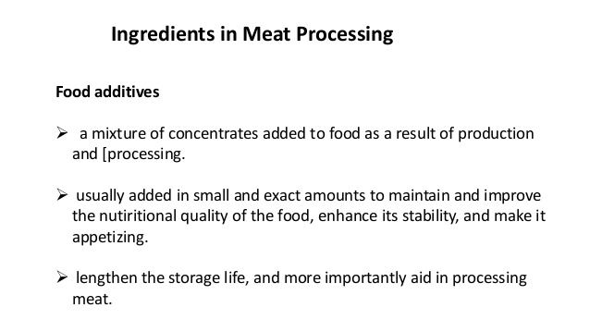

Slide 11
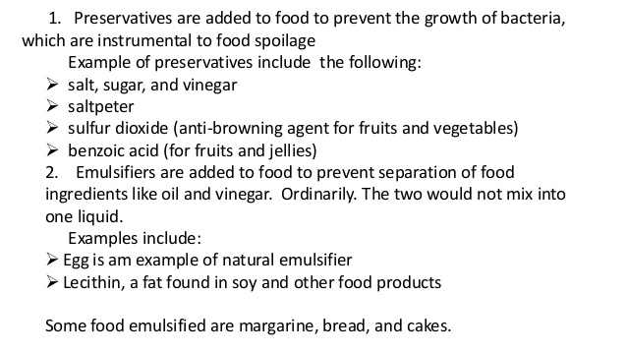

Slide 12
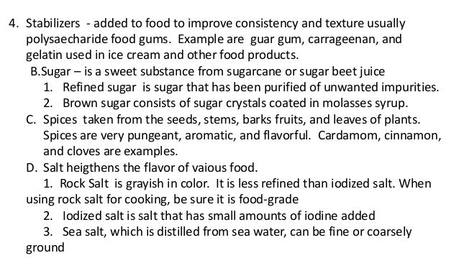

Slide 14
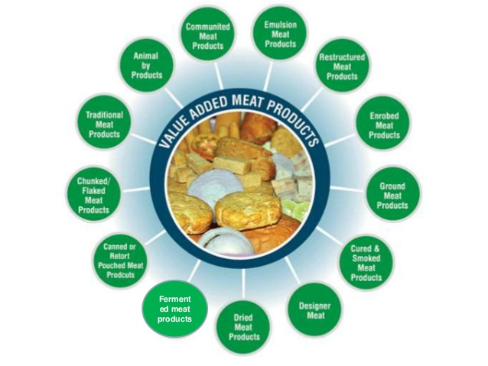

Slide 16
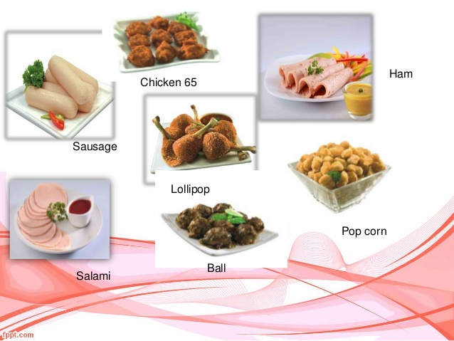

Slide 19
THANKS

