Slide 1
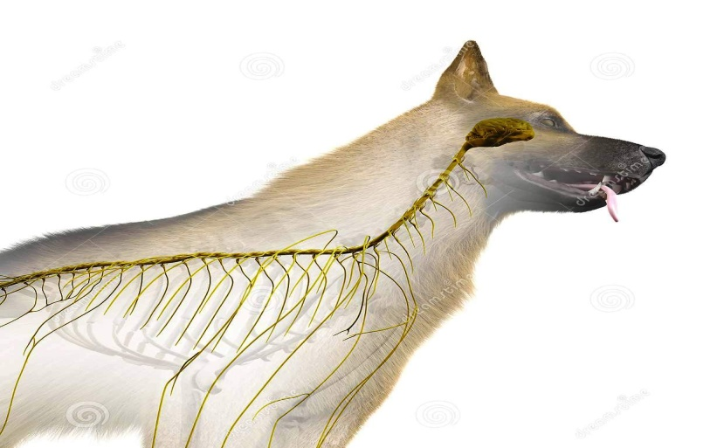
Diseases of Nervous system-II (Neurological Examination )
Unit-2
Dr. Vivek Kr. Singh
Assistant Professor
Department of Veterinary Clinical Complex

Slide 2
Introduction
Neurological examination is most rewarding in dogs and cats because all the techniques can be easily employed
In large animals neurological examination is less fruitful because all the techniques can’t be employed and poor response to many techniques

Slide 3
Neurological examination includes-
Recording History
General and detailed clinical examination of nervous system
Examination of CSF
Radiographic examination
EEG
Brain Biopsy

Slide 4
History
Duration of signs
Mode of onset (acute or Chronic)
Progression of disease
Description of sign
Access to poison and traumatic injury

Slide 5
General Clinical Examination
Manifestation of mental state
Involuntary movement
Abnormality in posture and gait
Disturbance in sensation
Nystagmus
Balance
Muscle tone

Slide 6
Detailed Clinical Examination
Examination of Cranial nerves
Postural reactions
Examination of spinal Nerves

Slide 7
Olfactory nerve (1st Cranial Nerve ) | Usually fail to give an result
Optic nerve (2nd ) | Menace response, Ability to avoid objects in its path
Oculomotor, Trochlear and abducent nerves (3rd ,4th and 6th) | Movement of eye ball
Trigeminal nerve (5th) | Unable to masticate, Drop jaw
Facial Nerve (7th) | Dropping of ear, jaw, eye remains open
Auditory nerve (8th) | Head tilt , falling to the side, rolling, circling,
Glossopharyngeal nerve (9th) Vagus nerve (10th) | Dysphagia, inspiratory dyspnea (due to laryngeal paralysis), voice change and regurgitation
Spinal accessory nerve (11th) | Deviation of the neck
Hypoglossal nerve (12th) | Asymmetry of the tongue

Slide 8
Postural Reactions
Postural reactions test the proprioceptive fibers of-
Peripheral nerves
Spinal cord
Brain stem
Cerebrum
Cerebellum
Inner ear
Place the patient’s limb in an abnormal position to see if the patient returns the limb to a normal position

Slide 9
Proprioceptive positioning
It is performed by making the animal stand on a limb knuckled over at paw and observe its ability to correct this abnormal position

Slide 10
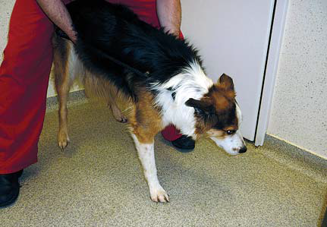
Hopping reaction
Hopping reaction is performed by holding the patient in a way so that the majority of its weight is placed on one limb

Slide 11
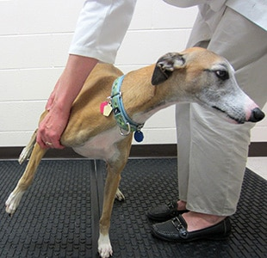
Hemihopping/ Hemistanding/ Hemiwalking
Patient’s limbs on one side are held off the ground, and the patient is forced to walk sideways on its remaining two limbs

Slide 12
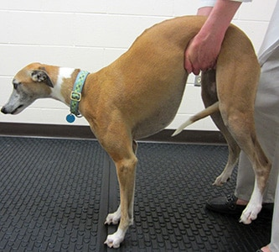
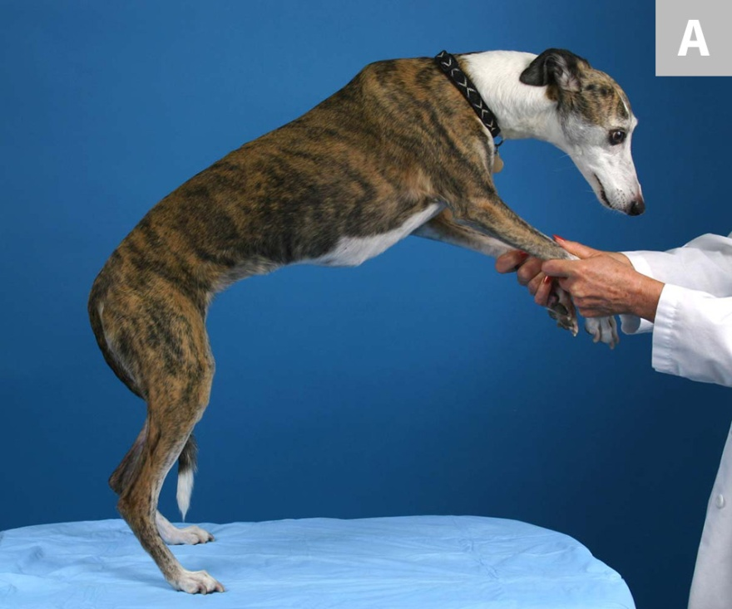
Wheel Barrowing
Initially patient’s thoracic and then pelvic limbs are held off the ground, and animal is make to walk forward and backward on its two legs

Slide 13
Spinal segmental reflex
These reflexes directly test reflex arc of spinal cord
Proprioceptive reflexes
Nociceptive reflexes
Special reflexes

Slide 14
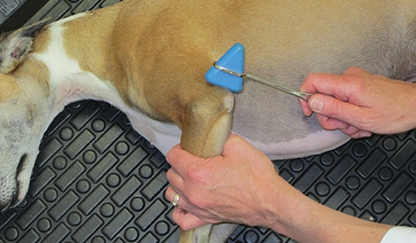
Proprioceptive reflexes
1. Triceps reflex- Tests the radial nerve which arises from C7-T1

Slide 15
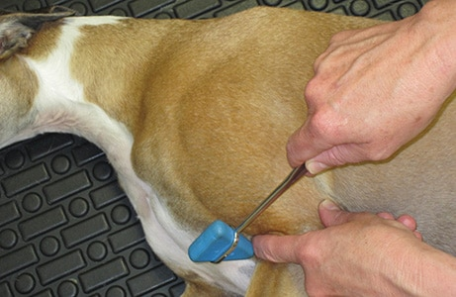
2. Biceps reflex- Evaluates the musculo-cutaneous nerve which arise from spinal cord segment C6-C7

Slide 16
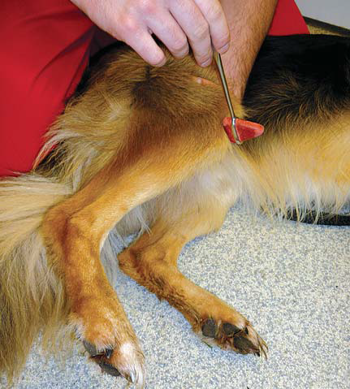
3. Patellar reflex – Evaluates the femoral nerve in the segment of the spinal cord L4-L6

Slide 17
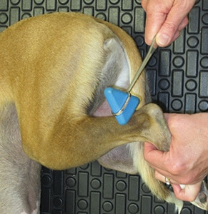
4. Gastrocnemius reflex- Evaluates the tibial branch sciatic nerve which originates from L6-S1

Slide 18
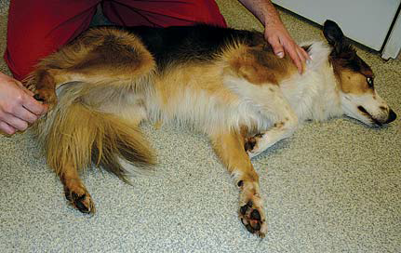
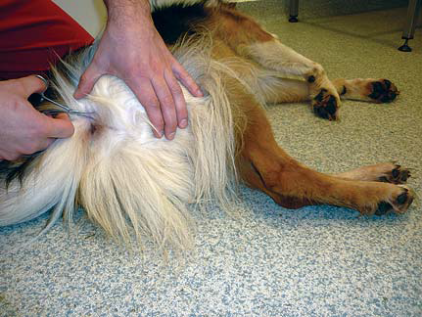
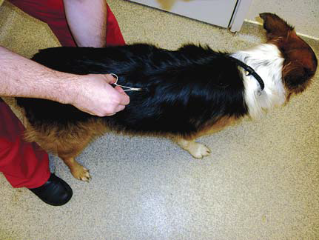
Nociceptive reflexes
Initiated by nociceptive (Painful) stimuli
Loss of nociceptive indicates LMN lesions
Flexor reflex
Perineal reflex
Panniculus reflex (Cutaneous trunic reflex)

Slide 19
Analysis of CSF
Electroencephaography
Computerized tomography
Magnet resonance imaging

Slide 20
Thanks

