Slide 1
Diseases of Urinary System Part-1
Dr. Pallav Shekhar
Asstt. Professor
Veterinary Medicine
Unit 2

Slide 2
Introduction
Renal disease is any morphological or biochemical lesion in the kidney.
Kidney can adapt to nephron loss by compensation.
Consequently a diagnosis of kidney dysfunction is extremely difficult in animals.

Slide 3
Basic anatomy

Slide 5
Primary Function
Execration of Waste Product
Conservation and Execration of water and Electrolytes
Production of hormone Erythropoietin
Production of enzyme Renin
Metabolism of Vit. D

Slide 6
Pathophysiology of Renal Disorder

Slide 7
Indications
Sign
Vomition
Melena
History
Changes in water consumption
Pu and PD
Physical Examination
Palpation of Bladder
Examination of External genitalia
Serum Chemistry
Urinalysis
Anuria
Frequency of Urination
Appetite
Drug Administration
Appearance of Urine
Volume of Urine
Diagnostic
X ray
USG
Cystoscopy

Slide 8
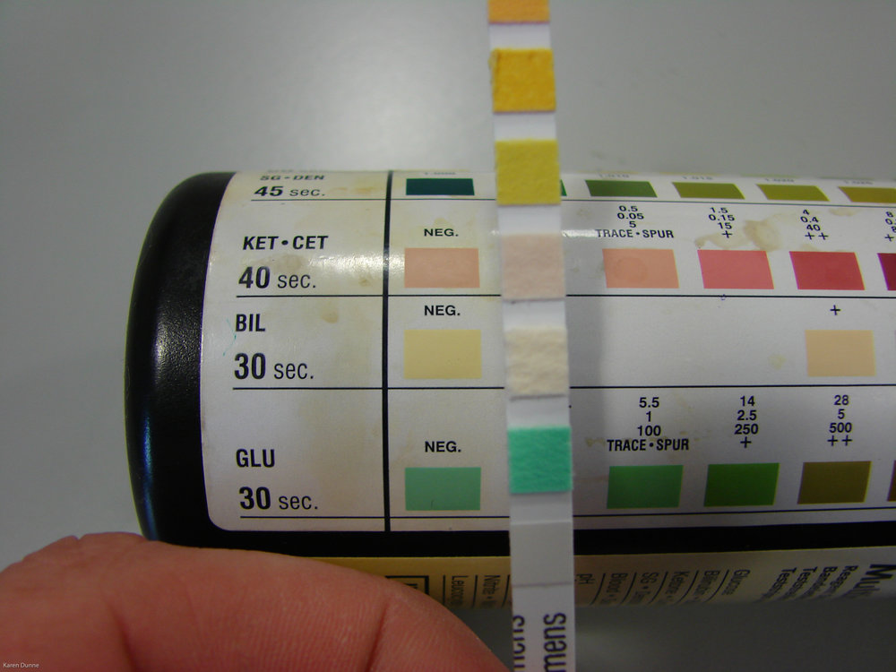
Urinalysis
Collection of Urine
Urine specific gravity
Colour
Turbidity
pH
Glucose
Ketone
Bilirubin
WBC
Occult blood
Protein
Crystals
Casts
Epithelial Cells

Slide 9
Serum Chemistry
BUN
Creatinine
Calcium
Phosphorus
Bicarbonate
Serum Electrolytes

Slide 10
Acute Renal Failure (ARF)
Acute renal failure (ARF) is by sudden onset of filtration failure by the kidneys, accumulation of uremic toxins, and dysregulation of fluid, electrolyte, and acid–base balance. It is potentially reversible if diagnosed quickly and treated aggressively.

Slide 11
Etiology
Shock
Malignant hypertension
Heart failure, thromboembolism
Heatstroke
Excessive vasoconstriction (e.g., administration of nonsteroidal anti-inflammatory drug [NSAID])
Excessive vasodilation (e.g., administration of angiotensin-converting enzyme [ACE] inhibitor or antihypertensive drug)
Prolonged anaesthesia
Administration of antimicrobials
Aminoglycoside
Sulfonamide
Cephalosporin
Amphotericin B
Chemotherapeutic agent (e.g., cisplatin and doxorubicin)
Thiacetarsamide
NSAIDs
Radiographic contrast agents
Ethylene glycol
Heavy metals (e.g., lead, mercury, arsenic, and thallium)
Insect or snake venom
Heme pigment
Calcium
Leptospirosis
Immune-mediated glomerulonephritis and arteritis
Septicemia
DIC
Hepatic failure
Heat stroke
Transfusion reaction
Bacterial endocarditis
Pyelonephritis
Cortical necrosis
Lymphosarcoma

Slide 12
Clinical signs
Sudden onset of anorexia
Listlessness
Vomiting (± blood)
diarrhea (± blood)
Halitosis
Ataxia
Seizures
Oliguria/anuria or polyuria

Slide 13
Diagnosis
Clinical signs
Normal or high PCV
Variable leukocytosis
Elevated BUN, creatinine, and phosphate, potassium and glucose
Low bicarbonate and calcium
Inability to concentrate urine.

Slide 14
Treatment
Discontinuation of nephrotoxic drugs
Treatment of etiology
Maintenance hemodynamic stability
Peritoneal dialysis and hemodialysis.

Slide 15
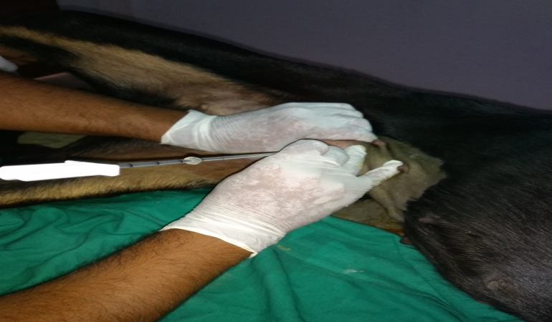
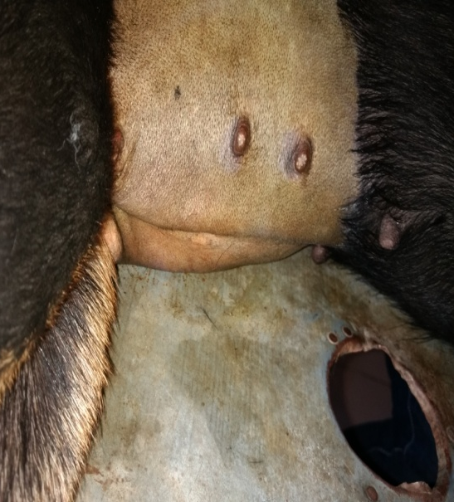
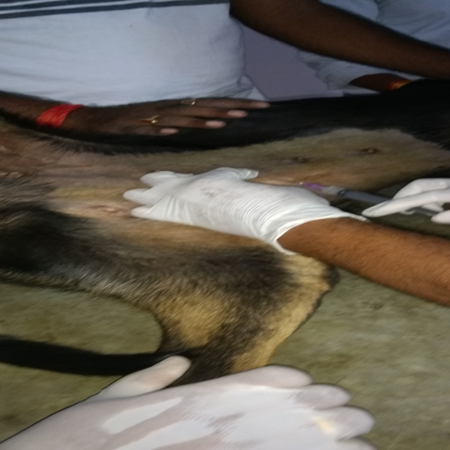
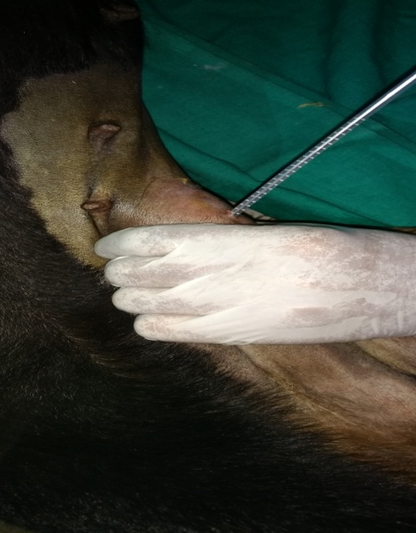
Fig Procedure of Peritoneal Dialysis

Slide 16
