Slide 1
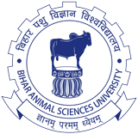
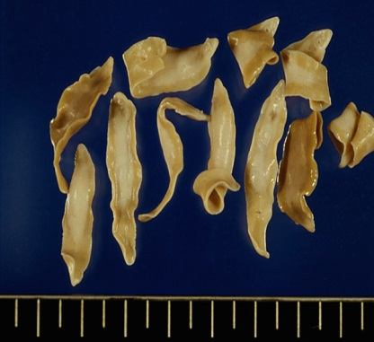
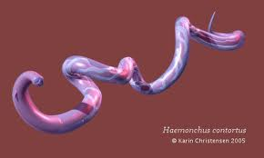
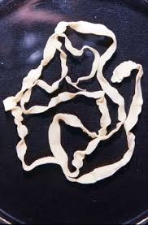
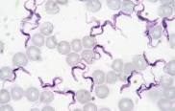
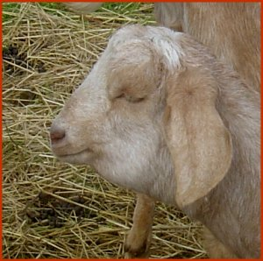
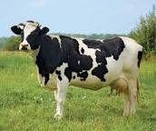
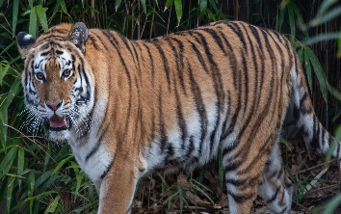
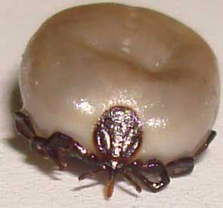
Veterinary Parasitology
Dr. AJIT KUMAR
Department of Veterinary Parasitology
Bihar Veterinary College
Bihar Animal Sciences University
Patna-800014
Image source: Google image

Slide 2
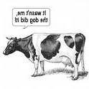
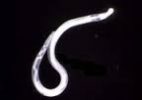
VETERINARY PARASITOLOGY
Parasitology: The Branch of science which deals the phenomenon of parasitism.
Veterinary Parasitology is a branch of animal science which provides knowledge of taxonomy, morphology, biochemistry, physiology, cell biology, immunology, pharmacology, pathogenesis including symptoms seen in hosts, method of diagnosis, treatment and control of parasites and diseases caused by parasites in animals and birds.
Image source: Google image

Slide 3
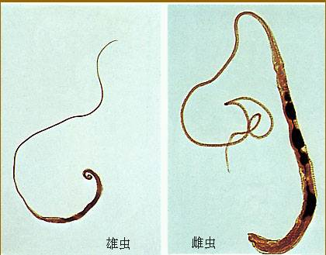
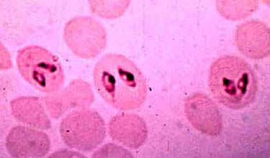
VETERINARY PARASITOLOGY
Parasite: The word parasite is derived from the Greek word (Para means beside and sitos means food).
An animal species which live in or on a large animal (host) and dependent metabolically on it.
The main aim of parasite is to live and let live because death of host causes death of parasite.
Image source: Google image

Slide 4
Veterinary Parasitology
Course Name | Units | Credit Hrs
Veterinary Parasitology | Unit- 1 ( General Veterinary Parasitology | 3+2
 | Unit-2 (Trematodes and Cestodes of Veterinary Importance)
 | Unit-3 (Nematodes of Veterinary Importance)
 | Unit- 4 (Arthropods of Veterinary Importance)
 | Unit-5 (Protozoa of Veterinary Importance

Slide 5
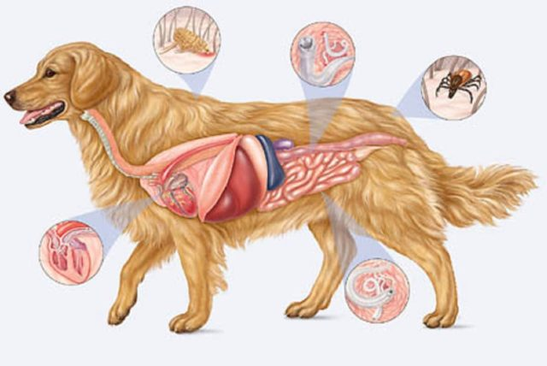
General Veterinary Parasitology (Unit-1)
Introduction,
Important Historical land marks,
Types of Parasites
Types of hosts Types of Animal Association
Modes of transmission of Parasites
SNOAPAD
Immunity against parasitic infections/infestations
General Harmful effects of Parasites
General Control measures against parasites
Characters of various phyla of parasites
Image source: Google image

Slide 6
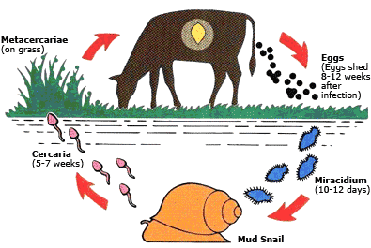
Trematodes and Cestodes of Veterinary Importance (Unit-2)
Trematodes: Introduction , general account and classification, general life cycle of trematodes with morphological features of their developmental stages, important morphological features, life cycle, modes of transmission, pathogenesiss, diagnosis and general control measures of trematode parasites.
Image source: Google image

Slide 7
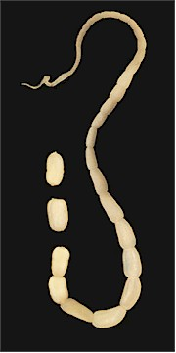
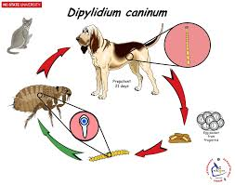
Trematodes and Cestodes of Veterinary Importance (Unit-2)
Cestodes: Introduction , general account and classification, general life cycle of trematodes with morphological features of their developmental stages, important morphological features, life cycle, modes of transmission, pathogenesis, epidemiology, diagnosis and management of cestode parasites

Slide 8
Nematodes of Veterinary Importance (Unit-3)
Nematodes: Introduction , general account and classification, general life cycle of cestodes with morphological features of their developmental stages, important morphological features, life cycle, modes of transmission, pathogenesis, epidemiology, diagnosis and management of nematode parasites
Image source: Google image

Slide 9
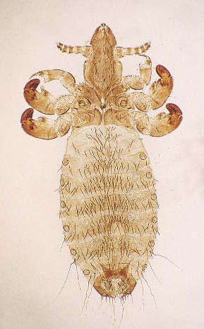
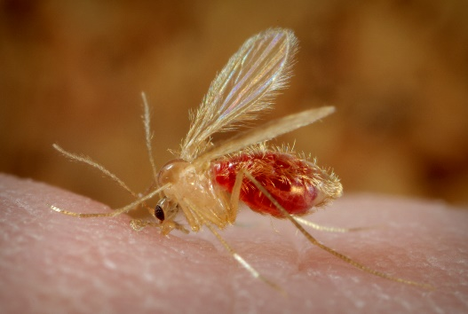
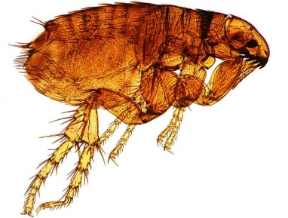
Arthropods of Veterinary Importance (Unit-4)
Arthropods : Introduction , general account and classification, general life cycle of arthropods with morphological features of their developmental stages, important morphological features, life cycle, Vector potentiality, pathogenesis, and control of arthropods affecting animals and birds.
Image source: Google image

Slide 10
Protozoa of Veterinary Importance (Unit-5)
Protozoa: Introduction , general account and classification, general life cycle of protozoa with morphological features of their developmental stages, Differentiation from bacteria and rickettsia, important morphological features, life cycle, modes of transmission, pathogenesis, epidemiology, diagnosis and control of protozoan parasites of veterinary and zoonotic importance.
Trypanosoma sp. in blood plasma
Babesia sp. inside RBCs
Image source: Google image

Slide 11
Veterinary Parasitology Internal Assessment Examination
Internal Assessment | Maximum Marks | Weightage
First | 40 | 10
Second | 40 | 10
Third | 40 | 10
the result of the best of two Results of the best of two Internal Assessments shall be accounted

Slide 12
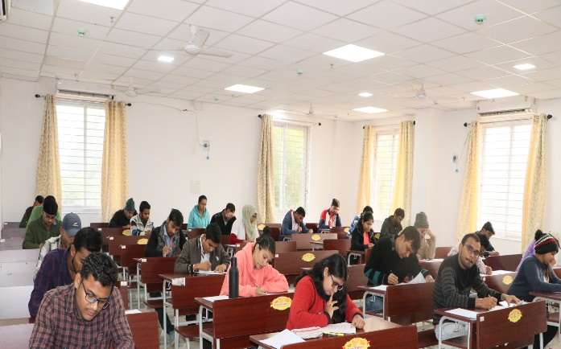
Veterinary Parasitology Annual Examination
Papers |  | Units | Maximum Marks | Weightage
Theory | Paper-I | Units- 1,2, & 3 | 100 | 20
 | Paper- II | Units- 4 & 5 | 100 | 20
Practical | Paper-I | Units- 1,2, & 3 | 60 | 20
 | Paper- II | Units- 4 & 5 | 60 | 20

Slide 13
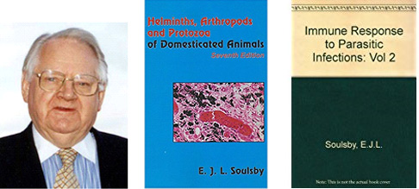
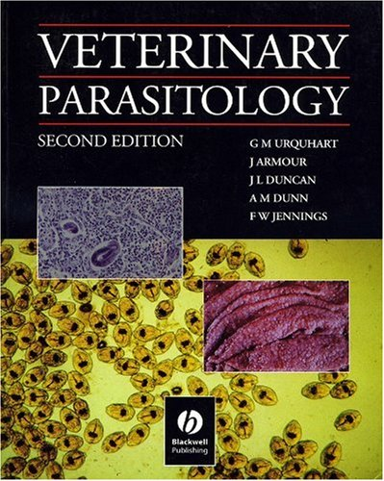
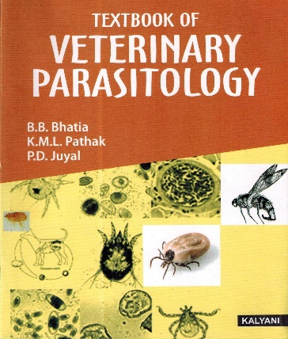
Text Books of Veterinary Parasitology
Helminths , Arthropods and Protozoa of Domesticated Animals – E.J.L.Soulsby
Veterinary Parasitology- G.M. URQUHRT, J. ARMOUR,
J.L.DUNCAN, A.M.DUNN, F.W. JENNINGS
Text Book of Veterinary Parasitology - B. B. Bhatia,K.M.L.Pathak,
P.D.Juyal

Slide 14
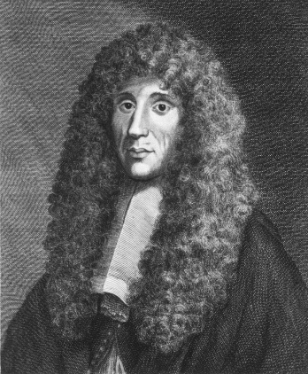
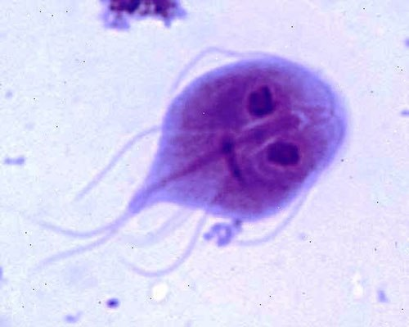
History of Parasites
Francisco Redi is considered as Grand father or Father or Founder of Parasitology.
1674 – A. V. Leeuwenhoek observed first parasitic protozoa i.e. Eimeria stiedae from the gall bladder of rabbit.
1681- A.V. Leeuwenhoek also first observed Giardia lamblia from his own stool.
Image source: Google image
Giardia

Slide 15
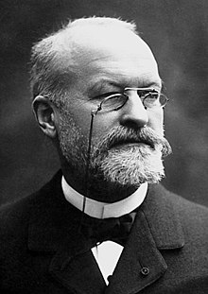
History of Parasites
1849- Gross described first parasitic amoeba, Entamoeba gingivalis in the human mouth.
1878 – Lewis first time reported the mammalian trypanosome, Trypanosoma lewisi in rats.
1880- C.L.A. Laveran first discovered the human malarial parasite i.e. Plasmodium malariae.
C.L.A. Laveran
Image source: Google image

Slide 16
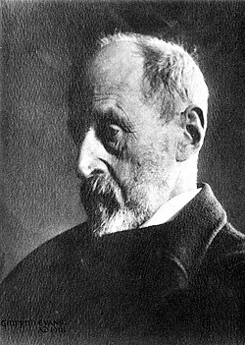
History of Parasites
1880 – Griffith Evans discovered first pathogenic trypanosome, Trypanosoma evansi from blood of horses and camels suffering from ‘surra’.
Trypanosoma evansi
Griffith Evans
Image source: Google image

Slide 17
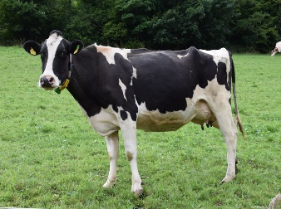
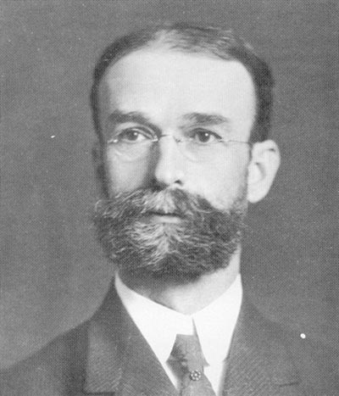
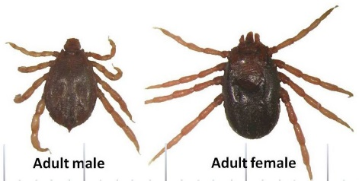
History of Parasites
1893- Theobald Smith and Kilbourne first documented the transmission of a disease agent by an arthropod and described the transmission of Babesia bigemina (caused Texas cattle fever) by the cattle tick, Boophilus microlus.
1894-99 – Alfred Lingard made chemotherapeutic studies against Surra with arsenicals which were emulated by Ehrlich to treat syphilis in human beings.
Theob Smithald
Image source: Google image

Slide 18
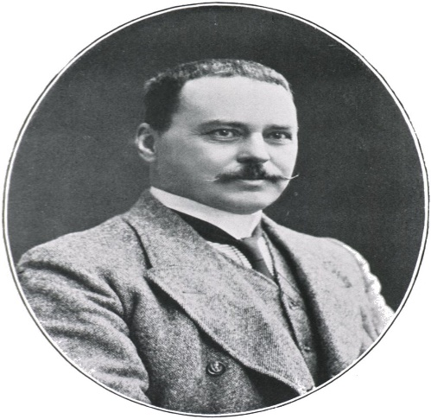
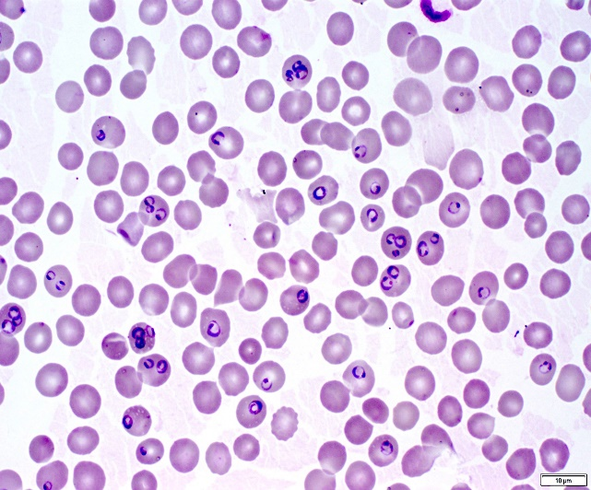
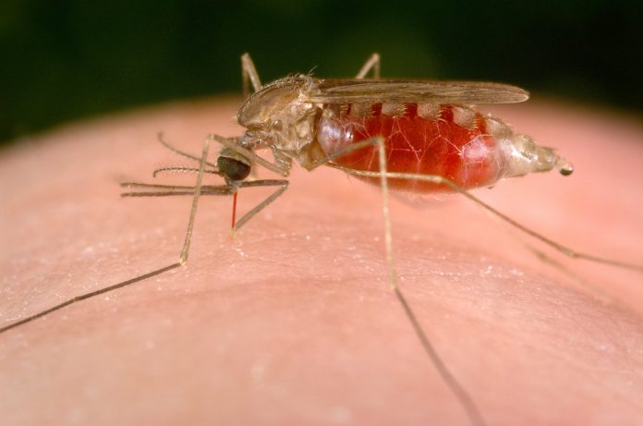
History of Parasites
1897 – Ronald Ross found Female Anopheles mosquito as the vector of human malarial parasites and got Nobel Prize.
1898 – Ronald Ross observed Culex fatigans as the vector of bird malaria parasite, Plasmodium relictum.
1902 – Graham found Aedes aegypti as vector for Dengue fever.
Female Anopheles
Plasmodium sp.
Image source: Google image

Slide 19
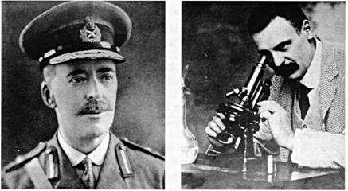
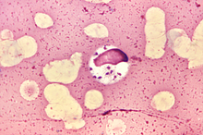
History of Parasites
1903 – Leishman and Donovan independently discovered Leishmania donovani in spleen smears of a soldier who died of a fever at Dum Dum (W. Bengal), the cause of Kala azar.
Amastigote stage of Leishmania donovani
W.B. Leishman and Charles Donovan

Slide 20
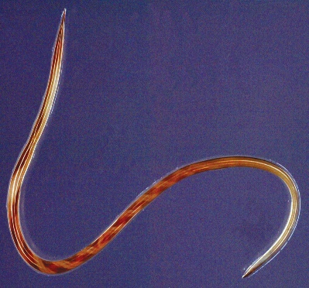
History of Parasites
1928- Stoll showed “Self-cure” phenomena in sheep infected with the Haemonchus contortus.
1959-63 – Jarett and co-workers introduced first commercially antiparasitic vaccine (Dictol) against lungworms in sheep and cattle.
1989-94- Rand, Rodriquez and other workers commercialized recombinant tick vaccine (“Tick Guard” and “Guvac”).
Haemonchus contortus
Image source: Google image

Slide 21
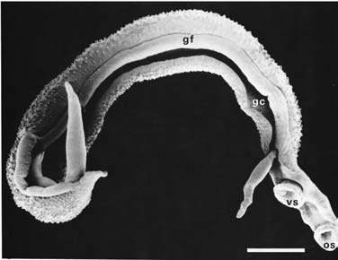
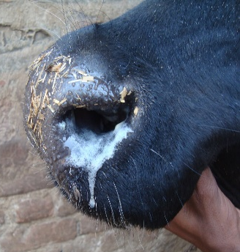
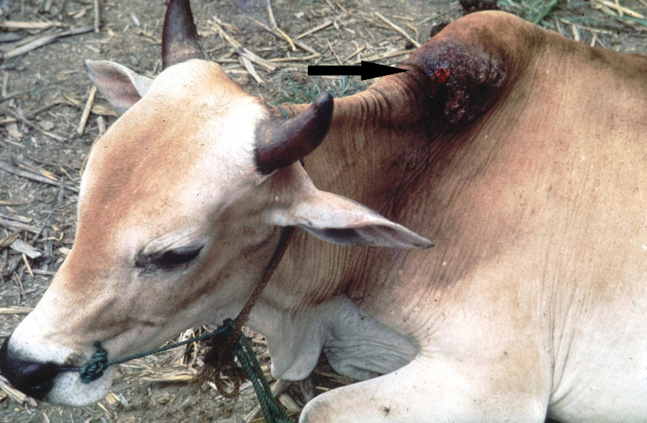
History of Parasites
1932-33- M.A.N Rao discovered Schistosoma nasale from veins of nasal mucosa of cattle. Parthasarathy Naidu treated nasal granuloma disease with Antimonium tartarate in 1921.
1935-36- P.G. Pandey described Stephanofilaria assamensis as causative worm of “Hump Sore” in cattle.
Schistosoma nasale
Hump sore
Image source: Google image

Slide 22
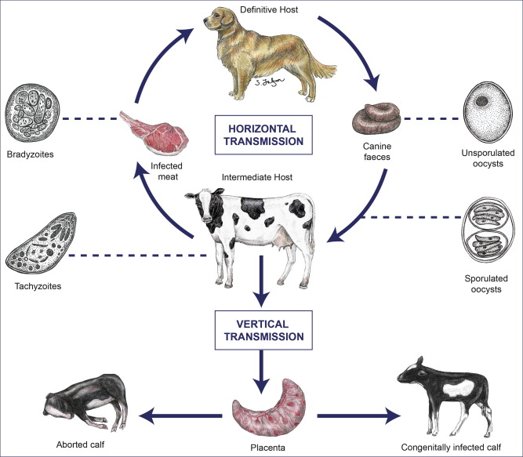
History of Parasites
1950- H.N. Ray described Stilbamidine test as a diagnostic tool for latent trypanosomosis in bovines.
1958- S.N. Singh described Stephanofilaria zaheeri as causative agent of “Ear Sore” in buffaloes.
1988- J.P. Dubey and co-workers discovered Neospora caninum.
J.P. Dubey

