Slide 1
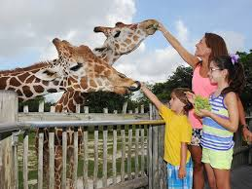
Public Health Problems Arising From Zoo
Dr. Vivek Kr. Singh
Assistant Professor
Department of Veterinary Clinical Complex

Slide 2
Introduction
Zoos and biological parks are considered as a hub for public recreation and education
Veterinary professionals play a pivotal role in health management of wild animals in zoos
Since veterinarians work in close contact with wild animals, there is a potential risk of transmission of zoonotic diseases

Slide 3
Cont…
Approximately 1415 infectious agents, causing diseases in humans
Out of which 868 (61%) are known to be zoonotic in nature
More than 70% of the emerging zoonotic diseases have wild animals as reservoir hosts

Slide 4
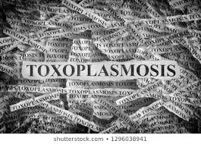
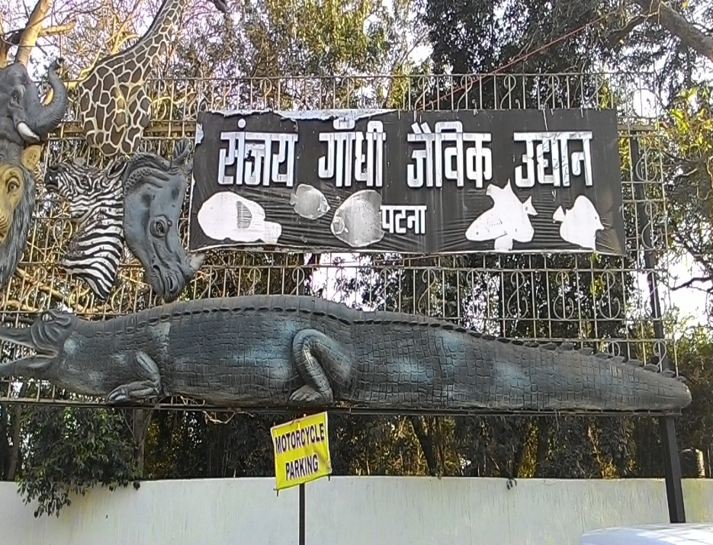
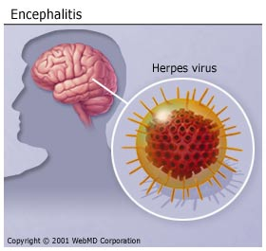
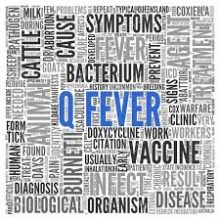
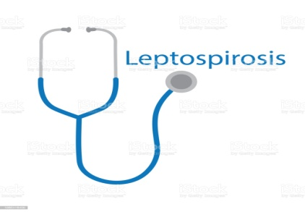
Major zoonotic diseases transmitted from wild animals to humans

Slide 5
Rabies
Etiology
Lyssaviruses of Rhabdovirus family
Mode of Transmission
Via introduction of virus laden saliva into tissues usually by the bite of rabid animals

Slide 6
TUBERCULOSIS
Etiology
Mycobacterium tuberculosis
Clinical signs
Chronic cough, sputum production, appetite loss, weight loss, fever, night sweats and hemoptysis
Mode of Transmission
Aerosol

Slide 7
Anthrax
Etiology
Bacillus anthracsis
Clinical signs
Fever and neck swelling occur,
Sore throat, dysphagia, respiratory distress, and oral bleeding
Mode of Transmission
Wound inoculation, ingestion or inhalation of spores

Slide 8
LEPTOSPIROSIS
Etiology
Pathogenic serovars of Leptospira spp.
Clinical signs
First phase (with fever, chills, headache, muscle aches, vomiting, or diarrhea
Second phase kidney or liver failure or meningitis
Mode of Transmission
Direct contact

Slide 9
Q-fever
Etiology
Coxiella burnetii
Clinical signs
Most cases are clinically
asymptomatic or mild
characterized by a nonproductive cough, fever, and minimal auscultatory abnormalities
Mode of Transmission
Ixodid ticks acts as reservoir host
Inhalation, Ingestion or direct contact with birth fluid or placenta

Slide 10
Psittacosis
Etiology
Chlamydophilla psittaci
Clinical signs
Respiratory distress, varies from flu-like symptoms to systemic disease
Mode of Transmission
Aerosols

Slide 11
NIPAH VIRUS
Etiology
Nipah virus (Genus- Henipavirus, Family- Paramyxoviridae)
Clinical signs
Fever with encephalitis
Mode of Transmission
Bats act as reservoir host
Pigs
Human

Slide 12
HERPES B ENCEPHALITIS
Etiology
Herpes B virus
Clinical signs
Seizures, hemiparesis or hemiplegia, progressive ascending paralysis
Mode of Transmission
monkey bites, monkey scratches, or cage scratches; direct contamination of a preexisting wound

Slide 13
TOXOPLASMOSIS
Etiology
Toxoplasma gondii
Clinical signs
Cervical lymphadenopathy
Fever, night sweats
Mode of Transmission
Oral route

Slide 14
Kyasanur Forest Disease (KFD)
Etiology
Flaviviridae family
Clinical signs
High fever with frontal headaches, chills, Severe muscle pain with vomiting, gastrointestinal symptoms and bleeding problems
Mode of Transmission
Bite of infected hard ticks

Slide 15
Thanks

